Slide 1
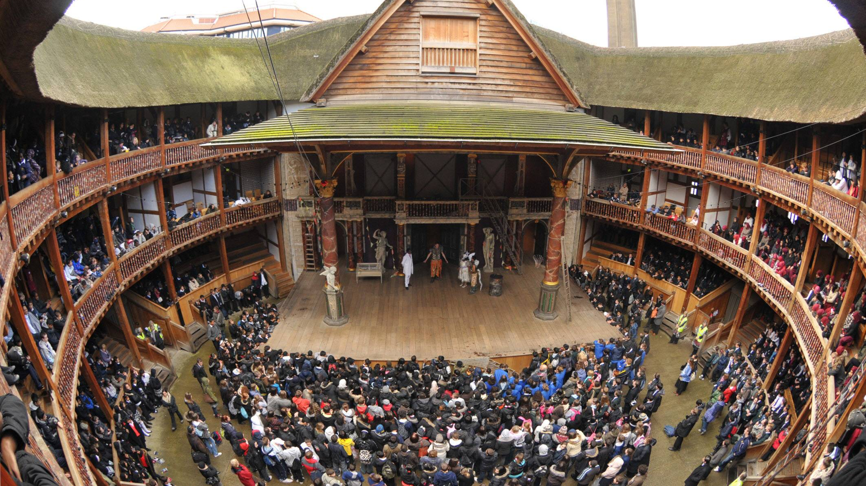
British Renaissance
Theater and Beyond

Slide 2
Renaissance Theater – Basic Features
Based on the excerpt from the novel:
a form of entertainment
competing with:
bear baiting arenas
inns and brothels
visited by all of society:
highly educated people (e.g. John Dee himself)
the poor and miserly (cf. Dee’s frequent references to the smell)
professionals of all kind (prostitutes, hairdressers, etc.)
different forms of behavior accepted:
many people go there to:
chat
meet friends
do networking
show off their wealth or connections
do business

Slide 3
Renaissance Theater – Basic Features
Based on the excerpt from the novel:
a form of entertainment
different forms of behavior accepted:
it is normal to shout back or interact in other ways
people often leave before the end or arrive after the beginning
multilayered, complex performance to suit all kinds of viewers
blood flowing all over the place (Dee’s former servant’s level)
inclusion of medieval allegorical figures (level of people with average education/knowledge)
possible to interpret it in the light of books on alchemy (highly specialized, advanced knowledge – Dee’s level)

Slide 4
Renaissance Theater – Basic Features
Based on the excerpt from the novel:
technical details:
wooden scaffolding
several floors
frequent problems with fire
different types of seating
viewers frequently above the stage
standing and huge crowds are normal
acoustics can be a problem

Slide 5
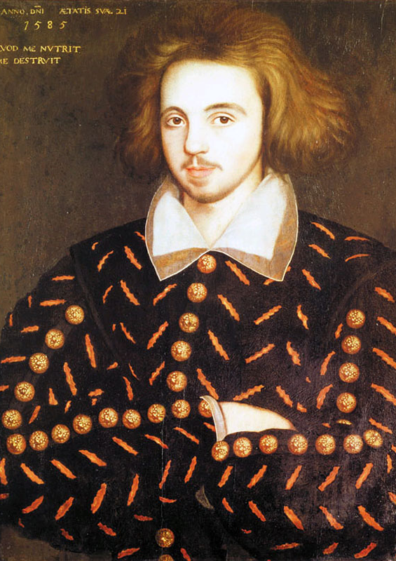
Christopher Marlowe (1564 – 1593)
Most famous plays:
Tamburlaine
the first English play written in blank verse
The Jew of Malta
Doctor Faustus
a life full of intrigue, violence, mystery
espionage
bar fights
homosexuality
university educated (Cambridge, BA)
very popular in the Renaissance
strong influence on other playwrights

Slide 6
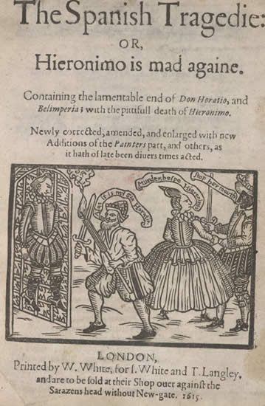
Thomas Kyd (1558 – 1594)
Most famous plays:
The Spanish Tragedy
establishing the genre of the revenge tragedy
Ur-Hamlet (?)
a life less intriguing
working extensively as a lord’s secretary
translating works from Italian and French
until he shares a room with Marlowe
arrested
loses his job and good reputation

Slide 7
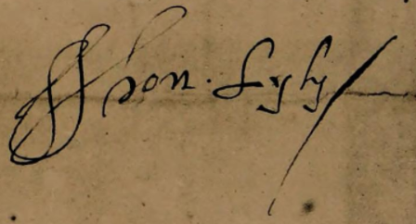
John Lyly (1553 – 1606)
Most famous plays:
Love’s Metamorphosis
allegorical pastoral play
strong influence on Shakespeare’s Love’s Labor’s Lost
Gallathea
comedy
an important source of Shakespeare’s A Midsummer Night’s Dream
university education (Oxford, MA)
comedies and pastorals are his theatrical genres
also important as a writer of prose romances
Euphues: The Anatomy of Wit
Euphues and his England

Slide 8
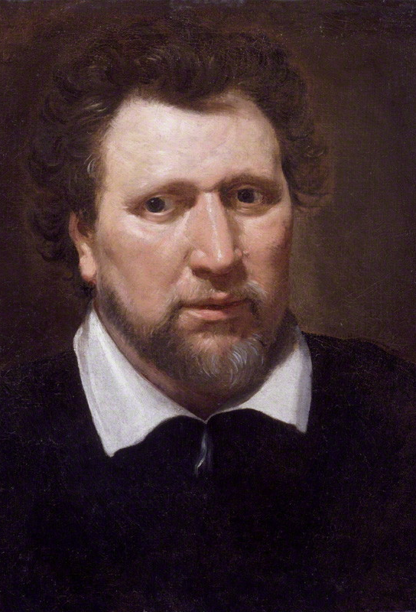
Ben Jonson (1572 – 1637)
playwright and poet
as a playwright he is mostly known for his satirical comedies:
A Tale of a Tub
Every Man in His Humour
Volpone
The Alchemist
Bartholomew Fair
in the 17th century considered rivaling Shakespeare as a playwright and John Donne as a poet
also important as a writer of masques
festive courtly entertainment
elaborate stage design (e.g. Jonson often cooperating with Inigo Jones)
a Gesamtkunstwerk of music, dancing, singing, acting, design and illusions

Slide 9
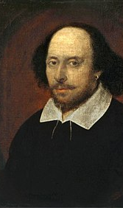
William Shakespeare (1564 – 1616)
a prolific author:
about 39 plays
comedies (e.g. The Comedy of Errors)
histories (e.g. Henry IV)
tragedies (e.g. Macbeth)
romances (e.g. The Winter’s Tale)
154 sonnets
4 narrative poems:
Venus and Adonis
The Rape of Lucrece
A Lover’s Complaint
The Phoenix and the Turtle
very little is known about his life
actor, writer and part owner of a theater company
from Stratford-upon-Avon
Married to Ann Hathaway, 3 children (Susanna, Hamneth, Judith)

Slide 10
Renaissance Poetry – The Sonnet
The Italian Sonnet:
an octave (2 quatrains) + a sextet (2 tercets)
(a-b-b-a, a-b-b-a) + (c-d-e-c-d-e or c-d-c-c-d-c, ...)
The English Sonnet:
3 quatrains and a couplet
(a-b-a-b, c-d-c-d, e-f-e-f, g-g)
sharp turn in imagery or in content

Slide 11
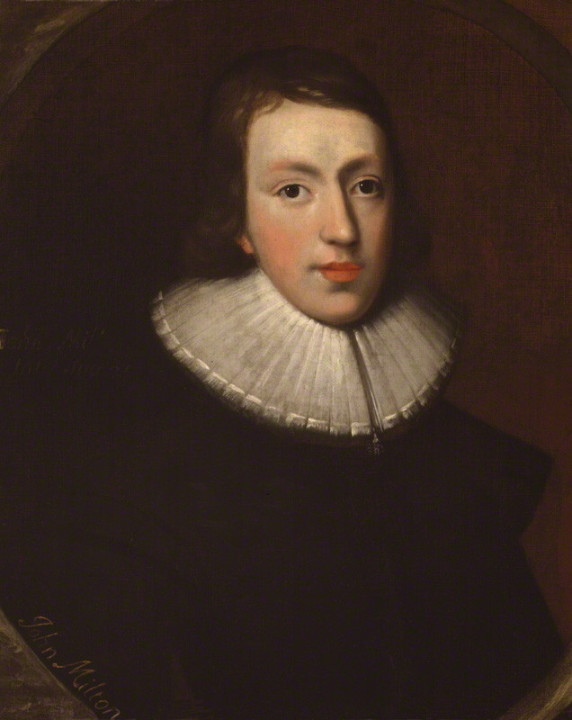
Renaissance Poetry – The Italian Sonnet
How soon hath Time, the subtle thief of youth, (A) Stolen on his wing my three and twentieth year! (B) My hasting days fly on with full career, (B) But my late spring no bud or blossom shew'th. (A) Perhaps my semblance might deceive the truth, (A) That I to manhood am arrived so near, (B) And inward ripeness doth much less appear, (B) That some more timely-happy spirits indu'th. (A) Yet be it less or more, or soon or slow, (C) It shall be still in strictest measure even (D) To that same lot, however mean or high, (E) Toward which Time leads me, and the will of Heaven. (D) All is, if I have grace to use it so, (C) As ever in my great Task-master's eye. (E)
John Milton, “On His Being Arrived to the Age of Twenty-three”

Slide 12
Renaissance Poetry – The English Sonnet
Let me not to the marriage of true minds (A) Admit impediments. Love is not love (B) Which alters when it alteration finds, (A) Or bends with the remover to remove. (B) O no, it is an ever fixed mark (C) That looks on tempests and is never shaken; (D) It is the star to every wand'ring barque, (C) Whose worth's unknown although his height be taken. (D) Love's not time's fool, though rosy lips and cheeks (E) Within his bending sickle's compass come; (F) Love alters not with his brief hours and weeks, (E) But bears it out even to the edge of doom. (F) If this be error and upon me proved, (G) I never writ, nor no man ever loved. (G)
William Shakespeare, “Sonnet 116”

Slide 13
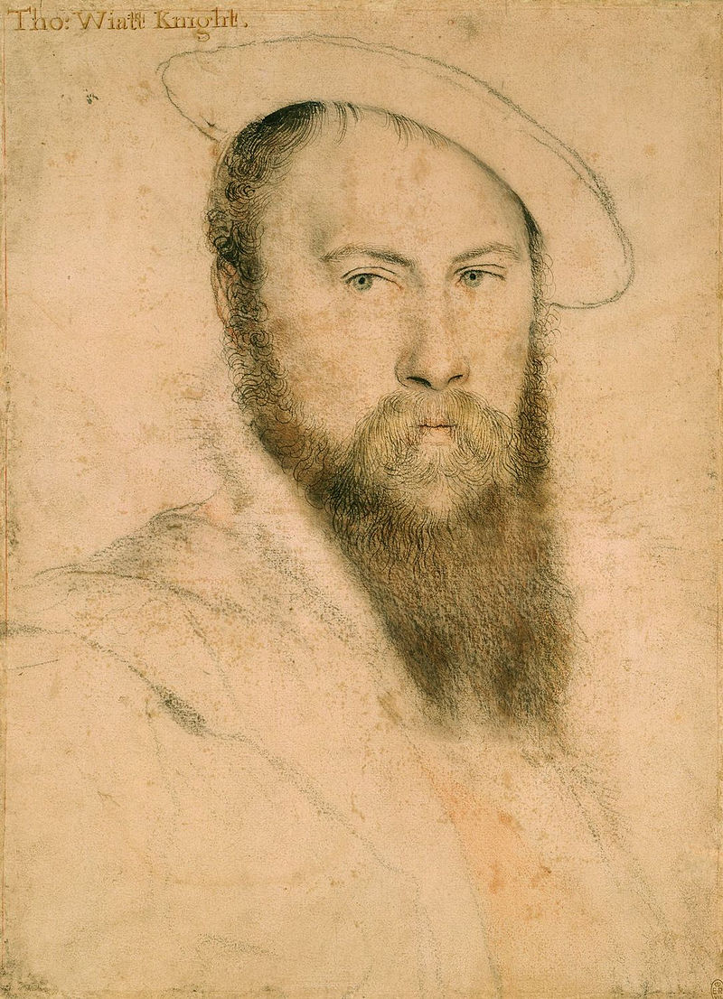
Sir Thomas Wyatt (1503 – 1542)
politician, ambassador, lyric poet
introduced the Italian/Petrarchan sonnet to England
modified the form, often finishing with cddc ee, introducing the closing couplet to sonnets early on
strongly influenced by Chaucer’s language
more intimate, personal and less ceremonial than Petrarch and other Italian models
also wrote in other genres: songs, satires, epigrams

Slide 14
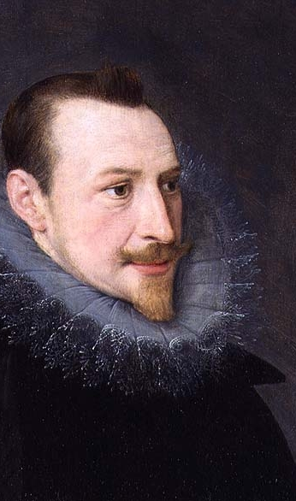
Edmund Spenser (1552 – 1599)
one of the prime masters of poetry in English
best known for his masterpiece, The Fairie Queene
an epic poem
allegorical work, possible to read on several levels
also wrote in other genres:
The Shepheardes Calender – a pastoral work of twelve eclogues for each month of the year
Amoretti and Epithalamion – sonnets written to/about his second wife

