Slide 1
Tones and tone groups lesson 4
What are the suprasegmentals?
Which minimal units carry prosodic characteristics?
What is prosody?
What is intonation?

Slide 2
plan
Syntactic vs Phonological hierarchy
What meanings can intonation convey?
How can we analyze pitch movement?

Slide 3
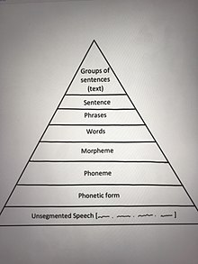
Syntactic/ Phonological hierarchy
Utterance – a piece of connected speech that has suprasegmental features (can be as short as only one syllable e.g Yes./No.)
Is it you?
A tone unit (one tone, min. one syllable or one foot)
A tonic syllable ( the one with NUCLEAR tone / accent)

Slide 4
An utterance – a tone group/unit – a phonetic word (foot) – a syllable – a phoneme A tone group - is the stretch of speech over which a pitch contour extends. (also known, by different writers, as tone unit, intonation unit, breath group and sense group)
Pete, is that you?
Give me those!
Bill called to give me those.

Slide 5
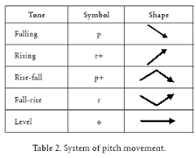
Tone inventory in English

Slide 6
The interval between the highest and the lowest pitched syllable is called the range.
The change of pitch within the last stressed syllable of the tone-group is called a nuclear tone(3). It may occur not only in the nucleus but extend to the tail — terminal tone (3+4).
A tone group can include a Pre-HEAD(1), a HEAD(2), a TAIL (4)
The inventory of tonal types given by different phoneticians is different.
Tones can be: simple, complex and compound.

Slide 7
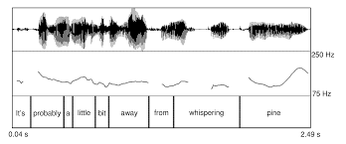
Auditory/acoustic parameters pitch – fundamental frequency (Fo) melody – Fo line loudness – intensity speed/tempo - time

Slide 8
Some practice…
A: That’s not the right answer.
B: (Disbelieving) No?
A: Is Istanbul the capital of Turkey?
B: (Factually) No.
A: Is that the right answer?
B: No, but you’re warm.
A: Have you ever been convicted of a crime?
B: No. A: Have you ever been refused a visa? B: No.
A: You’ll drive me home, won’t you?
B: (Indignantly) No.

Slide 9
Some more practice…)))
This honey is much better.
He didn’t have the courage.
Let’s go to the country.
How about the luggage?
Why are you so worried?
Shut up!

Slide 10
Identify the contour
https://www.youtube.com/watch?v=A6aE4nceJt8
Intonation of a question ( from 8:00)
Problems identifying intonation:
- Does the tone unit always have one tonic syllable?
- How can we identify tone-unit boundaries?
- What happens if the speaker gets interrupted?

Slide 11
Introspective research
Auditory analysis is a kind of introspective research used in phonetic studies.
Analyst is a researcher or Analyst isn’t a researcher
The rules :
- timing is critical
- verbal protocols
- instructions to the participants (not too directive)

Slide 12
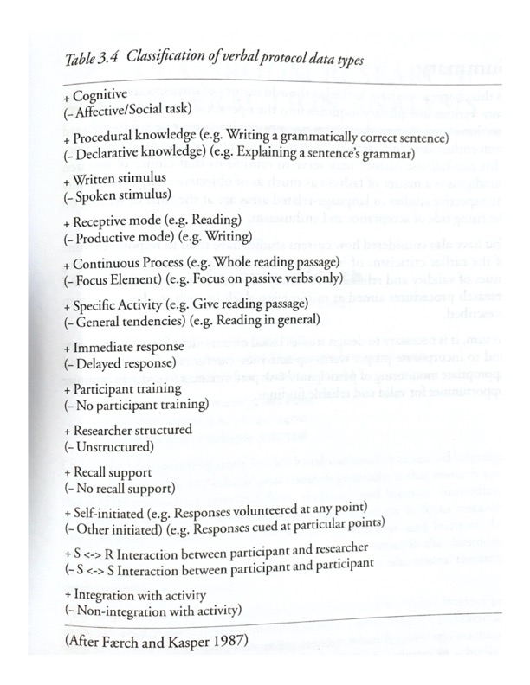
Verbal Protocols

Slide 13
Home assignment
A. Brown Ch. 21,22 Tone Groups, Tones. Pp.122-127
Introspective research: develop a verbal protocol for your study.

