Slide 1
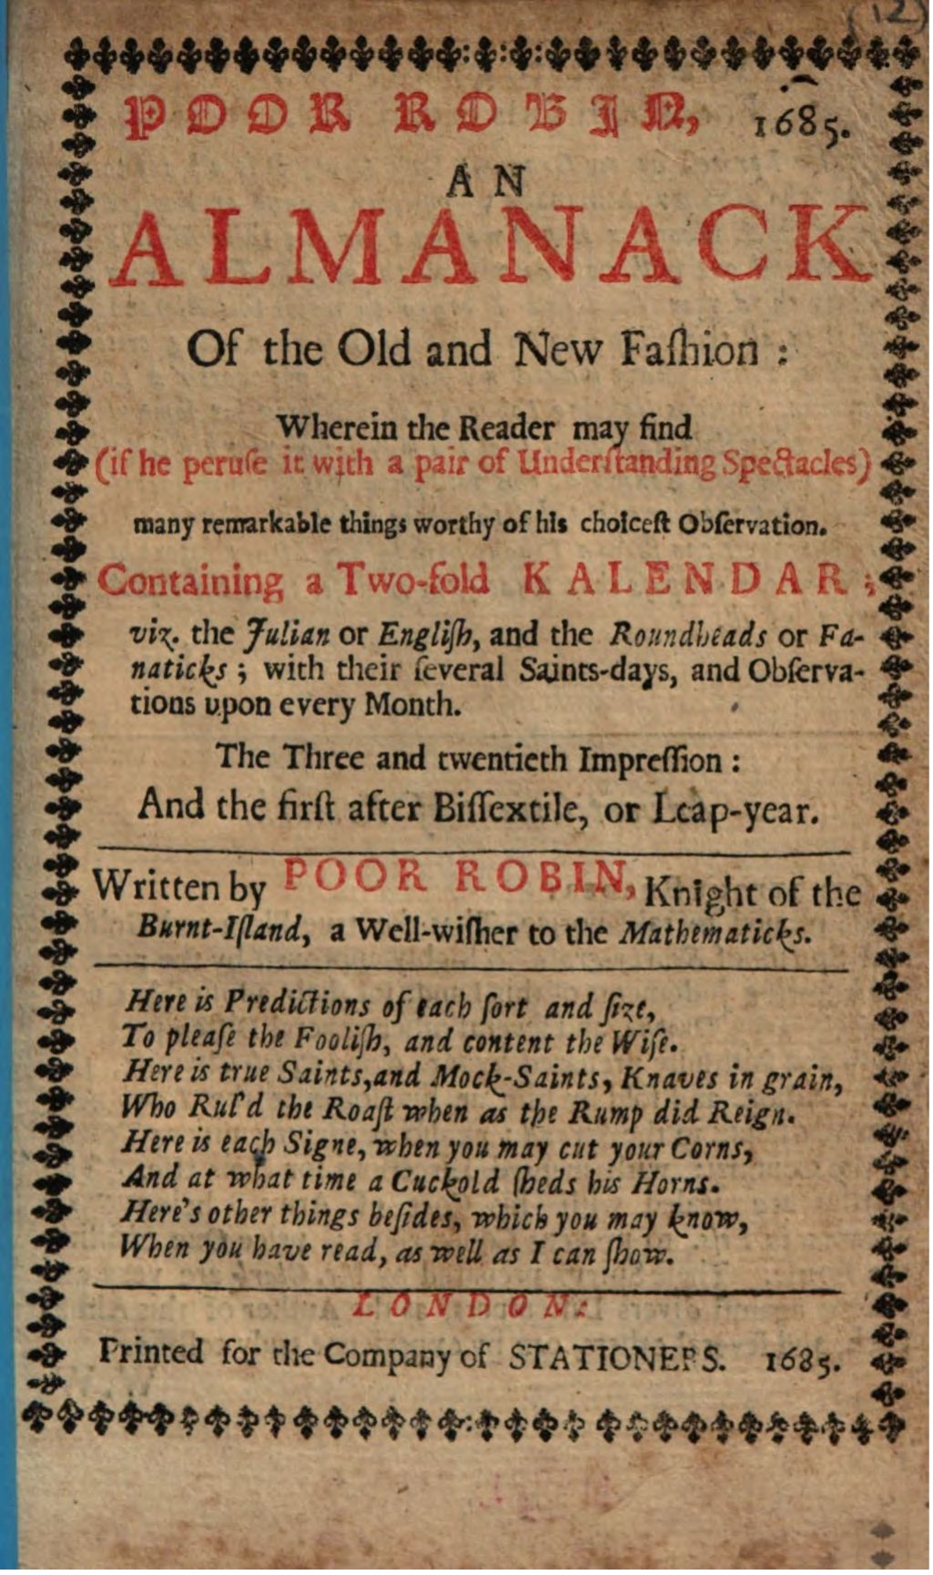
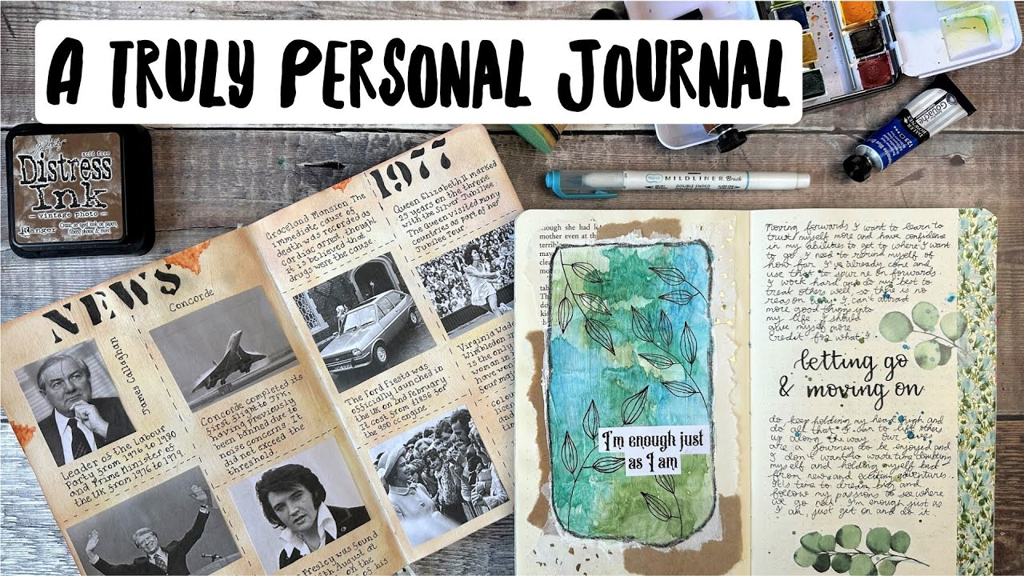
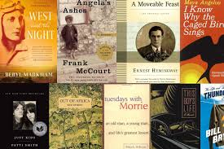
Life-writing
“Life-writing of [the post-war] period … played an essential part in expanding and enriching what it means to pursue self-fulfilment.”

Slide 2
Life-writing
a broad generic category encompassing a myriad of diverse literary subgenres related to autobiographical storytelling
Different forms:
autobiography, biography, memoir, diary, travel writing, autobiographical fiction, letters, collective biography, poetry, case history, personal testimony, illness narrative, obituary, essay, and reminiscences

Slide 3
testimony narratives
became important within various processes of historical redress, raising consciousness and generating empathic connections with the victimised and the oppressed
many people have come to understand life-writing as having a significant therapeutic potential: learning to identify yourself with a narrative that explains what kind of person you are, and what kind of journey you are on, became essential to the ethos of empowerment which modern ways of thinking about selfhood have tended to enshrine.

Slide 4
Annotated almanac
published annually and include up-to-date facts about the world, current events, countries, sports records, business and the economy, astronomy, education, awards, space, and much more
use an almanac when you are looking for current statistical data and basic information about a topic

Slide 5
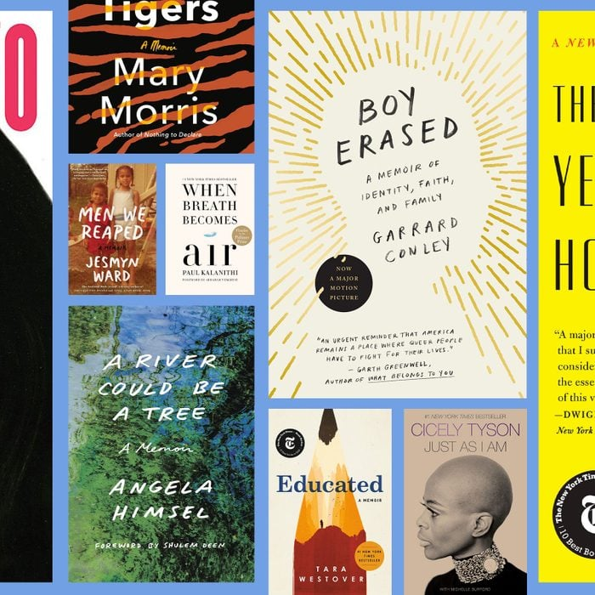
Memoir
https://www.rd.com/list/memoirs-everyone-should-read/

Slide 6
Memoir
This activity requires people to boil a story down to its core, then summarize it in half a dozen words.
Zak Nelson: “I still make coffee for two.” The fact that Nelson doesn’t reveal the backstory keeps readers wondering: What happened to the second coffee drinker? How long has he or she been gone? And why does this mysterious person still hold the author’s daily attention?

Slide 7
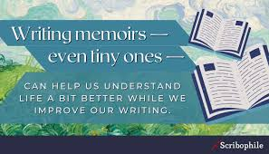
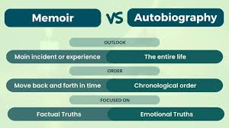
Memoir

Slide 8
Found in the news
This challenge is about making poetry from the news.
This is editing at its extreme:
Find a current news article or comment piece. A longer piece will probably be easier to work with
Highlight the interesting phrases and words you want to keep (or another approach is to delete everything that doesn't move you and work with what is left)
Arrange your text fragments into a poem, paying attention to line breaks and rhythm.

Slide 9
Found poetry
Amelia was just fourteen and out of the orphan asylum;
at her first job—in the bindery, and yes sir, yes
ma’am, oh, so anxious to please.
She stood at the table, her blond hair hanging about
her shoulders, “knocking up” for Mary and Sadie,
the stitchers (“knocking up” is counting books and
stacking them in piles to be taken away).

