Slide 1
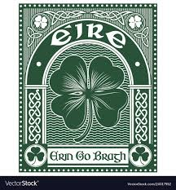
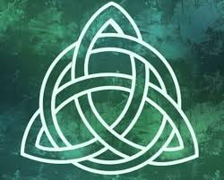
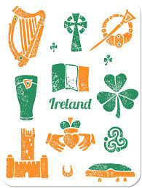
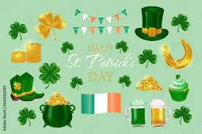
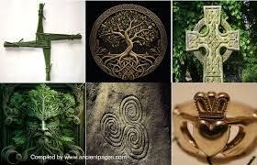
Irish, history, literature and culture

Slide 2
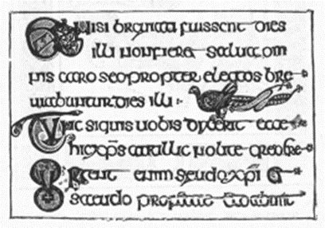
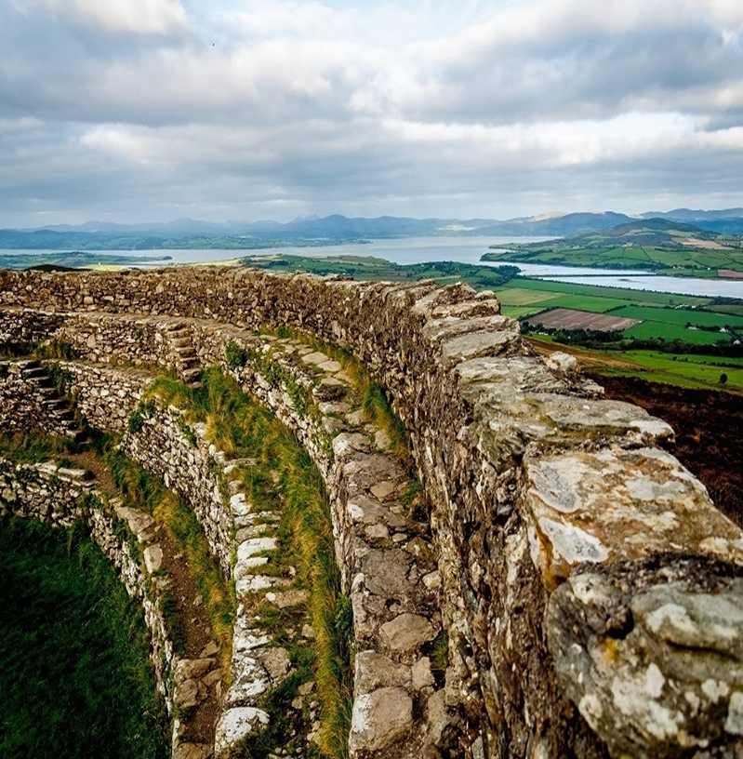

Slide 3
Milestones of irish History
The spread of Christianity
The arrival of Henry Plantagenet in Ireland
The Plantation of Ulster
The sack of Drogheda
The battle of Aughrim
An Argument on Behalf of the Catholics of Ireland
Daniel O’Connell and Catholic Emancipation
The Great Famine
Leaders of the Easter Rising are executed
Bloody Sunday
The Good Friday Agreement

Slide 7
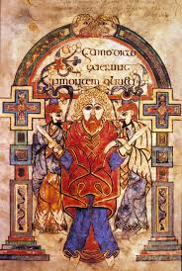
Irish literature
Four epic cycles:
the Mythological Cycle, which concerns the Irish pagan pantheon, the Tuatha Dé Danann;
the Ulster Cycle, mentioned above, also known as the Red Branch Cycle or the Heroic Cycle. This cycle contains tales of the conflicts between Ulster and Connacht;
the Fenian cycle (a body of romance woven round Fionn Mac Cumhaill, his son Oisin, and his grandson Oscar, in the reigns of the High King of Ireland Cormac mac Airt)
the Historical Cycle, or Cycle of the Kings. The Historical Cycle ranges from the almost entirely mythological Labraid Loingsech, who allegedly became High King of Ireland around 431 BC, to the entirely historical Brian Boru, who reigned as High King of Ireland in the eleventh century AD
Book of Kells: an illuminated manuscript and Celtic Gospel book in Latin, containing the four Gospels of the New Testament together with various prefatory texts and tables.

Slide 8
Anglo-Irish literature
Were not the people of Ireland born as free as those of England? How have they forfeited their Freedom? Is not their Parliament as fair a Representative of the People, as that of England? And hath not their Privy Council as great, or a greater Share in the Administration of publick Affairs? Are they not Subjects of the same King? Does not the same Sun shine over them? And have they not the same God for their Protector? Am I a Free-man in England, and do I become a Slave in six Hours, by crossing the Channel? J. Swift

Slide 9
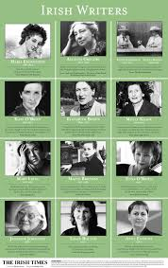
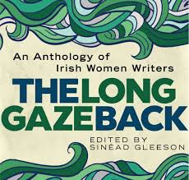
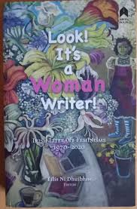
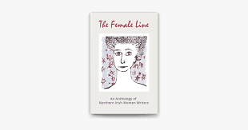
Irish writers

Slide 10
a fresh selection of Irish authors you should be reading right now?!

Slide 11
a fresh selection of Irish authors you should be reading right now?!

Slide 12
New irish writers
how we could be doing better in terms of diversity in the arts in Ireland
why it’s vital to put more support in place for writers from under-represented communities
Nidhi Zak/Aria Eipe, Christie Kandiwa, Chandrika Narayanan-Mohan, Khanyo Dlamini and Chiamaka Enyi-Amadi

