Slide 1
Tone languages Suprasegmentals Class 3
Why do we need to know that [v] is a labiodental sound and [d] is an alveolar one?
What kind of transcription is there in the following word: [ˈpʰɹ̥ʷɛʔt.sɫ̩]?
What is the difference between qualitative and quantitative research?

Slide 2
Plan
1. Tone languages. Is English a tone language?
2. Suprasegmentals. What are the components of prosody?
3. The nature of stress and pauses. What is the difference between stress and accent?
4. Case studies.
5. Structure of a research paper.

Slide 3
Tone Languages
import – to import
record – to record
Important
A very important message

Slide 4
Stress vs Accent
Stressed syllables are usually louder than unstressed ones.
Stressed syllables are usually longer than they would be if they were unstressed.
Stressed syllables are usually pronounced on a different pitch (usually a higher one)
than surrounding syllables .
Stressed syllables are never weak syllables, but have a full quality. Weak syllables are those that contain [ə] or [i].
Stress is a complex mixture of these factors. Pitch and length have the greatest effect.
Stress – word
Accent – foot/tone group

Slide 5
Suprasegmental features of speech
Pitch variation
Loudness
Tempo (pauses and speed) - (sounds per second) –English speed - VOA
https://www.youtube.com/watch?v=QvU4InKZSUE
Rhythm – Abercrombie vs O'Connor
Voice Quality (Paralinguistic features)
Prosody - the patterns of stress and intonation in a language.
Intonation – pitch variation, the melody of speech, the rise and fall of the voice in speaking.

Slide 6
Functions of Intonation #1 - discourse
2. Attitudinal
3. Grammatical
4. Accentual
e.g.
She won’t go out with anyone.
I have plans to leave.
Can you lend me some money?

Slide 7
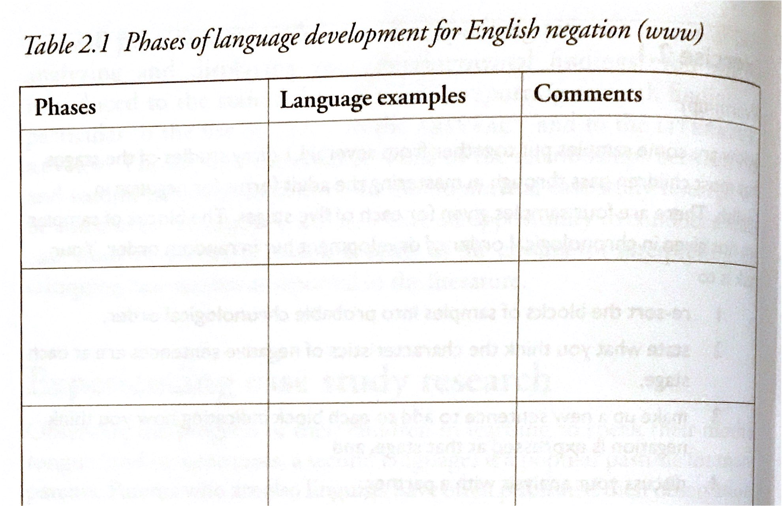
RESEARCH STRATEGIES
1. Significance of defining research
2. Case study vs Developmental research
Compiling Case Study Data

Slide 8
Reporting Your Results

Slide 9
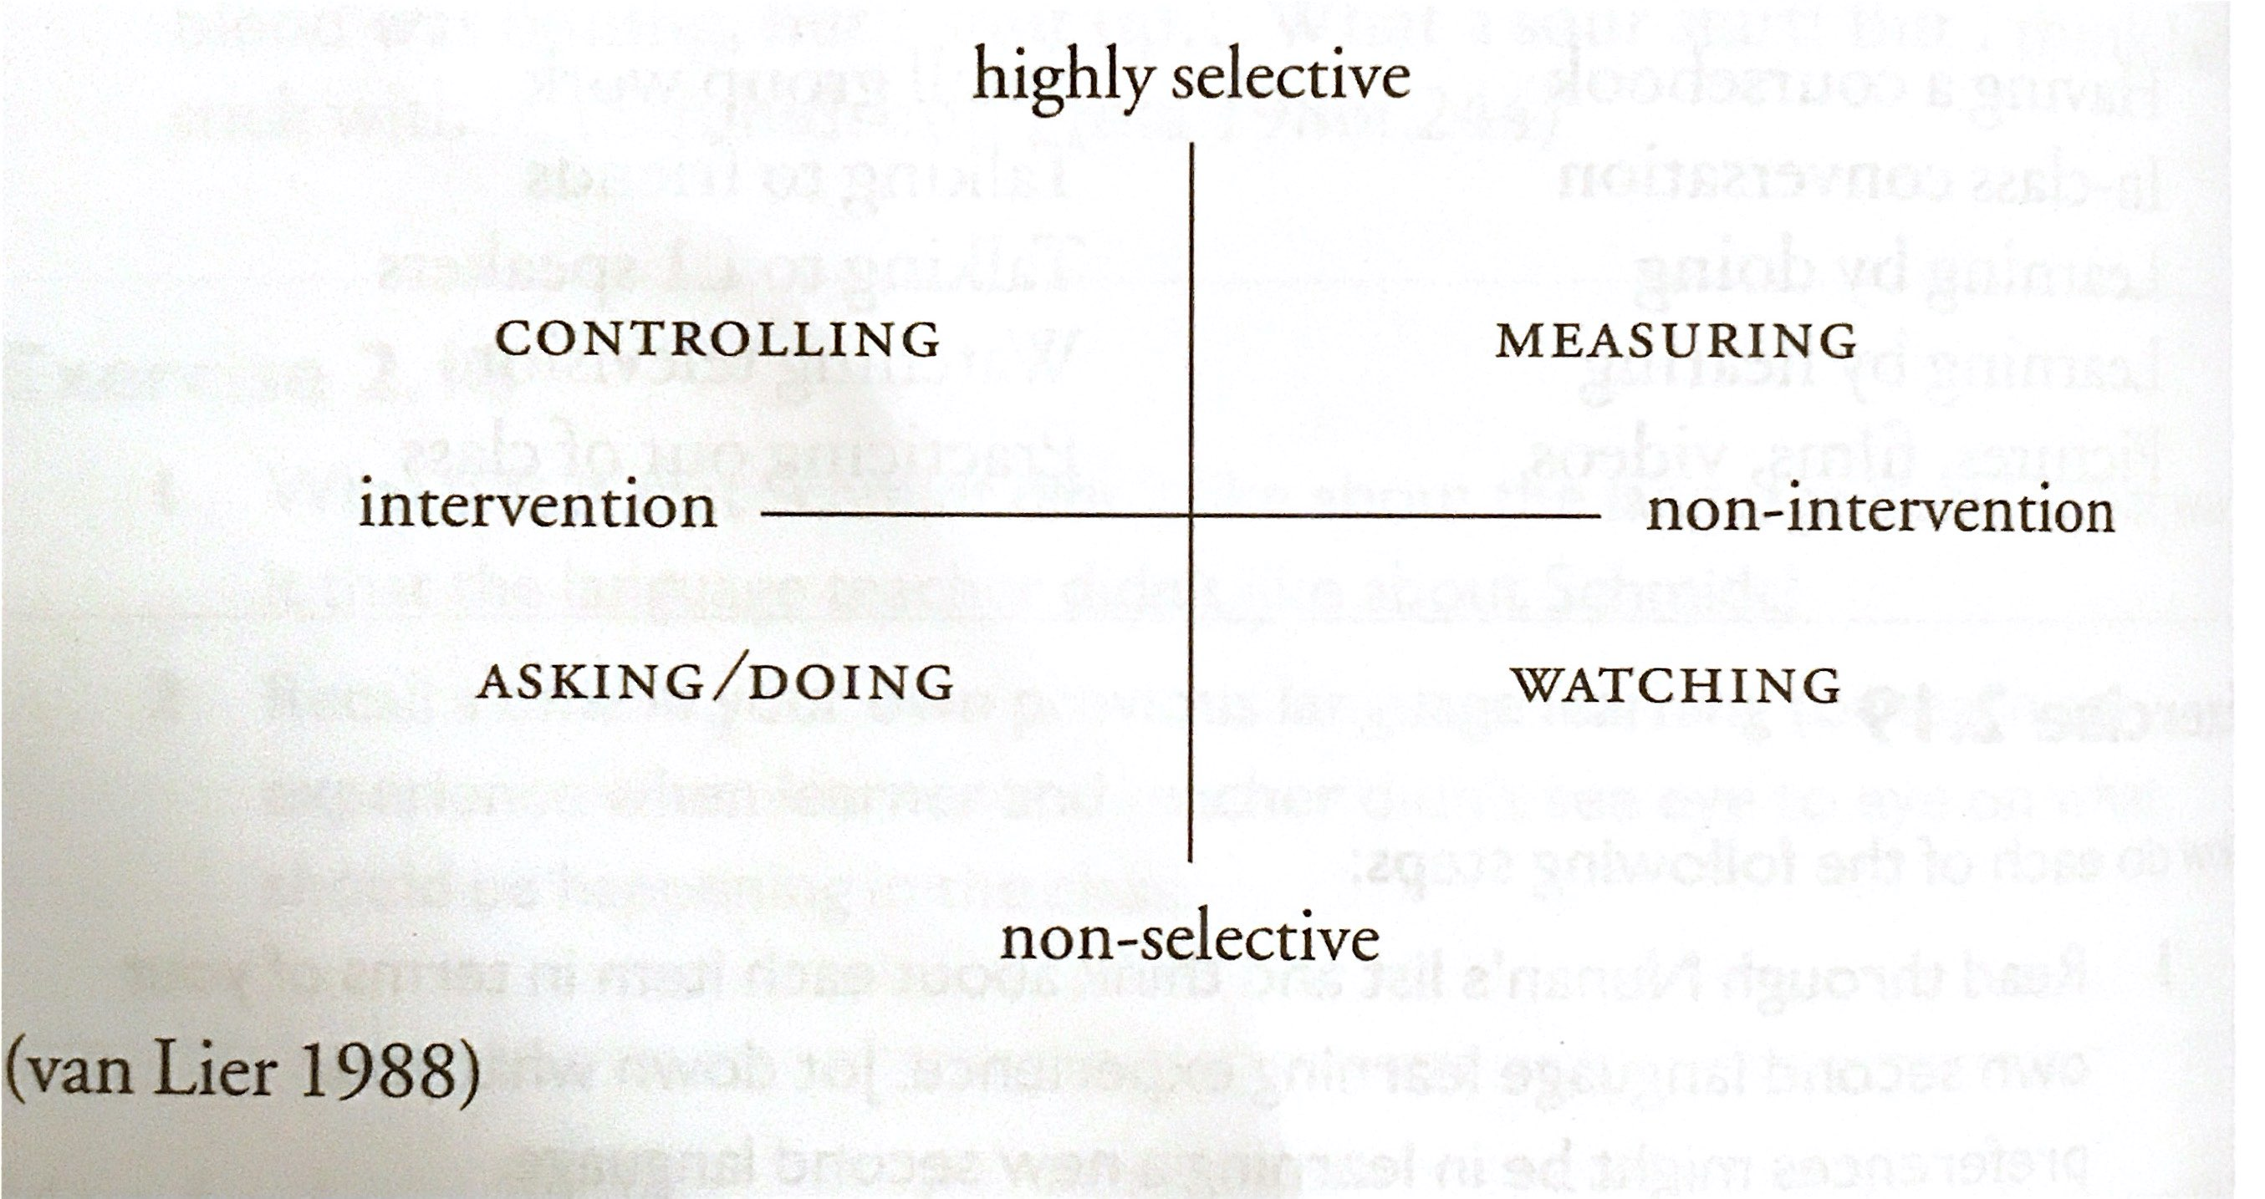
Interpreting Case Study Research
Internal validity
External validity
Benefits for teachers/learners/ learning research

Slide 10
Home assignment
Adam Brown (PDF) – Chapters 18 (pausing and speed), 19 (Word stress) ,22 (Rhythm)
Peter Roach - Tone Languages, Suprasegmentals
Skills: Case Study Design

