Slide 1
Modernism
An Overview of Basic Characteristic Features and Roots

Slide 2
A term with vague and imprecise meaning
no agreement on what it is or when it is
not a particular school or trend
A convenient shorthand or umbrella-term for different trends at a certain period
negative definition – against 19th-century schools
usually understood as between the 1890s and the 1940s (other periodizations exist)
Modernism

Slide 3
Modernism
Common trends:
against realism
interest shifts from the outside world to the work of art itself
techniques, methods, devices are in the focus
“What Is Art?” NOT “How Should a Good Work of Art Look Like?”
prefers experimenting
breaks down the boundaries of tradition – tries to come up with new foundations

Slide 4
Realistic and other 19th-century schools:
belief in progress
the possibility to know and control the world (Rationalism, Empiricism)
big scientific and geographical discoveries
advances in medicine and biology
Industrial Revolution
Huge, “safe” and “controlled” colonies
the UK is one of the great powers
Before Modernism

Slide 5
End of the 19th century:
unwelcome changes in society
disturbing scientific discoveries
and with them the age of skepticism
1st half of the 20th century:
wars and the feeling that
anyone can be tortured and obliterated at any moment
one is fundamentally alone
human beings are hopeless against bigger events of history
The Background of Modernism

Slide 6
The Background of Modernism
Industrialization – not only social changes:
new materials:
concrete
iron and steel
glass
mass production:
reproduction and general availability of works of art
cheap, disposable things
standardized objects
more homogeneous style in fashion, furniture, etc.

Slide 7
New Materials

Slide 8
End of the 19th century:
unwelcome changes in society
disturbing scientific discoveries
and with them the age of skepticism
1st half of the 20th century:
wars and the feeling that
anyone can be tortured and obliterated at any moment
one is fundamentally alone
human beings are hopeless against bigger events of history
The Background of Modernism

Slide 9
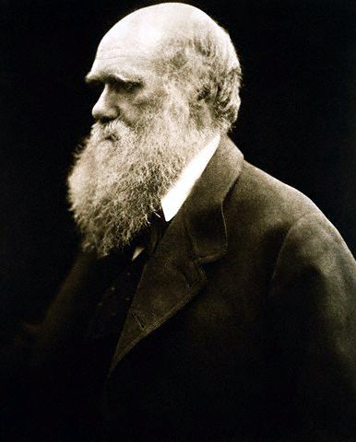
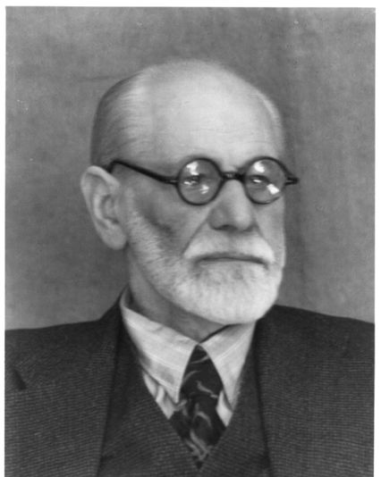
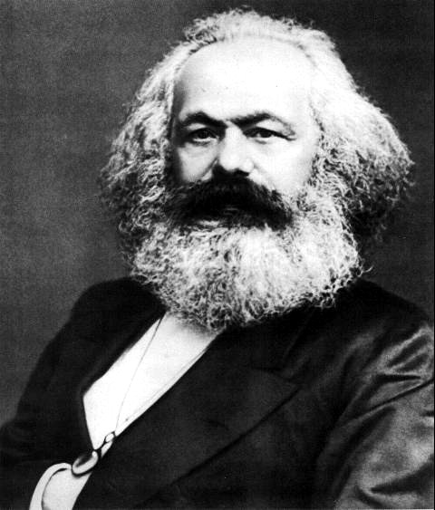
FamilyID=Office_ArchiveTorn
Old Men with Beards

Slide 10
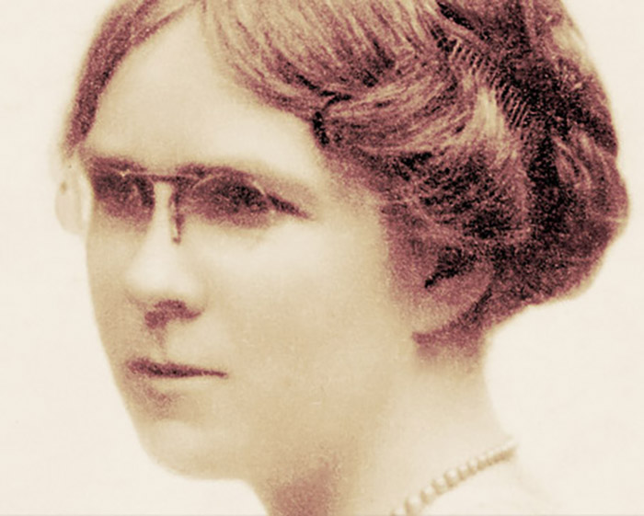
British Modernism: Fiction
Dorothy Richardson (1873-1957)
novelist, literary critic, translator (French, German)
feminist
stream of consciousness
a writer of both London and the countryside
Works:
Pilgrimage (13-volume prose experiment)
various other novels and short stories

Slide 11
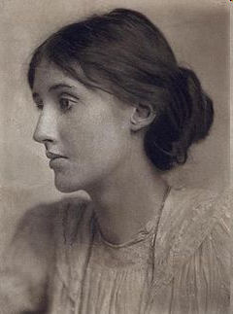
British Modernism: Fiction
Virginia Woolf (1882-1941)
interested in the thoughts and emotions of the protagonist
little action
stream of consciousness
Most important works:
Mrs Dalloway
To the Lighthouse
Orlando
A Room of One’s Own (non-fiction)

Slide 12
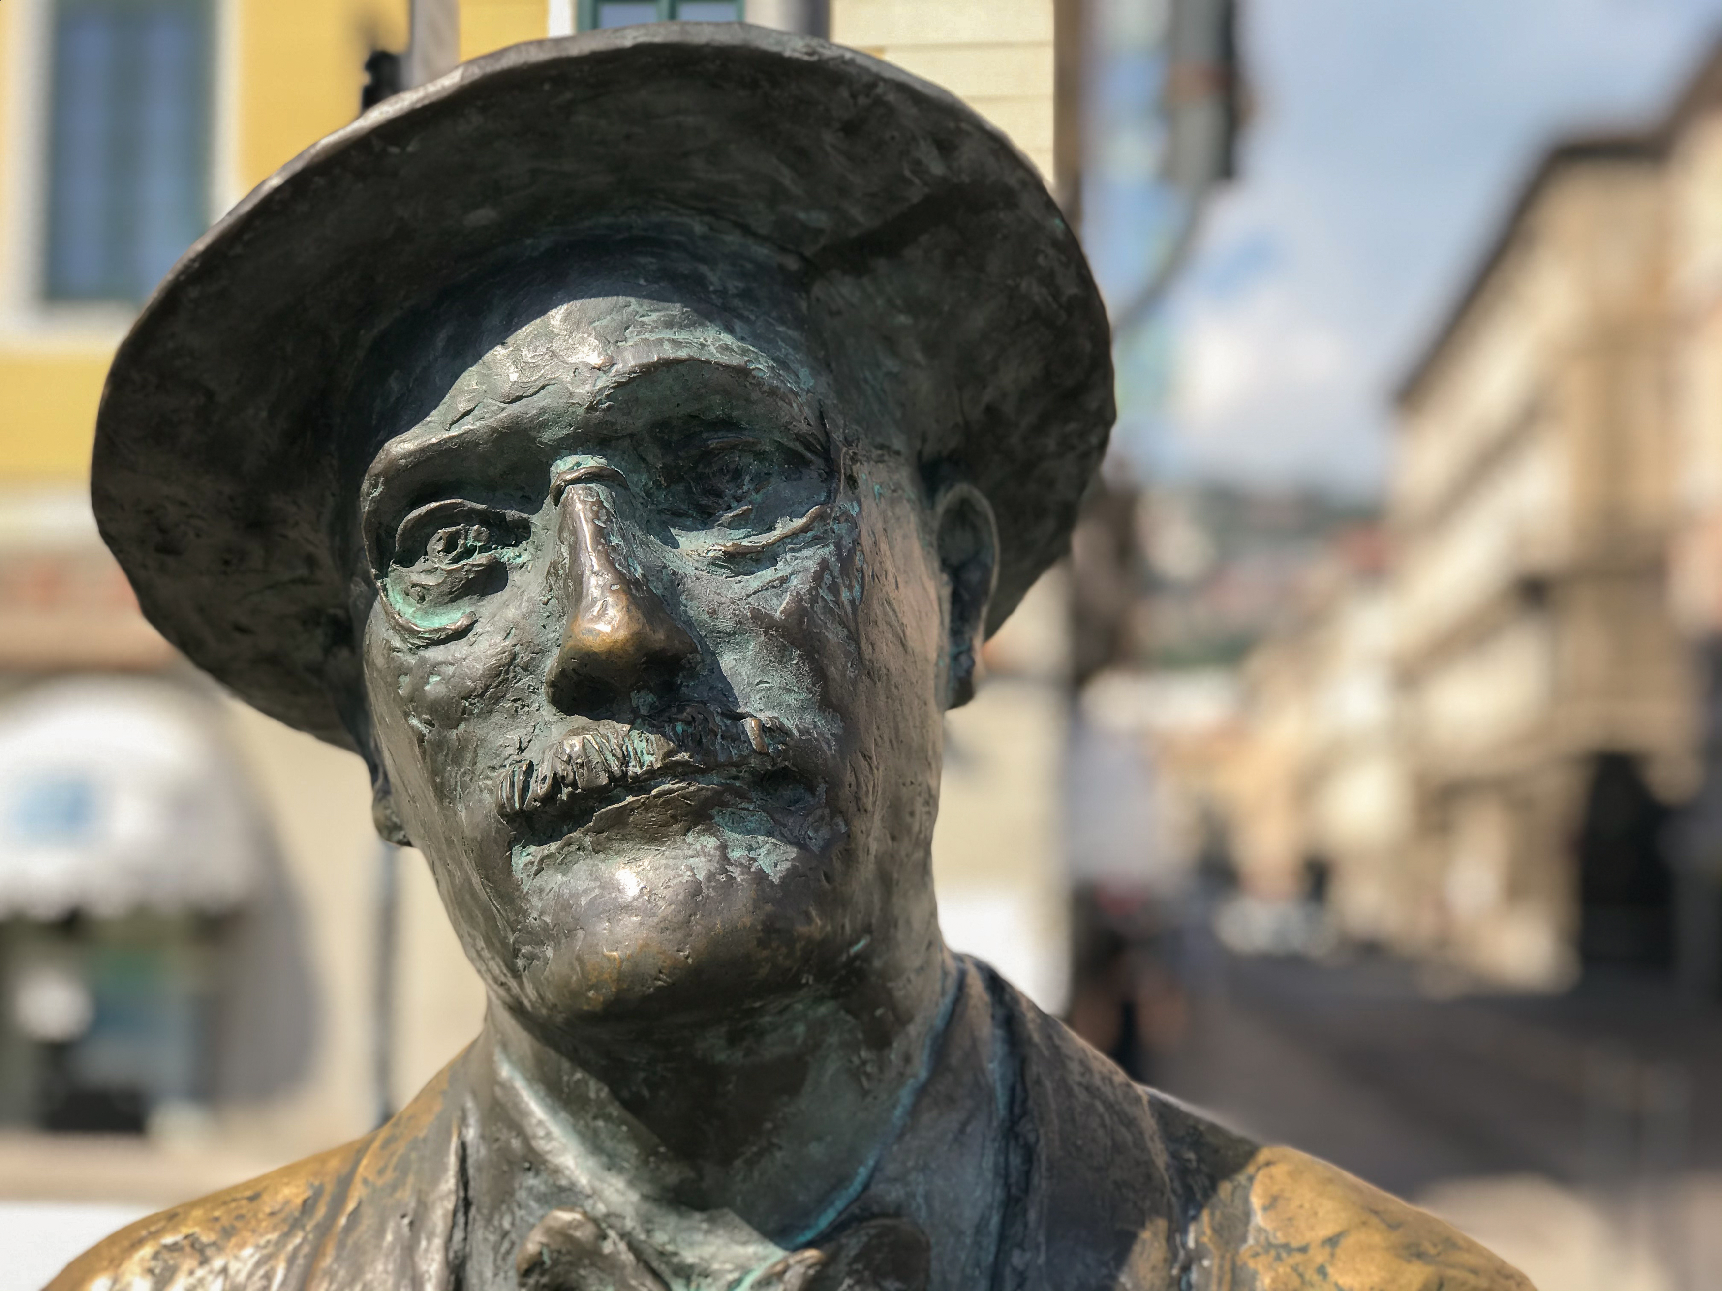
British Modernism: Fiction
James Joyce (1882-1941)
expatriate writer
works take place in Dublin
stream of consciousness
Most important works:
Dubliners
A Portrait of the Artist as a Young Man
Ulysses
Finnegans Wake

