Slide 1
Children’s/YA literature Resources
Guidelines
Lists/webs

Slide 2
YA literature
"Books for Young Persons" (for those between fourteen and twenty-one)
S. E. Hinton – The Outsiders (1967)
the "fab five“:
I Know Why the Caged Bird Sings (1969) – Maya Angelou
The Friends (1973) – Rosa Guy
The Bell Jar (US 1963, under a pseudonym; UK 1967) – Sylvia Plath
Bless the Beasts and Children (1970) – Glendon Swarthout
Deathwatch (1972) – Robb White

Slide 3
YA literature
1980s:
books dealing with topics such as rape, suicide, parental death, and murder, saw significant critical and commercial success
Michael L. Printz Award and Alex Awards – designed to recognize excellence in writing for young adult audiences
Michael L. Printz Award: annually honours the best book written for teens, based entirely on its literary merit, each year. In addition, the Printz Committee names up to four honour books, which also represent the best writing in young adult literature.
The Alex Awards are given to ten books written for adults that have special appeal to young adults, ages 12 through 18. The winning titles are selected from the previous year's publishing. The Alex Awards were first given annually beginning in 1998 and became an official ALA award in 2002.

Slide 4
YA literature
YA fiction expands into other media and genres: graphic novels/manga, light novels, fantasy, mystery fiction, romance novels, and even subcategories such as cyberpunk, techno-thrillers, and contemporary Christian fiction.
New adult fiction (also known as NA): written about and aimed towards young adults between 18 and 30 years old
Jennifer L. Armentrout, Jamie McGuire, Colleen Hoover, and Tammara Webber

Slide 5
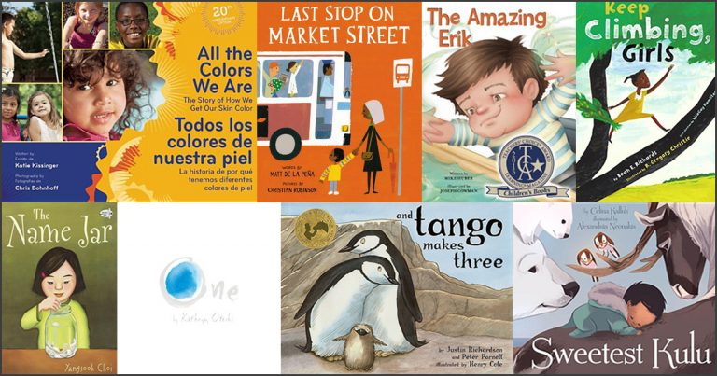
Selecting anti-bias children’s books

Slide 6
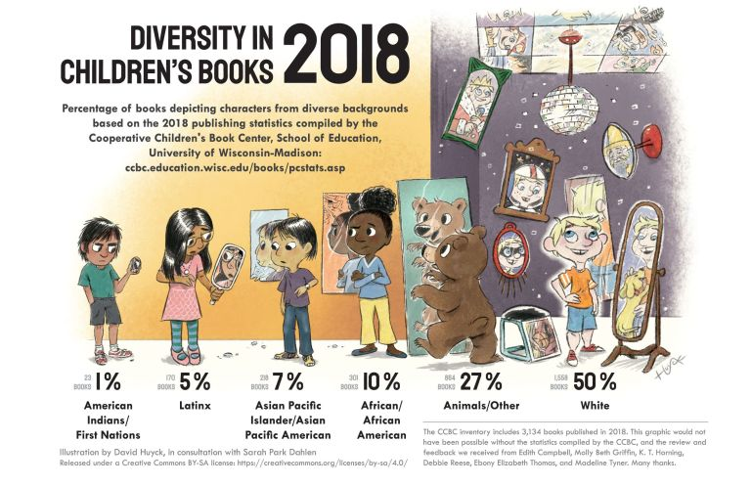

Slide 7
Selecting anti-bias children’s books
books reflect the attitudes in our society about diversity, power relationships among different groups of people, and various social identities (e.g., racial, ethnic, gender, economic class, sexual orientation, and disability).

Slide 8
Selecting anti-bias children’s books
What to do:
Check the Illustrations
Look for Stereotypes
Look for Tokenism
Look for Invisibility
Check the Story Line and the Relationships Between People
Look at Messages About Different Lifestyles

Slide 9
Selecting anti-bias children’s books
Consider the Effects on Children’s Self and Social Identities
Look for Books About Children and Adults Engaging in Actions for Change
Consider the Author’s or Illustrator’s Background & Perspective
Watch for Loaded Words
Look at the Copyright Date
Assess the Appeal of the Story and Illustrations to Young Children
Check for age appropriateness

Slide 10
Common Harmful/Undermining Stereotypes
Strong, independent girls and women are “manlike”
Book-loving or nonathletic boys and men are “effeminate”
Latino men talk funny, are lazy, gang members, or wear oversize sombreros
Latina women are earth mothers or subservient
African American men are gang members, oversexed, or underemployed
African American women are too independent, oversexed, or “welfare moms”
LGBTQ people are invisible or sexual predators
Poor people are invisible or depicted as passively needing help from others
American Indians live in teepees, carry bows and arrows, or are half-naked in winter
People with disabilities are not independent or are to be pitied
Arab and/or Muslim men are terrorists
Arab and/or Muslim women are voiceless and passive
All Muslims are Arab

Slide 11
Examples of Groups of People Who Are Often Invisible in Children’s Books or Mainstream Media
Families who live in rural areas
Blue-collar workers
Musicians, artists, and writers
Families with two dads or two moms
Single mothers or fathers
Homeless families
Families with an incarcerated parent
People of Arab descent and/or families who practice Islam
Transgender adults and children

Slide 12
