Slide 1
creativity and motivation workshop
If you can’t reach them, you can’t teach them

Slide 2
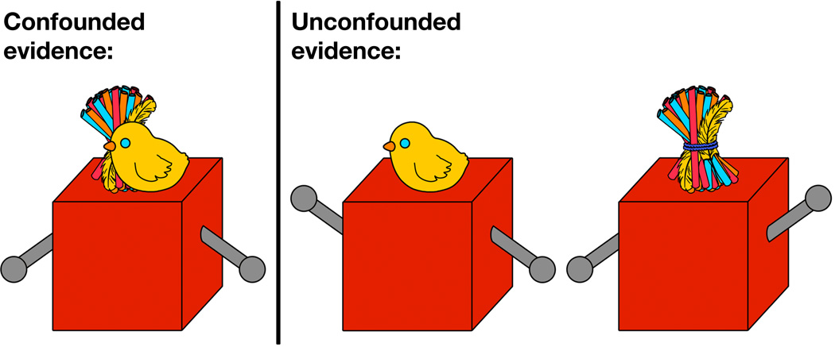
Curiosity=lust for knowledge
Hard to define
Natural/inborn/intrinsic
Declines with age
Retain an information gap
Give a choice
Change the routine (remain unpredictable)

Slide 3
Attention=cognitive control of irrelevant stimuli
Sustained
Directed
Selective
Divided
Focused
Arousal
Orientation
Focus
Awareness of incoming information
Why do I need it?
What will come next?
+ multisensory approach to fit all types of learners

Slide 4
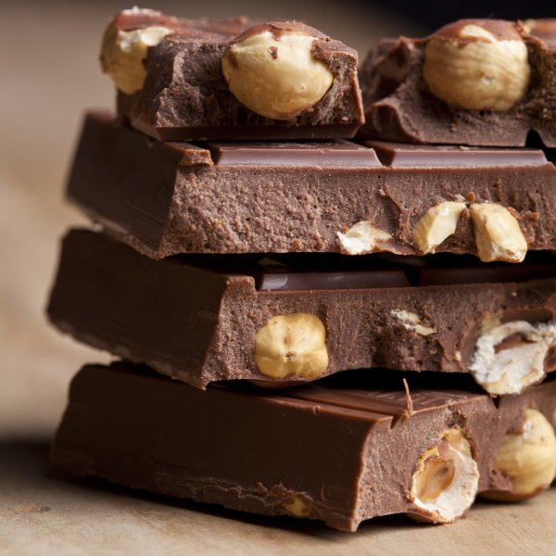
emotions
Emotional hijacking
Power of emotions
Emotionally charged incidents
Emotions are contagious
Appeal to emotions (emotional hooks = looks, sounds, feelings)
Create special relationship

Slide 5
Finding connection+ multisensory

Slide 6
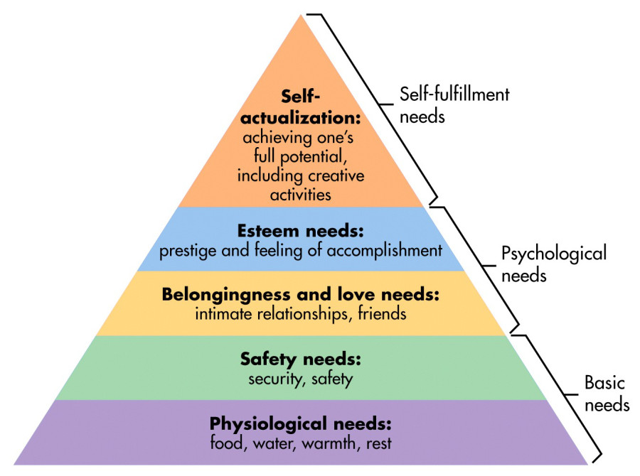
Motivation=something that makes you act
Intrinsic
Extrinsic =rewards+punishments

Slide 7
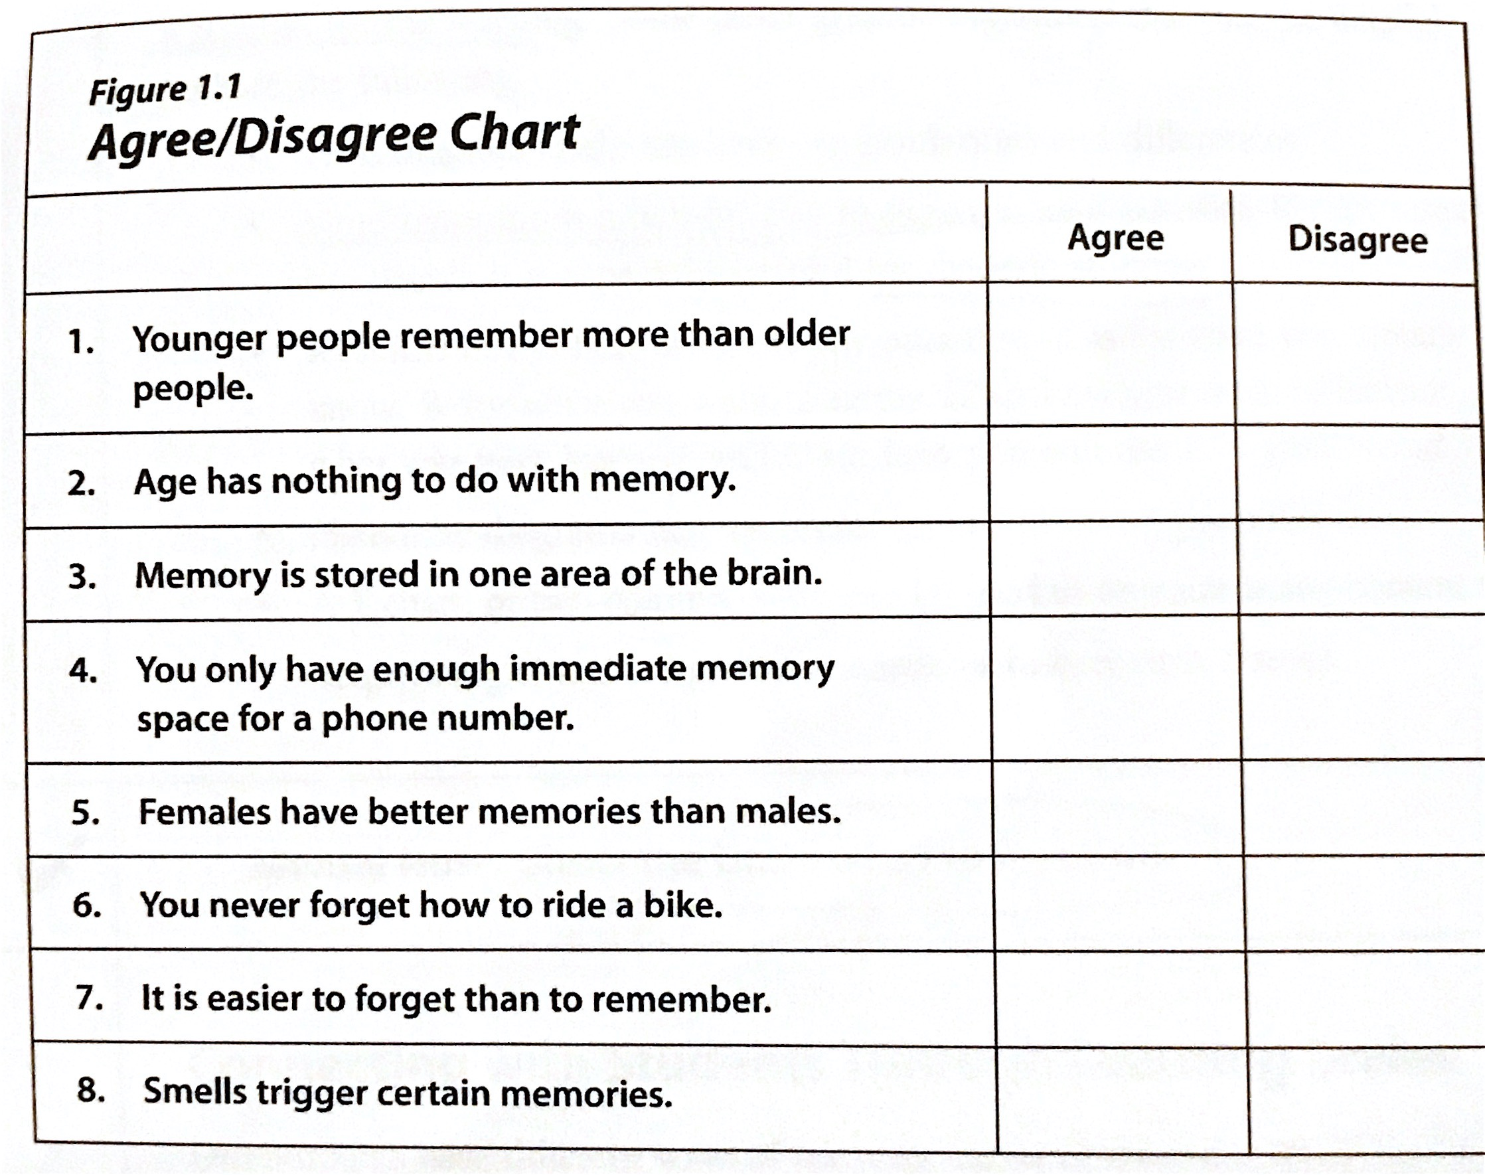
Great motivators
Aims and goals (better self-imposed)
Criteria of assessment
Feedback (positive/negative/extinction)
Curiosity (knowledge gap)+ self esteem

Slide 8
Case study=
Relevancy, Relationships and the Real world

Slide 9
Sum up

Slide 10
Make your choice (alternative sources)
A GAME/ A PUZZLE
A FAIRY TALE
A QUESTIONAIRE
PERSONAL PHOTOS
A VIDEO
A SOCIAL NETWORK
A MOBILE PHONE
A QUOTE
CONTRIBUTING TO A TEXTBOOK

