Slide 1
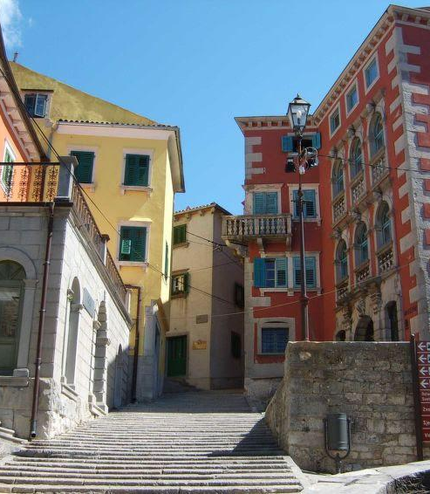
Renaissance and Humanism
A Basic Overview

Slide 2
Renaissance and Humanism
Origins:
Northern Italy, Florence, 14th century
the intellectual school of Humanism founded by Francesco Petrarca
“Man is the measure of all things” (Prothagoras)
Humans are essentially good
God has given vast intellectual and creative potential to people -> to be used to the fullest

Slide 3
The Renaissance
study of ancient literature and philosophy has moral and practical value
reading classical sources, and considering them as models
human beings are creatures of the mind and the senses
does not mean atheism
Renaissance Man:
wide, general and multi-faceted education and knowledge
balance in all fields of knowledge, art and exercise

Slide 4
How Could Things Have Changed So Radically?
Great Plagues radically changing:
the ownership of wealth
people‘s outlook on life
4th Crusade – the siege of Constantinople and the subsequent short-lived Frankokratia in parts of Greece
revival of interest in learning Greek and Latin
access to the libraries of Constantinople

Slide 5
How Could Things Have Changed So Radically?
Toleration of lending
in various Italian city-states (Florence, Venice, Naples, …)
parts of the German-speaking world
Switzerland
Free Imperial City of Augsburg (Fuggers)
Inventing the printing press – Johannes Gutenberg (~1440-1450)
reading (and publishing) becomes affordable
leaflets and pamphlets help disseminate ideas

Slide 6
Renaissance Art
classical Greek and Roman art as models
realism
attention to details
perfection in execution and craftsmanship
discovery of linear perspective
non-religious subject matter
the system of patronage

Slide 7
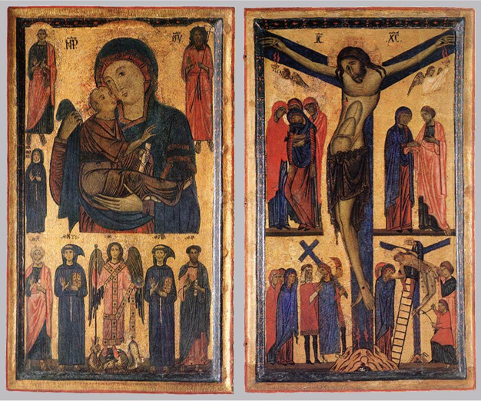
Bonaventura Berlinghieri, Madonna and Child with Saints and Crucifixion, 1270, Uffizi, Florence

Slide 8
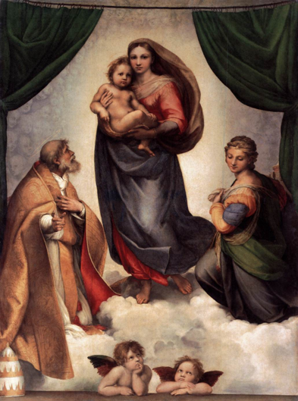
Raphael, The Sistine Madonna, 1513–14, Gemäldegalerie, Zwinger, Dresden

Slide 9
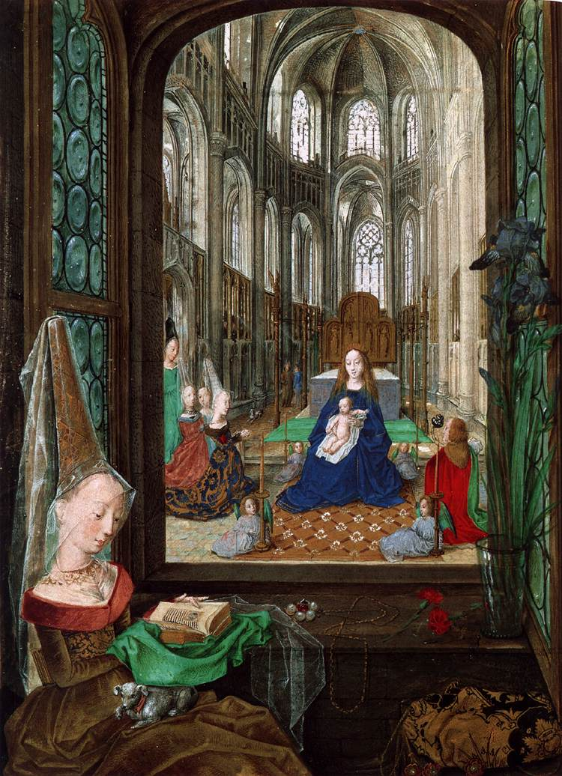
The Virgin and Child in a Church with Mary of Burgundy at Her Devotions, Folio 14, The Hours of Mary of Burgundy, 1477

Slide 10
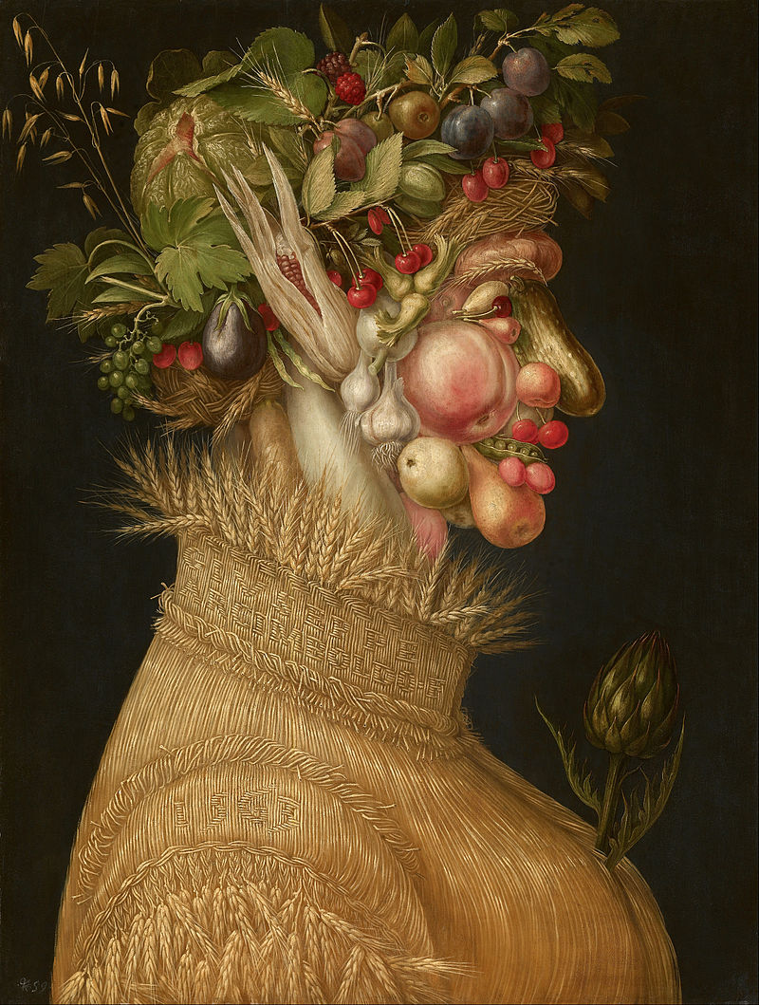
Giuseppe Arcimboldo, Summer, 1563, Kunsthistorisches Museum, Vienna

Slide 11
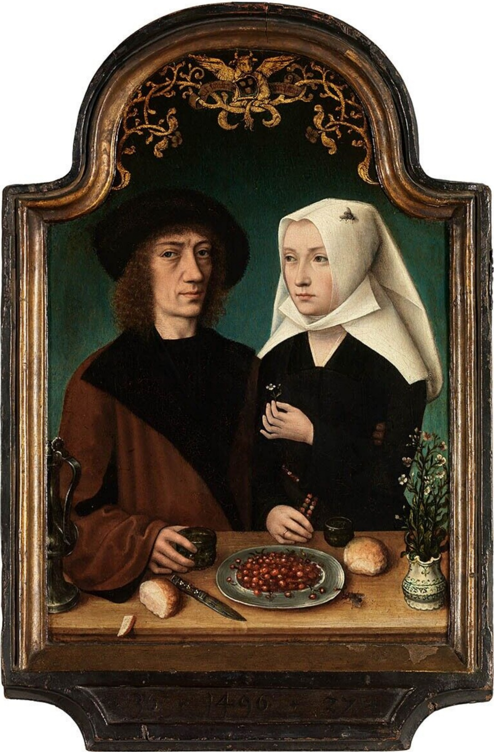
Master of Frankfurt, Self-portrait of the Artist with his Wife, 1496, Royal Museum of Fine Arts, Antwerp

Slide 12
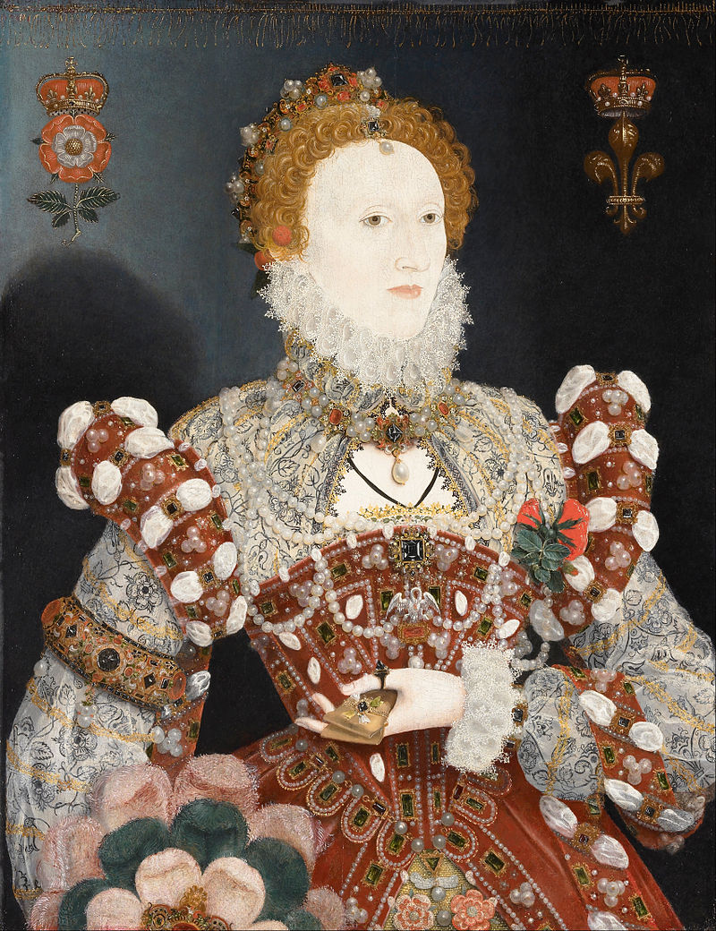
Nicholas Hilliard, Elizabeth I (Pelican Portrait), 1572, Walker Art Gallery, Liverpool

Slide 13
Renaissance Architecture
classical Roman examples
symmetry, proportion, geometry, regularity
columns
pilasters (column built into or onto a wall)
lintels (horizontal element supported by columns)
semicircular arches
domes
niches
aedicules (little buildings)

Slide 14
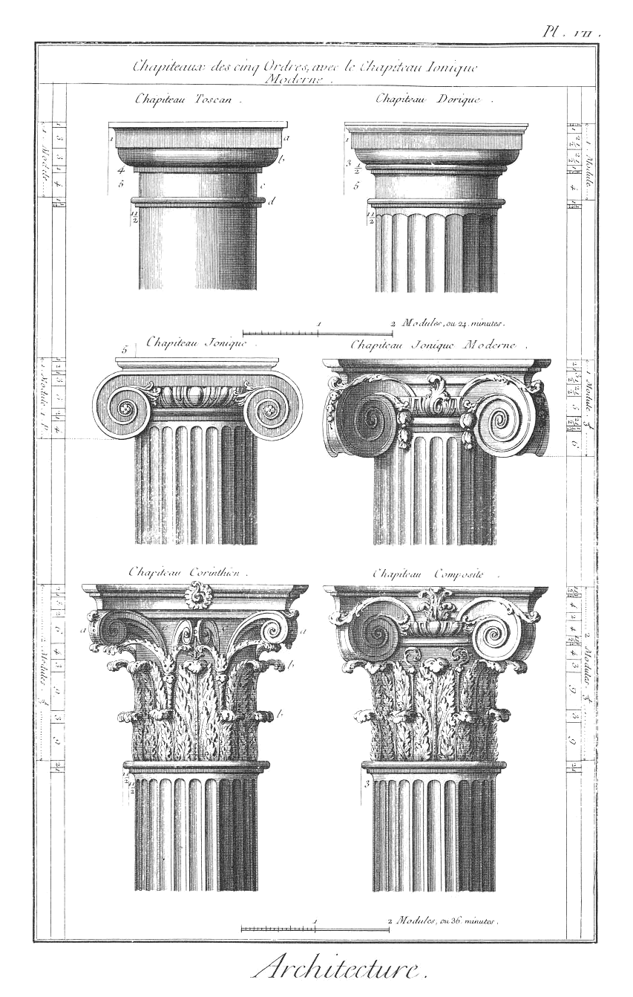
Classic Orders of Columns
TOSCAN and DORIC
IONIC
CORINTHIAN and COMPOSITE

Slide 15
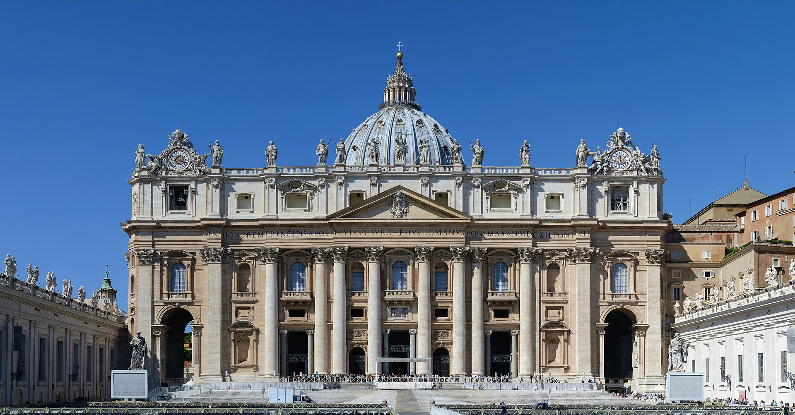
Papal Basilica of St Peter in the Vatican, various architects, 1506–1626

Slide 16
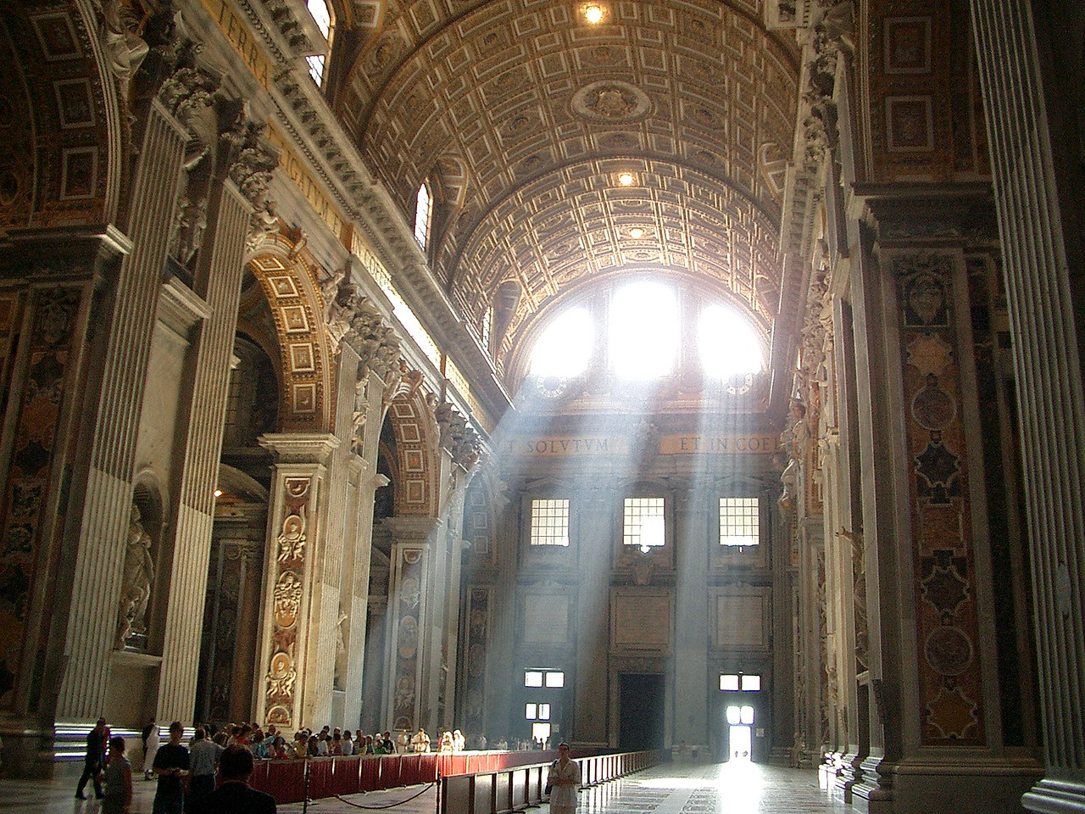
Papal Basilica of St Peter in the Vatican, various architects, 1506–1626

Slide 17
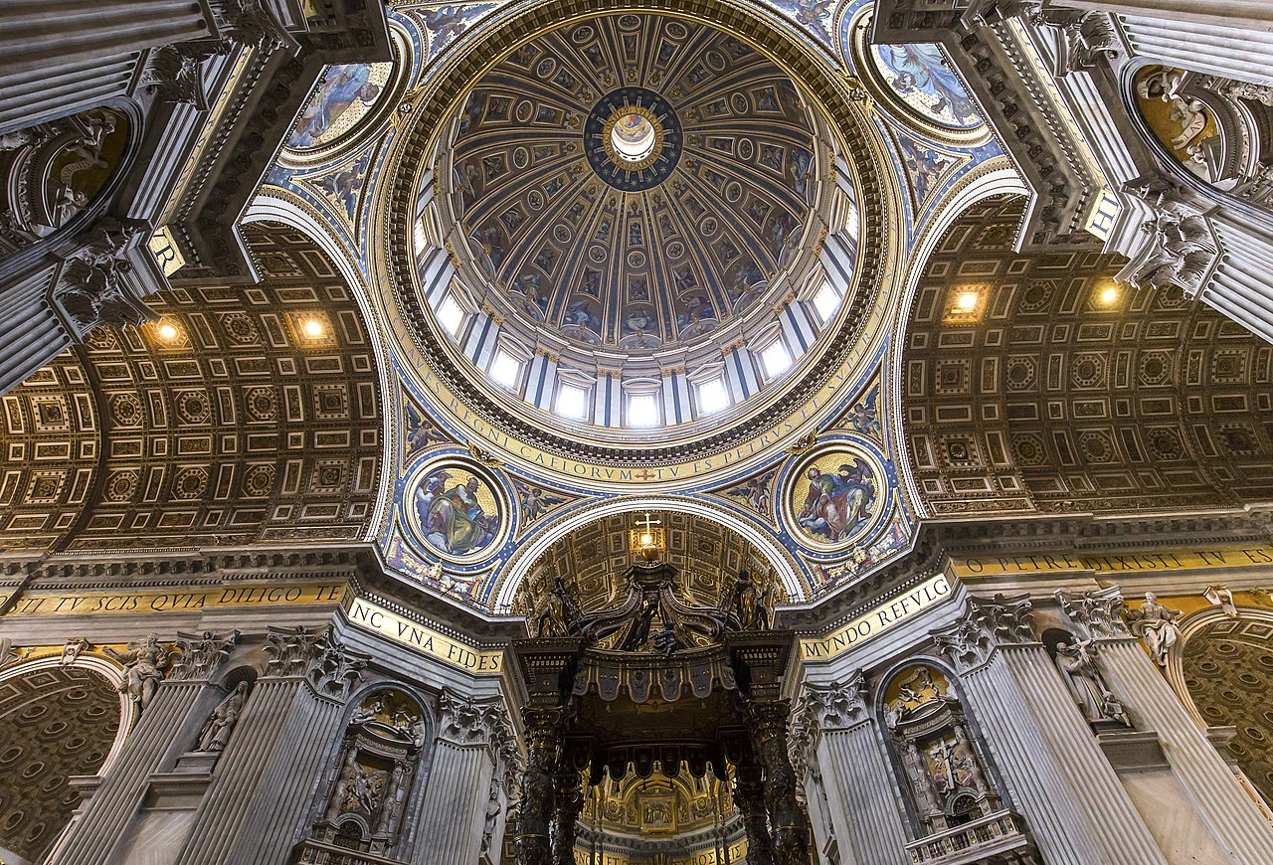
Papal Basilica of St Peter in the Vatican, various architects, 1506–1626

Slide 18
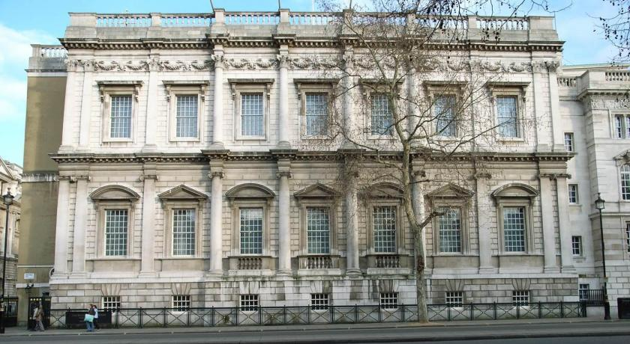
Inigo Jones, Banqueting House, Whitehall, London, 1622

Slide 19
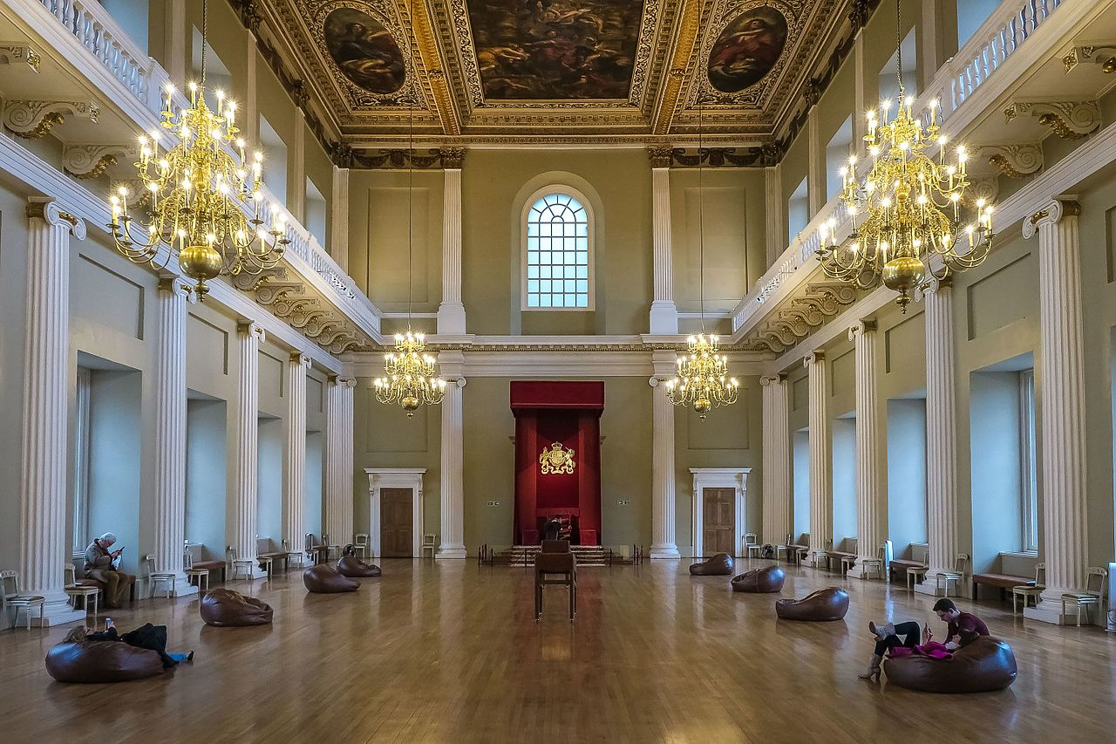
Inigo Jones, Banqueting House, Whitehall, London, 1622

Slide 20
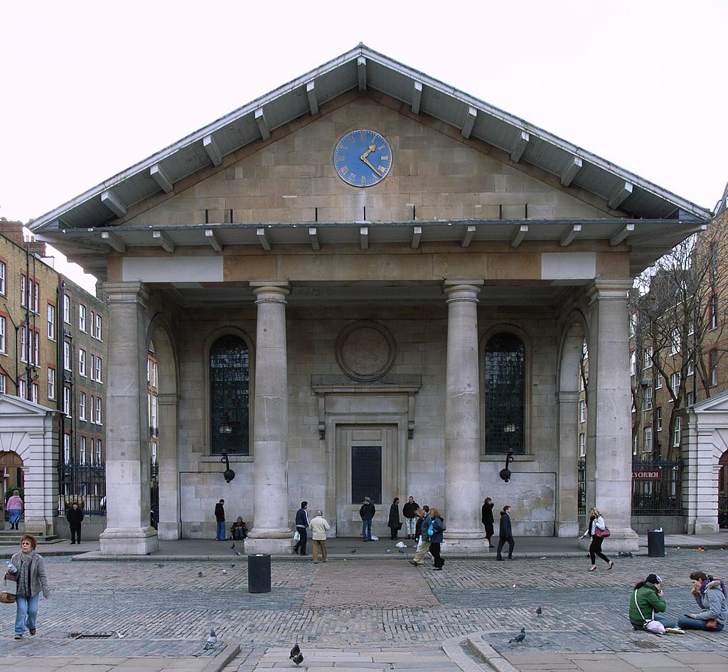
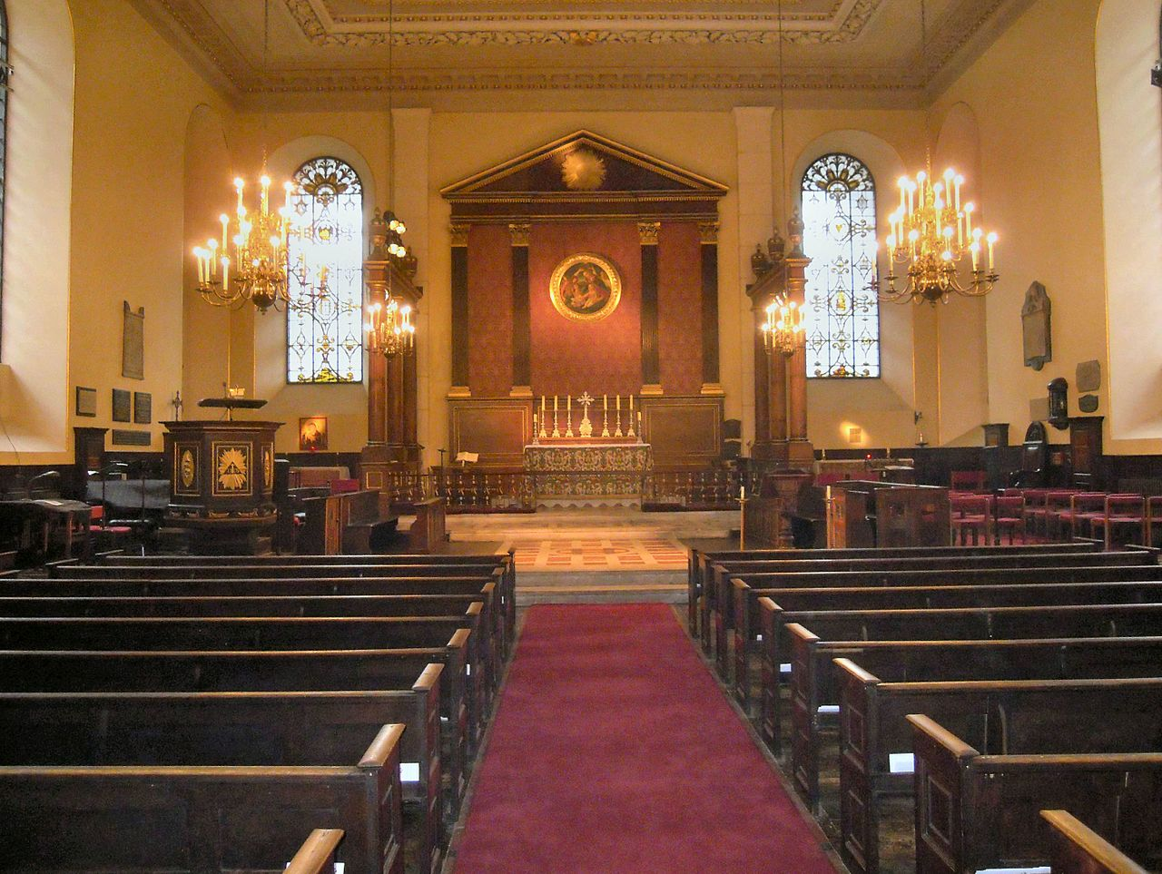
St Paul’s, Covent Garden, London, Inigo Jones?, 1633

Slide 21
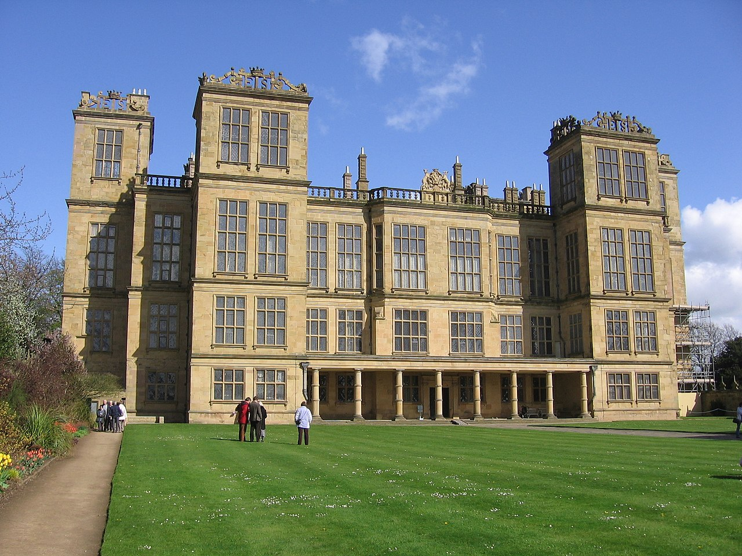
Robert Smythson, Hardwick Hall, Ault Hucknall, 1597

Slide 22
Renaissance Poetry – The Sonnet
The Italian Sonnet:
an octave (2 quatrains) + a sextet (2 tercets)
(a-b-b-a, a-b-b-a) + (c-d-e-c-d-e or c-d-c-c-d-c, ...)
The English Sonnet:
3 quatrains and a couplet
(a-b-a-b, c-d-c-d, e-f-e-f, g-g)
sharp turn in imagery or in content

Slide 23
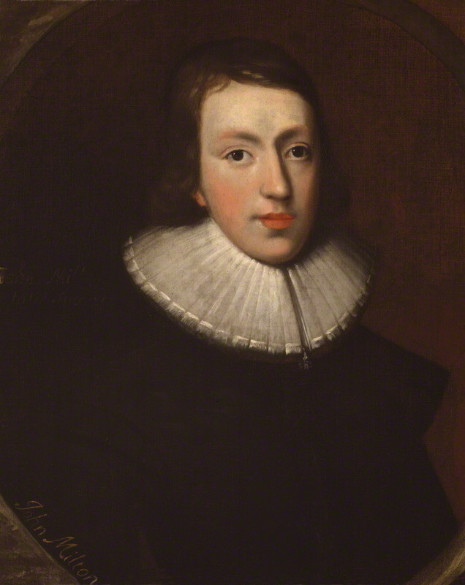
Renaissance Poetry – The Italian Sonnet
How soon hath Time, the subtle thief of youth, (A) Stolen on his wing my three and twentieth year! (B) My hasting days fly on with full career, (B) But my late spring no bud or blossom shew'th. (A) Perhaps my semblance might deceive the truth, (A) That I to manhood am arrived so near, (B) And inward ripeness doth much less appear, (B) That some more timely-happy spirits indu'th. (A) Yet be it less or more, or soon or slow, (C) It shall be still in strictest measure even (D) To that same lot, however mean or high, (E) Toward which Time leads me, and the will of Heaven. (D) All is, if I have grace to use it so, (C) As ever in my great Task-master's eye. (E)
John Milton, “On His Being Arrived to the Age of Twenty-three”

Slide 24
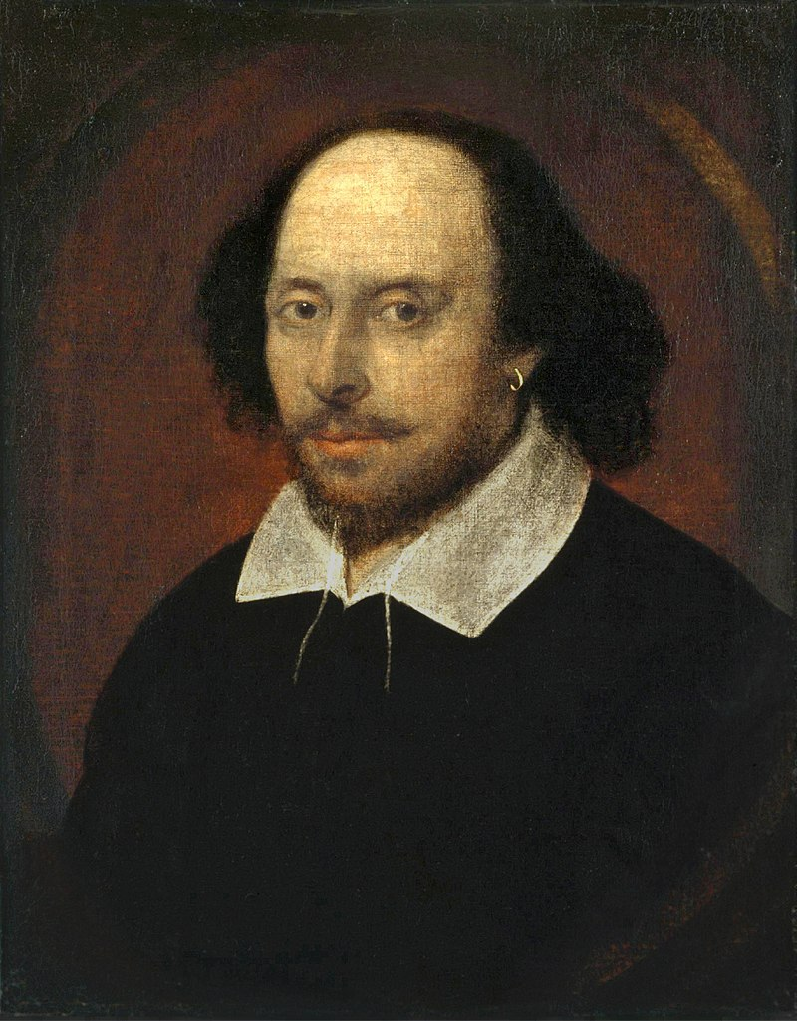
Renaissance Poetry – The English Sonnet
Let me not to the marriage of true minds (A) Admit impediments. Love is not love (B) Which alters when it alteration finds, (A) Or bends with the remover to remove. (B) O no, it is an ever fixed mark (C) That looks on tempests and is never shaken; (D) It is the star to every wand'ring barque, (C) Whose worth's unknown although his height be taken. (D) Love's not time's fool, though rosy lips and cheeks (E) Within his bending sickle's compass come; (F) Love alters not with his brief hours and weeks, (E) But bears it out even to the edge of doom. (F) If this be error and upon me proved, (G) I never writ, nor no man ever loved. (G)
William Shakespeare, “Sonnet 116”

