Slide 1
Credit Questions
1) What is Phonetics?
2) Name three branches of Phonetics?
3) Name two things that make Phonology different from Phonetics.
4) Name at least 3 components of pronunciation teaching
5) What are the segmentals of speech?
6) What are suprasegmentals? Give examples.
7) What is the difference between a text and an utterance?
8) How can we divide an utterance into small units? Name these units.

Slide 2
Making and classifying speech sounds
Plan for Today
A Definition of a Phoneme
Phonemic/phonetic transcription
Cardinal Vowels
English Vowels and Consonants
Doing Second Language Research

Slide 3
Phoneme as an abstract, material, functional unit.
any of the abstract units of the phonetic system of a language that correspond to a set of similar speech sounds (such as the velar \k\ of cool and the palatal \k\ of keel) which are perceived to be a single distinctive sound in the language
The smallest phonetic unit in a language that is capable of conveying a distinction in meaning, as the m of mat and the b of bat in English.
A set of phonetically similar but slightly differing sounds in a language that are heard as the same sound by native speakers and are represented in phonemic transcription by the same symbol.
An indivisible unit of sound in a given language. A phoneme is an abstraction of the physical speech sounds (phones) and may encompass several different phones.

Slide 4
Phonemic/Phonetic Transcription
‘strewn’ | /strun/
‘tenth’ | /tɛnθ/
‘clean’ | /klin/
‘strewn’ | [stru:n]
‘tenth’ | [tʰɛ̃n̪θ]
‘clean’ | [kl̥i:n]
Phonemic and phonetic transcription both have their purposes.
The goal of a phonemic transcription is to record the ‘phonemes as mental categories’ that a speaker uses, rather than the actual spoken variants of those phonemes that are produced in the context of a particular word.
Phonetic transcription on the other hand specifies the finer details of how sounds are actually made. So a non-English speaker trained in the IPA could look at a phonetic transcription like [tʰɛ̃n̪θ], and know how to pronounce it accurately without knowing the rules about English phonemes

Slide 5
Cardinal Vowels
English Vowels ???

Slide 7
Vowel sounds are made without any great obstruction to the airstream.
All English vowels are voiced and oral.
English vowels can be divided into historically long and short vowels.
Long vowels comprise long monophthongs and diphthongs.
The production of monophthongs can be described by stating the vertical height of the tongue, its horizontal position and the position of the lips.

Slide 8
Consonants
Bilabial
Labiodental
Dental
Alveolar
Post alveolar
Palatal
Velar
Glottal
Voiced/voiceless
Place of Articulation
Manner of Articulation

Slide 9
English Consonants. Manner of Articulation: Stops/Fricatives/Approximants
Plosives (Stops) involve complete closure in the mouth and a velic closure preventing air from escaping through the nose. Air does not escape. They are analyzed as having three phases: approach, hold, release. There are six plosives in English: [p, b, t, d, k, g].
Nasals (Stops) involve complete closure in the mouth, but a velic opening, allowing air to escape through the nose. There are three nasals in English: [m, n, ŋ].
Fricatives involve frication, the hissing noise caused by air escaping through a small gap left between the articulators. English has nine fricatives: [h], and the voiced/voiceless pairs [v, f], [ð, θ], [z, s] and [􏰀, ∫ ].
Affricates involve a complete closure followed by a fricative release. There are two affricates in English: [d􏰀, t∫ ].
Approximants do not involve compete closure or frication. There are four approximants in English: [l] is a lateral approximant, and the other three [r, w, j] are central approximants.

Slide 11
Airstream Mechanism

Slide 12
Doing Research in Phonology

Slide 13
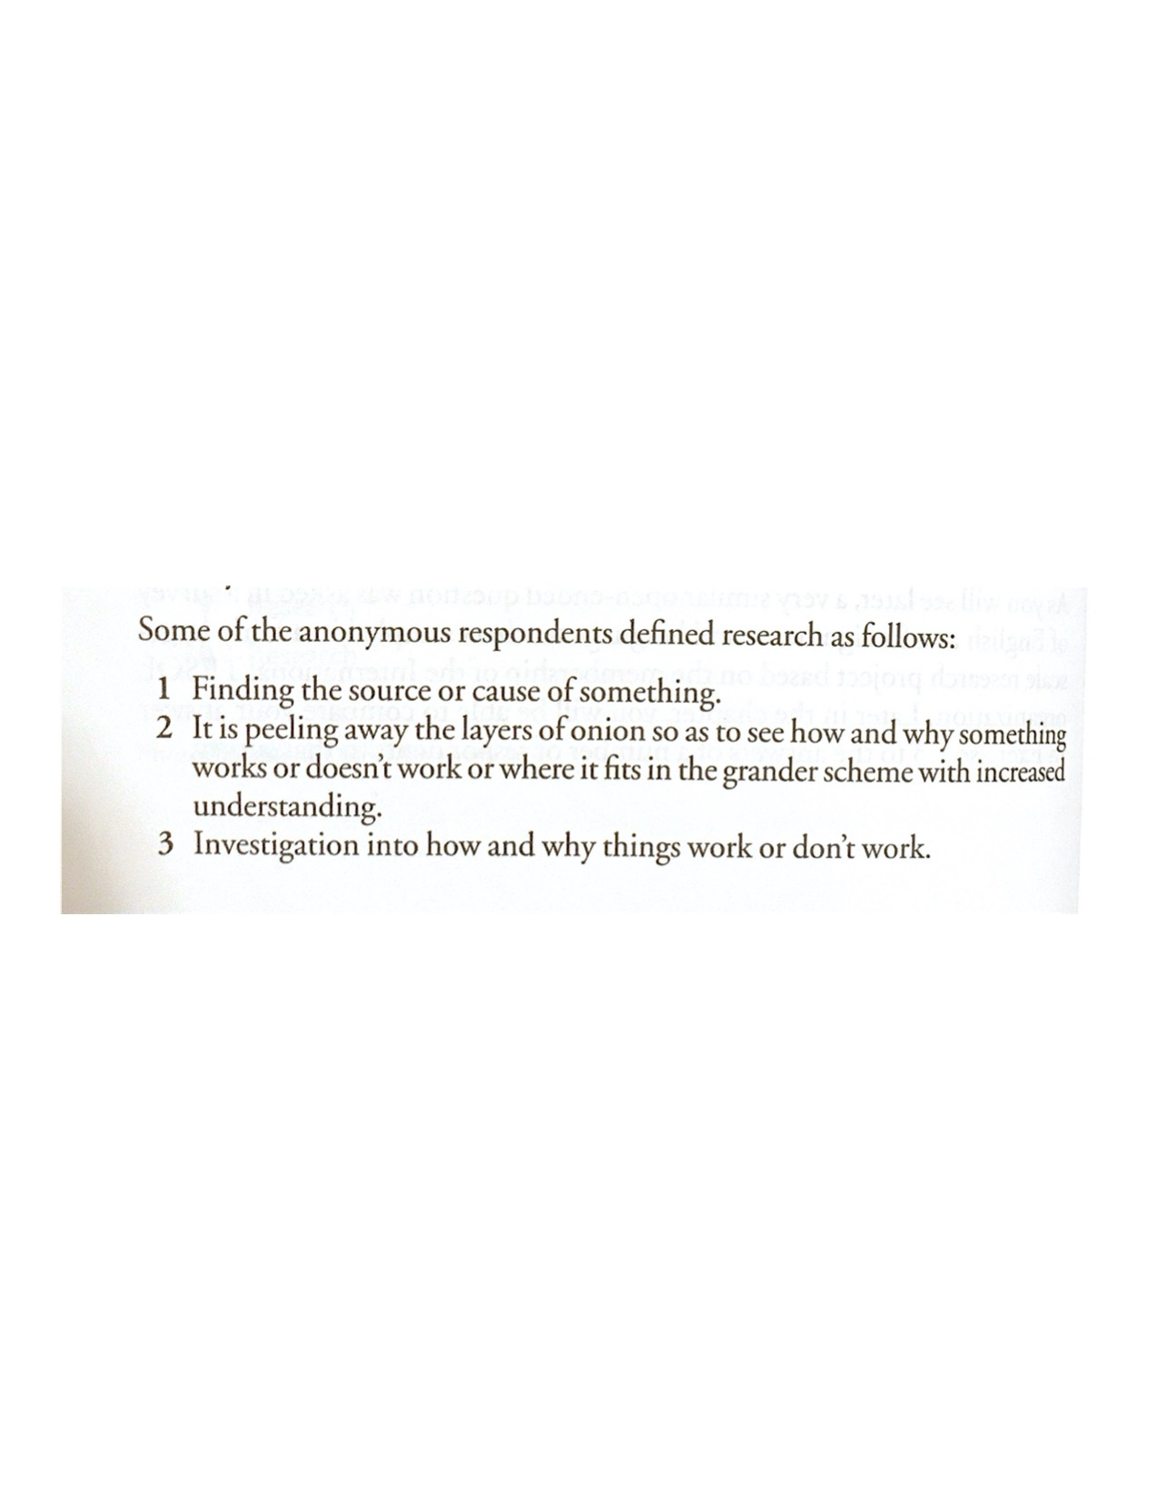
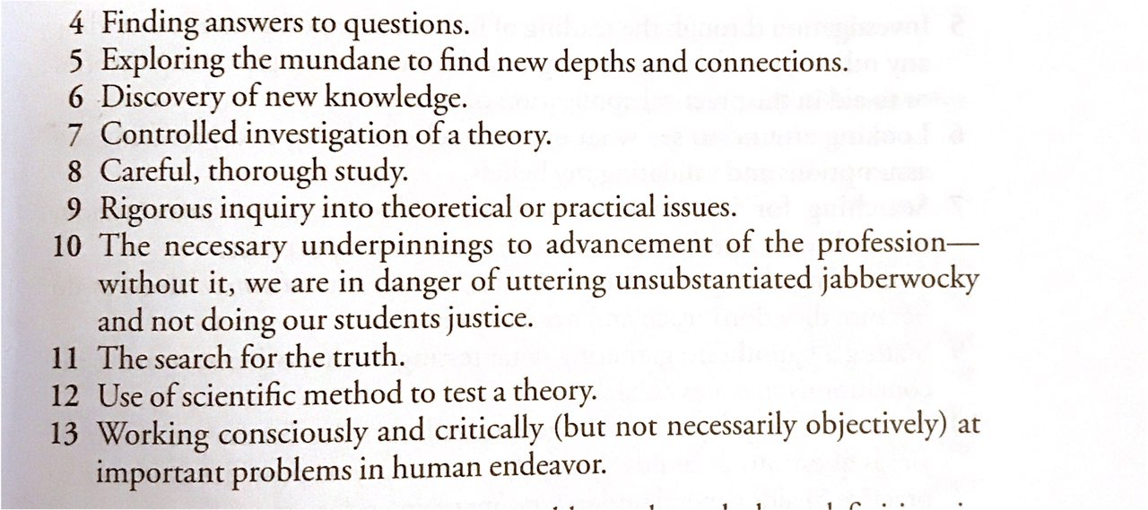

Slide 15
Home assignment
Pronunciation and Phonetics by Adam Brown - Chapters: 4-10 pp. 20-61
Answer the question:
”Which types of research methods are most suitable for doing research in Phonetics/Phonology?”

