Slide 1
Life in 19th-century Britain
An Overview of the Social and Political Situation

Slide 2
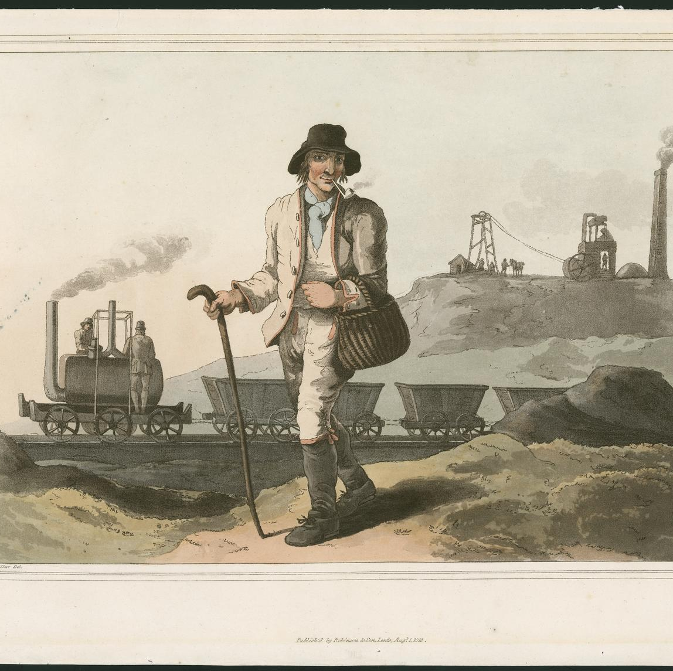
The Political Situation
The Rise of the Middle Classes
greater economic power
higher number of members
Reform Act of 1832
Labor Movement
more organized:
cheap postal service
railway system
highly publicized case of the Tolpuddle Martyrs (1834)

Slide 3
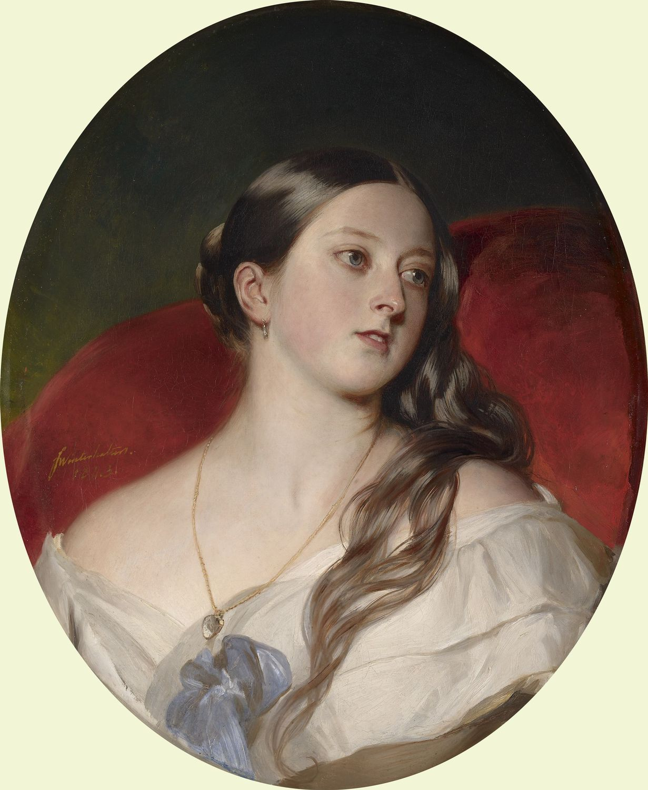
The Political Situation
Symbolic Monarchy
Queen Victoria and her family
The Royal Family as role model as show
political rather than economic colonization
to support and protect

Slide 4
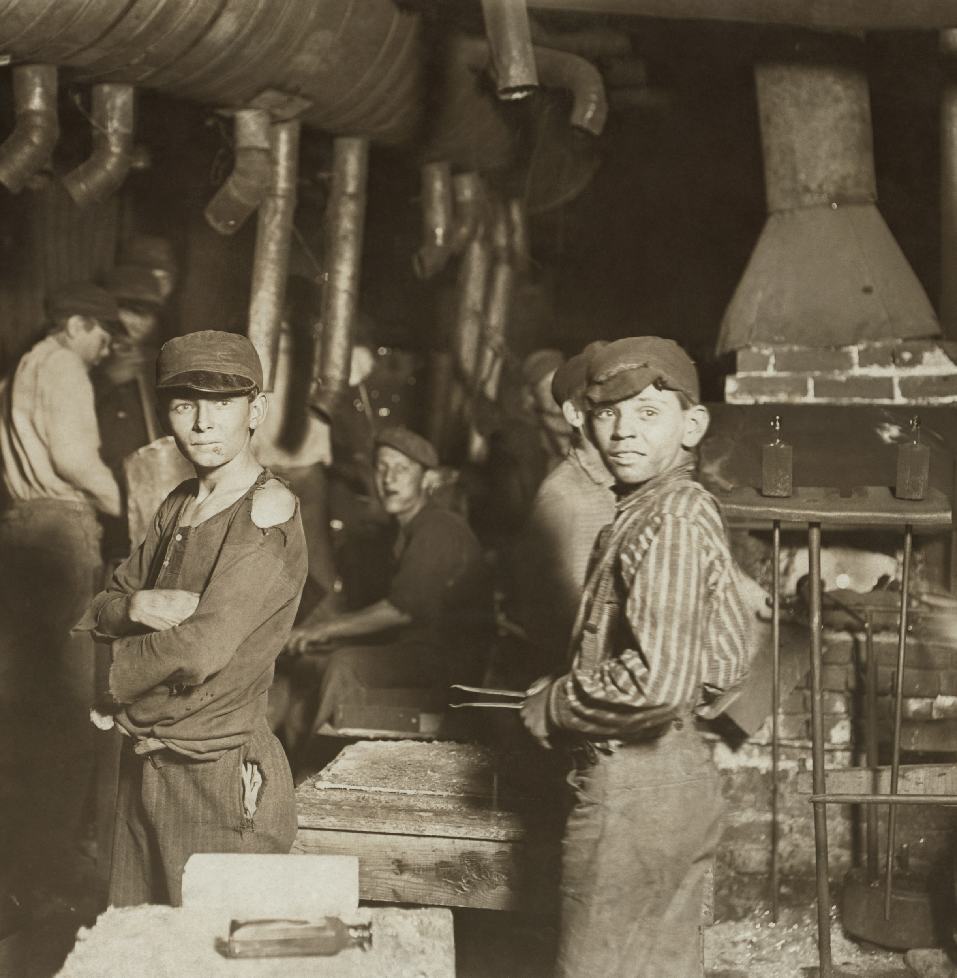
Working Conditions
average working hours: 12 – 16 h
child labor widespread
physical punishment
1 short break per day
Factories Act (1847):
maximum number of working hours per day limited to 10

Slide 5
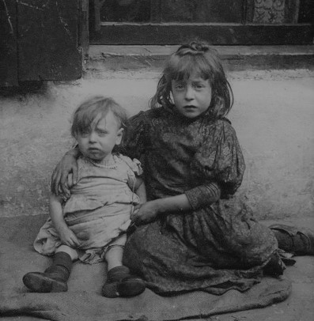
Life in the Industrial City
overpopulation
sudden, massive migration from the countryside to the cities
inappropriate living conditions
open sewers or no sewers
sewage and water filtering into the walls
contaminated water supplies
frequently no bathrooms or water closets
crowded streets and tenements
open fire
often owning a single pot per household

Slide 6
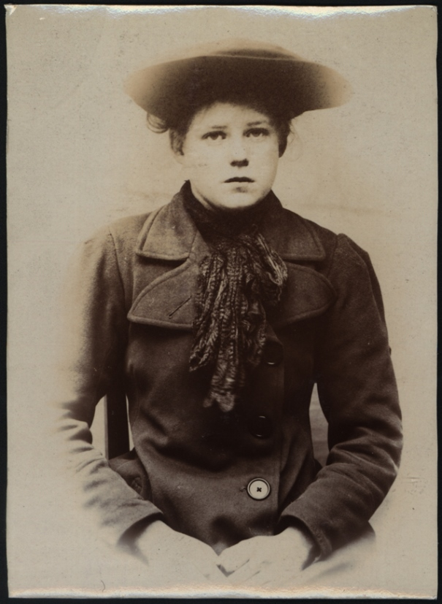
Life in the Industrial City
average life expectancy in 1841:
Surrey 45 years
London 37 years
Liverpool 26 years
for laborers, mechanics and servants: 15 years
massive waves of epidemics:
1831–33: flu (2x), cholera
1836–42: several waves of flu, typhus, typhoid fever, cholera
…
endemic diseases:
measles
whooping cough
TBC (25% of all deaths)

Slide 7
Improving Healthcare
Between 1801 and 1850 more university-educated men entered the medical profession than in all previous history – over 8,000 new doctors
Over 70 new hospitals founded between 1800 and 1860
Apothecary Act of 1815 – compulsory practical training for half a year in a hospital
hospital surgeons started actively teaching at universities
Anatomy Act of 1832 – all unclaimed bodies sent for dissection
new drugs discovered: morphine, quinine, atropine, digitalin, codeine, iodine
the propagation of the necessity of antisepsis by Joseph Lister

Slide 8
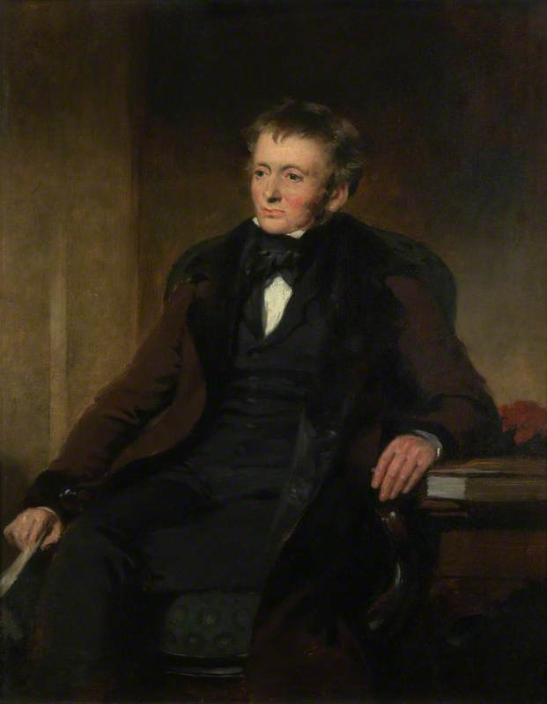
Realism and Controversial Topics
Charles John Huffam Dickens
George Gissing
The Nether World (1889)
The Odd Women (1893)
Thomas Hardy
Far from the Madding Crowd (1874)
Jude the Obscure (1895)
George Eliot (Mary Ann Evans)
Silas Marner (1861)
Middlemarch (1872)
Thomas de Quincey
Confessions of an English Opium-Eater (1821)
“On Murder Considered as One of the Fine Arts” (1827)
Robert Louis Stevenson
Strange Case of Dr Jekyll and Mr Hyde (1886)

