Slide 1
Public Speaking
Some questions:
1) Why are nonverbals important when analysing spontaneous speech?
2) Give an example of classifying nonverbal means of communication?
3) Do pitch and loudness belong to nonverbal means of communication?
4) What does inferring statistics show?

Slide 2
Plan
1. Speaking in public.
2. Rhetorical devices
3. Overcoming stage fright.
4. Effective presentation skills
5. Combining Research types

Slide 3
Public speaking is the art of using words to share information with an audience. It includes speaking to audiences of any size, from a handful of seminar participants to millions of people watching on television.
Situations of public speaking include….
Four types of public speaking:
ceremonial,
demonstrative,
informative,
persuasive.

Slide 4
How to make a speech
Prepared VS Impromptu
Introduction. Give your name and the name of your Talk (Show title slide)
Begin with an outline.
Use a conversational tone. Use short sentences.
Use the speaker notes. Give out handouts.
Be specific.
Conclusion. (Show closing slide that includes contact information)

Slide 5
Some tips from experts…
https://www.youtube.com/watch?v=W_aYXVrU8x4
https://www.youtube.com/watch?v=fBO0riisOzU&list=RDCMUCie09bMB6ITYmpU3z6vv2tw&start_radio=1&t=18

Slide 6
Rhetorical devices
A rhetorical device, persuasive device, or stylistic device is a technique that an author or speaker uses to convey to the listener or reader a meaning with the goal of persuading them towards considering a topic from a perspective, using language designed to encourage or provoke an emotional display of a given perspective or action.
Rhetorical devices evoke an emotional response in the audience through use of language, but that is not their primary purpose. Rather, by doing so, they seek to make a position or argument more compelling than it would otherwise be.

Slide 7
“Fear leads to anger. Anger leads to hate. Hate leads to suffering.” –Star Wars: The Empire Strikes Back. Rhetorical Device:
“Ask not what your country can do for you, ask what you can do for your country.” —President John F. Kennedy. Rhetorical Device:
"I will not make age an issue of this campaign. I am not going to exploit, for political purposes, my opponent’s youth and inexperience." –President Ronald Reagan Rhetorical Device:
“But in a larger sense, we cannot dedicate, we cannot consecrate, we cannot hallow this ground.” —Abraham Lincoln, Gettysburg Address. Rhetorical Device:
“Ladies and gentlemen, I've been to Vietnam, Iraq, and Afghanistan, and I can say without hyperbole that this is a million times worse than all of them put together.” –The Simpsons. Rhetorical Device:

Slide 8
Sum up
1 Parallel structures, repetition.
2. Lists of three.
3. Negation, Inversion
4. Metaphor, hyperbole, alliteration.
5. Contrastive pairs, simile
6. We-they opposition
7. Intonation variation

Slide 9
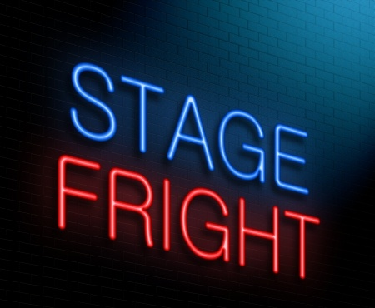
Stage fright or performance anxiety is the anxiety, fear, or persistent phobia which may be aroused in an individual by the requirement to perform in front of an audience, whether actually or potentially (for example, when performing before a camera). 77% of people have it.
Don’t Fight Your Stage Fright…
Work With It!
Arrive Early
Practice as Much as Possible
(before the big day)
Learn to Improvise

Slide 10
PPPresentation is an aid not an aim!!!
Face the audience!
Don’t read!
Have an Intro/Plan/Conclusions/References
Number the slides 5/12. Total max. 15
Don’t put much text!
Comment on everything you have (graphs, definitions, comics).

Slide 11
Speeches to analyse
J.K. Rowling Speaks at Harvard (Commencement)
M.L. King I have a Dream
JFK Inaugural Address
Emma Watson "Gender equality is your issue too!“
Meghan Markle's Fight Speech For Feminism

