Slide 1
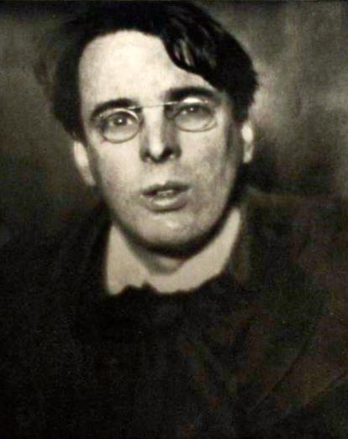
20th Century “British” Literature
Poetry
William Butler Yeats (1865-1939)
“the only poet worthy of serious study” (Ezra Pound)
poet, playwright, public figure, cultural icon
his poetry:
relatively traditional form
strong, complex symbolism
mystical and occult inspirations
based on Irish folk traditions

Slide 2
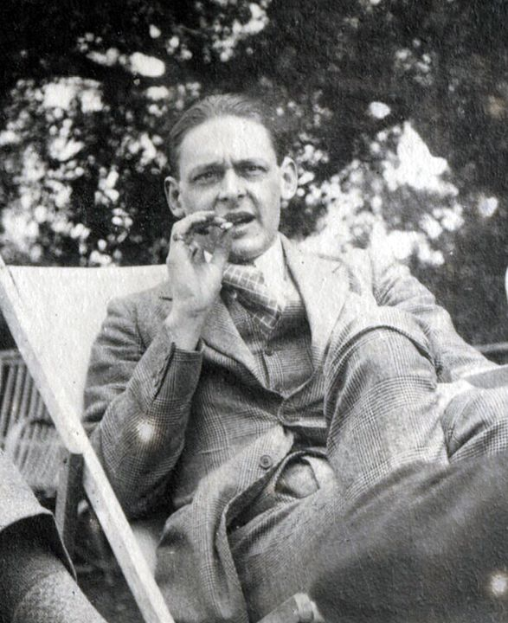
20th Century “British” Literature
Poetry
Thomas Stearns Eliot (1888-1965)
poet, playwright, literary critic
US-born
one of the giants of modern poetry
complexly textured
intertextual
multivocal
Major Works:
The Waste Land
Old Possum’s Book of Practical Cats

Slide 3
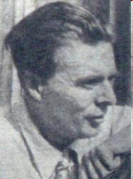
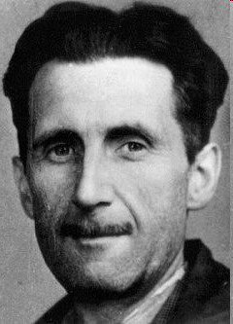
20th Century British Literature
Fiction
Aldous Huxley (1894-1963)
writer of novels of ideas
significant innovator
Most important works:
Point Counter Point
Brave New World
George Orwell (1903-1950)
writer of dystopias and political parables
Most important works:
1984
Animal Farm

Slide 4
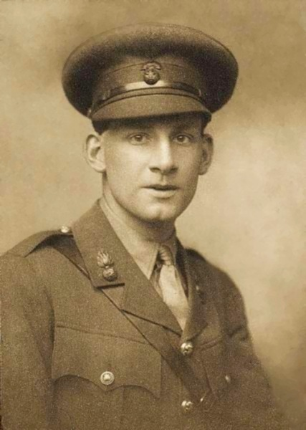
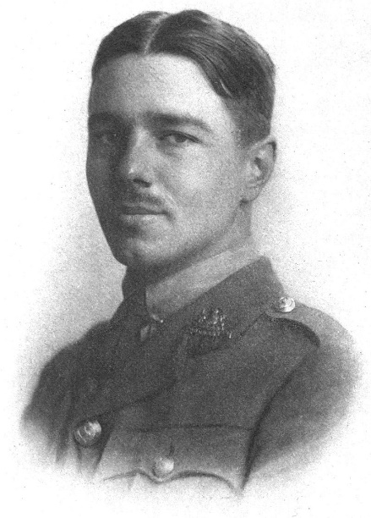
20th Century British Literature
Poetry
Siegfried Sassoon (1886-1967)
a major poet of WW I
brutally honest description of the horrors of the war
against the glorification of heroism
Wilfred Owen (1893-1918)
combines the brutal descriptions of war with an almost Romantic transcendentalism
possibly the biggest modern poet of war in English

Slide 5
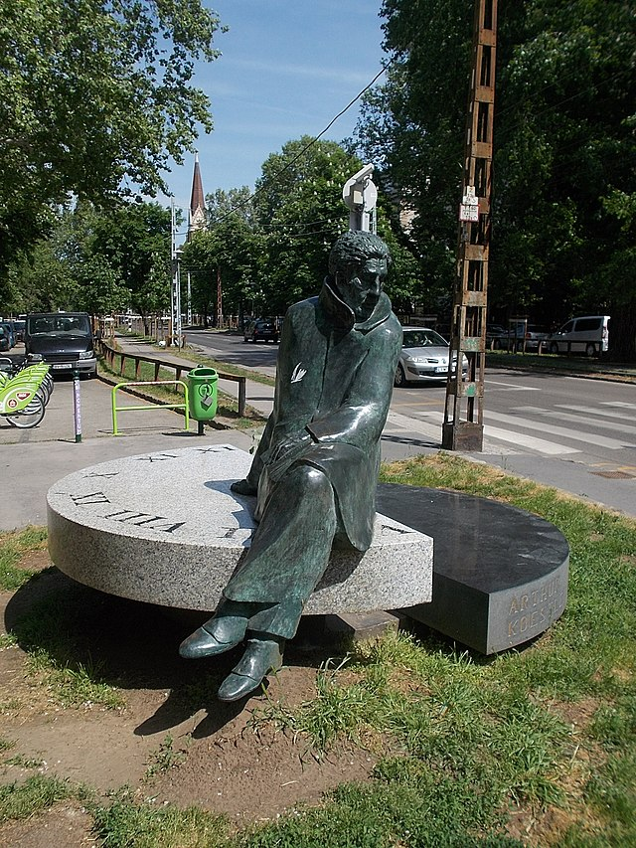
Arthur Koestler (1905–1983)
Topics covered in his fiction include:
terrorism – Thieves in the Night (1946)
massive migration – Thieves in the Night (1946)
espionage – The Age of Longing (1951)
rape trauma – Thieves in the Night (1946)
war trauma – Arrival and Departure (1943), The Age of Longing (1951)
the crisis of faith – The Age of Longing (1951)
fake news – The Age of Longing (1951)
the role and responsibility of intellectuals in major international crises – The Age of Longing (1951), The Call-Girls (1972)
humankind facing (self)destruction – Twilight Bar (1945), The Call-Girls (1972)

Slide 6
Humankind Facing Imminent Annihilation
Twilight Bar: An Escapade in Four Acts (1945)
Koestler’s only published play
elements of SF
written at least twice
in 1933 – probably in German
in 1944 – in English
The Call-Girls: A Tragi-comedy with Prologue and Epilogue (1972)
his last novel
published after a hiatus of 21 years

