Slide 1
Rozvoj lidských zdrojů TUL pro zvyšování relevance,
kvality a přístupu ke vzdělání v podmínkách Průmyslu 4.0
CZ.02.2.69/0.0/0.0/16_015/0002329
Electrotechnology
Studijní program B0714A270001 - Mechatronika
Ing. Miroslav Novák, Ph.D.

Slide 2
ETG 01 Mass structure © 2020, rev. 2022
Electrotechnology is a comprehensive science of production methods, processing of materials, semi-finished products (components) and products in electrical engineering. It covers the fields of physics, chemistry, metallurgy, mechanical engineering, measuring and automation technology and others. An important part is the science of materials and their properties.
Contents
Mass structure
Molecules and atoms bonds
Connection between bonding forces and properties of matter
Arrangement of atoms in solids
Crystal defects
Electron energy and band model
Properties of electrotechnical materials
Notes:
Vynalezen Michael Faraday 1831 - pouze jako princip, zatím nevyužíván pro přenos energie.
Energetické využití: 1878 -1883 - The Ganz Company (Budapest, Hungary), k vidění v:
Museum of Electrical Engineering - Budapest - Energetický transformátor výrobní číslo (5), viz foto na slide. https://www.mmkm.hu/en/institutions?tid=11
Transformer history: https://edisontechcenter.org/Transformers.html

Slide 3
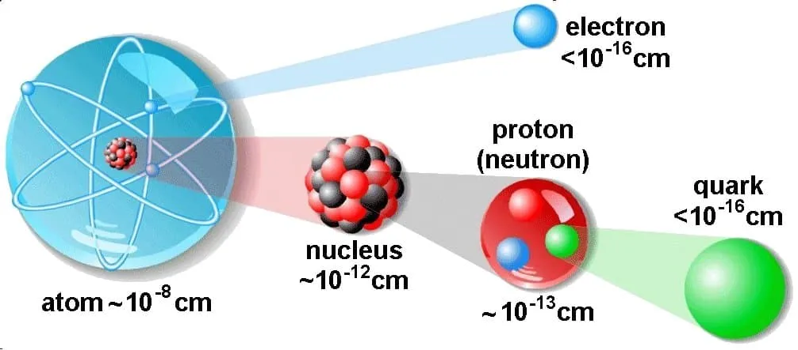
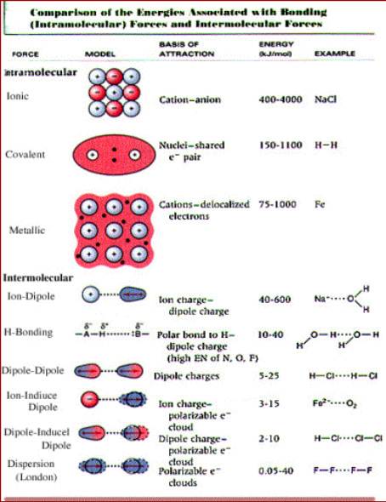
Internal structure of the material
Arrangement of atoms or molecules in space
Atoms consists of nucleus (protons + neutrons) encircled by moving electrons in their orbitals with specific energy levels
The most top electron orbital (valence electrons) affects most material properties (chemical, nature of bonding, size of atom, optical/electrical)
Protons = electrons charge is 1.60x10⁻¹⁹ Coulombs. Neutrons are electrically neutral.
Protons & neutrons mass is 1.67x10⁻²⁷ kg, electrons 9.11x10⁻³¹ kg.
Atoms are held in position by intra/inter-molecular forces (IMF)
Mean distance between atoms in solids is in the range of 0.25 nm
Primary (strong): Ionic, Covalent, Metallic bonds (almost in all solid materials) Atoms tend to acquire stable electron arrangement in their valence orbitals by transferring (ionic), sharing (covalent, and metallic) valence electrons. This leads to formation of bonds. Bond energies are in order of 1000 kJ/mol.
Secondary (weak): Hydrogen bonding, van der Waals forces (dispersed, induced and dipole) (in substances like water along with primary forces) Atomic or molecular dipoles Bonds between induced and permanent dipoles (polar molecules). Bond comes into existence because of Columbic attraction between positive end of one dipole and negative end of another dipole. Bond energies are in order of 10 kJ/mol
Notes:
https://www.nuclear-power.com/nuclear-power/reactor-physics/atomic-nuclear-physics/atomic-nuclear-structure/
https://en.wikipedia.org/wiki/Chemical_bond
https://en.wikipedia.org/wiki/Intermolecular_force

Slide 4
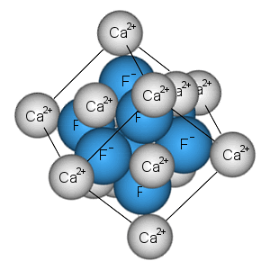
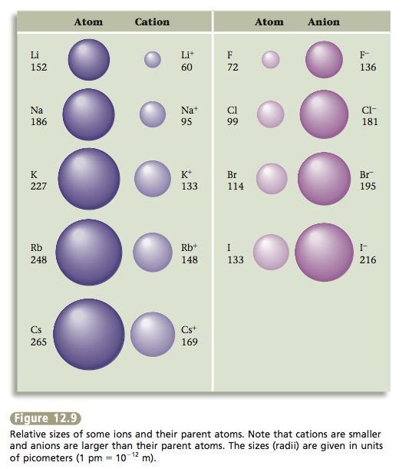
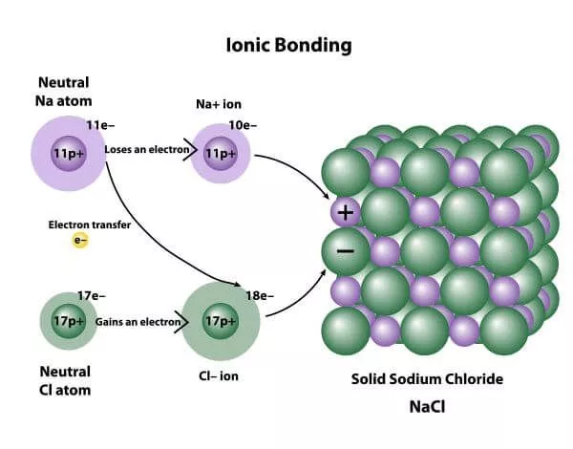
Ionic bond
Between metals + non-metals with considerably different electronegativities
Large interatomic forces, nondirectional, electron transfer, coulombic forces
This primary bond exists between two atoms when transfer of electron(s) results in one of the atoms to become negative (has an extra electron) and another positive (has lost an electron).
This bond is a direct consequence of strong Coulomb attraction between charged atoms.
Basically ionic bonds are non-directional in nature. In real solids, ionic bonding is usually exists along with covalent bonding.
Properties
The strong electrostatic attraction (high bonding energy) > High Melting and Boiling Points, Hard
Brittle > strong repellent forces when atomar layers separated
Cannot conduct electricity > ions are not able to move (an only conduct electricity if it has melted or been dissolved in water) = insulators
NaCl: sodium chloride
NaBr: sodium bromide
NaF: sodium fluoride
NaI: sodium iodide
KF: potassium fluoride
KCl: potassium chloride
KI: potassium iodide
KBr: potassium bromide
LiI: lithium iodide
Li₂O: lithium oxide
MgO: magnesium oxide
MgS: magnesium sulfide
MgSe: magnesium selenide
CaCl: calcium chloride
CaO: Calcium oxide
CaSe: Calcium selenide Al₂O₃: Corundum Na2SO4: sodium sulfate
NH4SCN: ammonium thiocyanate
KOH: potassium hydroxide
(NH4)2CO3: ammonium carbonate
Fe2O3: Hematite
Notes:
https://slideplayer.com/slide/10002043/
https://www.chemicool.com/definition/ionic-compounds.html
https://opengeology.org/Mineralogy/13-crystal-structures/

Slide 5
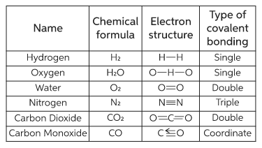
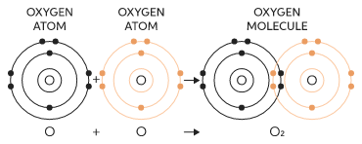
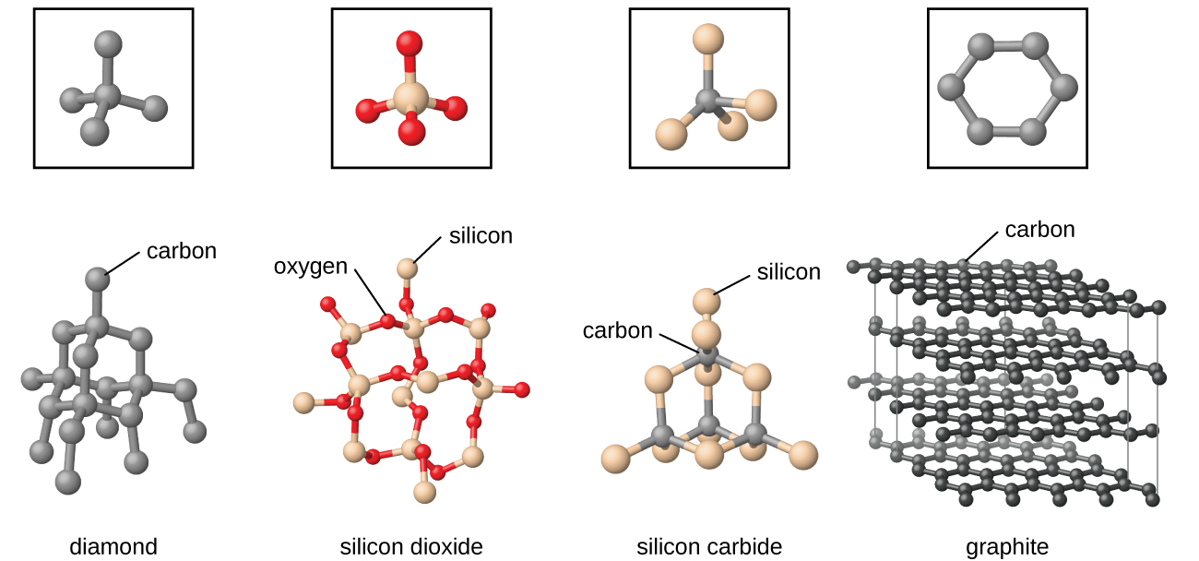
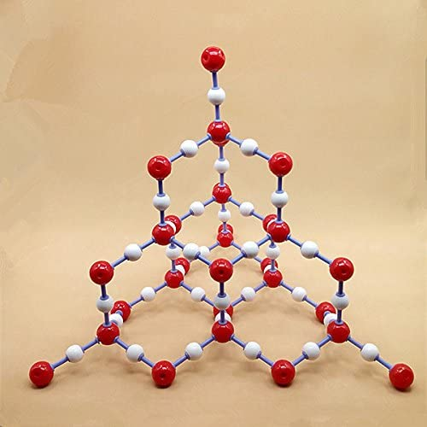
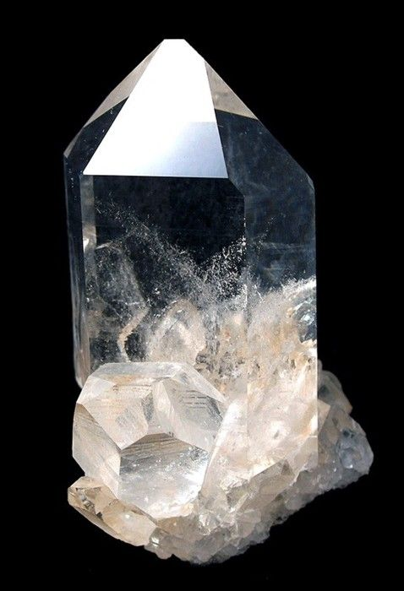
Covalent bond
Between non-metals with similar electronegativities
Large interatomic forces, localized (directional), electron sharing
Valence electrons are shared between a pair of atoms, thus acquire stability by saturating the valence configuration.
Covalent bonds are stereospecific i.e. each bond is between a specific pair of atoms, which share a pair of electrons (of opposite magnetic spins).
Typically, covalent bonds are very strong, and directional in nature.
Properties
High bonding energy > hardness, strength, and high melting point (diamond > 3500 °C)
Brittle
Cannot conduct electricity = insulators
Gases - symmetrical outside charge = no forces or repulsion from other molecules, liquids = non symmetrical charge orientation - weak bonds to other molecules
Boron nitride (BN) Silicon carbide (SiC) - carborundum SiO₂ - quartz Si Ge α-Sn GaAs InAs
quartz

Slide 6
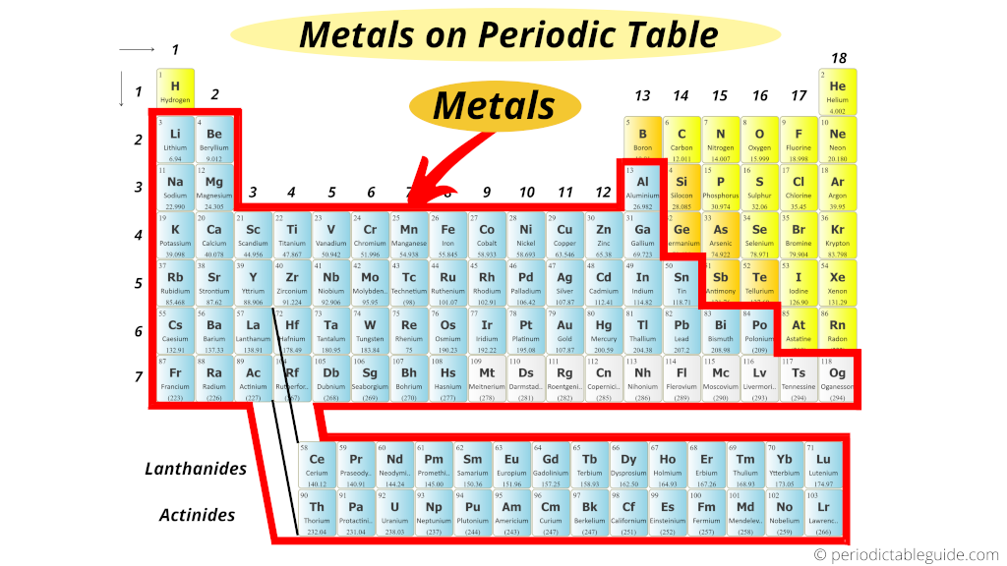
Metalic bond
Moderate-strong forces, nondirectional
Valence electrons are shared between number of atoms, i.e. arranged positive nucleuses are surrounded by electron pool.
Shared electrons are not specific to a pair of atoms, in contrast to Covalent bond, i.e. electrons are delocalized.
As shared electrons are delocalized, metallic bonds are nondirectional.
Very characteristic properties of metals like high thermal and electrical conductivities are result of presence of delocalized electron pool.
Properties
high coordination and density
high electrical & thermal conductivity
ductility (kujnost/tažnost)
Notes:
https://www.chegg.com/learn/chemistry/introduction-to-chemistry/covalent-bonding

Slide 7
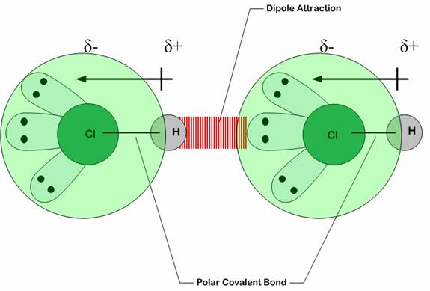
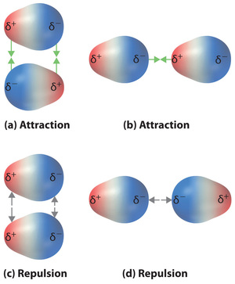
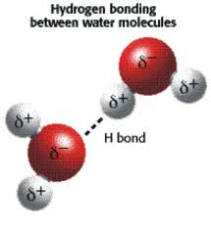
Secondary bonds
These bonds involves atomic or molecular dipoles.
Bonds can exists between induced and permanent dipoles (polar molecules).
Bond comes into existence because of Columbic attraction between positive end of one dipole and negative end of another dipole.
Bond energies are in order of 10 kJ/mol
Existence of these depends on three kinds of dipoles – fluctuating dipoles, Polar-molecule dipoles and Permanent dipoles.
Permanent dipole bonds are also called Hydrogen bonds as covalently bonded hydrogen atoms – for example C-H, O-H, F-H – share single electron becomes positively charged proton that is capable of strong attractive force with the negative end of an adjacent molecule.
Hydrogen bonds is responsible for water exist in liquid state at room temperature.
Notes:
http://chemistry-york.weebly.com/background-information4.html

Slide 8
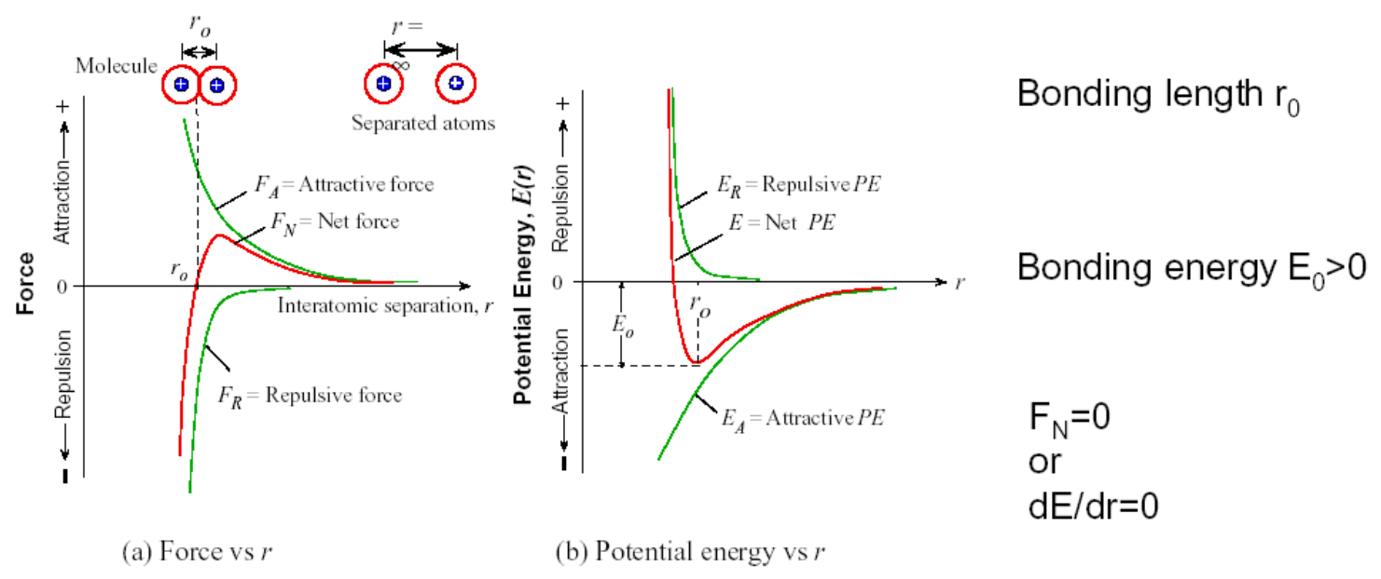
Bonding forces & energy
F_{A} – attractive force is defined by the nature of the bond (e.g. Coulomb force for the ionic bonding)
F_{R} – atomic repulsive force, when electron shells start to overlap
F_{N} (r) = F_{A} + F_{R} - the net force
Atoms are held at preferred distances r₀ from each other (equilibrium distances). Equilibrium spacing r₀ is approximately 0.3 nm.
To break the bond, bonding energy must be supplied from outside. Breaking the bond means that the two atoms become infinitely separated. In real materials, containing many atoms, bonding is studied by expressing the bonding energy of the entire materials in terms of the separation distances between all atoms.
Notes:
https://web.eng.fiu.edu/wangc/EGN3365-2b.pdf
https://www3.nd.edu/~amoukasi/CBE30361/Lecture_4_2014_lecture.pdf

Slide 9
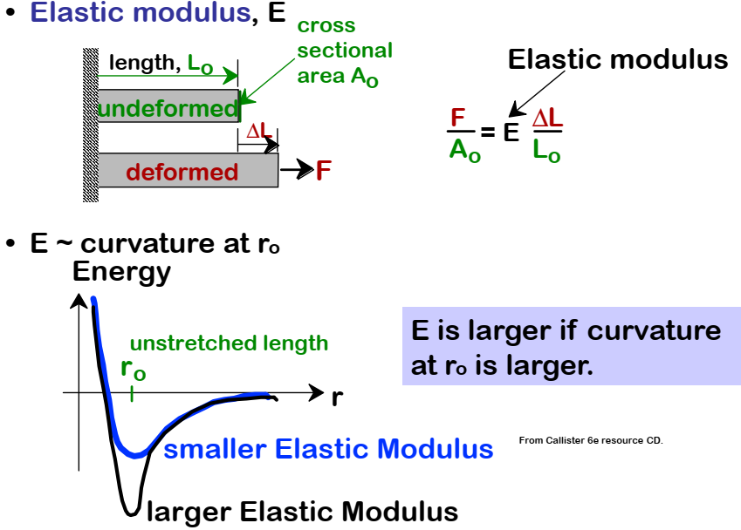
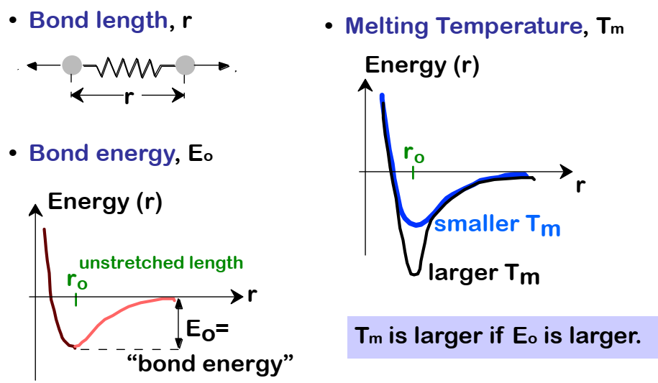
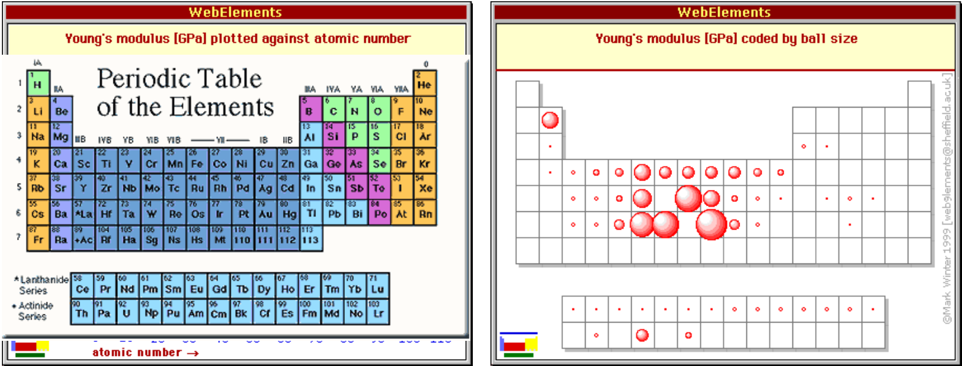
Properties dependent on bonding energy

Slide 10
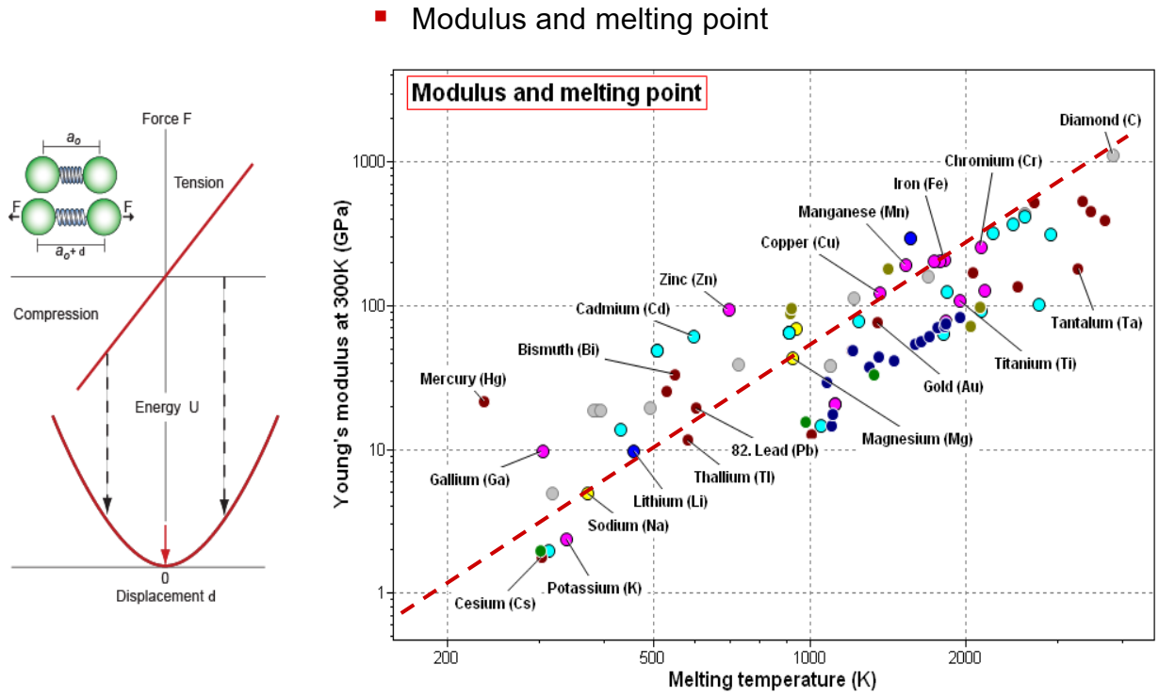
Relation between properties

Slide 11
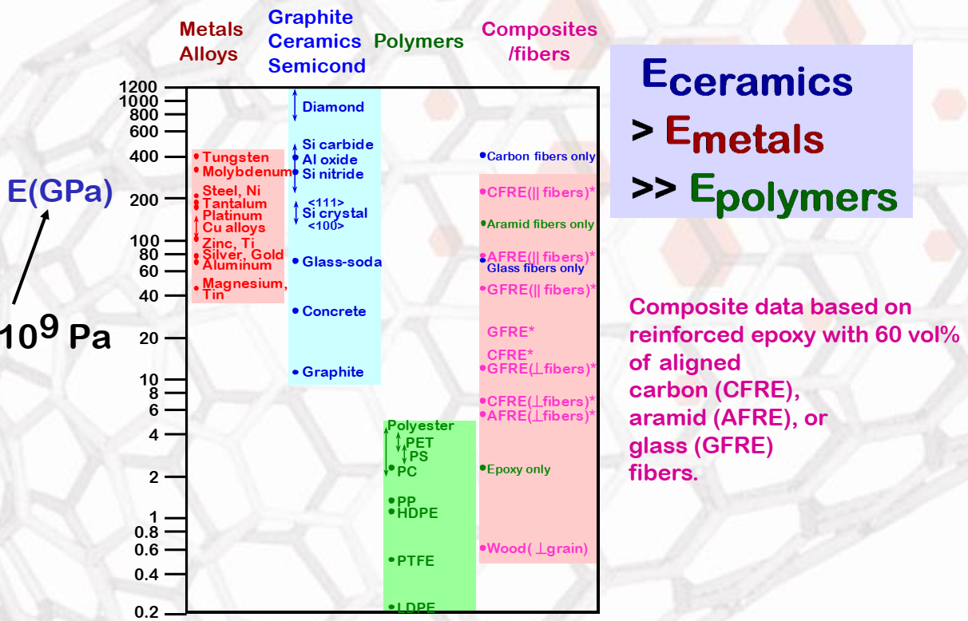
Young’s modulus comparison

Slide 12
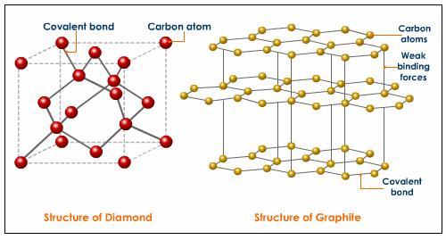
Summary
Graphene?
Notes:
https://slideplayer.com/slide/6657562/
https://en.wikipedia.org/wiki/Graphene

Slide 13
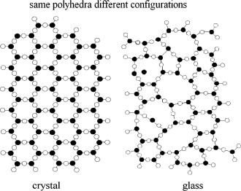
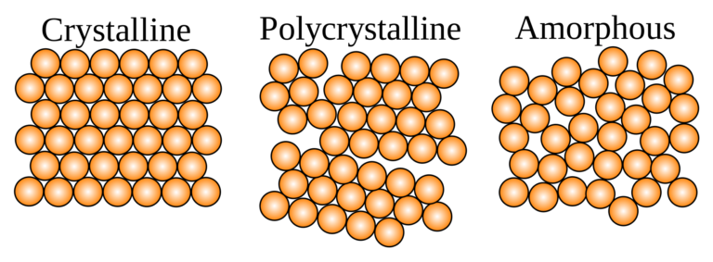
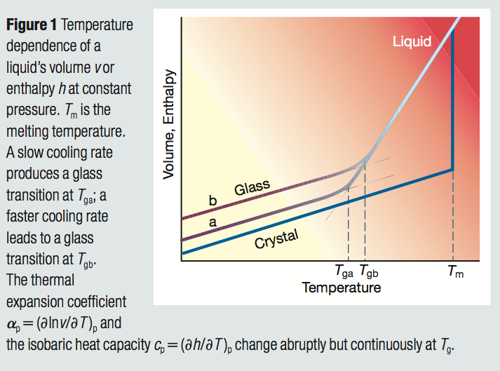
Arrangement of atoms in solids
Crystals
their particles are arranged in a repeating pattern of a three-dimensional network = Crystal lattice (the smallest unit of a crystal is a Unit Cell)
Crystals have a long-range order, which means the arrangement of atoms is repeated over a great distance.
Amorphous
They are/resemble hypothermic liquids
The reason for the high stiffness, comparable to crystalline substances, is the high viscosity of 10¹³ to 10¹⁵ Pa.s.
They also show an arrangement rules of "basic" units.
Examples: glass, gels, plastics, various polymers, wax, thin films
T_{gb} .. high speed cooling T_{ga} .. lower speed of cooling T_{m} .. crystal melting/creation temp.
Notes:
https://nptel.ac.in/content/storage2/courses/112108150/pdf/PPTs/MTS_02_m.pdf
http://soft-matter.seas.harvard.edu/index.php/Glass_Transition_Temperature

Slide 14
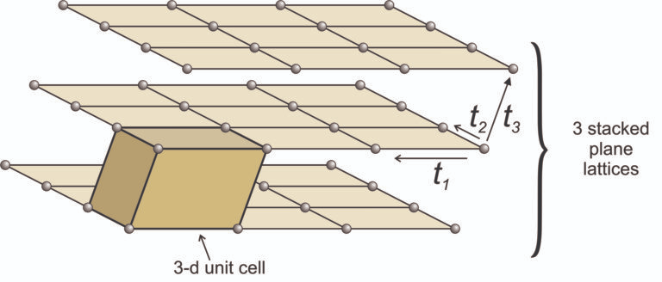
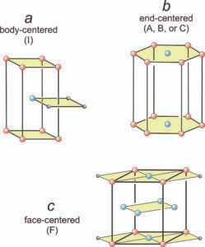
Crystal lattice
Unit cell parameters
dimensions a, b, c
angles α, β, γ
coordination number Z - number of neighboring atoms
Each unit cell corresponds to the one of the seven primitive crystal systems: cubic, tetragonal, orthorhombic, hexagonal, monoclinic, triclinic, and rhombohedral.
More complex stacking plane lattices can lead to other, non-primitive, unit cells: body-centered, end-centered, face-centered. Offset layer puts an extra lattice points to base unit.
Notes:
https://opengeology.org/Mineralogy/11-crystallography/

Slide 15
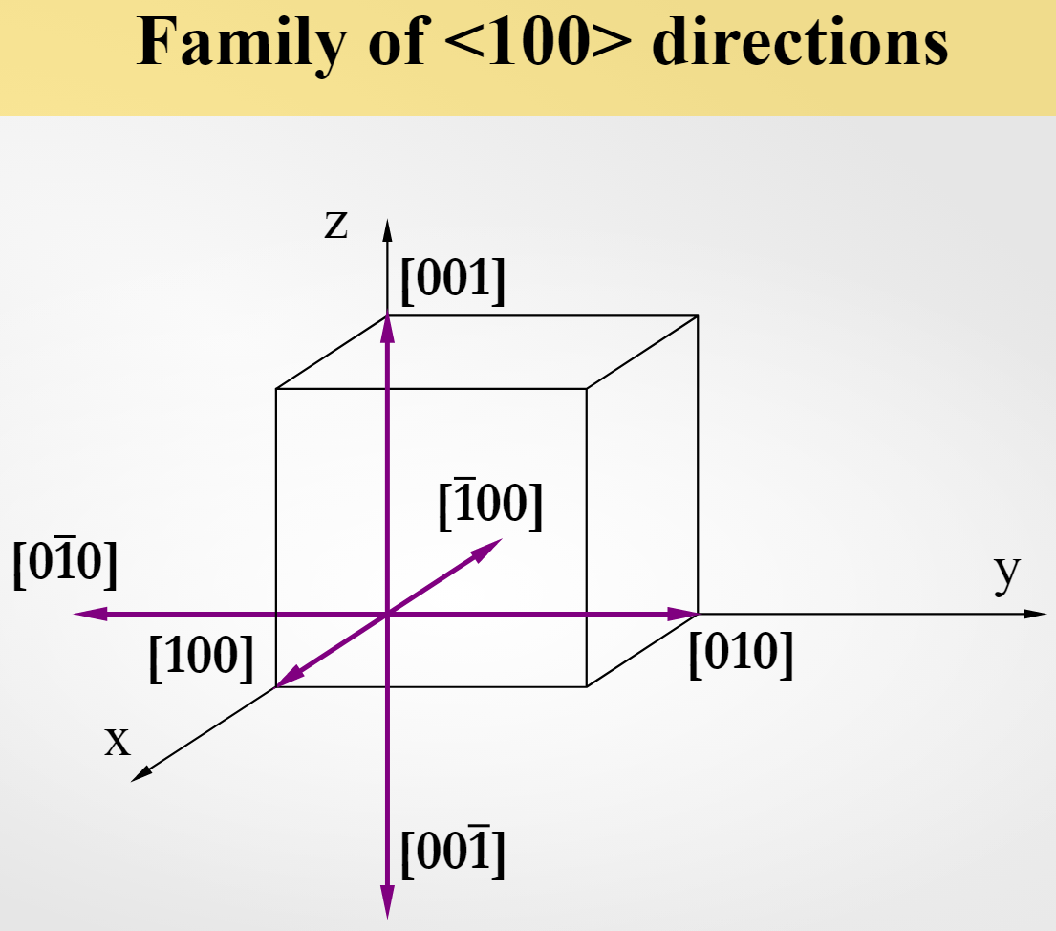
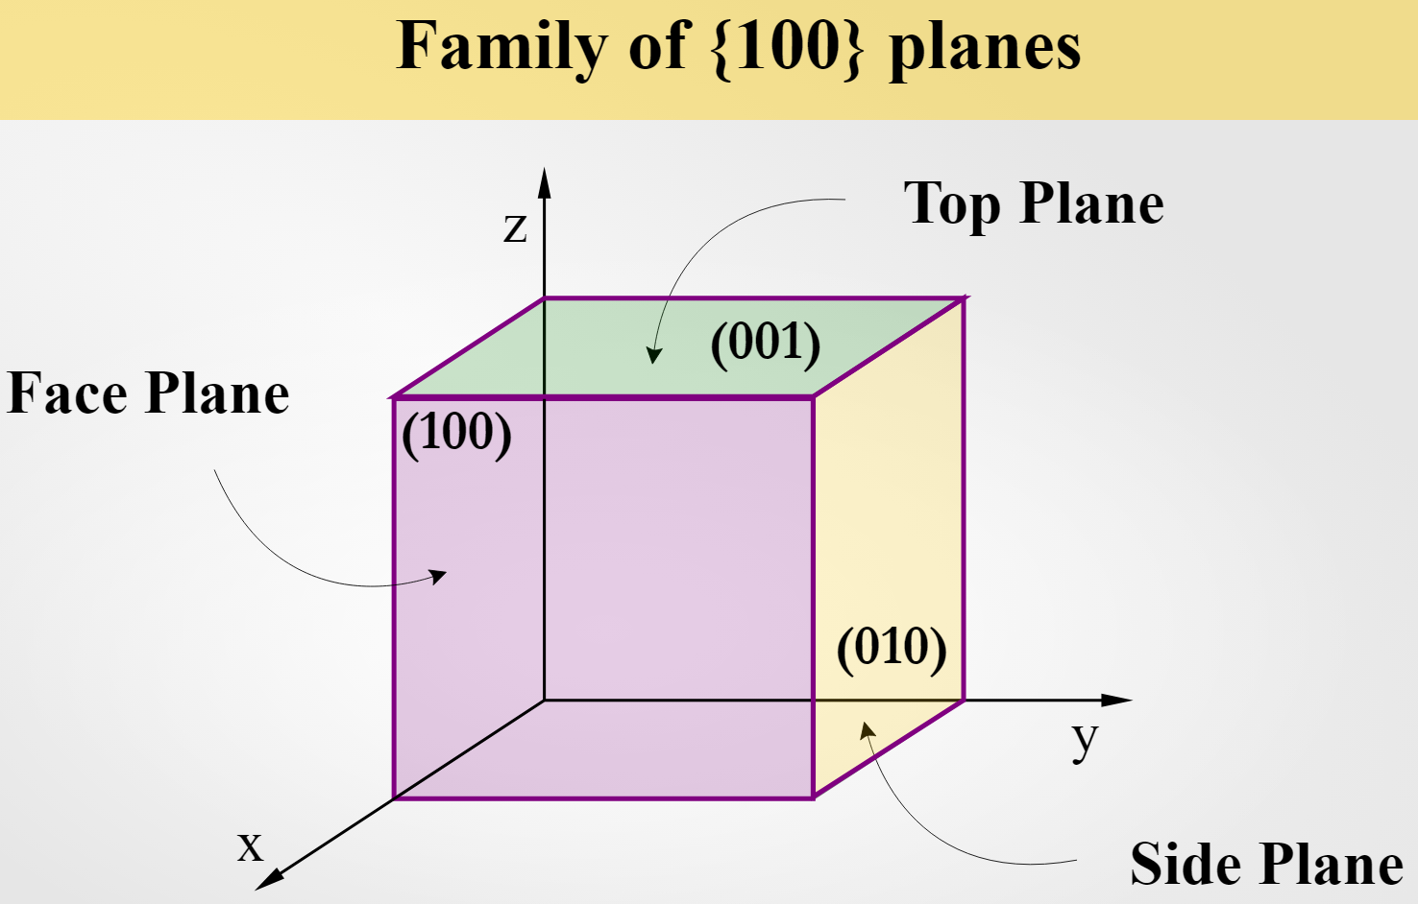
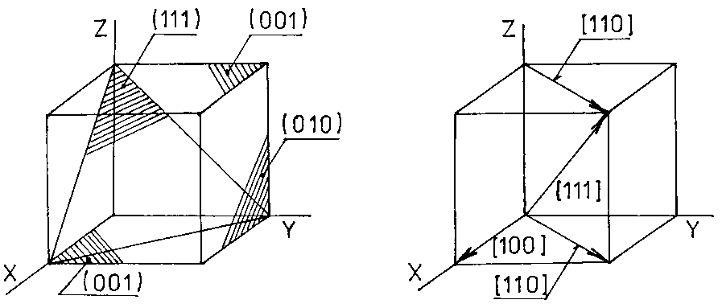
Miller indices
Miller Indices are a 3-dimensional coordinate system for crystals, based on the unit cell. This coordinate system can indicate directions or planes, and are often written as (hkl). Some common examples of Miller Indices on a cube include [111], the body diagonal; [110], the face diagonal; and (100), the face plane.
Square brackets [] indicate a specific direction. For example, in a cubic system [100] and [010] are perpendicular directions.
Angle brackets <> indicate a family of directions. For example, in a cubic system <100> includes these directions [100], [/100], [010], [0/10], [001], and [00/1].
Parenthesis () indicate a specific plane. For example, in a cubic system (100) and (010) are perpendicular planes.
Curly brackets {} indicate a family of planes. For example, in a cubic system {100} includes (100), (/100), (010), (0/10), (001), and (00/1).
Notes:
https://msestudent.com/miller-indices/

Slide 16
Basic crystal structures
Notes:
https://en.wikipedia.org/wiki/Crystal_structure

Slide 17
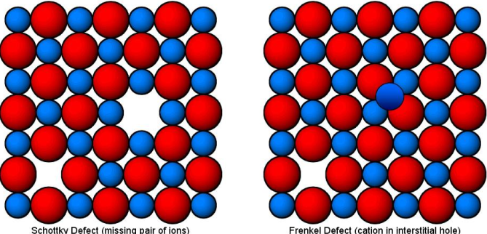
Crystallographic defects
Point defects (0 dimensional)
Vacancy
Interstitial
Frenkel pair
Substitutional defects
Antisite defects
Topological defects
Complexes forms point defects
Line defects - dislocations (1D - linear)
Edge dislocation
Screw dislocation
Planar defects (2D - flat)
Grain boundaries
Antiphase boundaries
Stacking faults
Twin boundary
Bulk defects (3D - spatial)
Macroscopic (bulk defects) - pores, cracks, inclusion
Voids = cluster of vacancies
Impurities clusters = precipitates
Affect properties of material
Electrical (conductivity) - all defects, especially point defects
Mechanical (strength, hardness, deformation style) - all defects, especially dislocations
Optical (color) - all defects, especially point defects
Magnetic - all defects
Kinetic = diffusion - all defects, especially point defects
Notes:
https://en.wikipedia.org/wiki/Crystallographic_defect
https://ppt-online.org/272381

Slide 18
Defects energy - state equilibrium
ΔH always positive
ΔS_{osc} always negative
n/(N+n) < 1, ln < 0
Defect formation only with increased entropy.
After n exceeds limit no significant increase S_{c} produced
Perfect crystal - all atoms are at correct lattice position (expect 0 K)
Entropy S = k lnW
For perfect only one arrangement W = 1 -> S = 0
Atoms vibration can be regarded as a form of defect.
Perfect -> imperfect = n vacancies created
Gibbs free energy ΔG = G_{def} - G_{perf} = ΔH - TΔS
Enthalpy change ΔH = nΔH_{i}
ΔS = ΔS_{osc} + ΔS_{c}
ΔH_{i} enthalpy of formation of one vacant site
ΔS_{osc} change of oscillation entropy of atom surrounding the vacancy
ΔS_{c} change in configurational entropy of system on vacancies formation
ΔS_{c} = ΔS_{c(def)} - ΔS_{c(id)}
ΔS_{c} = k lnW_{def} - k lnW_{id} = k ln W_{def} / W_{id}
Now, N atoms distributed over N + n sites. And n vacancies distributed over N + n sites.
Notes:
https://ppt-online.org/272381

Slide 19
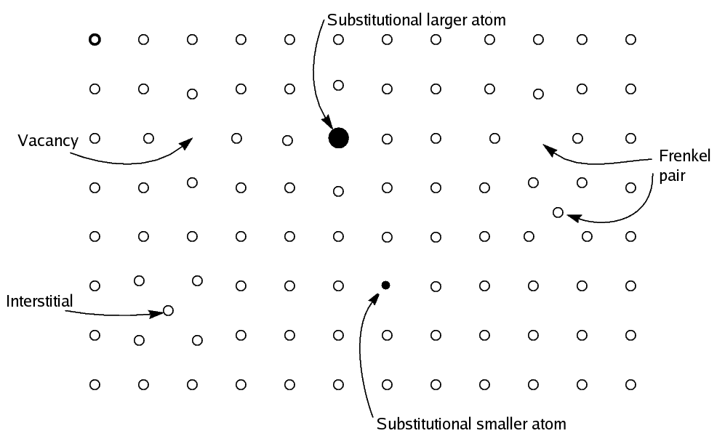
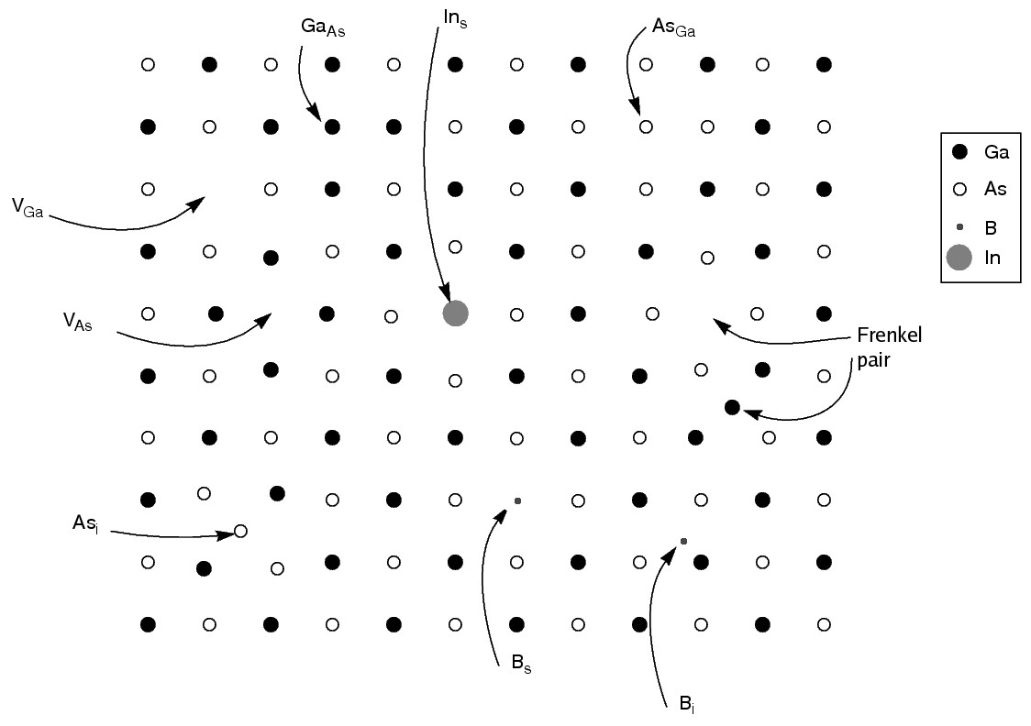
Point defects
Simple defects in monatomic solids
Vacancy - missing atom A vacancy (or pair of vacancies in an ionic solid) is sometimes called a Schottky defect.
Interstitial Eighter small atoms or high energy state.
Frenkel pair Atom moves from position and create vacancy + interstitial
Substitutional defects An impurity, the atom is often incorporated at a regular atomic site.
Antisite defects A atoms sit on the corners of a cubic lattice, and type B atoms sit in the center of the cubes. If one cube has an A atom at its center, the atom is on a site usually occupied by a B atom, and is thus an antisite defect.
Topological defects Example: carbon rings form 6 athoms, if there is 5 or 7 in ring but total 6 (double bonds) it is topological defect.
Complexes forms point defects Example: vacancy + huge impurity atom
GaAs as example of compound solid
Notes:
https://opentextbc.ca/chemistry/chapter/10-5-the-solid-state-of-matter/

Slide 20
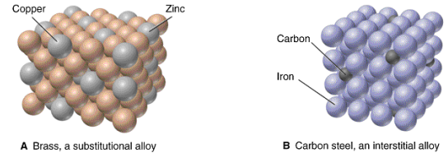
Substitutional × interstitial alloys
Substitutional – one atom is replaced by as different type of atom
Hume-Rothery rules for the substitutional type of the solute and solvent atoms that determine the degree to which the former dissolves in the latter, as follows:
Atomic size factor – The atomic radii of the solute and solvent atoms must differ by no more than 15%
Crystal structure - The crystal structures of solute and solvent must match.
Electronegativity - The solute and solvent should have similar electronegativity. If the electronegativity difference is too great, the metals will tend to form intermetallic compounds instead of solid solutions.
Valences - Complete solubility occurs when the solvent and solute have the same valency. A metal will have more of a tendency to dissolve another metal of higher valence than one of a lower valence
Interstitial – extra atom is inserted into the lattice structure at a normally unoccupied position
a) Fe and Cu. r_{Cu}=0.128nm, r_{Fe}=0.126 nm; Fe=BCC, Cu=FCC; Cu⁺ / Cu⁺² , Fe³⁺ / Fe⁺²
- No soluble at room temperature, slightly soluble at high temperature
b) Ni and Cu. r_{Cu}=0.128nm, r_{Ni}=0.125 nm; Ni=FCC, Cu=FCC; Ni⁺² , Cu⁺ / Cu⁺²
- fully soluble
c) Al and Ag. r_{Al}=0.143nm, r_{Ag}=0.144 nm, Al=FCC, Cu=FCC; Al⁺³ , Ag⁺¹
- Al is soluble of in Ag, Ag is slightly soluble in Al.

Slide 21
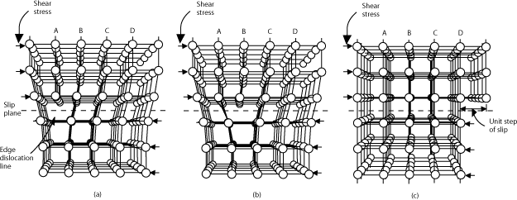
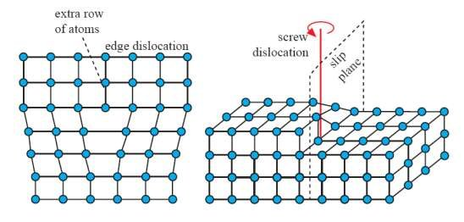
Dislocations
Edge dislocation
Screw dislocation

Slide 22
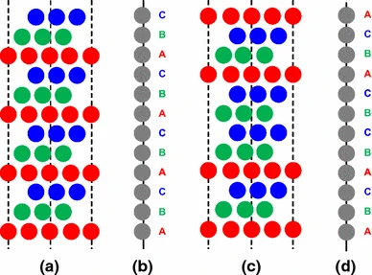
Plane defects
Mosaic crystals
Slightly mis-oriented volumes withing a single crystal. Lattices are close enough to provide continuity (so not separate crystals)
Antiphase domains
Antiphase domains has short-range order
Stacking faults = layers disorder

Slide 23
Literature
https://nptel.ac.in/content/storage2/courses/112108150/pdf/PPTs/MTS_02_m.pdf
https://physics.uwo.ca/~lgonchar/courses/p2800/Chapter2_Bonding_Handouts.pdf
https://www3.nd.edu/~amoukasi/CBE30361/Lecture_4_2014_lecture.pdf

Slide 24
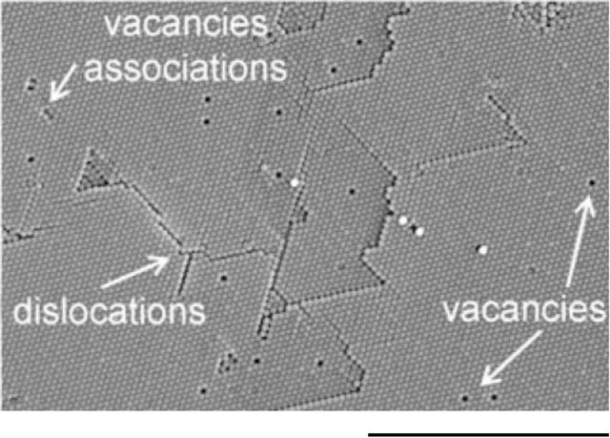
Thank you for your attention

