Slide 1
The Enlightenment or the Age of Reason
Philosophy, Literature, Society

Slide 2
The Enlightenment
can be seen as a return to where the Renaissance left off
it goes beyond, however:
the world can be known through:
reason (Descartes)
senses (David Hume)
political power is a result of a social contract (John Locke, J.-J. Rousseau)
separation of:
church and state (Locke, Thomas Jefferson)
the powers of government (aka checks and balances) (Montesquieu)
religious tolerance*

Slide 3
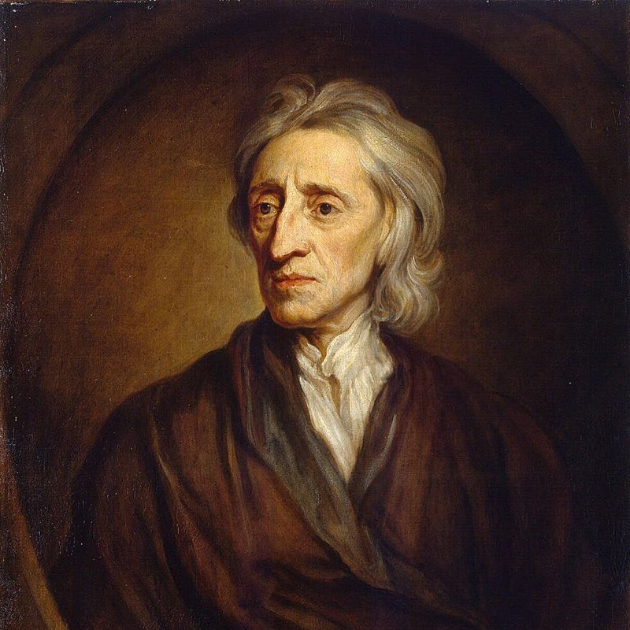
John Locke (1632 – 1704)
philosopher and physician
one of the most influential thinkers of the Enlightenment:
Voltaire, Rousseau, Montesquieu (as a social/political philosopher)
Hume, Kant (theory of mind, empiricism)
American and French Revolutions
most important texts:
Letters Concerning Toleration (1689, 1690, 1692)
Two Treatises of Government (1689)
An Essay Concerning Human Understanding (1689)
major “non-political” ideas:
the mind as tabula rasa
religious tolerance
modern Western conception of the self

Slide 4
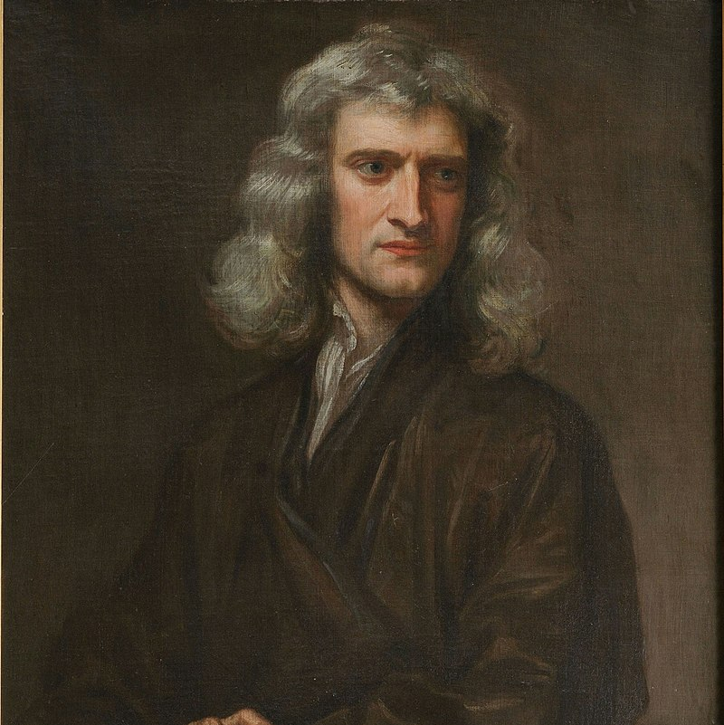
Isaac Newton (1642 – 1726)
mathematician, physicist, astronomer, theologian
one of the most influential scientists of all time:
laws of motion
universal theory of gravity
seminal contributions to optics
modern calculus (“with” Leibniz)
first attempt at a systematic measurement of temperature
most important texts:
Philosophiae Naturalis Principia Mathematica (1687)
Opticks (1704)
Arithmetica Universalis (1707)

Slide 5
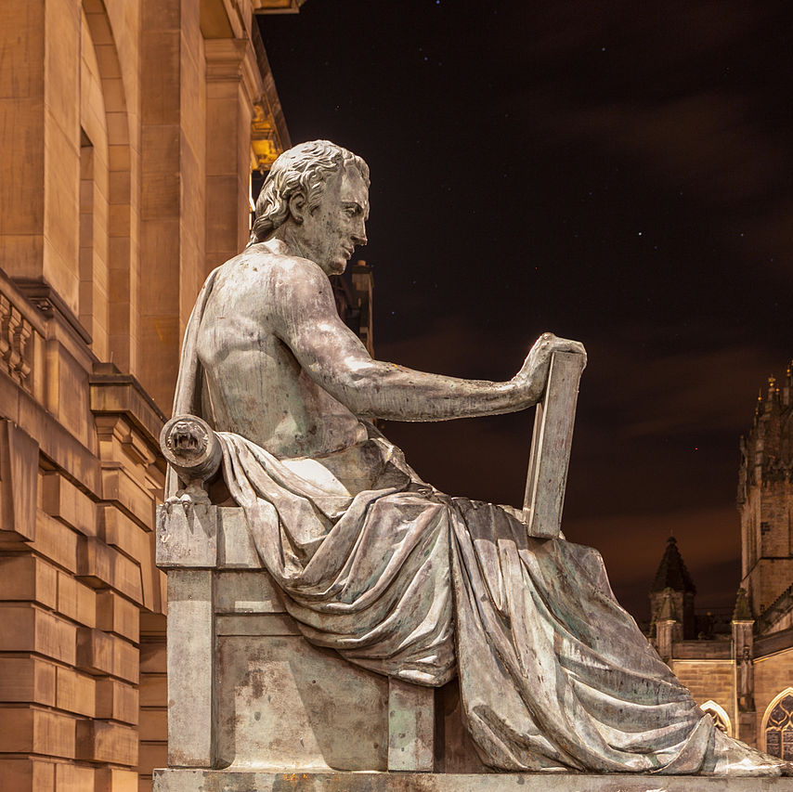
David Hume (1711 – 1776)
philosopher, historian, economist
argues against innate ideas (like Locke)
inductive reasoning and causality:
are not universal laws
cannot be justified rationally
are the results of custom and mental habit
passions and impressions govern human behavior, not reason
ethics are based on emotions, not on abstract moral principles
there is no self, only a bundle perceptions without unity or cohesion
political theory:
private property
limited government
constitutionalism
most important texts:
A Treatise on Human Nature (1739-40)
An Enquiry Concerning Human Understanding (1748)
An Enquiry Concerning the Principles of Morals (1751)

Slide 6
Augustan Literature
knowledge is gained through:
reason, intellect, the head
senses (observation)
interested in:
society, civilization
what can be known
the world is primarily understood (rather than experienced)
literary works:
balance, symmetry
convention, tradition
public issues

Slide 7
Augustan Literature
typical genres:
essay
satire
dialog
novel
readership:
wide and exponentially growing
books are cheaper
periodicals and newspapers
circulating libraries
still no concept of modern copyright
middle-class women

