Slide 1
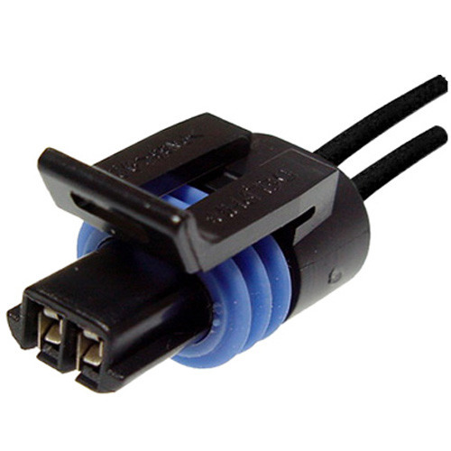
ETG 07 Wire connections and connectors © 2022, rev. 2022
Miroslav Novák
Department of Mechatronics and Technical Informatics
Faculty of Mechatronics, Informatics and Interdisciplinary Studies
Technical university of Liberec

Slide 2
Content
Overview of connection types
Detachable connections
Principle of electrical contact - contact resistance
Criteria for minimizing transient resistance and long life
Electrical and mechanical properties
Galvanic plating of electrical contacts, differences, advantages, disadvantages, mutual reactions, resistance, etc. penetration of intermetallic layers, their properties and influence on the service life of the coating
Identification - by measurement, microscope
Environmental impact on durability - UV, temperature, pressure, humidity, acids, oil, corrosion, etc.

Slide 3
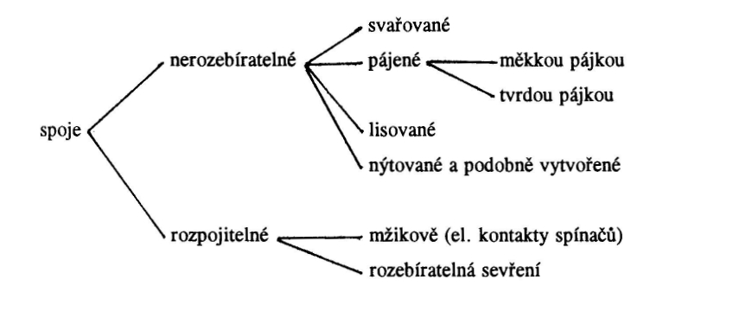
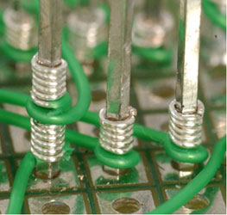
Wire connections
Metallic joints
Soldering
Soft
Hard
Welding
Contact joints (gas tight)
Pressing
Riveting
Wrapping
Screw terminals
Screwless (hot-swap)
Insulation piercing clamps
Plug-in connections
1
Notes:
<number>
Metalické spoje obvykle dosahují nižších přechodových odporů a delší živostnosti.
U kontaktních spojů je nutné zajistit, aby byly plynotěsné.

Slide 4
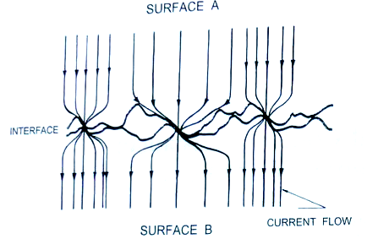
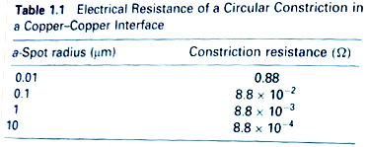
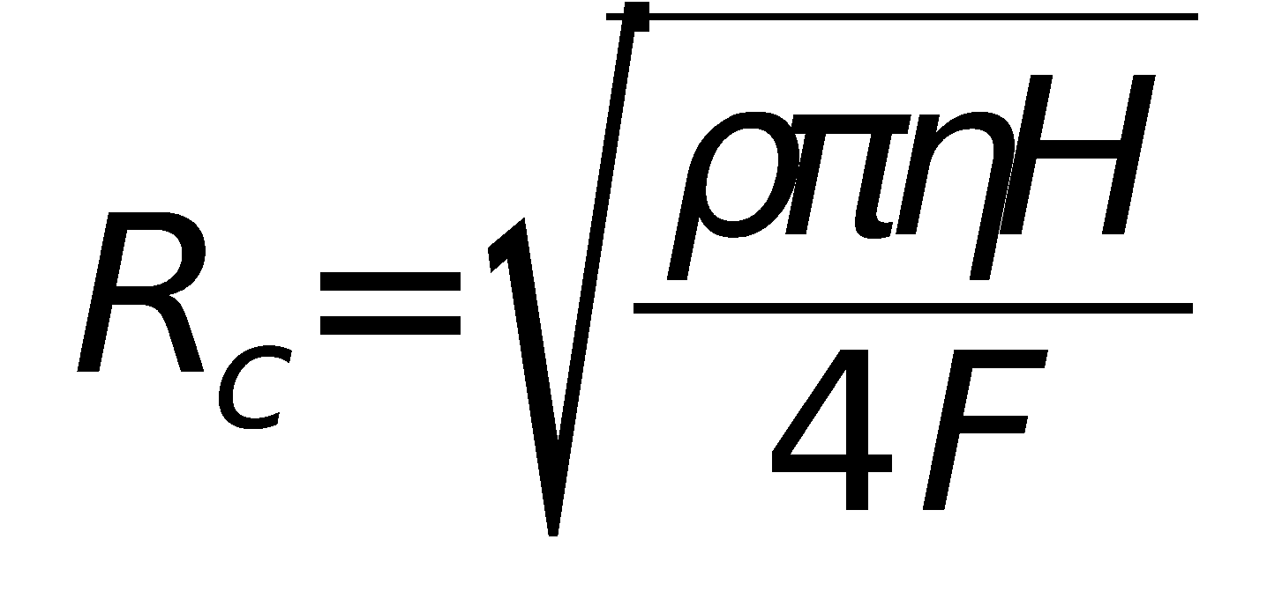
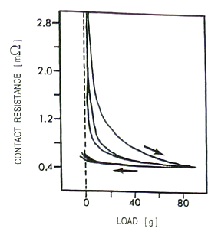
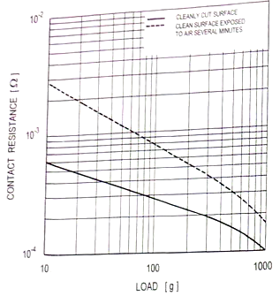
Contact resistance
The surface of the contacts is not ideally flat - a narrowing phenomenon occurs
Contact points
Total contact resistance
R₀ = ρl / S
R₀ .. conductor resistance without contact
R_{c} .. contact resistance
R_{pp} .. Coating resistance
I .. current
ρ .. Material resistivity
H .. Hardness of softer metals (Brinell or Vickers)
F .. Compression force
S .. Contact area
a .. Contact point radius
η .. Contact purity coefficient (net = 1)
1
Notes:
<number>
Výpočet z kontaktní síly je empirický, dobře popisuje makroskopický náhled a potvrdila ho řada experimentů [1, 2].

Slide 5
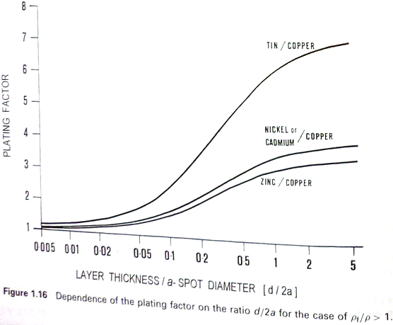
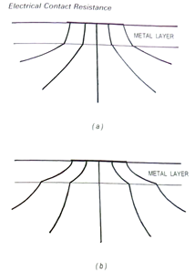
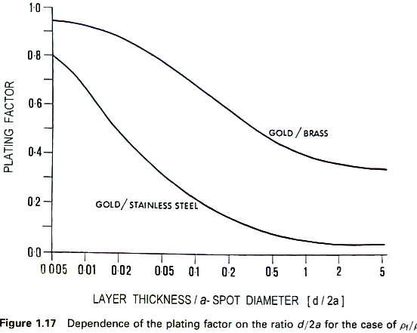
Influence of plating on contact resistance
Metal layers are used to modify corrosion resistance and arc burning stability
Hardness modification
They have a different conductivity - a change in contact resistance
Changes the sensitivity to surface cleanliness
Higher resistivity of coating
Lower resistivity of coating
R_{c} .. contact resistance
_{p}.. Probe resistivity
.. Contact resistivity
P_{f} .. plating coefficient – how many times resistivity increases
H .. Hardness of softer metal (Brinell or Vickers)
F .. Contact force
a .. Diameter of contact point
d .. Layer thickness
η .. Coefficient of cleanliness (clean = 1)
1
Notes:
<number>
Pokovení může kontaktní odpor snížit nebo zvýšit [1].
Samotné hledisko kontaktního odporu není jediné, důležité jsou ostatní provozní vlastnosti.

Slide 6
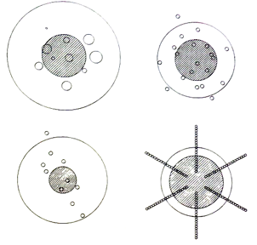
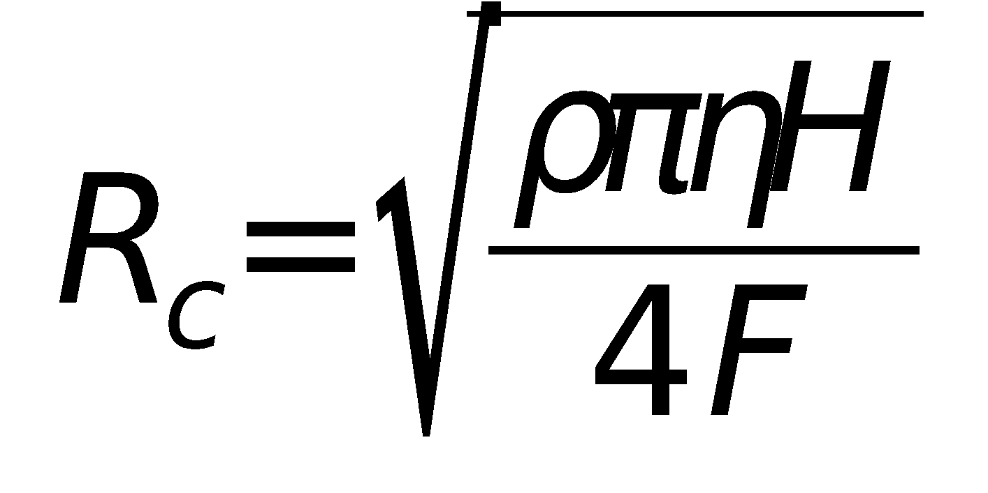
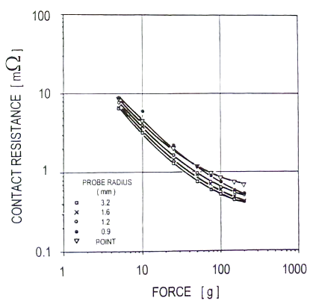
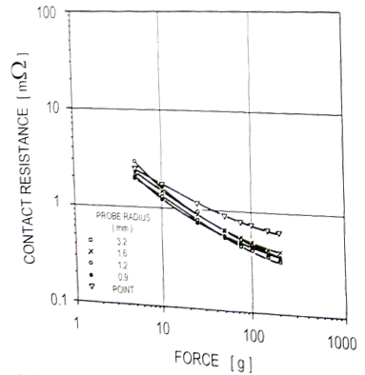
Contact resistance
The shape of the contacts does not matter much - contact resistance given by the size and number of contact points =
material hardness
and pressing force
Contact Au-Au Au-clean Cu
1

Slide 7
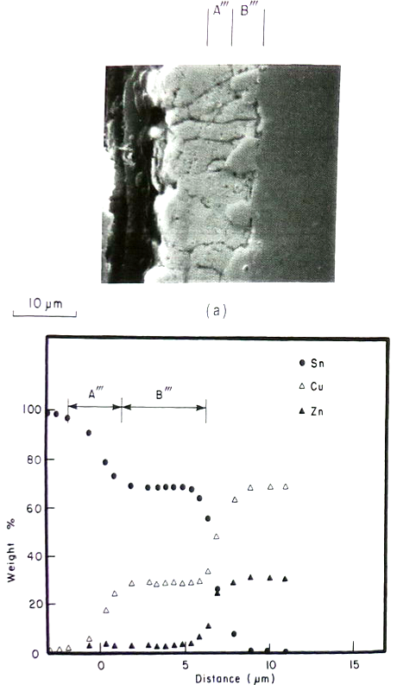
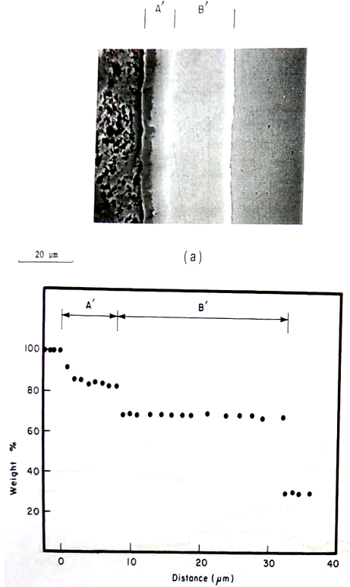
Intermetallic layers
Brass-Sn Brass-Zn
At the interface of the metallized layers, intermetallic layers gradually grow by mutual diffusion
Growth is accelerated by temperature, current flow, pressure
Intermetallic compounds have different physical properties and significantly affect the system
High resistivity
Low strength = cracks to loss of cohesion and peeling
1
Notes:
<number>
Problematika je komplikovaná. Některé vrstvy jsou téměř neškodné. Jiné vedou k vážným defektům funkce. Vrstvy tlustší než 2 um mohou být problém.

Slide 8
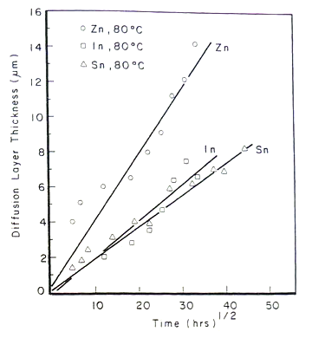
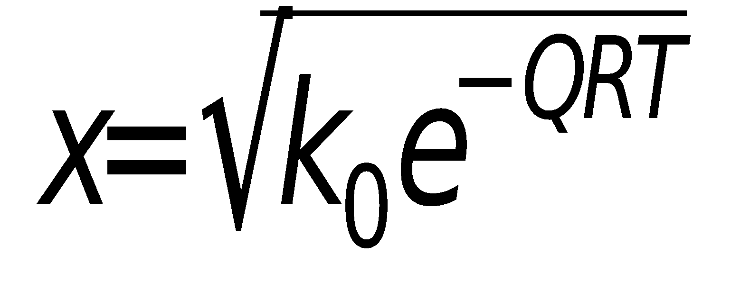
Intermetallic layers - growth rate
Brass as base metal, 80 °C
Growth rate
k₀ .. constant
Q .. Activation energy
R .. Universal gas constant
T.. Absolut temperature
We suppress by creating an interlayer – for Cu alloys = Nickl
Effective barrier against intermetallic layer growth is > 1 μm Ni
4 days 70 days
1
Notes:
<number>
Růst závisí na teplotě. Bývá selektivní – pod kontaktními body, kde je vyšší teplota.
Při pokojové teplotě je dosažení škodlivé tloušťky záležitostí měsíců až let.
Vyšší teploty zkracují až na několik sepnutí.
Efektivní ochranou je použití barierních mezivrstev.

Slide 9
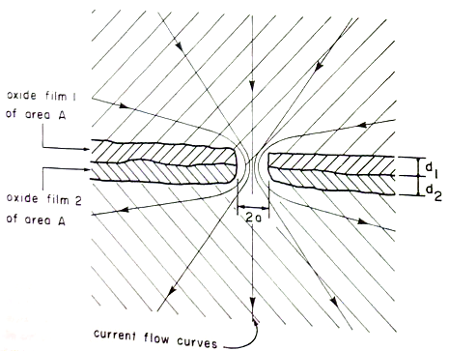
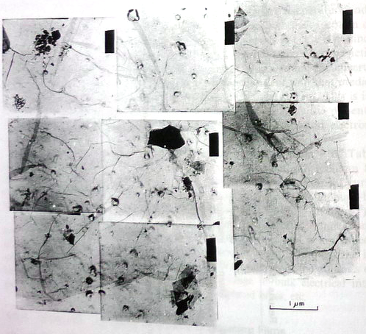
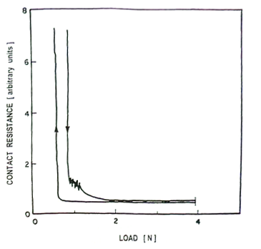
Surface film
An oxidation layer forms on the surface
It is non-conductive (Al₂O₃ for aluminum)
When connecting the contacts, the layer must be broken
higher pressing force
shift contacts
"High voltage" (breakthrough, couple of volts is enough for a 1 μm thick layer)
The size of the contact point is limited by cracks
Al-Al at vacuum
Dark line as cracks in Al₂O₃ film when contact is loaded
1
Notes:
<number>
[1]

Slide 10
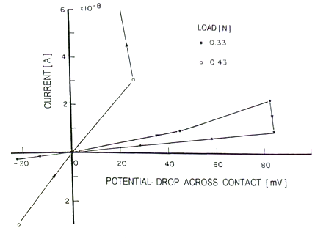
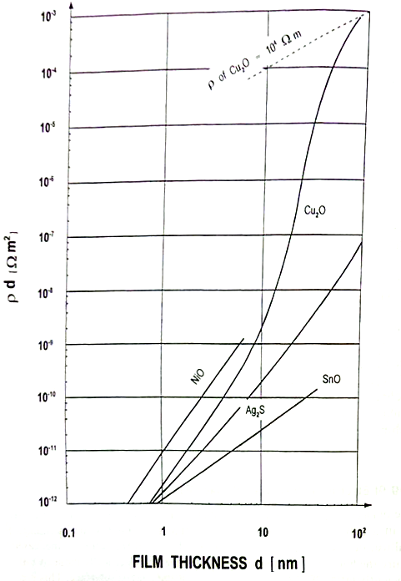
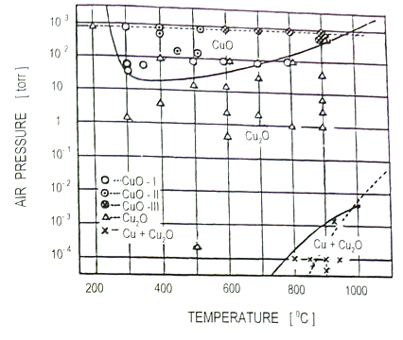
Surface film
Compression force and the circuit voltages act together
Al-Al
1
Notes:
<number>
Při nárůstu napětí dojde k proražení povrchové vrstvy a prudkému poklesu rezistivity.
Při vyšší kontaktní síle je vrstva poškozena mechanicky.

Slide 11
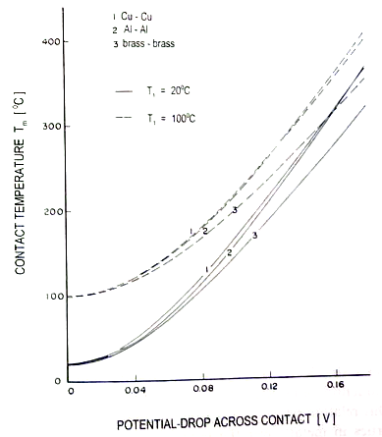
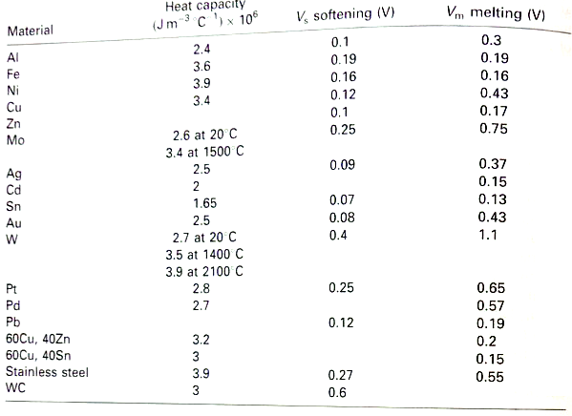
Contact point warming
Passing current heats up the mostly contact points
The temperature of the contact points corresponds to the voltage drop across the contacts
The heat is conducted by contact and dissipated to the surroundings
Conductors with good thermal conductivity (Al, Cu) have an advantage
An increase in temperature means an increase in resistance = acceleration of warming (for metals with lower thermal conductivity there will be instability, from a certain current the temperature will start to rise even if the current no longer increases and points will melt Fe 300 °C, Ni 348 °C, therefore they are not used as contact metals - Ni only as a coating)
Finally, it leads to melting of contact points and welding of contacts
1
Notes:
<number>
Pozor na povrstvené kontakty z teplotního pohledu je nutno je posuzovat komplexně.
Je třeba zajistit dobrou tepelnou vodivost vrchních vrstev.
Teplotně stabilní jsou materiály Cu, mosazi, Cu a Al bronzi.

Slide 12
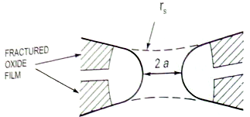
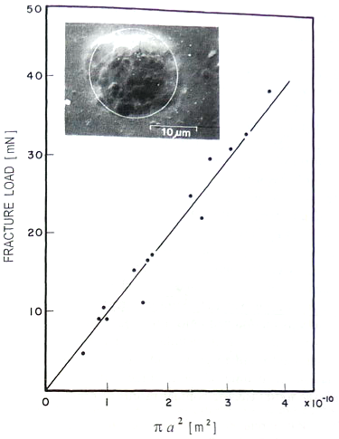
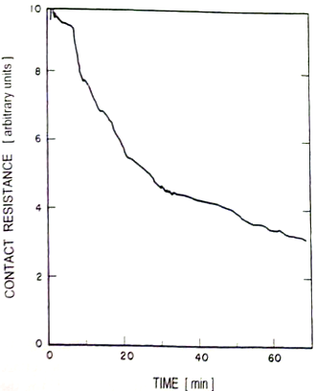
Contact point mechanics
Adhesion between molecular forces at the contact point = corresponds to welding
Necessary tear-off force - corresponds to the strength of the material!
Contact points slowly "grow" over time
Al-Al cleaned at vacuum
fracture stress 99 MPa
1
Notes:
<number>
Měrná síla potřebná k odtržení kontaktního bodu je velká, ale body jsou velmi malé.
To je hlavní kritérium pro konstrukci vratké pružiny.
Na snímku povrch po odtržení.

Slide 13
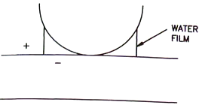
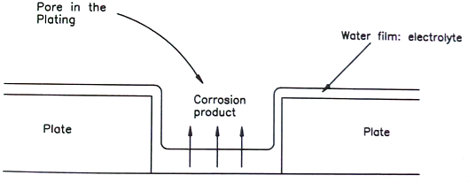
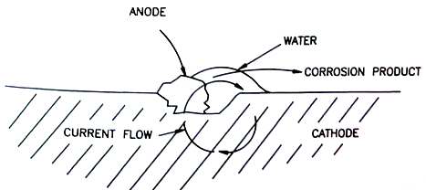
Connected contact
Contact corrosion
It depends on the environment (pollution),
exhaust gases from combustion engines SO₂, NO₂, O₃,
cities - see engine exhaust + local heating
chemical production H₂S (textile, refineries, steel mills), Cl (plastics - production and release from PVC, galvanizing, insecticity)
rot of organic material H₂S, ammonia
Water as an electrolyte
from relative humidity - water film 0.03 μm
in this film, CO₂ or other products dissolve and acid is formed
Damaged contact point coatings and impurities - spot corrosion of contacts = galvanic cells - electrochemical corrosion
Slit corrosion of connected contacts
broken contact point or pore in the plating
dust
1
Notes:
<number>
Rozebíratelné spoje jsou z pohledu koroze rizikovým místem.

Slide 14
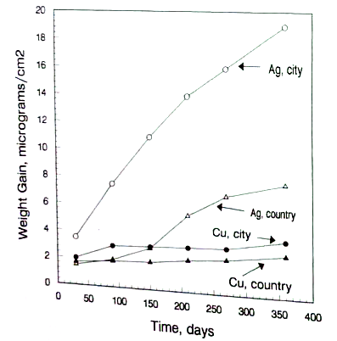
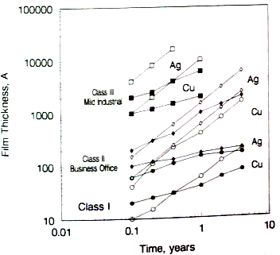
Speed of corrosion
In adverse conditions, the development of corrosion is surprisingly fast
Factors by importance
relative humidity
chlorides
H₂S
air exchange rate
humidity (temperature) cycles
oxidants NO₂, O₃
SO₂
temperature
Pollutants are active from concentrations of 1 ppb!
1 nm
1

Slide 15
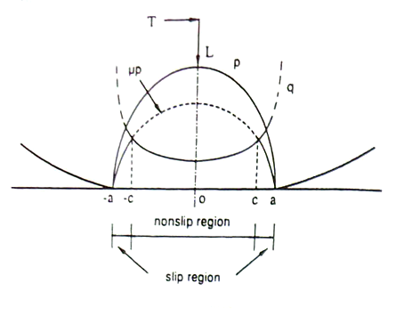
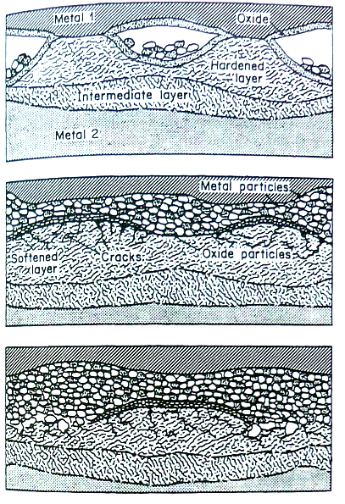
Friction in the contact area
Caused
Vibration
Thermal expansion
different expansions of materials
On / Off current
Material relaxation
The main reason for the failure of contacts plated Sn and Al contacts (Al₂O₃ is very hard and insulator), but it accompanies all materials Au, Pa, Ni, Ag, Cu, Al…
Affected by
Contact conditions (geometry, pressing force, stroke amplitude, frequency, duration)
Environment (temperature, humidity, chemistry, lubricant)
Material properties (hardness, stress, fatigue, corrosion, ductility, adhesion)
Process
Disruption of the oxide film by movement - exposure of pure metal (destruction of the passivation layer) - further oxidation
Removal of material from contact points by adhesions, sliding of micro-welds
Layer delamination
Residue oxidation - forms hard abrasive particles - further mechanical destruction of the joint
Formation of a thick insulating layer of oxides and wear products between the contact surfaces = fault, circuit permanently open
1
Failure development

Slide 16
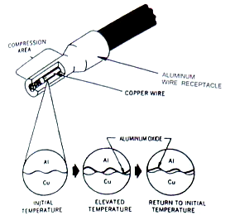
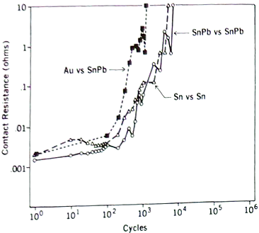
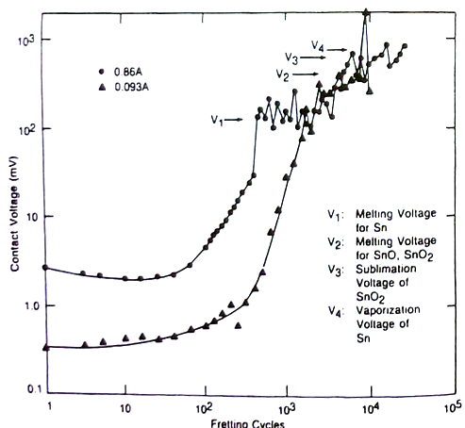
Examples of friction failures
Crimp connectors
The different thermal expansion of the connector and the conductor will cause the grip to release when the temperature changes
Cyclical warming - repetitive gradual opening
Air and corrosion products penetrate the slot
Gradual increase in transient resistance - overheating, even accident
If a thick oxide layer forms - loss of conductivity
1
Notes:
<number>
Už po několika stovkách teplotních cyklů může dojít k prudkému nárůstu odporu.
Vede až k přerušení obvodu.
Úbytky napětí odpovídají natavení vrstev a následně až odpaření.

Slide 17
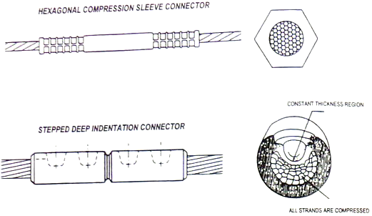
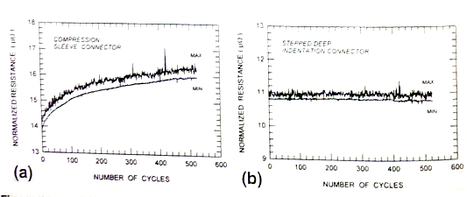
Sleeve or dimple joint
The dimples show a greater deformation of the material
Larger gas-tight area
After the cyclic current load, a opening is created
The socket joint retains its parameters better
<number>

Slide 18
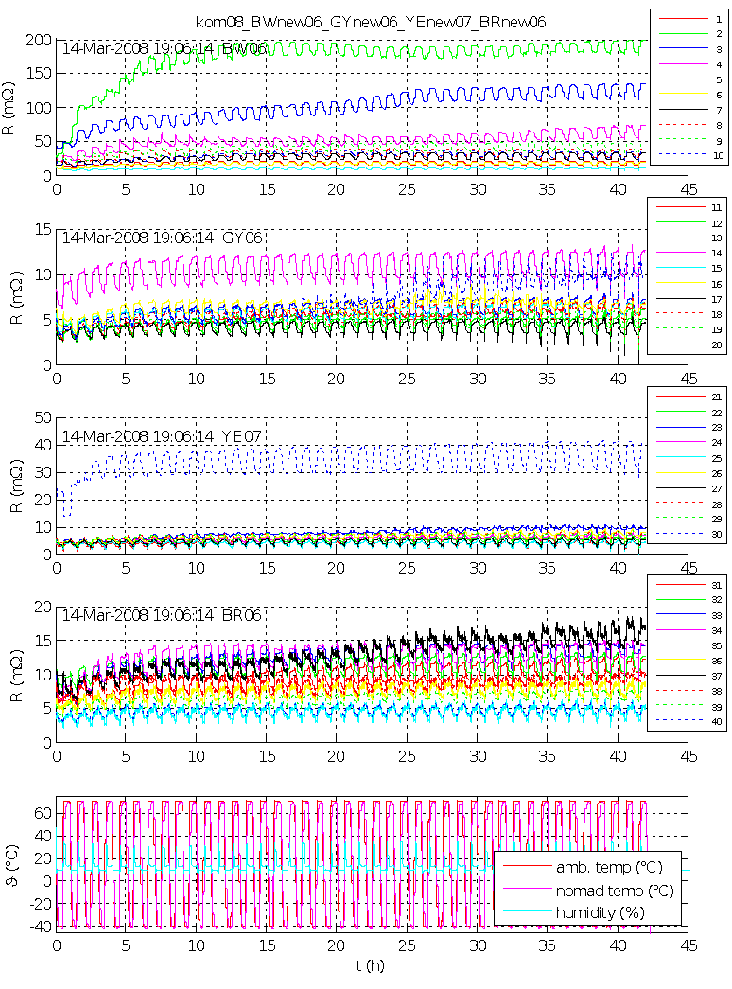
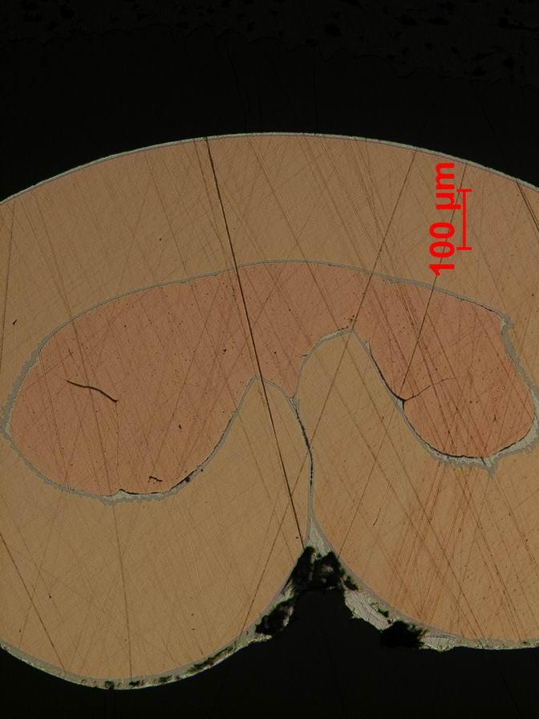
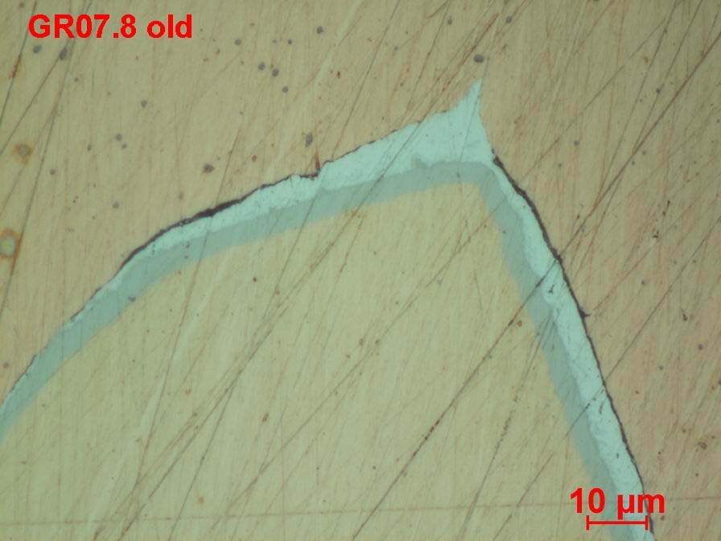
Example of opening
MOLEX 016-02-0086
Layer 3,8 um Sn on Ni barier
crimp automat
2015
Spojování vodičů a konektory
<number>
Notes:
<number>
Volantový kabelový svazek
Malý počet kontaktů (jednotky %) vykazovali rychlý nárůst přechodového odporu při teplotních cyklech.
Bylo závislé na krimpovacím nástroji a stroji. Ale i s nejlepšími podmínkami stále zůstávali „vadné spoje“ – nedošlo k úplné ztrátě obvodu, ale přechodový odpor se blížil až k 1 Ohm – způsobovalu chybu funkce.

Slide 19
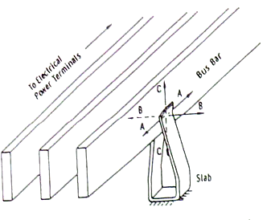
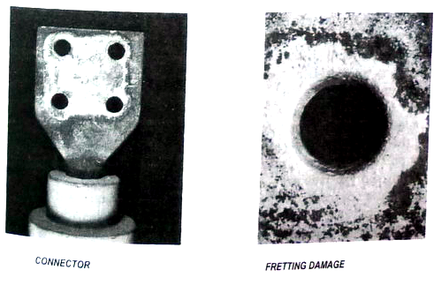
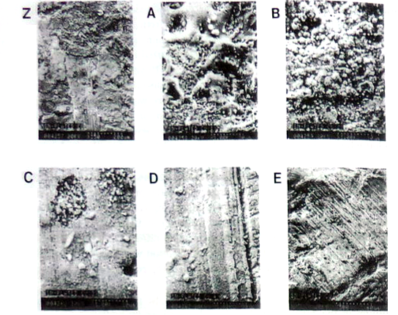
Example
Bus contacts
significant displacements of up to 20 μm
Screw connections
considered to be durable (high pressure force, feed prevention)
they also fail in adverse conditions (Al-Cu joint, significant temperature cycles)
Z - friction damage
A - electroerosion
B - accumulated friction products
C - delamination
D - abrasion
E - delamination with abrasion
<number>

Slide 20
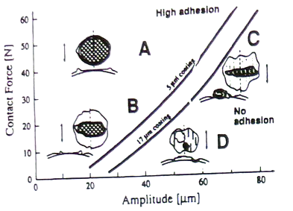
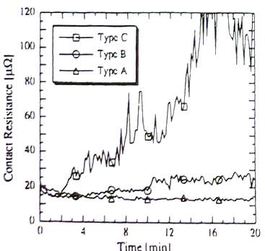
Ag contact and friction
Test results
Cu with layers 5 and 17 μm Ag
Variable vibrations from the generator 20 to 70 μm 100 Hz
Contact force 5 to 50 N
Dry friction
Vibration test for 100 A DC
Continuous 4-point contact resistance measurement
The damage occurred from 2 to 20 minutes
For failure in case C only after abrasion on Cu substrate
(case C - 1000% increase in resistance after 20 min.)
<number>

Slide 21
Amplitude of friction movements
Nb, 2 um displacement, 1 kg, 100 Hz 10⁶ cycles
Friction modes according to the feed amplitude
Contact - the movement takes place within the elastic deformation
Mixed feed and contact approx. 5 μm - fatigue crack formation, surface wear, contamination by abrasion products
Large feed 10-100 μm - damage to the contacts during each cycle, significant damage leading to delamination of the layers
Mutual displacement> 100 μm (insertion of connectors), abrasion of layers
Possibility of suppression
Construction - low rigidity of the contact point to the surroundings - additional spring
Lubricants
CrNi steel AISi 304, 4 um displacement, 1,15 kg, 100 Hz 10⁶ cycles
Cut - fatigue fractures below the surface
C steel AISI 1018, 15 um displacement, 0,57 kg, 20 kHz 10⁶ cycles
<number>

Slide 22
Contact force
The notch (slot) in the bus helps to increase the contact area and the force under the screws
Contact force guarantees stable contact points (airtight connection)
Reduction due to relaxation and creep (Al)
Screw terminal dependence on tightening
<number>
Notes:
<number>
Maximální síla nebývá zmiňována. Omezeno vytlačením vrstev, rozměry cenou.

Slide 23
Contact force
A flexible element is needed to maintain it throughout life
Disc springs provide higher force and keep it for a longer period of time
Current cycle loading
<number>

Slide 24
Damage due to plugging in connectors
Like microfriction, it causes surface damage
Material drift - the tip is formed
Abrasion + brittle fracture - up to complete abrasion of the layer - galvanic corrosion
Delamination - crack in the bottom layer and complete separation
Can be suppressed with grease
Limits the number of insertions x coating thickness
Ag contact 3,2 mm, 500g, Sn layer
<number>
Notes:
<number>
Míra abraze závisí na přítlačné síle. Pokud konektor není zasouván často nebývá problém.
Jinak je nutno volit odolnější vrstvy.

Slide 25
Connector materials
Requirements
High strength = creation of contact force in the spring part
Low hardness = larger contact point
Corrosion resistance
Good thermal conductivity
Temperature stability
Decent electrical conductivity
Ag - switching on / off currents 1-600 A, contact force> 15 g also as plating, but low melting point, tendency to weld contacts and form sulfide films, prone to electromigration through plastics
Cu - low strength, easy oxidation, sulfidation = unsuitable, must be coated, for spring contacts - bronzes and brass, eg Be bronze use up to 150 ° C (recrystallization)
Pt - corrosion resistant, for currents <2A, with low contact force, where reliability is important, unsuitable for joints with friction and vibration
Pa - cheaper replacement Pt, usable up to 350 ° C, in environments with organic pollution form non-conductive polymers
Au - excellent corrosion resistance, soft, prone to mechanical wear and contact welding, <0.5 A low voltage applications
W - hard, resistant to wear, welding and discharge burning, easy to corrode, high resistance, difficult processing, 1-5A, frequent handling
Ni - good corrosion resistance
the optimal solution is cladding Au, Ag, Pt on brass, bronze
difficult compromise
- alloys, coating
<number>

Slide 26
Contact layers
Coating
electrolytic or chemical plating
mechanical plating
Commercial use
Sn, SnPb (2.5-5 μm) non-critical applications, tendency to grow whiskers
Hard Au (1.25 um aggressive environment, 0.75 um standard) for long life
Au or Au80Pd20Ni thin layer (0.75-1.25 um)
Ag
Rh
Ni (5 μm for high forces, corrosion environment, battery contacts; 1.25-2.5 μm substrate - anti-intermetallic)
The problem is the porosity of the coating - pitting corrosion - the number of pores decreases with the thickness of the layer and with the smoothness of the substrate, sometimes it is solved with the substrate layers
<number>

Slide 27
Power connectors – automotive
Cu, Al, brass, bronze with Ni, Ag, Sn coatings
Ag coatings are very prone to corrosion in atmospheres with sulfur, thickness> 20 μm otherwise electrochemical cells accelerating corrosion
More advantageous use of Sn coating, suitable for spring connectors in relatively aggressive atmospheres
contact must be mechanically stable (displacements> 5 μm lead to gas tightness and oxidation)
contact force> 100 g
suitable to add a lubricant to suppress the penetration of the atmosphere
do not use> 100 ° C (loses mechanical strength and rapid diffusion of Cu to Sn)
at least 5 μm, (glossy or matte Sn has no effect)
the top layer must be abraded when contacted
never use for current interruption (disconnect contacts only without current)
suitable from uV / mA up to hundreds of V and A
Protection against dust penetration into the contact point is an advantage
<number>

Slide 28
Measurement of contact parameters
Functional tests
Contact resistance measurement it is advisable to use conditions corresponding to the actual circuit (we will also detect non-penetration of insulating layers, overheating in case of overcurrent) 4 wire method, microohmmeters
The measurement of voltage drop at operating current is equivalent gives indirect information about the temperature of the contact points, we can infer a risk
Brief inspection of thermal imaging - for current-stressed connections
Metallographic analysis
Optical and SEM images (surface and sections of contact points) we are looking for the degree and type of damage
Analytical methods (emission spectrometry, fluorescence analysis - detection of pollutants, intermetallic layers, exact composition)
Tests by simulated conditions (we evaluate R, t, dU, metallography, F…)
Temperature cycles
Vibration wear tests
Behavior at current pulses (short circuits)
<number>

Slide 29
Summary
We have outlined the pitfalls of electrical contact
We imagined the problem and solution of contacts for low voltage and medium currents (automotive)
Microelectronics, power engineering, high voltage technology, etc. are a separate issue
We have gone through testing methods
<number>

Slide 30
Literature
Electrical Contacts, Principles and Applications. SLADE Paul G. New York: CRC Press, 1999. ISBN 0-8247-1934-4
HAMPL Josef a kol. Materiály pro elektrotechniku, 2. přeprac. vyd. Praha: ČVUT, 1999, ISBN 80-01-01544-0
HOLM Ragnar. Electric contacts. Berlin: Springer, 2000. reprint z 1967, ISBN 978-3540038757

