Slide 1
Augustan Literature
An Overview of Main Figures and Works

Slide 2
The Origin of the Name
Alexander Pope’s epistle, “To Augustus”
modelled after Horace’s “Ad Augustum”
a poem celebrating the emperor Augustus
as a ruler
as a patron of literature
as an author
George II (named George Augustus)
weak ruler
barely speaks English
only cares about the most popular form of entertainment
criticized in contemporary press under the guise of the Roman emperor
satirical mock-praise
comparing the present age to the Roman one

Slide 3
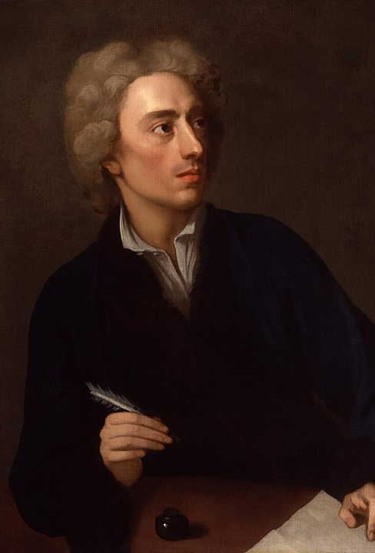
Alexander Pope (1688–1744)
Catholic, thus:
largely self-educated (Test Acts)
French, Italian, Latin and Greek
read Homer since age 6
had to live in the countryside
suffering from tuberculosis of the spine since age 12
hunchback
very small
constant health problems (headaches, fevers, stomach aches)

Slide 4
Alexander Pope (1688–1744)
wrote and published a lot of biting satire – many enemies
most important works:
The Rape of the Lock (1712/1714)
An Essay on Criticism (1711)
The Dunciad (1728/…/1743)
mostly wrote in heroic couplets
also important as a translator:
Iliad (1720)
Odyssey (1726, with co/authors)

Slide 5
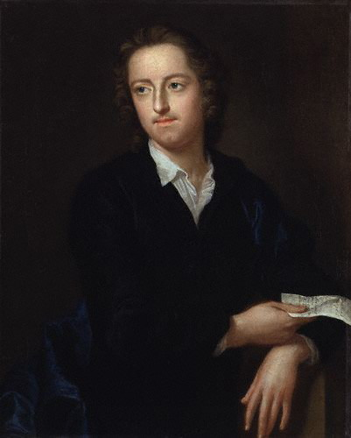
Thomas Gray (1716–1771)
poet and scholar
overly self-critical
published only 13 poems in his lifetime
turned down the position of Poet Laureate
widely considered a forerunner of Romanticism
gothic themes
attraction to the countryside
lyrical, contemplative tone
criticized by the Romantics themselves
Best-known work:
“Elegy Written in a Country Churchyard” (1751)

Slide 6
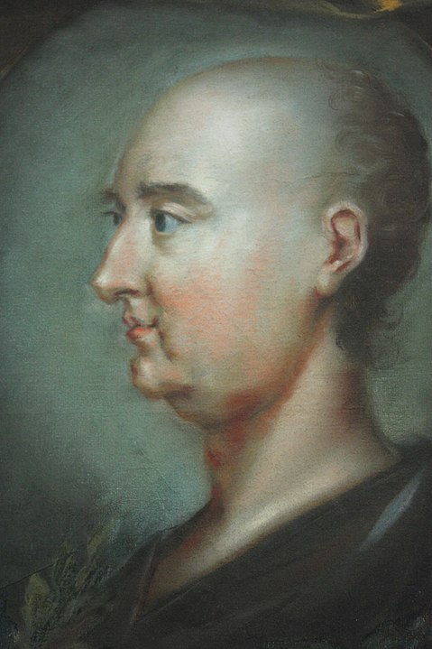
Jonathan Swift (1667–1745)
satirist, essayist, pamphleteer, poet and cleric
extensive formal education
BA, DD – Trinity College, Dublin
MA – Hart Hall, Oxford
government advisor (cca. 1710–1714)
spent most of his life in Ireland
Political views
satires (both political and religious)
extremely prolific writer
14 volumes of prose
3 volumes of correspondence
> 900 pages of poetry

Slide 7
Jonathan Swift (1667–1745)
Best-known works:
A Tale of a Tub (1704)
“The Battle of the Books” (1704)
Gulliver’s Travels (1726)
“A Modest Proposal” (1729)
Poetry:
“Cadenus and Vanessa” (1713/1726)
“The Lady’s Dressing Room” (1732)

Slide 8
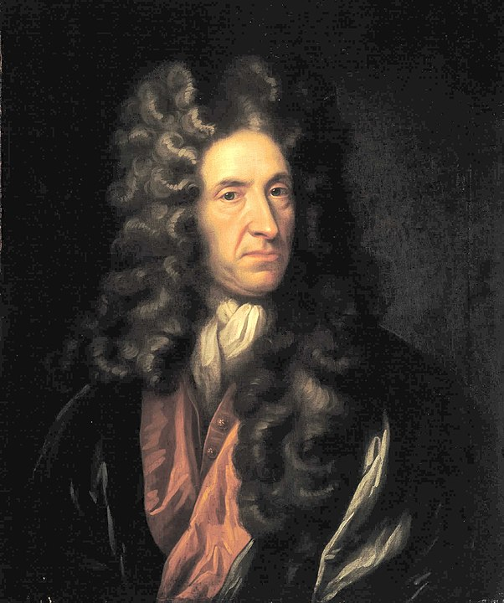
Daniel Defoe (1660–1731)
troubled businessman, spy, journalist, writer and pamphleteer
born as Daniel Foe
Extremely prolific (more than 500 titles to his name)
Biographies
Essays
Works of history
Novels
Robinson Crusoe (1719)
Moll Flanders (1722)
A Journal of the Plague Year (1722)

Slide 9
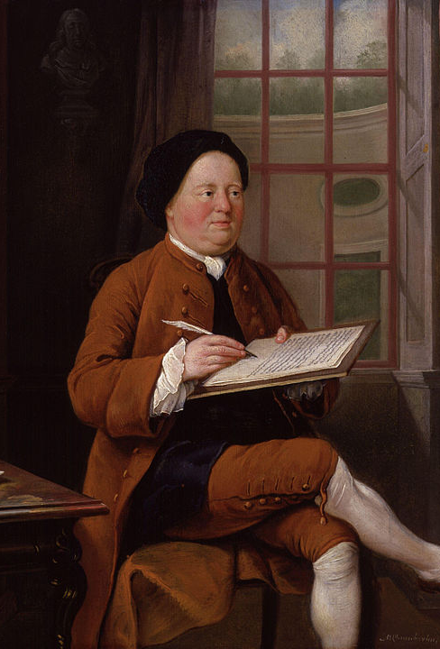
Samuel Richardson (1689?–1761)
writer, printer and publisher
little formal education
extensive apprenticeship in the printing trade
best known for his epistolary novels:
Pamela; or, Virtue Rewarded (1740)
Clarissa, or, the History of a Young Lady (1748)
also worked as an editor (e.g. Aesop’s Fables)
published various manuals and works of moral instruction
The Apprentice’s Vade Mecum (1734)

Slide 10
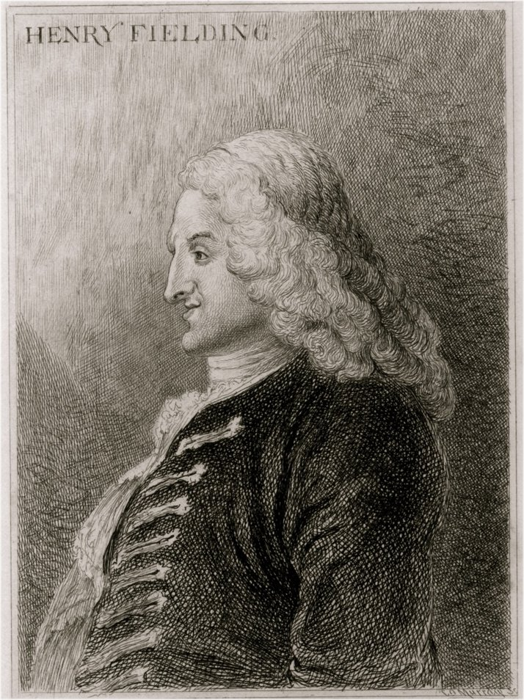
Henry Fielding (1707–1754)
novelist, dramatist, judge
partially educated at Leiden University
successful playwright before 1737 (Licensing Act)
founder of London’s first police force
best known today for his novels and novellas:
Shamela (1741)
The History of the Adventures of Joseph Andrews and his Friend, Mr. Abraham Abrams (1742)
The History of Tom Jones, a Foundling (1749)

Slide 11
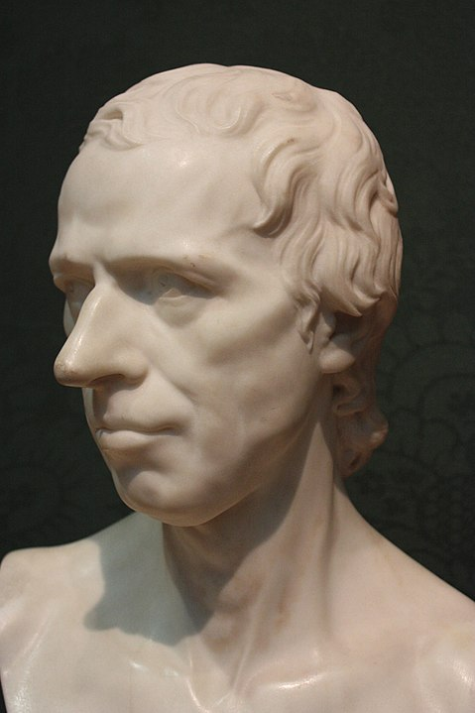
Laurence Sterne (1713–1768)
novelist and cleric
educated at Cambridge (MA)
suffering most of his life from tuberculosis
published and wrote little compared to most of his contemporaries:
A Political Romance (1759)
The Life and Opinions of Tristram Shandy, Gentleman (1759, …, 1767)
A Sentimental Journey through France and Italy (1768)

Slide 12
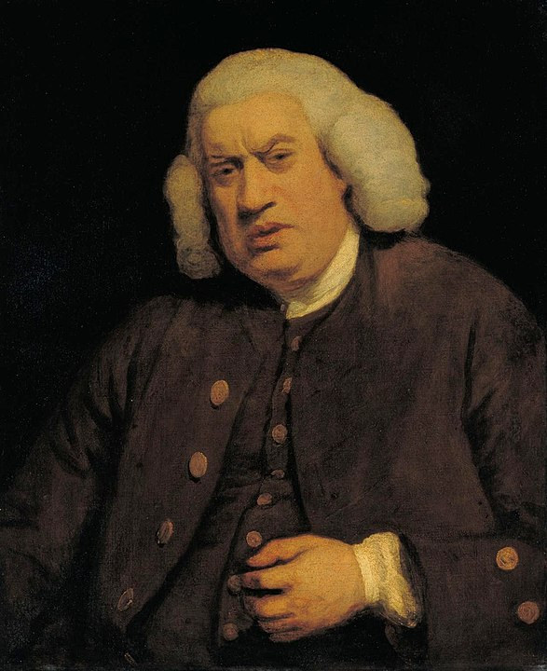
Samuel Johnson (1709–1784)
lexicographer, literary critic, biographer, editor, essayist, poet and playwright
studied at Oxford, but never finished his regular studies (granted an MA in 1755)
most typically referred to as Dr. Johnson
Best known for:
A Dictionary of the English Language (1755)
Lives of the Most Eminent English Poets (1781)
The Plays of William Shakespeare (1765)

