Slide 1
Preeklampsie a HELLP syndrom
Petr Křepelka

Slide 2
Preeclampsie a HELLP syndrom
Hypertenze+proteinurie (generalizované otoky)
a/nebo orgánová dysfunkce
TK >140/90 – 2 po sobě jdoucí měření – interval 4-6 hodin
Preexistující hypertenze syst.TK >30, diast.TK >15
Porucha funkce endotelu v graviditě
>20.týden grav ….4-6 týdnů po porodu
Incidence 5-14%
10%<34.týden
Notes:
Overview
Preeclampsia is a disorder of widespread vascular endothelial malfunction and vasospasm that occurs after 20 weeks' gestation and can present as late as 4-6 weeks postpartum. It is clinically defined by hypertension and proteinuria, with or without pathologic edema.
The incidence of preeclampsia in the United States is estimated to range from 2% to 6% in healthy, nulliparous women.[1, 2, 3] Among all cases of the preeclampsia, 10% occur in pregnancies of less than 34 weeks' gestation. The global incidence of preeclampsia has been estimated at 5-14% of all pregnancies.
In developing nations, the incidence of the disease is reported to be 4-18%,[4, 5] with hypertensive disorders being the second most common obstetric cause of stillbirths and early neonatal deaths in these countries.[6]
Medical consensus is lacking regarding the values that define preeclampsia, but reasonable criteria in a woman who was normotensive before 20 weeks' gestation include a systolic blood pressure (SBP) greater than 140 mm Hg and a diastolic BP (DBP) greater than 90 mm Hg on 2 successive measurements, 4-6 hours apart. Preeclampsia in a patient with preexisting essential hypertension is diagnosed if SBP has increased by 30 mm Hg or if DBP has increased by 15 mm Hg.

Slide 3
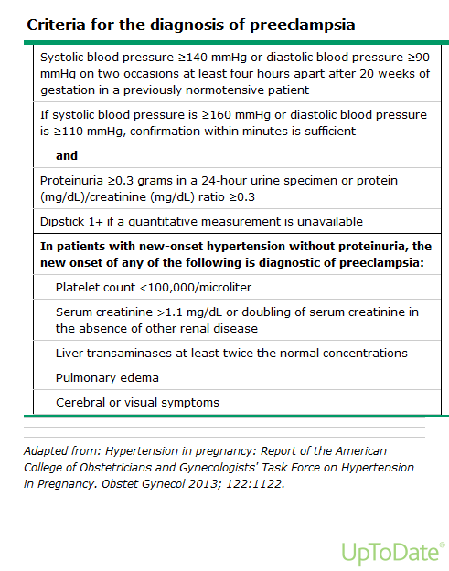
Notes:
Trombocytopenie <100 000/mm
Plazmatická koncentrace kreatininu >97 mikromoll/l
Elevace transamináz nad dvojnásobek normální hodnoty
Edém plic
Cerebrální asymptomy
Poruchy vidění

Slide 4
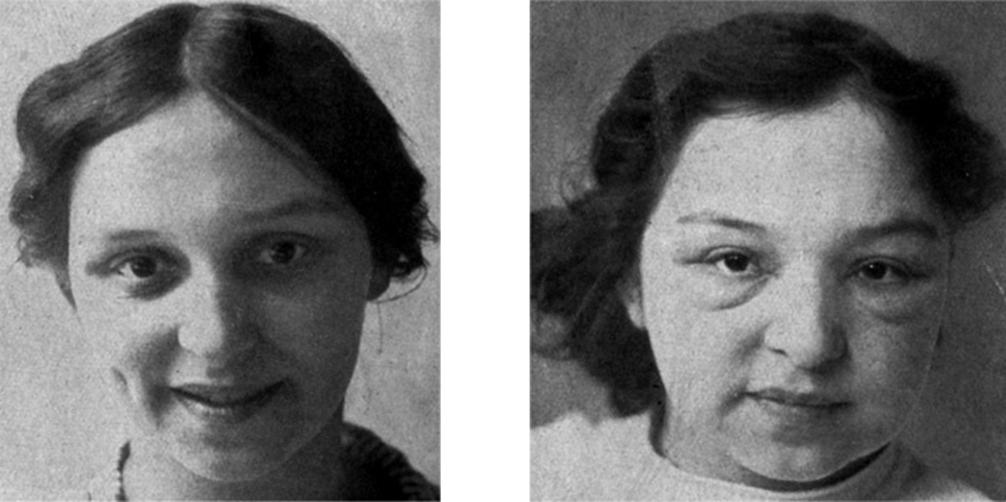

Slide 5
Klasifikace
Mírná a těžká preeklampsie 3:1
Těžká preeclampsie
>160/110 (2x během 4-6 hod)
Proteinurie >5g/24 hod.
Proteinurie >3g ve 2 náhodných vzorcích během 4 hod.
Plicní otok, cyanosa
Oligurie <400 ml/24 hod.
Cefalea
Epigastrická bolest/porucha jaterních funkcí
Oligohydramnion, IUGR, abrupce placenty

Slide 6
Klasifikace
Gestační hypertenze
>140/90 poprvé v grav.zjištěna
Upraví se do 12 týdnů po porodu
Chronická hypertenze
>140/90 zjištěna před graviditou nebo před 20.týdnem grav., zjištěna po 20.týdnu, ale přetrvává déle než 12 týdnu po porodu
Superponovaná preeclampsie
Proteinurie >300 mg/24 hod. u ženy s hypertenzí před 20.týdnem, nebo vzestup TK nebo proteinurie nebo rozvoj trombocytopenie <100000/mm u ženy s hypertenzí a proteinurií před 20.týdnem grav
Notes:
Classification and Characteristics of Hypertensive Disorders
Preeclampsia is part of a spectrum of hypertensive disorders that complicate pregnancy. As specified by the National High Blood Pressure Education Program (NHBPEP) Working Group, the classification is as follows[8] :
Gestational hypertension
Chronic hypertension
Preeclampsia/eclampsia
Superimposed preeclampsia (on chronic hypertension)
Although each of these disorders can appear in isolation, they are thought of as progressive manifestations of a single process and are believed to share a common etiology.
Gestational hypertension
The characteristics of gestational hypertension are as follows:
BP of 140/90 mm Hg or greater for the first time during pregnancy
No proteinuria
BP returns to normal less than 12 weeks' postpartum
Final diagnosis made only postpartum
Chronic hypertension
Chronic hypertension is characterized by either (1) a BP 140/90 mm Hg or greater before pregnancy or diagnosed before 20 weeks' gestation; not attributable to gestational trophoblastic disease or (2) hypertension first diagnosed after 20 weeks' gestation and persistent after 12 weeks postpartum.
Preexisting chronic hypertension may present with superimposed preeclampsia presenting as new-onset proteinuria after 20 weeks' gestation.
Preeclampsia/eclampsia
Preeclampsia/eclampsia is characterized by a BP of 140/90 mm Hg or greater after 20 weeks' gestation in a women with previously normal BP and who have proteinuria (≥ 0.3 g protein in 24-h urine specimen).
Eclampsia is defined as seizures that cannot be attributable to other causes, in a woman with preeclampsia
Superimposed preeclampsia
Superimposed preeclampsia (on chronic hypertension) is characterized by (1) new onset proteinuria (≥ 300 mg/24 h) in a woman with hypertension but no proteinuria before 20 weeks' gestation and (2) a sudden increase in proteinuria or BP, or a platelet count of less than 100,000/mm3, in a woman with hypertension and proteinuria before 20 weeks' gestation.
HELLP syndrome
HELLP syndrome (hemolysis, elevated liver enzyme, low platelets) may be an outcome of severe preeclampsia, although some authors believe it to have an unrelated etiology. The syndrome has been associated with particularly high maternal and perinatal morbidity and mortality rates and may be present without hypertension or, in some cases, without proteinuria.
Proteinuria
Proteinuria is defined as the presence of at least 300 mg of protein in a 24-hour urine collection. Some investigators and clinicians have accepted a urine protein-creatinine ratio of at least 0.3 as a criterion for proteinuria, but the American College of Obstetricians and Gynecologists (ACOG) has not yet incorporated this into their definition.[9] In the emergency department, a urine protein-to-creatinine ratio of 0.19 or greater is somewhat predictive of significant proteinuria (negative predictive value [NPV], 87%).[10] Serial confirmations 6 hours apart increase the predictive value. Although more convenient, a urine dipstick value of 1+ or more (30 mg/dL) is not reliable in the diagnosis of proteinuria.

Slide 7
Léčba preeclampsie
Podle závažnosti a gestačního stáří
Mírná preeclampsie
indukce porodu > 37
Těžká preeclampsie
Kortikoidy < 34
Ukončit > 34
Notes:
Management of Preeclampsia
The optimal management of a woman with preeclampsia depends on gestational age and disease severity. Because delivery is the only cure for preeclampsia, clinicians must try to minimize maternal risk while maximizing fetal maturity. The primary objective is the safety of the mother and then the delivery of a healthy newborn. Obstetric consultation should be sought early to coordinate transfer to an obstetric floor, as appropriate.^{[47]}
Patients with mild preeclampsia are often induced after 37 weeks' gestation. Before this, the immature fetus is treated with expectant management with corticosteroids to accelerate lung maturity in preparation for early delivery.
In patients with severe preeclampsia, induction of delivery should be considered after 34 weeks' gestation. In these cases, the severity of disease must be weighed against the risks of infant prematurity. In the emergency setting, control of BP and seizures should be priorities. In general, the further the pregnancy is from term, the greater the impetus to manage the patient medically.

Slide 8
Těžká preeklampsie
> 34 – ukončit
Non reaktivní CTG, PROM, maternální distres – ukončit bez ohledu na fetální stáří
Notes:
Care in Severe Preeclampsia
When severe preeclampsia is diagnosed after 34 weeks' gestation, delivery is most appropriate. The mode of delivery should depend on the severity of the disease and the likelihood of a successful induction. Whenever possible, however, vaginal delivery should be attempted and cesarean section should be reserved for routine obstetric indications.
Women with severe preeclampsia who have nonreassuring fetal status, ruptured membranes, labor, or maternal distress should be delivered regardless of gestational age. If a woman with severe preeclampsia is at 32 weeks' gestation or more and has received a course of steroid, she should be delivered as well.
Patients presenting with severe, unremitting headache, visual disturbance, and right upper quadrant tenderness in the presence of hypertension and/or proteinuria should be treated with utmost caution.

Slide 9
Těžká preeklampsie a expektační přístup
< 34 týden
Stabilní stav matky a plodu (Sibaiova kritéria)
Interval predikce 24 hod
Plod
Vyloučit těžkou růstovou restrikci
Vyloučit akutní tíseň plodu
Matka
Diuresa
Laboratoř (jaterní funkce, KO, urikemie, LDH)
TK
Notes:
Expectant management of severe preeclampsia
If a patient presents with severe preeclampsia before 34 weeks' gestation but appears to be stable, and if the fetal condition is reassuring, expectant management may be considered, provided that the patient meets the strict criteria set by Sibai et al (see Laboratory values for preeclampsia and HELLP syndrome).^{[51]} This type of management should be considered only in a tertiary center. In addition, because delivery is always appropriate for the mother, some authorities consider delivery as the definitive treatment regardless of gestational age. However, delivery may not be optimal for a fetus that is extremely premature. Therefore, in a carefully chosen population, expectant management may benefit the fetus without greatly compromising maternal health.
All of these patients must be evaluated in a labor and delivery unit for 24 hours before a decision for expectant management can be made. During this period, maternal and fetal evaluation must show that the fetus does not have severe growth restriction or fetal distress. In addition, maternal urine output must be adequate. The woman must have essentially normal laboratory values (with the exclusive exception of mildly elevated liver function test results that are less than twice the normal value) and hypertension that can be controlled.
Fetal monitoring should include daily nonstress testing and ultrasonography performed to monitor for the development of oligohydramnios and decreased fetal movement. In addition, fetal growth determination at 2-week intervals must be performed to document adequate fetal growth. A 24-hour urine collection for protein may be repeated. Corticosteroids for fetal lung maturity should be administered prior to 34 weeks.
Daily blood tests should be performed for liver function tests (LFTs), CBC count, uric acid, and LDH. Patients should be instructed to report any headache, visual changes, epigastric pain, or decreased fetal movement.

Slide 10
Léčba těžké preeclampsie
ABC
Profylaxe křečí - MgSO₄
Antihypertenzní terapie
léčit hypertenzi >160/110
udržet hodnoty TK 140/90
Hydralazin - 5-10 mg i.v. a 20 min do celkové dávky 30 mg
Labetalol - 20 mg i.v. a 10 min. do celkové dávky 300 mg
Nifedipin - 10 mg p.o. a 15-30 min. do celk.max 3 dávek
Nitroprusid sodný - Postpartální aplikace – ARO
Infuzní terapie – prevence otoku plic - restrikce tekutin 80 ml/hod., 1 ml/1 kg/hod.,p+v
Notes:
Seizure Treatment and Prophylaxis With Magnesium Sulfate
The basic principles of airway, breathing, and circulation (ABC) should always be followed as a general principle of seizure management.
Magnesium sulfate is the first-line treatment for the prevention of primary and recurrent eclamptic seizures. For eclamptic seizures that are refractory to magnesium sulfate, lorazepam and phenytoin may be used as second-line agents.
Active seizures should be treated with intravenous magnesium sulfate as a first-line agent.^{[7]} A loading dose of 4 g should be given by an infusion pump over 5-10 minutes, followed by an infusion of 1 g/h maintained for 24 hours after the last seizure. Recurrent seizures should be treated with an additional bolus of 2 g or an increase in the infusion rate to 1.5 g or 2 g per hour.
Prophylactic treatment with magnesium sulfate is indicated for all patients with severe preeclampsia. However, no consensus exists as to whether patients with mild preeclampsia need magnesium seizure prophylaxis. Although ACOG recommends magnesium sulfate in severe preeclampsia, it has not recommended this therapy in all cases of mild preeclampsia.
Some practitioners withhold magnesium sulfate if BP is stable and/or mildly elevated and if the laboratory values for LFTs and platelets are mildly abnormal and/or stable. Other physicians feel that even patients with gestational hypertension should receive magnesium, as a small percentage of these patients may either have preeclampsia or may develop it. The ultimate decision should depend on the comfort level of the labor and delivery staff in administering intravenous (IV) magnesium sulfate. An estimated 100 patients need to be treated with magnesium sulfate therapy to prevent 1 case of eclampsia.^{[52, 7, 53]}

Slide 11
HELLP Sy
První signál rozvíjející se preeklampsie
POZOR – často chybná dg
… hepatitis, idiopatická trombocytopenická purpura, onemocnění močových cest
Trombocyty - nejvýznamnější
LDH - 2,2 - 3,6 µkat/l
Klasifikace
Memphis úplný, částečný (neúplný)
Mississipi – trombocytopenie
<50 000 – 50 000-100 000 - >100 000
Notes:
HELLP syndrom
První signál rozvíjející se preeklampsie
POZOR – často chybná dg
… hepatitis, idiopatická trombocytopenická purpura, onemocnění močových cest

Slide 12
… děkuji za pozornost

