Slide 1
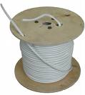
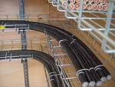
Conductors and cables
ETG 06 - Cables
Rev. 2022
Miroslav Novák
Technical University of Liberec
🕿 +420 48 535 3626 e-🖂 miroslav.novak@tul.cz
Notes:
‹#›

Slide 2
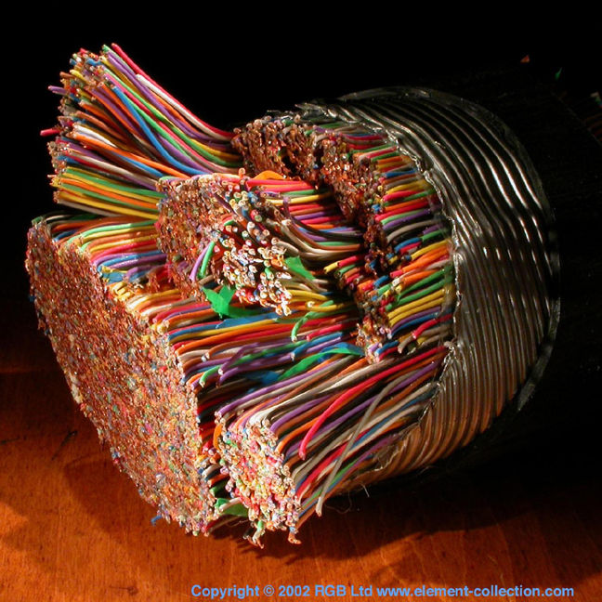
Contents
Lifetime limitations
Design criteria
Short circuit current immunity
Color codes
Cables serve for transfer of el. energy or transfer of signals (measuring, regulation, signalization)
Notes:
‹#›

Slide 3
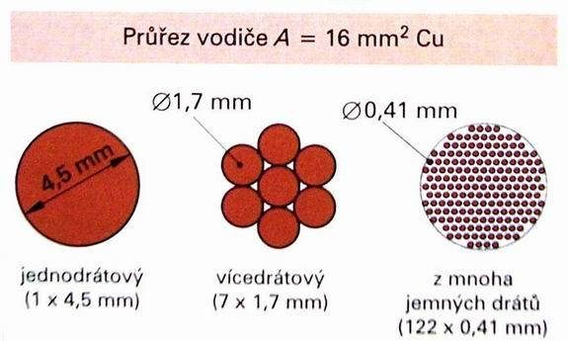
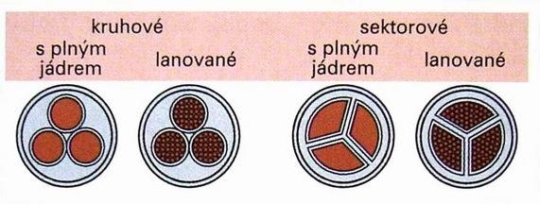
Types of conductors
Insulated conductor it mustn’t lay into the soil
Cable (more strands) consists of insulated conductors, common sheath and sometimes filler, reinforcement and support additional sheath protects against mechanical or chemical stress
Conductor cross-section A = 16 mm² Cu
Circular Sectional
Full Strands Full core Strands

Slide 4
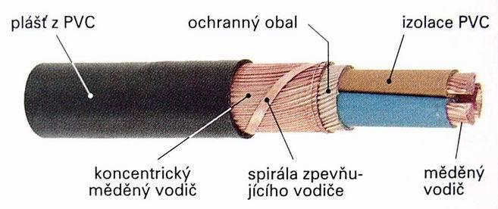
Demands x implementation
Mechanical endurance
Acceptable working temperature
Low voltage drop
Low resistance for overcurrent short circuit protection
Chemical endurance
Minimal cross section
Ampacity
Voltage drop
Allowable length for short-circuit protection
Core and insulation design
PVC shell protection wrapping PVC insulation
Concentric cooper Spiral of Cooper wire strengthening conductor conductor

Slide 5
Design of conductors
Tasks of design:
Choose type of conductor suitable for given environment and conditions of operation
Choose placing
Calculation of conductor cross-section
Fundamentals:
Temperature has to be in allowed limits
Conductor cross-section has to be in economical limits
Conductors has to have sufficient mechanical ruggedness
Voltage drop has to be in limits
Has to withstand short current forces and temperatures
Notes:
‹#›
mechanical ruggedness = mechanická odolnost

Slide 6
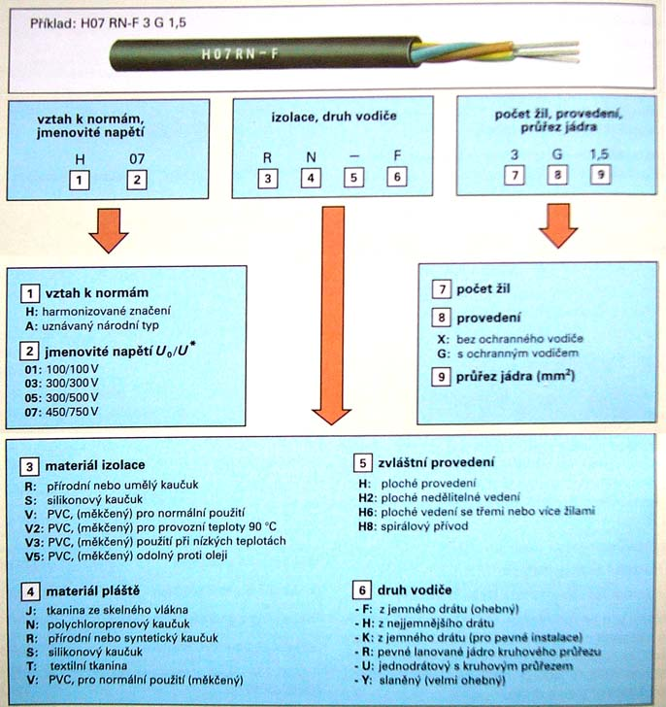
Conductor marking du eto CENELEC in document
PN-HD 361 S3 "System for cable designation"
New marking
(international)
https://www.tme.eu/en/news/library-articles/page/41461/designation-of-cables-according-to-harmonised-standards/
Notes:
https://www.tme.eu/en/news/library-articles/page/41461/designation-of-cables-according-to-harmonised-standards/

Slide 7
Mechanical ruggedness
The cross-section area is limited for short parts by mechanical ruggedness, depends on conductor placing – distance of shoring, flexible conductors
Solid conductors low flexibility, < 10 mm², only for firm placing
Divided core better flexibility, all > 16 mm²
With fine and ultra fine fibers safe for moving applications, flexible connections
Solid core Cu
Cross-section | Type, usage
1,5 mm² | Lighting, wall sockets
0,5 mm² | Signalization, control circuit
4 mm² | Eqipotential bonding
10 mm² | Over head lines
Fine fiber core Cu
Cross-section | Typ, usage
0,1 mm² | Hand appliances <1 A, <2 m
0,5 mm² | Appliances <2,5 A, <2 m
0,75 mm² | Appliances < 10 A
Notes:
‹#›
Shorings – podpěry

Slide 8
Force action of short circuit currents
Several times > nominal currents
Should be revised on conductors placed close together
Force F = BlI sin α (two conductors close together carry current)
B = μ₀H (T); μ₀ = 4π10⁻⁷ (Hm⁻¹); H = I / (2πa) (Am⁻¹)
α Force direction, highest in perpendicular direction sin α = 1
l length of conductor
a distance
I short circuit current, limited by power source (net) and short circuit impedance (ordinarily thousands of A)
=> F = 2.10⁻⁷ I²l/a (N)
Should be more than thousand Newton's per meter!

Slide 9
Dielectric strength of insulation
Basic parameter for insulation choosing
Heat stress decreases dielectric strength

Slide 10
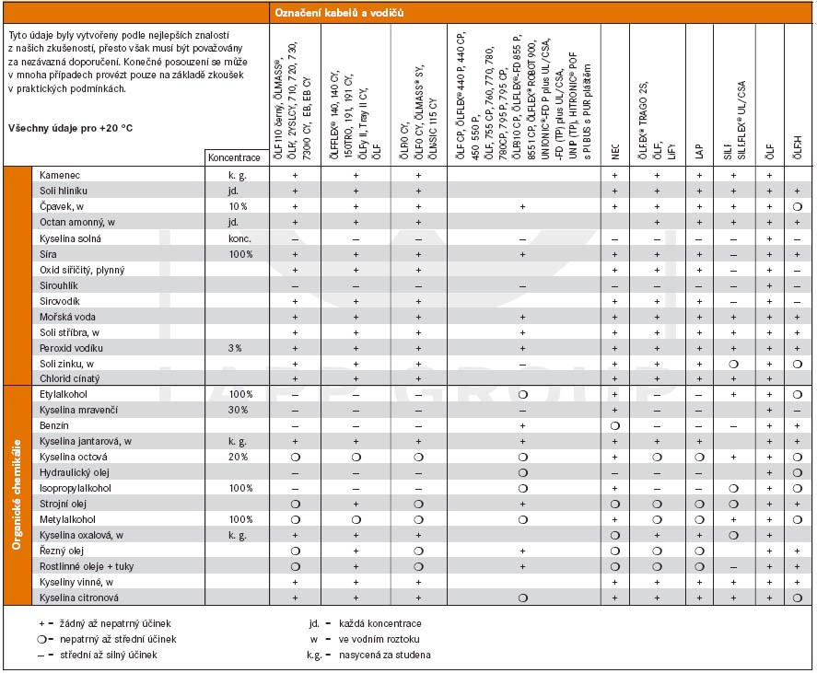
Chemical endurance of cable sheating

Slide 11
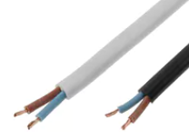
Examples of conductors
H07V2-K single core cable
Relation to the harmonised standard: H - cable made in accordance with the harmonised standard
Nominal voltage: 07- 450/750V
Insulation & sheath materials: V2- polyvinyl chloride resistant to increased temperature (PVC)
Cable structure: no designation: round cable
Conductor material: a dash, which means copper
Conductor structure: K - fine wire for fixed installation (class 5)
Number of conductors: 1
Protective conductor: X - lack of green/yellow protective conductor
Conductor cross-section: 10mm2
H03VVH2-F multicore power cable
Relation to the harmonised standard: H - cable made in accordance with the harmonised standard
Nominal voltage: 03 - 300/300V
Insulation & sheath materials: V- polyvinyl chloride(PVC)
Non-metal coating: V - polyvinyl chloride(PVC)
Cable structure: H2 - flat cable, non-separable
Conductor material: a dash, which means copper
Conductor structure: F - fine wire for cables (class 5)
Number of conductors: 12
Protective conductor: G - green/yellow protective conductor
Conductor cross-section: 1.5mm2

Slide 12
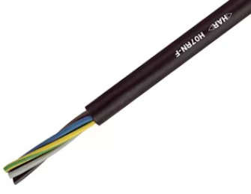
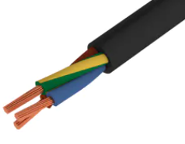
Examples of conductors
H07RN-F multicore power cable
Relation to the harmonised standard: H - cable made in accordance with the harmonised standard
Nominal voltage 07- 450/750V
Insulation & sheath materials: R - standard ethylene polypropylene rubber
Non-metal coating: N - flame retardant polychloroprene rubber
Cable structure: no designation: round cable
Conductor material: a dash, which means copper
Conductor structure: F - fine wire for cables (class 5)
Number of conductors: 12
Protective conductor: G - green/yellow protective conductor
Conductor cross-section: 1.5mm2
H05RR-F multicore power cable
Relation to the harmonised standard: H - cable made in accordance with the harmonised standard
Nominal voltage 05 - 300/500V
Insulation & sheath materials: R - standard ethylene polypropylene rubber
Non-metal coating: R - standard ethylene polypropylene rubber
Cable structure: no designation: round cable
Conductor material: a dash, which means copper
Conductor structure: F - fine wire for cables (class 5)
Number of conductors: 2
Protective conductor: X - lack of green/yellow protective conductor
Conductor cross-section: 0.75mm2

Slide 13
Design procedure ČSN 33 2000
Circuit current calculation
Cross-section calculation
Economical revision
Choice of protection (fuse, circuit-breaker)
Short circuit current calculation, check max. and min. values
Verify the functionality of protection
Verify voltage drop
Verify protection selectivity

Slide 14
Circuit current calculation
Current rating I_{b}:
Sum of conductor currents without corrections is not economical
Current is computed from apparent power and the lowest voltage level at network (230 V –10 %)
Current is multiplied by coefficient of utilization appliances do not take nominal power often. kb = 1 lighting, heaters; kb = 0,75 motors
Current is multiplied by coefficient of contemporaneity all appliances are not switch on together. ks = 1 lighting, heating, air-conditioning; ks = 0,1 to 0,2 wall sockets; ks = 0,7 pumps, ventilators
Adjust result by coefficient of expanding electric equipment innovation. kr = 1,2 for industry
For low number of connected devices (<=4) has to by kb = 1 and ks = 1
I_{b} = k_{b} . k_{s} . k_{r} . Σ I_{n} tables of coefficients in literature
Notes:
‹#›
coefficient of utilization = součinitelem využití
contemporaneity = součinitelem současnosti

Slide 15
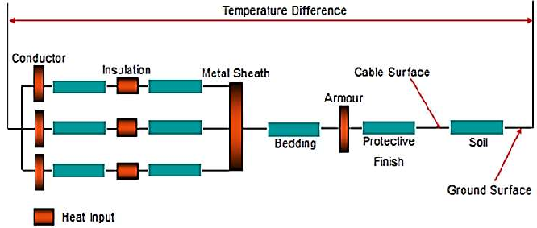
Conductor warming
Temperature limit depends on insulation material. Heat production depends on conductor load and type of operation. Conductor warming is key factor for operational economy
Ampacity (current load) limited by Joule’s heat and by heat transfer to conductor surroundings, free conductors J_{Cu} < 12 A/mm²; J_{Al} = 8 A/mm², tables of conductor loading are used in practice
Conductor placing inhibit heat transfer, ratio for decreasing conductor ampacity
Ambient temperature (including sun radiation) tables of loading are made for 30 °C, for other values use corrective coefficient
Parallel placing of more conductors conductors heat each other, use corrective coefficient

Slide 16
Conductor placing
function:
Mechanical support should resist to short circuit current forces, for over head lines has to carry own weight, wind, frost deposit
Mechanical and chemical shield of conductor
Make worse heat transfer
Conductors should be placed away from barriers – when conductor is endanger – use protection pipe, tracks are placed horizontally and vertically
Notes:
‹#›
frost deposit - námraza

Slide 17
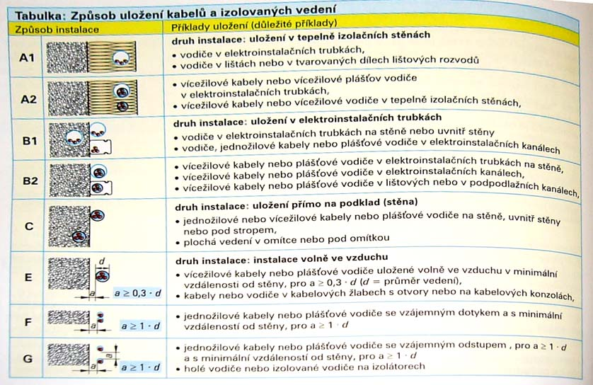
Conductor placing

Slide 18
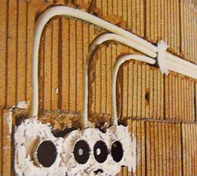
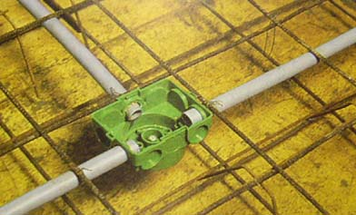
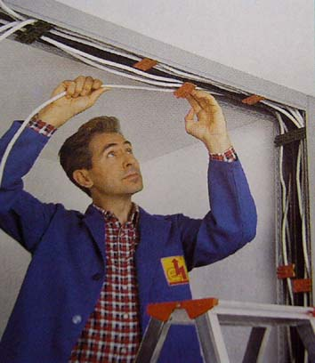
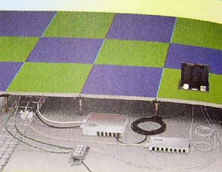
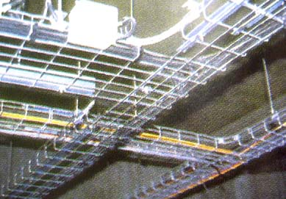
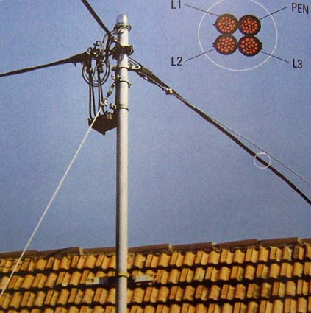
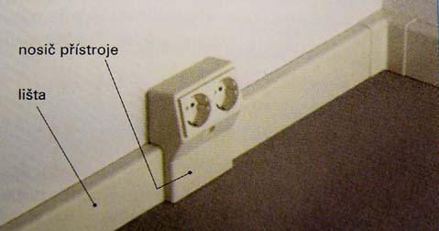
Conductor placing
Beneath plaster
Inside panels
Fillets
Double floor
Cable spouts
Floor fillets
Over head lines

Slide 19
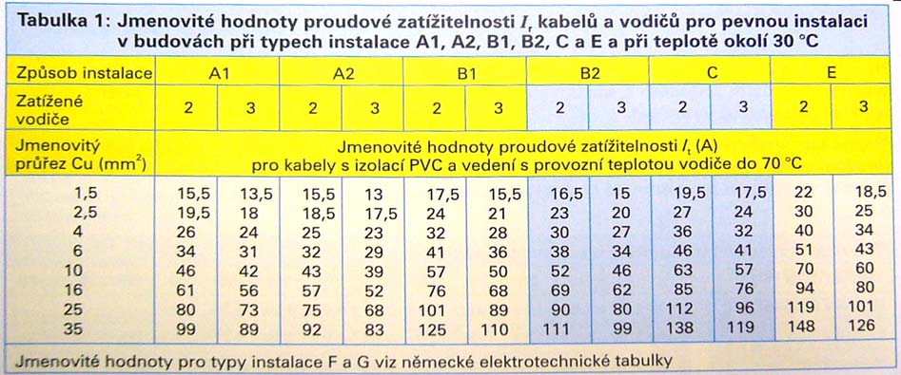
Nominal ampacities according to placing type for 30 °C DIN VDE 0298, ČSN 33 200-5-523

Slide 20
Ambient temperature correction coefficient
Temperature tolerance of insulation materials

Slide 21
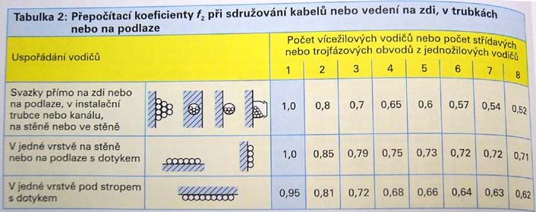
Parallel placing corrective coefficient

Slide 22
Conductor cross-section calculation from conductor warming
Calculate circuit current
Determinate ambient temperature – look for f1 coefficient
Look for parallel placing coefficient f2
Calculate corrected value of circuit current Ib’ = f1.f2.Ib
Determine type of placing
Determine cable construction
Look for conductor cross-section at ampacity table

Slide 23
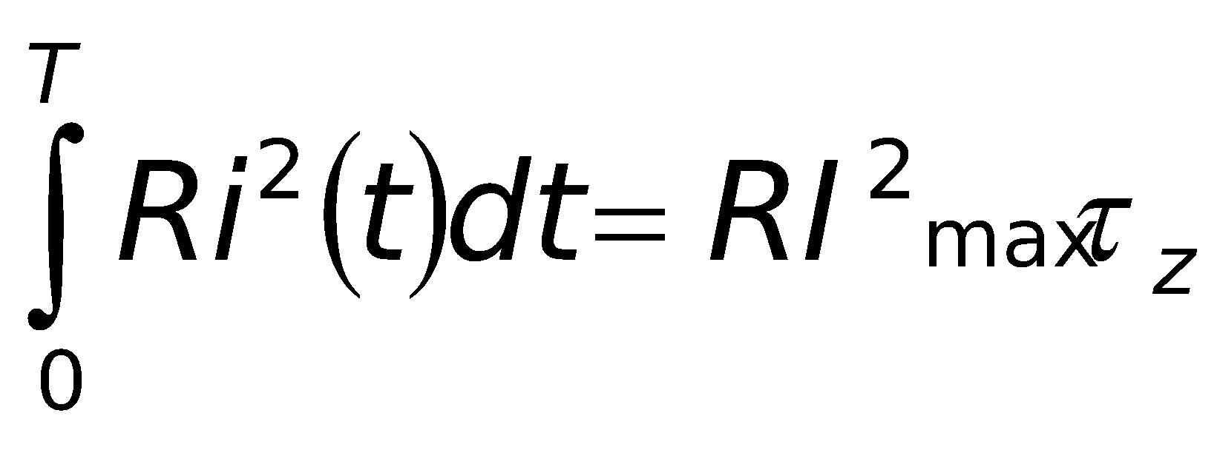
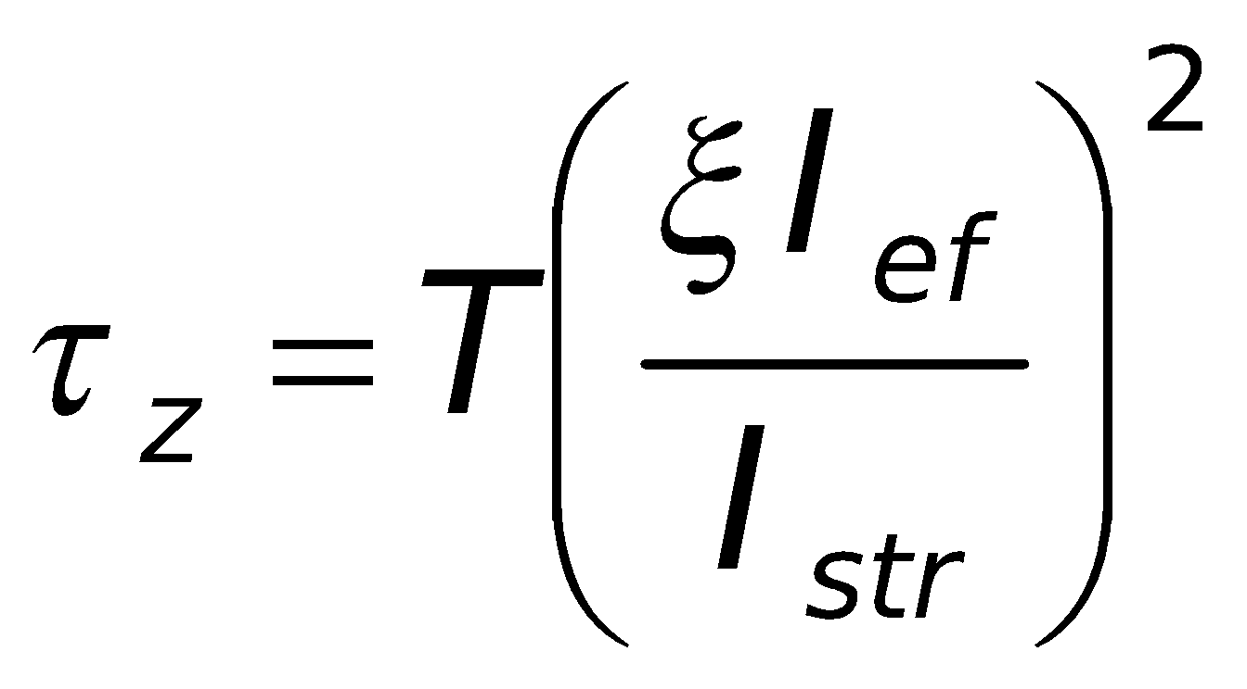
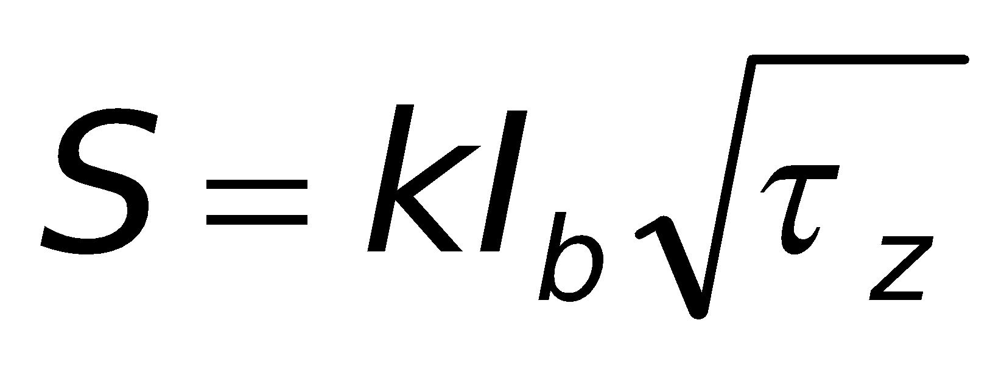
Calculation of economy of cross-section usage
It is ratio between investment into larger cross-section and conductor losses during all conductor life cycle.
Calculate only when> full load >1000 h/year and projected equipment life cycle >10 years
Period of full load τ_{z} = time when conductor leads maximal losses calculated from variable loading T .. Inspected time (h) ξ .. Service factor Iavg/Imax (-) I .. Loading current (A) S .. Economical cross-section (mm²)
Ib .. Calculated current (A)
K .. Type of conductor correction factor
Type of conductor / correction factor k (mm²A⁻¹) | Cu | Al
Free busbar | 0,006 | 0,014
Protected cables and conductors < 1 kV and < 16 mm² | 0,006 | 0,0129
Protected cables and conductors < 10 mm², conductors inside wiring tubes | 0,053 | 0,009

Slide 24
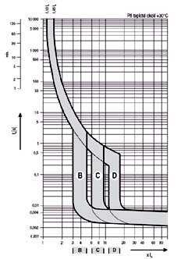
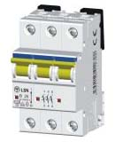
Protection
Overload protection must not be at:
Control circuits
Secondary circuit of current transformers
Protection circuits (PE)
Protection – eliminates risk of fire
Prevent for fault tripping I_{n} > I_{b} nominal cutoff current of protection is higher than calculated current
Protection cutoff current I_{a} < critical load of conductor I_{Zmax} < 1,45 I_{a}
Protection cutoff current I_{a} > minimal short circuit current of conductor
Check protection breaking capacity ability to interrupt high current (arc extinguishing) standard circuit breakers for low voltage 6-10 kA
Check time of cutoff t

Slide 25
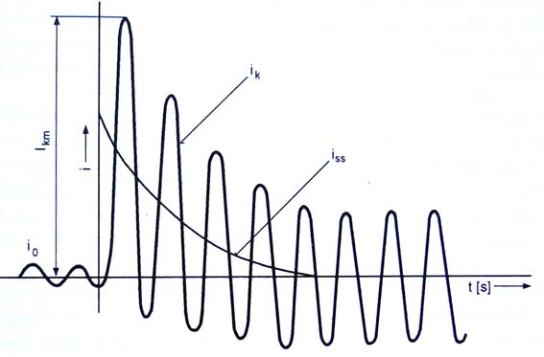
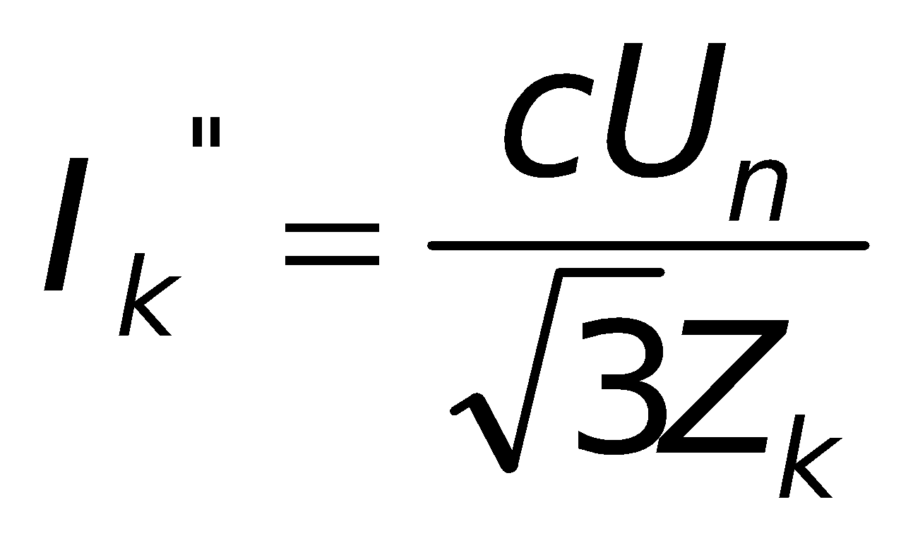
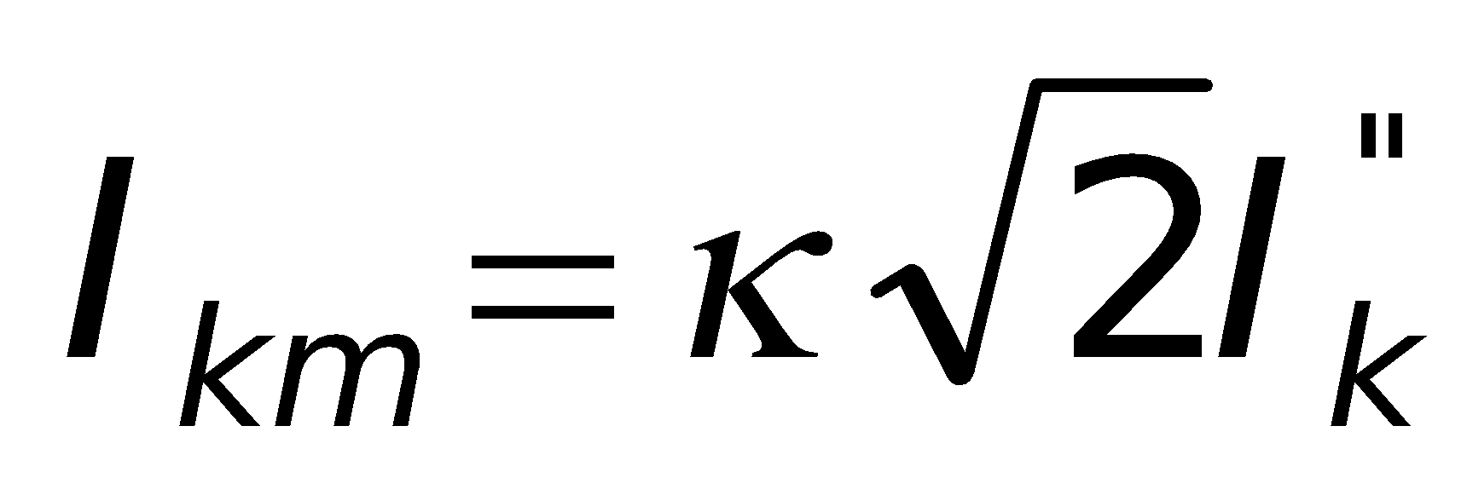
Calculation of short circuit currents
ČSN 33 2000 čl. 434.2 a 533.3
Maximal short circuit current is calculated for:
Breaking capacity of protection device
Overloading of conductors – by heat, by forces
Calculate from maximal network voltage and minimal impedance (shortest conductor, lowest temp.)
Minimal short circuit current is calculated for:
Checking if protection device is able to switch off fault on the most distant part of circuit
Checking maximal heat load of conductors
Calculate form lowest network voltage and maximal impedance (most distant part, highest temperature)
Initial current peak I_{k}’’ cU_{n}/√3 .. Equvalent voltage source at place of short circuit Z_{k} .. Short circuit impedance c .. Voltage coefficient (low voltage network c = 1)
Maximal short circuit current I_{km} κ .. Type of network coefficient κ = 1.02 + 0.98 e^{-3R/X} (low voltage network κ = 1.8)
Short circuit waveform

Slide 26
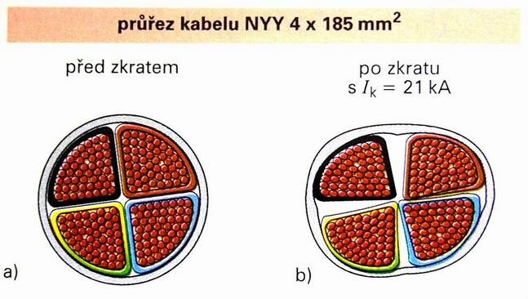
Calculation of short circuit currents 2
More methods of calculation
Values at place of connection to network gives your energy provider depends on distribution transformer and on conductors from transformer to short circuit place
Short circuit current together with nominal voltage gives short circuit impedance Z_{k}
Calculate as sum of network short circuit impedance plus conductor impedance from connection point to protection device
Cross-section of cable NYY 4x185 mm²
Before After short circuit
I_{k} = 21 kA
Estimative values of short circuit currents of distribution transformers
P (kVA) | 63 | 80 | 100 | 160 | 250 | 400 | 630 | 1000 | 1600
Ik (kA) | 2,3 | 2,8 | 3,4 | 5,5 | 8,6 | 10 | 16 | 22 | 37

Slide 27
Verify the functionality of protection
The dangerous voltage should appear on cover during faults. Voltage has to be switched off in short time ČSN 33 2000 čl. 413.1.1.1
Fault current I_{p} = U₀/Z_{s} U₀ .. Nominal voltage Z_{s} .. Impedance of fault loop
Circuit breaker: cutoff current of overcurent release Ia (electromagnetic release) has to be lower than fault current Ia < Ip, reaction time is short (5 ms)
The maximal length is limited for given conductor cross-section
Nominal voltage Uo (V) | Time of cutoff t0 (s)
 | Normal places UL = 50 V | Dangerous places UL = 25 V
230 | 0,4 | 0,2
400 | 0,2 | 0,05
>400 | 0,1 | 0,02

Slide 28
Verify voltage drop
Voltage drop depend on conductor load
Calculation from longitudinal impedance and from loading current ρ .. Rezistivity (Ωmm²m⁻¹) l .. Length of conductor (m) S .. Cross-section area (mm²) I .. Current (A) Uf, Us .. Phase/line to line voltage (V) cos fi .. Power factor (-) P .. Carried active power (W)
Voltage range 230 V ±10 % (207 – 253 V)
Exceptionally should be higher voltage drop e.g. Run-up of motors
Allowed voltage drop for lighting circuits is 3 % and 5 % for others
Limits maximal length of cable
One phase
3 phase

Slide 29
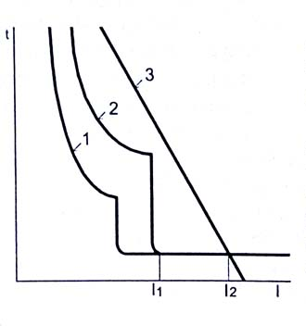
Verify protection selectivity
Fault should affects only bad point of circuit – avoid redundant tripping
Protection devices are placed in point, where cross-section is changed
Each conductor has characteristic similar to protection devices – they should not crossed each other

Slide 30
Standard colors of conductors
Important security element
Cable sheath
Power cable <1kV |  | Black
Power cable >1kV |  | Red
Mine cable |  | Yellow
Security circuits |  | Light blue
DC
Positive pole | L+ | Dark red
Negative pole | L- | Dark blue
Middle wire | M | Light blue
Protective earth | PE | Green-yellow
AC
Working wire | L1, L2, L3 | Black, brown, grey
Neutral | M | Light blue
Protective earth | PE | Green-yellow
 | PEN | Green-yellow

Slide 31
Neutral wire
In well-balanced systems should have smaller cross-section (in ideal zero current - motors)
In some cases should be overloaded by harmonics currents – large lighting systems
Protective earth
Check loading during short circuit

Slide 32
Literature
FENCL, František. Elektrický rozvod a rozvodná zařízení. Skriptum FEL-ČVUT v Praze. Česká technika – nakladatelství ČVUT. 2006. ISBN 80-01-02771-6 [UKN]
HÄBERLE, Heinz; kol. Průmyslová elektronika a informační technologie. Europa – Sobotáles cz. Praha, 2003. ISBN 80-86706-04-4 [UKN]
BASTIAN, Peter; kol. Praktická elektrotechnika. Europa – Sobotáles cz. Praha, 2004. ISBN 80-86706-07-9 [UKN]
KŘÍŽ, Michal. Dimenzování a jištění elektrických zařízení – tabulky a příklady. IN-EL. Praha, 2001. ISBN 80-86230-21-X [UKN]
LappGroup – cable producer: http://www.lappgroup.cz/10/cz/katalog/technicke_tabulky/index.html
B. de Metz-Noblat, F. Dumas, C. Poulain. Cahier technique no. 158, Calculation of short-circuit currents. 2005: http://www.schneider-electric.com/documents/technical-publications/en/shared/electrical-engineering/electrical-know-how/low-voltage-minus-1kv/ect158.pdf
http://en.wikipedia.org/wiki/Overhead_power_line
UKN – Library of TUL

