Slide 1
Rozvoj lidských zdrojů TUL pro zvyšování relevance,
kvality a přístupu ke vzdělání v podmínkách Průmyslu 4.0
CZ.02.2.69/0.0/0.0/16_015/0002329
Electrotechnology
Studijní program B0714A270001 - Mechatronika
Ing. Miroslav Novák, Ph.D.

Slide 2
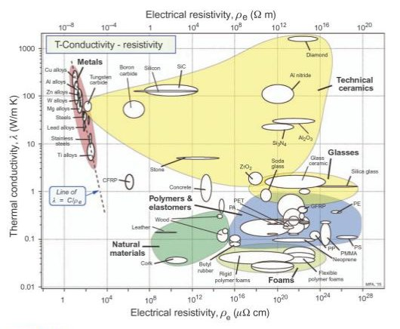
ETG 04 Dielectrics and insulators © 2022, rev. 2022
Contents
Physical properties of insulators
Intrinsic resistivity and surface resistivity
Insulator permitivity
Dielectric loss factors
Electrical strength
Mechanical properties
Heat resistance
Water absorption - wettability
Notes:
https://www.quora.com/What-materials-have-high-heat-conductivity-but-extremely-low-electrical-conductivity
http://wiki.robotz.com/index.php?title=Electrical_Conductivity_of_Various_Metals

Slide 3
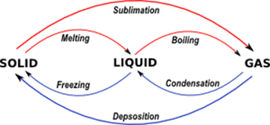
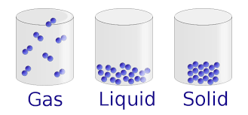
Causes
Mass structure (bonds)
State (solid, liquid, gaseous)
Properties of charge carriers (free, bound and its concentration) Insulators contain a small amount of free charges
Conditions (temperature, pressure, frequency of el. field, field intensity) Example: melted glass is good conductor but normally is insulator Example: evaporated metal is insulator
Reactive elements | State
 | Solid | Liquid | Gaseous
nonmetal - nonmetal | Covalent bond Insulator Semiconductor | Covalent bond Insulator | Covalent bond Insulator
nonmetal - metal | Ionic bond Insulator Semiconductor | Ionic bond Conductor II. type (Electrolytic conductivity) | Ionic bond Insulator
metal - metal | Metal bond Conductor I. type | Metal bond Conductor I. or II. type | No any bond Insulator

Slide 4
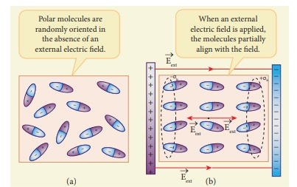
Difference Between Dielectric & Insulator
Dielectrics
Insulators
Dielectric
The substance that can become polarized after getting energy from the electrical field.
When field given to the dielectric material electrons do not cause current like metals but change their position at a certain point to make poles
The bond that exists in the dielectric material is weaker than the insulator.
The dielectric constant of dielectric material is large.
The dielectric substance has the ability to store charge.
Examples: Dry air, vacuum, distilled water.
Its common applications: Capacitor, power cable, etc.
Insulator
The material that block electric current flow through.
Their large resistance (low amount of free charges) halts to the current movement.
Examples: all kinds of nonmetals: porcelain, glass, plasts.
Every insulator contains some of transportable charges that can cause a current.
If an electrical field is large volts, the insulator it will show a conductor-like feature.

Slide 5
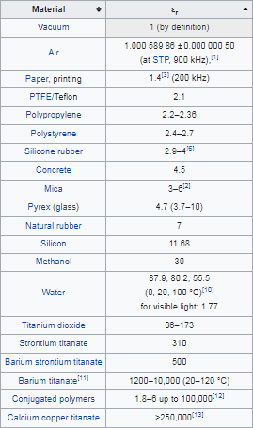
Macroscopic view of the dielectrics
The dielectric susceptibility (polarization coefficient) χ_{e} is a measure of how easily it polarises in response to an electric field.
Polarizability P (tansors) is a solid is defined as the dipole moment per unit volume of the crystal cell exposed to el. field E:
where ε₀ = 8.8542×10⁻¹² Fm⁻¹ is vacuum permittivity.
The electric displacement D (electric induction) is
From a macroscopic point of view, the most important variable is relative permittivity
ε_{r}(ω) = 1 + χ_{e}.

Slide 6
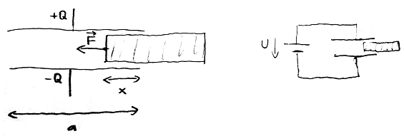
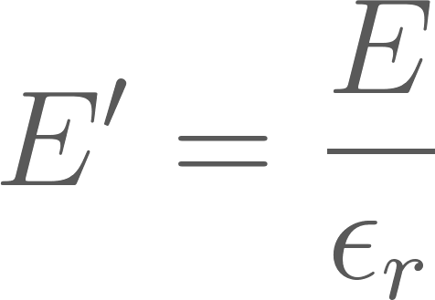
Dielectric inside capacitor
The capacitance is defined as C = Q/V, so
Case 1: What happens if we insert a dielectric into a charged (unconnected) capacitor?
Unconnected keeps induction
Intensity decreases by relative permittivity factor - voltage drop on electrodes
Case 2: What happens if we insert a dielectric in a capacitor connected to a voltage source?
Charge of dielectric material must be compensated by el. current
Kapacita kondenz8toru naroste

Slide 7
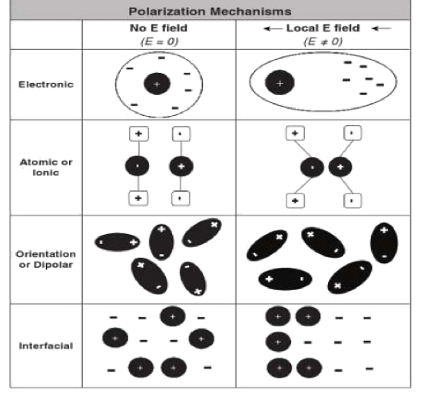
Polarization mechanisms
Polarization
by the action of the external field
spontaneous
Bonded charges
Free charges
Piezoelectric
Space charges (Migrations)
Pyroelectric
Piezoelectric
Strong
Week
Ion relaxation
Electron
Dipole relaxation
Ion
Deformation polarization
Flexible dipole

Slide 8
Polarization
Electronic Polarization P_{e}: all atoms under an electric field. The nucleus of the atom and the center of its electron cloud shift away from each other, creating a tiny dipole with very small polarization effect.
Ionic Polarization P_{I}:In ionic solids such as ceramic materials, the ions are symmetrically arranged in a crystal lattice with a net zero polarization. Once an electric field is applied, the cations and anions are attracted to opposite directions. This creates a relatively large ionic displacement (compared to electronic displacement), which can give rise to high dielectric constants in ceramics popularly used in capacitors.
Dipole (or Orientation) Polarization P_{D}: Certain solids have permanent molecular dipoles that, under an electric field, rotate themselves in the direction of the applied field, creating a net average dipole moment per molecule. Dipole orientation is more common in polymers since their atomic structure permits reorientation.
Space Charge (or Interfacial) Polarization P_{S}: In ceramics, this phenomenon arises from extraneous charges that come from contaminants or irregular geometry in the interfaces of the polycrystalline solids. These charges are partly mobile and migrate under an applied field, causing this extrinsic type of polarization.
Total polarization is the sum of any charge displacement
P_{t}= P_{e}+ P_{i}+ P_{d}+ P_{s}

Slide 9
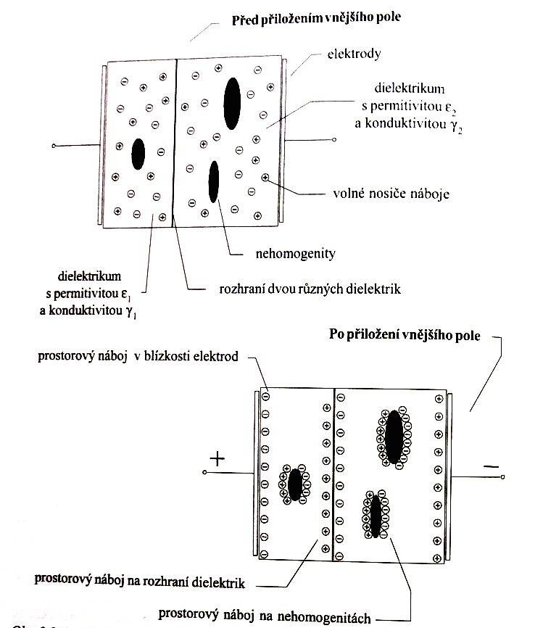
Space charges
(Migration polarization)
It is caused by free carriers (impurities, thermally released electrons).
The presence of inhomogeneities is necessary for the formation, where the charges are captured = the formation of a spatial charge.
= Bubbles, dirt particles, cracks or interface of substances
It means losses (charge moves)
Migration of charges is slow = influence at low and medium freq. of hf + DC component of voltage
Electrons are injected into the dielectric from the cathode. The output work of the electron from the metal - thus depends on the material of the electrodes.
Electrons can also be generated due to partial discharges.

Slide 10
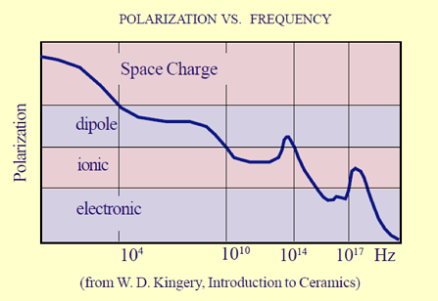
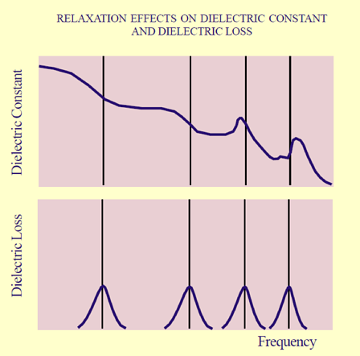
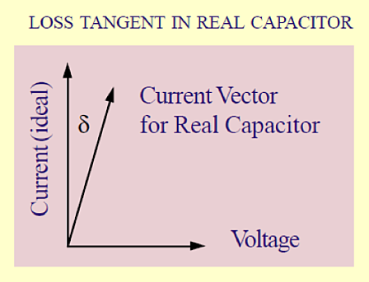
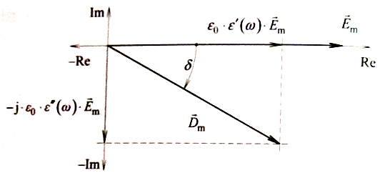
Polarization speed (frequency)
The speed depends on how much matter has to move (moment of inertia).
In AC circuit, the voltage and current across an ideal capacitor are 90° out of phase. The real-world dielectricshas the lag or “relaxation time” of the polarization mechanisms with frequency generates dielectric losses.
The angle by which the current is out of phase from the ideal is tan(δ). Also called the loss tangent, or dissipation factor. We also use the Q factor, which is the reciprocal of the loss tangent: Q = 1 / (tan δ).
Materials with higher dielectric constants (and therefore high polarization mechanisms) display higher dissipation factors.
Notes:
https://blog.knowlescapacitors.com/blog/capacitor-fundamentals-part-4-dielectric-polarization

Slide 11
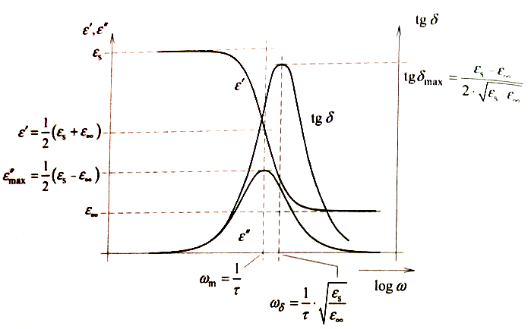
Frequency dependency
Dispersion region
= fall of real part of permittivity
Real dielectrics predominantly used under this region

Slide 12
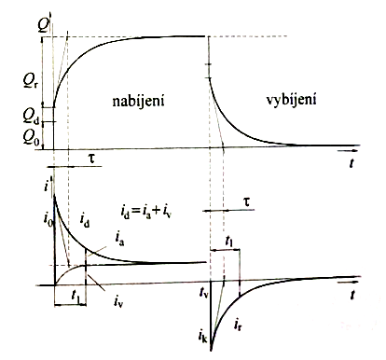
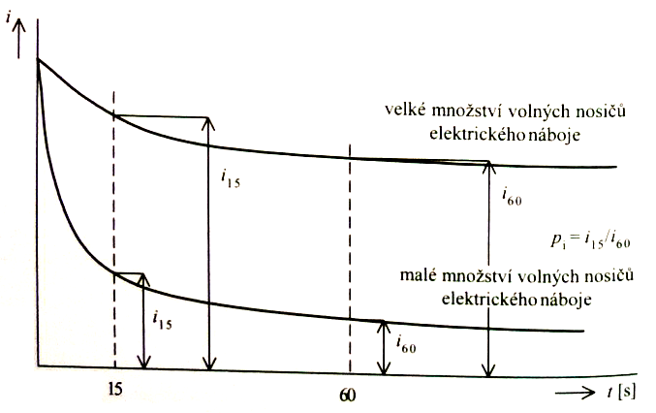
Dielectric absorption
The polarization rate is finite
i₀ charging current - deformation polarization effects
i_{a} sorption current - polarization, migration
i_{v} conductive current
i_{k} discharging current = i_{r} resorption current
charging
discharging
huge amount of charges = wet insulation
low amount of charges = dry insulation

Slide 13
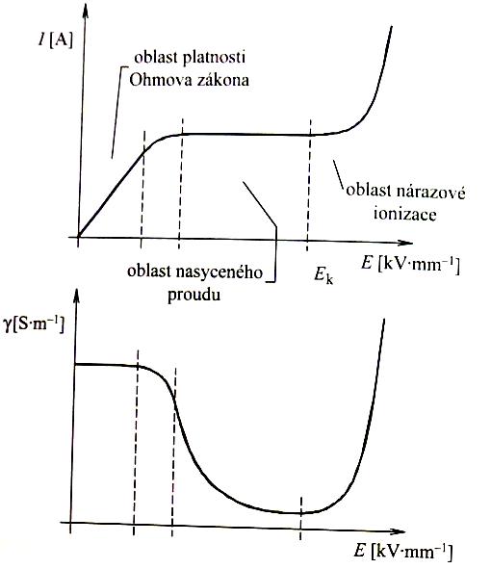
Conductivity of gaseous dielectrics
Ohms law region low el. field intensity = low speed of charge, high recombination rate
Saturated current region
lower recombination rate, high rate of neutralization on electrodes
It is constant = independent of el. field
Ionization area
E > 1 kV/mm avalanche effests
Ohms law region
shock ionization area
saturated current region
Notes:
Str 77.

Slide 14
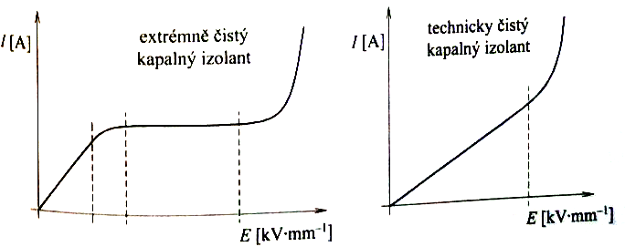
Conductivity of liquid dielectrics
Extreme purity 10⁻¹⁴ up to 10⁻¹⁵ S/m
Ionization of neutral molecules
molecules dissociation
thermal excitation of electron
electron emission from cathode
Technical purity 10⁻¹¹ up to 10⁻¹² S/m
ion conductance
electroforetic conductance
extreme purity
insulator
technical purity
insulator

Slide 15
Conductivity of solid dielectrics
Ion crystals
Two basic mechanisms:
Electron conductivity (present if E > 10-100 kV/mm)
Ion conductivity (present more often)
Frenknel pair crystal defect (Atom form lattice jumps into interstitial position = vacation + interstitial) – needs 1-2 eV to be created
Interstitial moving to neighboring position – needs 0.15 eV
Vacation movement – needs 0.4 eV
Secondary defects (impurities) – usually less bonding energy – increase conductivity
Grain boundaries – ion bonds are weaker = better conductivity -> poly-crystals has higher conductivity than mono-crystals
Inorganic glasses
Conductivity behavior like liquids – strongly depends on additives 10⁻³ up to 10⁻¹⁷ S/m (low for pure silica grass SiO₂ and boron glass B₂O₃)
Organic amorphous materials (polymers)
Usually better than 10⁻¹⁷ S/m
Non-polar polymers / conductivity mainly due to impurities
Polar polymers / dissociated ions contribute to conductivity
Some fillers increase conductivity
Wettability – increases conductivity
Notes:
Pg. 87 (Dielektrické systémy - Mentlík)

Slide 16
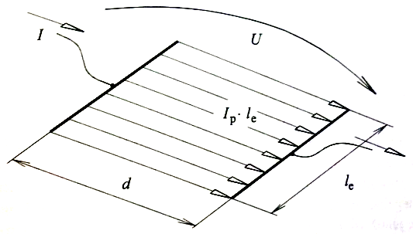
Surface conductivity of solids
Different mechanism than for volumetric conductivity
Dissociation of surface molecules
Surface dirt It depends on the quality of the surface
Water / wet Moisture is easily absorbed on ionic bonds Non-polar substances are better, but even here, when 100% humidity is reached, water droplets precipitate - but they do not form a continuous water surface
I current in surface (A)
U electrode voltage (V)
d electrode distance (m)
I_{e} length of electrodes (m)
Notes:
Pg. 92 (Dielektrické systémy - Mentlík)

Slide 17
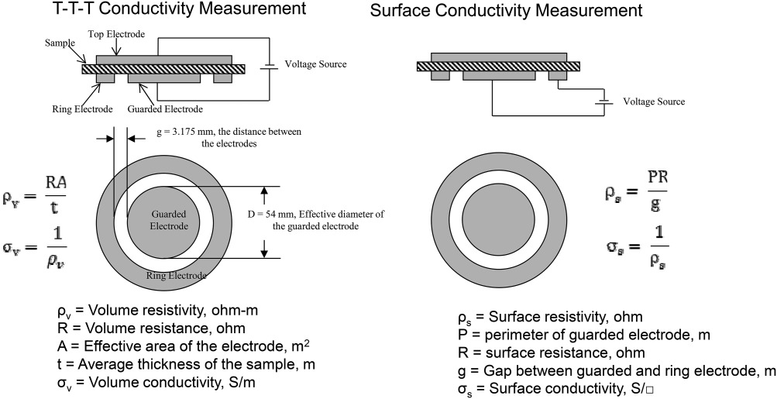
Measurement

Slide 18
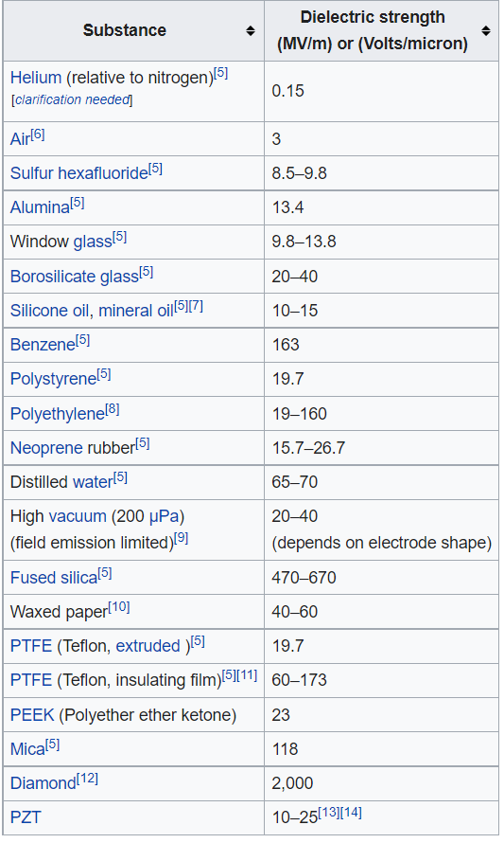
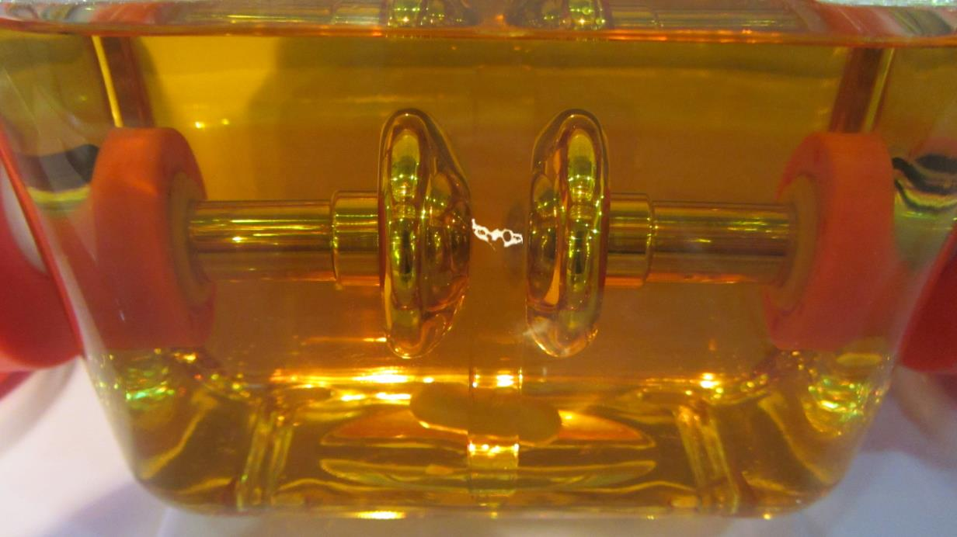
Dielectric strength
A quantity describing the purpose of insulators E_{p} = U_{p} / d (V/m = V / m) Dielectric strength = breakdown voltage / electrodes displacement Well defined only in homogenous fields
DC
AC
Impulse: waves 1,2/50 μs, 8/20 μs
As the intensity (voltage) increases, at a certain point there is a sharp increase in free charge carriers → uncontrollable current growth → discharge → degradation of material → after the discharge flame out, the properties are significantly deteriorated (depends on the power supply = discharge energy)
Breakdown – in solid matters = permanent deterioration
Flashover – in gases or liquids = temporary deterioration

Slide 19
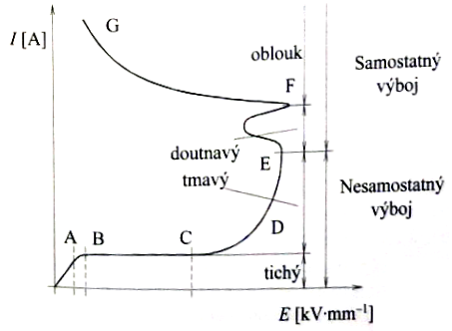
Gasses
D voltage is not enough to stabilize discharge = any source of ionization needed (thermal emission, external)
E-G stable discharge negative resistance characteristics = high energy and breakdown if energy is not limited by source
discharge
stable discharge
glow
dark
not self sustainable stable discharge
silent

Slide 20
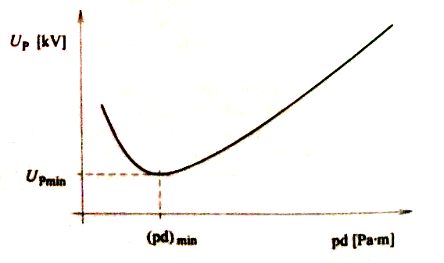
Gasses - Paschen law
Breakdown voltage depends on pressure and electrode distance
Low pressure + low distance - accelerated electron has low probability to collide with gas molecule (reach anode without collision) = no excitation
High pressure = short free distance between collisions = not enough energy for excitatiton

Slide 21
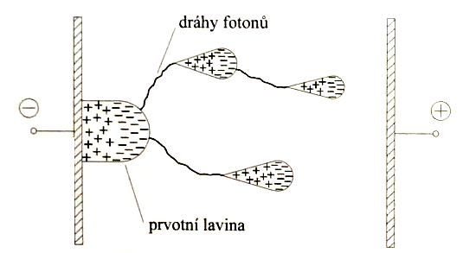
Gasses - Channal dicharge
Electron speed 10⁷ m/s
Ion speed 10³ m/s
Ions are almost non movable
When avalanche ionization occurs = cloud of cations = non-homogeneity of field density = forefront of avalanche is higher gradient = electron acceleration is higher
Photoionization produces other avalanches away from sources
Avalanches joints into discharge streamer
photon paths
primary avalanche

Slide 22
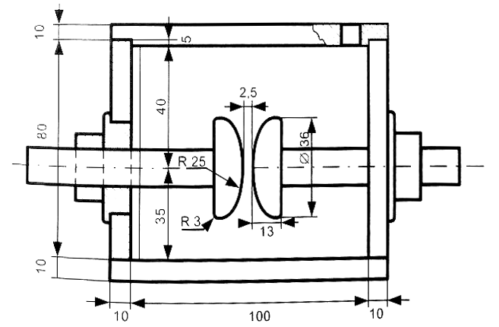
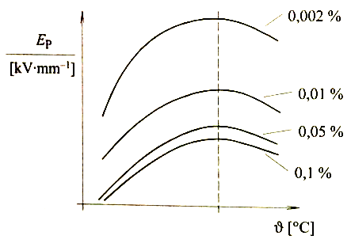
Dielectric strength - liquids
is higher than in gas
strongly depends on impurities, water amount, electrode non uniformities
Several theories of conductance
electron emission from electrodes + impact ionization
gas bubbles creation + discharge inside bubbles
Strong influence of impurities and temperature
Time dependent
Impulse strength is much higher than
for steady voltage
Breakdown voltage of mineral oil (% of absorbed water)
Notes:
Pg. 92 (Dielektrické systémy - Mentlík)

Slide 23
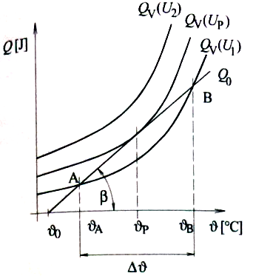
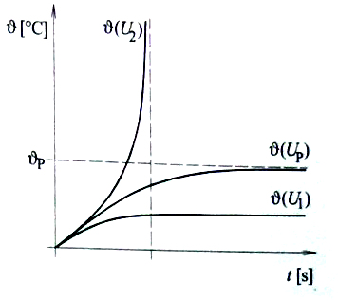
Dielectric strength - solids
Breakthrough is irreversible = permanent damage to the material
Only 1 measurement is possible per 1 sample
Mechanisms
pure electric
based on free electron in structure
thermal thermal equilibrium - local overheating - chemical or structural changes - breakdown
electro-chemical
reversibile
irreversible - structural changes
Partial discharges

Slide 24
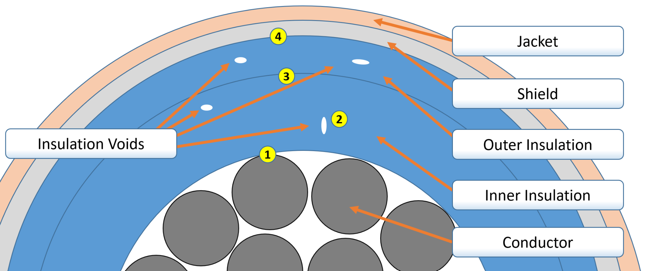
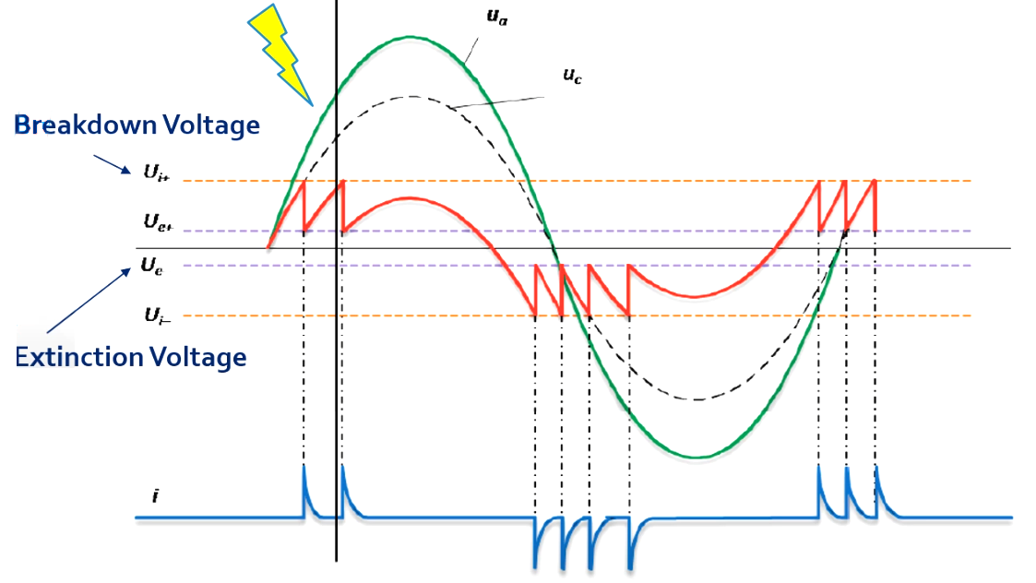
Partial discharges
Occurs in bubbles of voids of insulators
breakdown voltage of air is lower than insulator
Discharge is created inside bubbles = cumulates ions on sides of bubble = compensate el. field = distinguish discharge = if voltage increases phenomena is repeated
Causes of plasma im bubbles
bombarding of surrounding material by electrons and ions
influence of radiation
chemical reaction of plasma gasses
thermal
local increase of electric field
https://www.youtube.com/watch?v=k8hkGioVXUE
https://www.youtube.com/watch?v=6lbwI4PsjBs

Slide 25
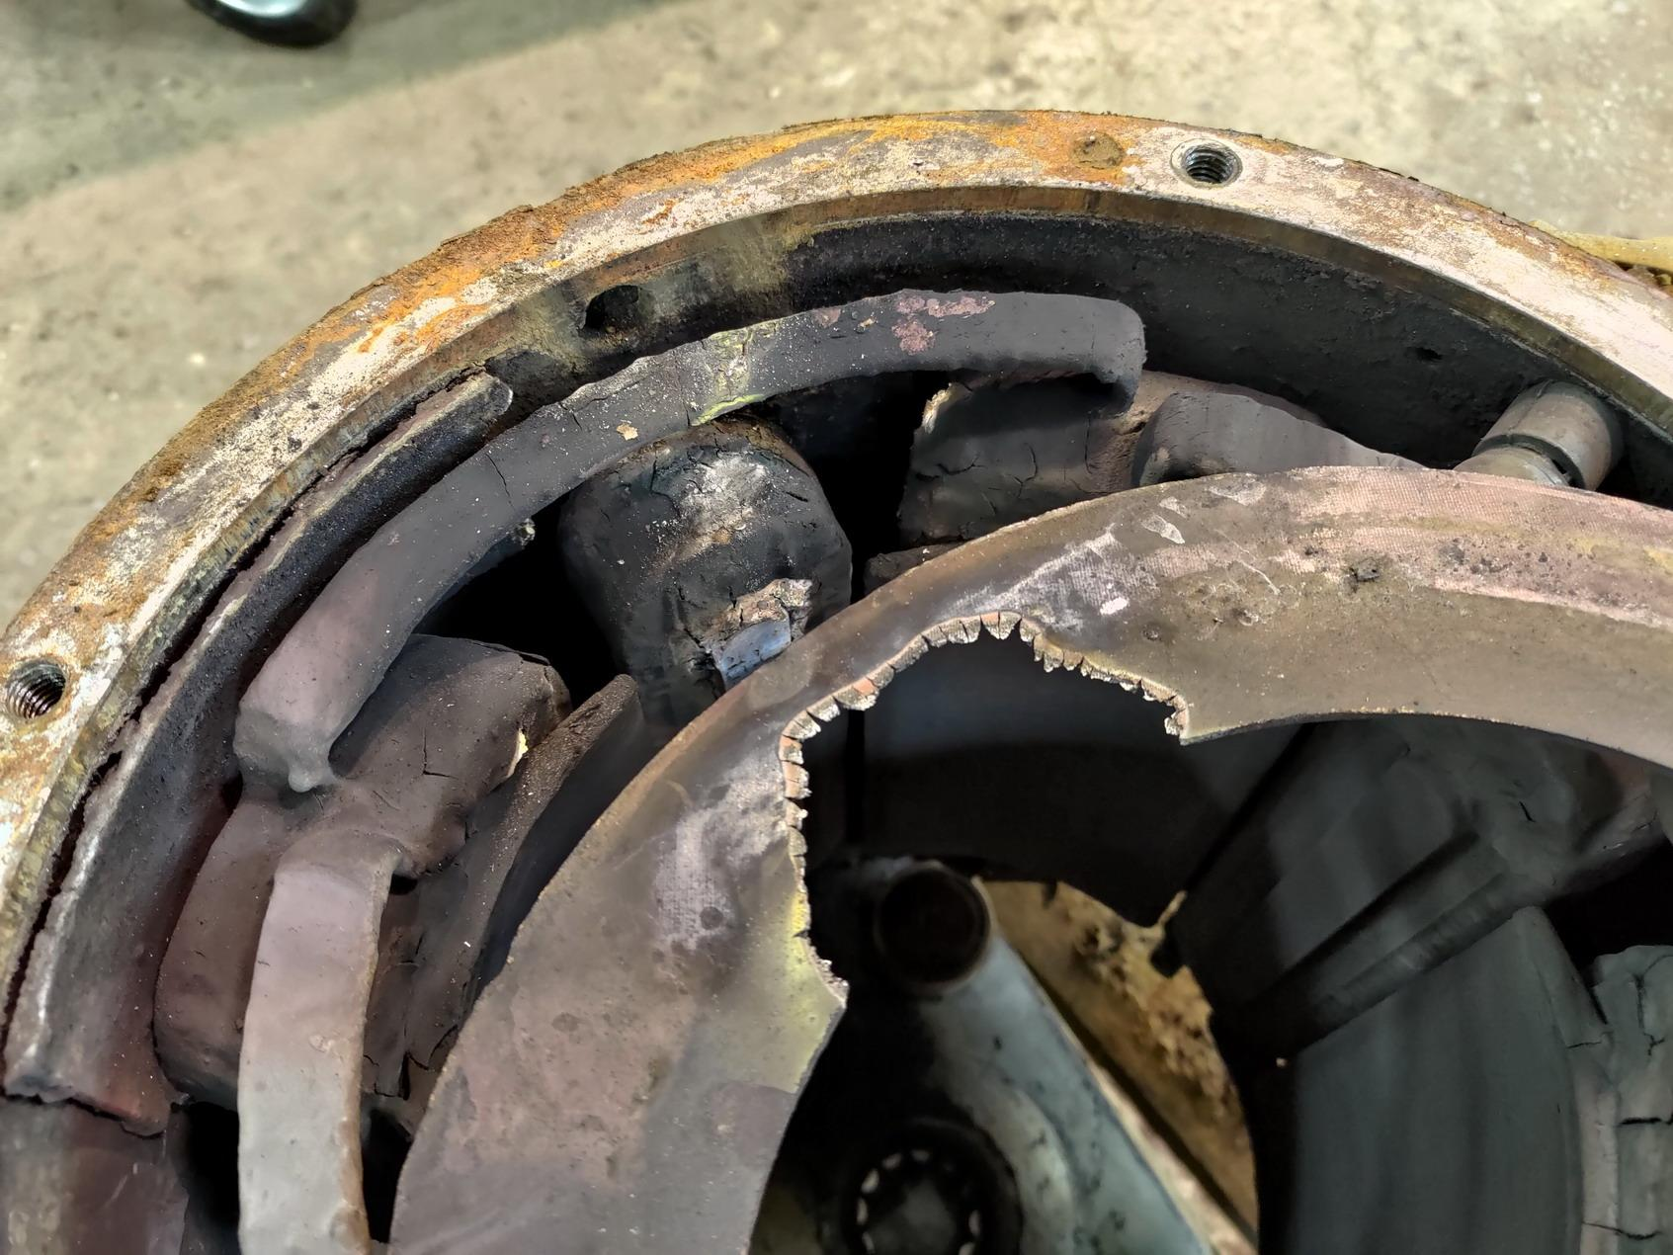
Tram DC motor TE 22 - conductor and insulation breakdown due to wet conditions

Slide 26
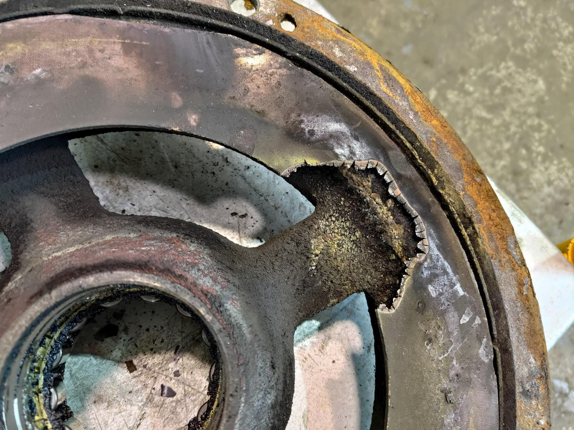
Textile paper + organic resin composite

Slide 27
Summary
We know dielectric properties of gases, liquids and solids
We know mechanism of polarization and its speed
We know surface conductivity
We know dielectric strength / breakdown voltage
we know basis of partial discharges

Slide 28
Literature
MANTRLÍK Václav. Dielektrické prvky a systémy, BEN: Praha, 2006, ISBN 80-7300-189-6
DRÁPELA Jaromír, KURSA Miroslav. Elektrotechnické materiály, učební text. Ostrava: VŠB, 2012, ISBN 978-80-248-2570-0
HAMPL Josef a kol. Materiály pro elektrotechniku, 2. přeprac. vyd. Praha: ČVUT, 1999, ISBN 80-01-01544-0

Slide 29
Thank you for your attention

