Slide 1
Acoustic of speech sounds
Soundwaves
Spectrograms
Classroom Research

Slide 2
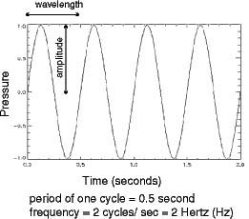
The nature of the soundwave
Frequency
Amplitude
Periodic/aperiodic sounds

Slide 3
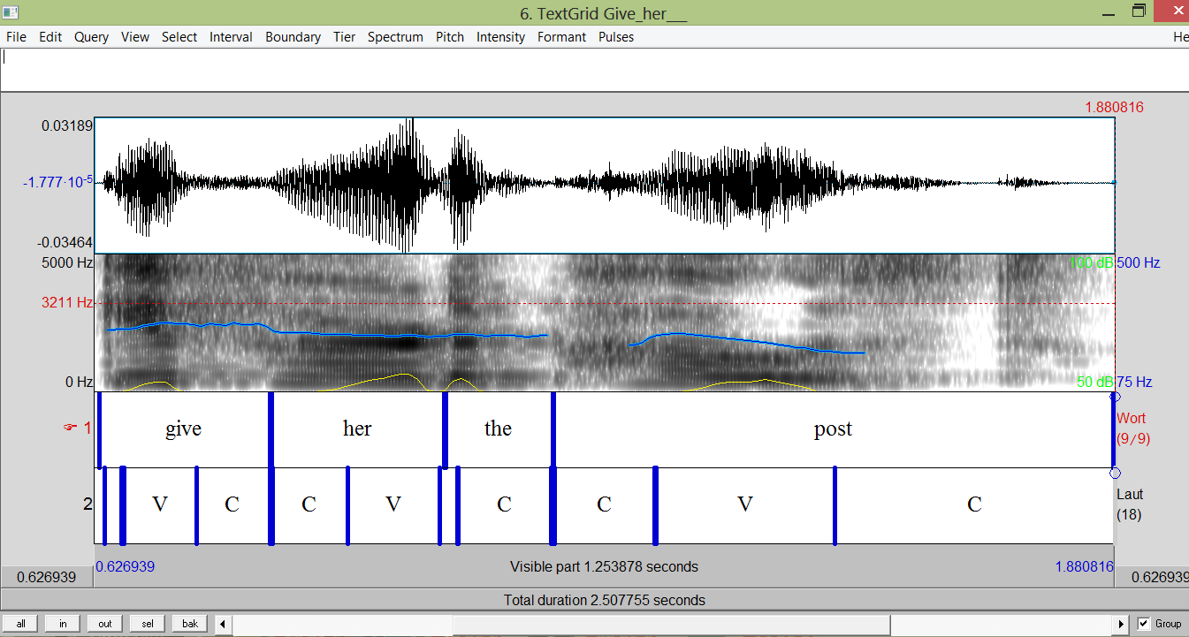
Analysing the spectrogram

Slide 4
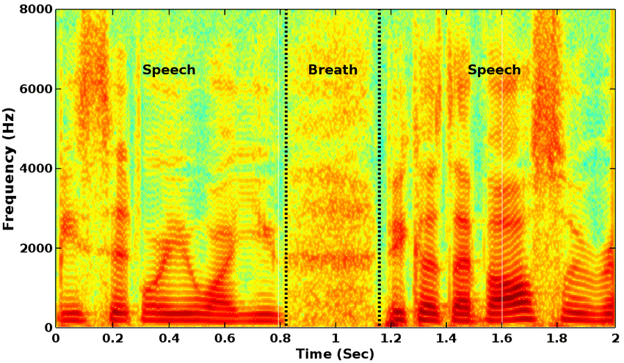
Analysing the spectrogram - Vowels
Formants 1,2
Source-filter approach
https://www.youtube.com/watch?v=mWel5j-F8lE&list=PLRIMXVU7SGRJu1hMMfINC585iHd8iXJnv&index=1

Slide 5
Analysing the spectrogram - consonants
https://www.youtube.com/watch?v=J-RVpvofhSY&list=PLRIMXVU7SGRJu1hMMfINC585iHd8iXJnv&index=2
Conclusions:
Vowels – periodic (with Formants)
Voiceless consonants – aperiodic
Voiced consonants – mixed (no Formants)
R- doubly periodic)))

Slide 6
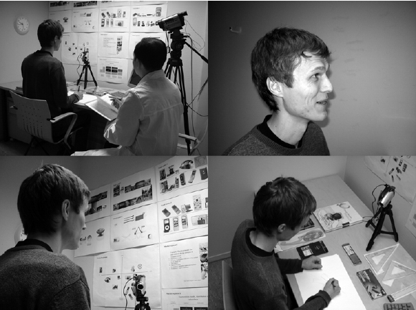
Feedback on verbal protocols

Slide 7
Classroom research
eg:
Teacher questions
Teacher error correction
Quantity of teacher speech
Teacher explanations
Teacher “wait-time” for students to respond
Learner-to learner interactions

Slide 8
Stages of classroom research
Getting inside/picking a technique
- diaries/ field notes/records/interviews/questionaries/checklists/protocols/
case studies/ formal experiments
- action research
- stimulated recall
Compiling data
Choosing relevant data +marking/coding it
Generalisations

Slide 9
Action Research

Slide 10
Home Assignment
1) Watch 2 videos (soundwaves, speech analysis) in the e-learning
2) Read “reflections on Classroom research”
3) Think of a plan for action research within the framework of your topic

