Slide 1
Early History of the British Isles
From Prehistory to the Norman Conquest

Slide 2
Periods
Stone Age
Paleolithic Period
Mesolithic Period
Neolithic Period (11,000 BC – 1700 BC)
Bronze Age (2100 BC – 750 BC)
Iron Age (750 BC – AD 43)
Roman Britain (43 – 409)
Anglo-Saxon Period (450 – 787)
Viking Period (787 – 1066)

Slide 3
Neolithic Britain
Skara Brae
Orkney Islands
Europe‘s most completely preserved Neolithic village
inhabited approx. 3180 BC to 2500 BC
older than Stonehenge and the Pyramids
Stonehenge
constructed between 3000 BC and 2000 BC
double-circle of standing stones (several of them still connected with lintels)
solstice-sunrise oriented

Slide 4
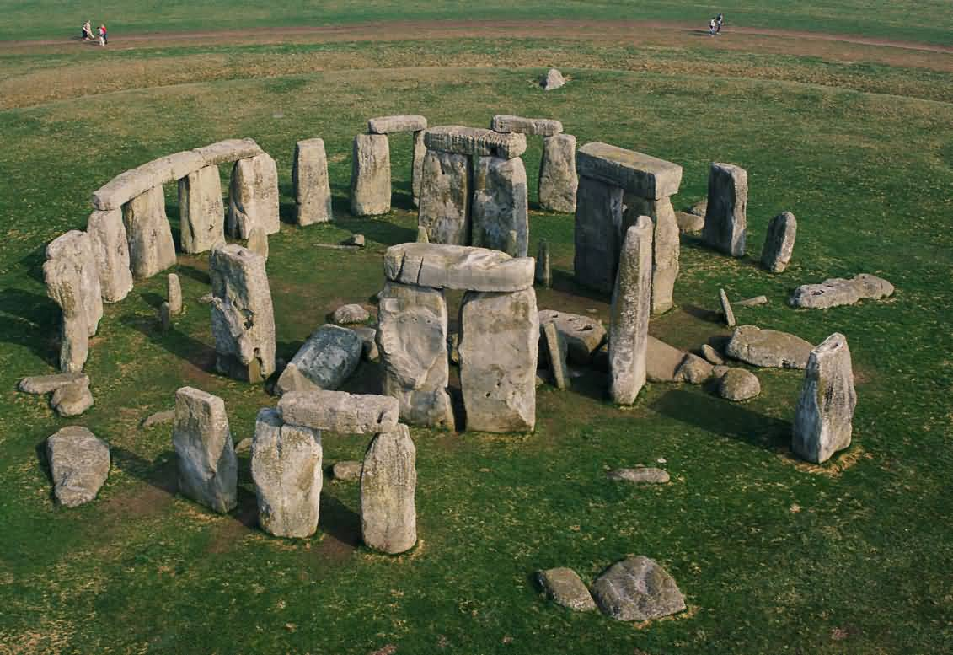
Stonehenge

Slide 5
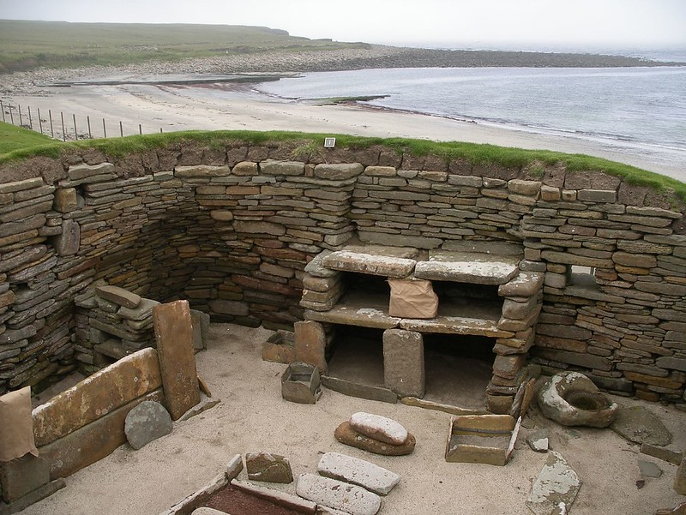
Skara Brae

Slide 6
Bronze Age Britain
turning to agriculture
ability to work with copper and gold, later bronze
wooden huts
embankments built of earth
Must Farm Settlement
Oxborough Dirk
Rillaton Gold Cup
Mold Cape

Slide 7
Must Farm Settlement

Slide 8
Must Farm Settlement

Slide 9
Oxborough Dirk

Slide 10
Rillaton Gold Cup

Slide 11
Iron Age Britain
frequent conflicts between the various groups of people
fortified farmsteads
roundhouses
hillforts (England)
brochs (Scotland)
Maiden Castle
Ness of Burgi fort (at Old Scatness)

Slide 12
Maiden Castle

Slide 13
Ness of Burgi Fort

Slide 14
Roman Britain
technologically advanced civilization
introduction of Latin to Britain (before: Celtic languages)
large-scale projects (e.g. roads, protective walls)
Hadrian‘s Wall
Antonine Wall
Roman Baths at Bath
numerous villas and forts

Slide 15
Roman Walls

Slide 16
Hadrian’s Wall

Slide 17
Roman Baths in Bath

Slide 18
Periodization of Art before the Norman Conquest
Pre-Roman Period
Roman Period
Migration Period / Early Anglo-Saxon Period
Migration Art
Insular (Hiberno-Saxon) Art
Late Anglo-Saxon Period

Slide 19
Insular (Hiberno-Saxon) Art
from Insula (Lat.), meaning island
in England ~ 600 – ~ 900, in Ireland ~ 600 – ~ 1200
a fusion of the symbolism of Irish monastic Christianity and decorative metalwork
no widespread culture of decorated and decorative objects, it appears in individual objects of „dazzling virtuosity“
main examples:
illuminated manuscripts
metalworks
stone carvings (above all else stone crosses)
highly decorated surfaces
complex patterning

Slide 20
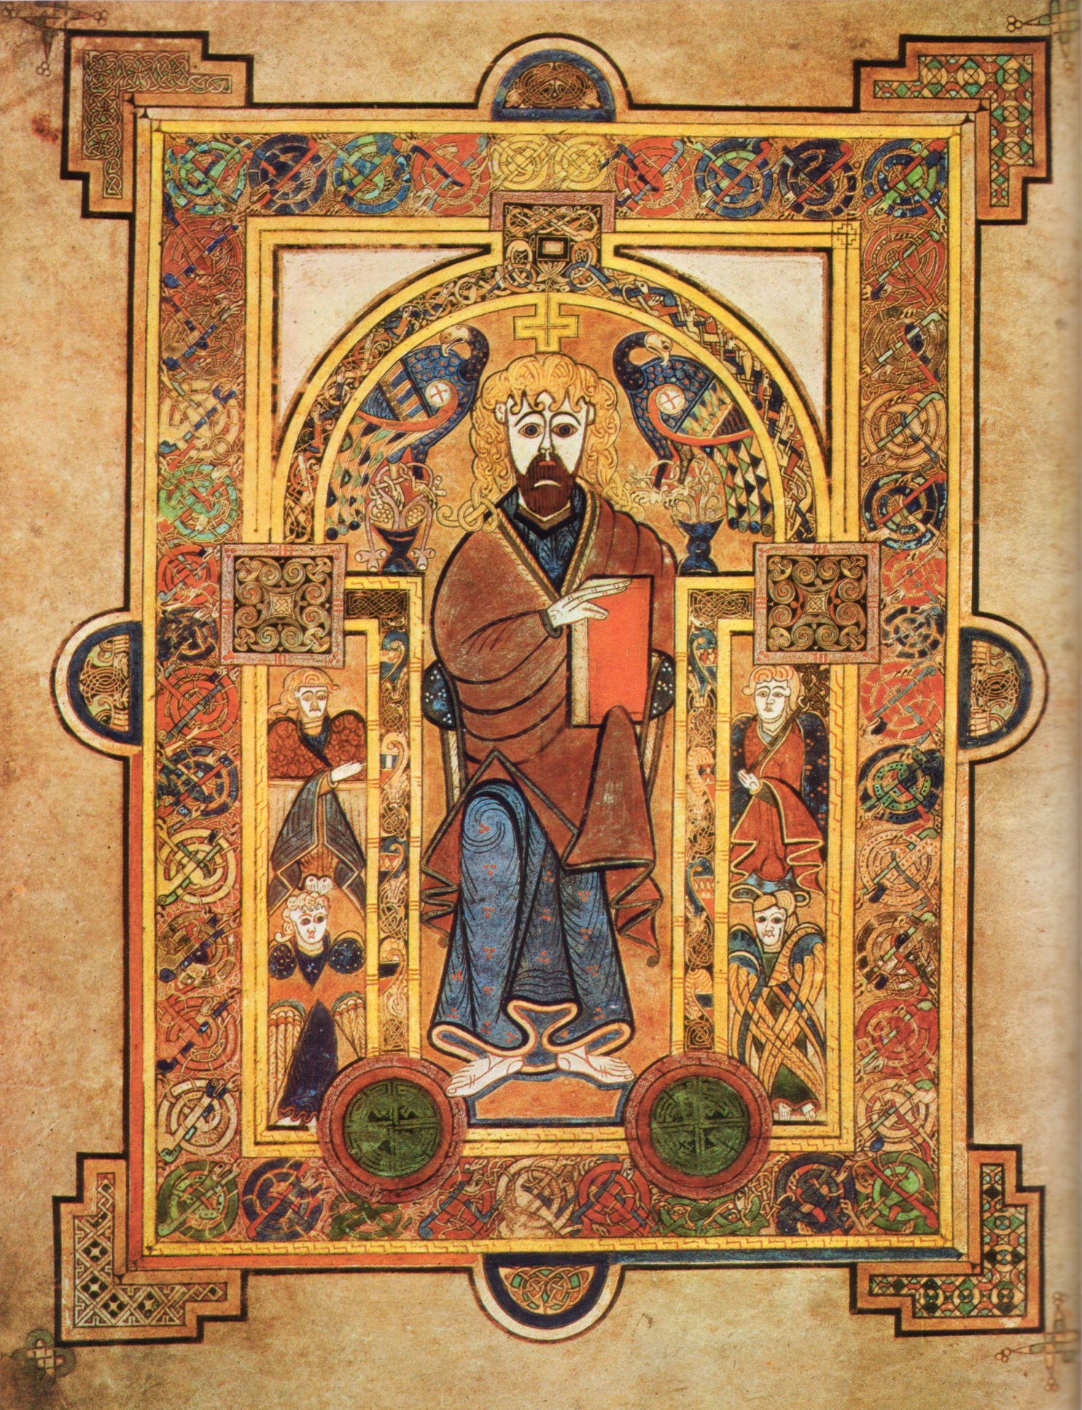
Book of Kells
transcribed by Celtic monks cca. 800
contains the four Gospels of the New Testament in Latin, plus some introductory texts and tables
340 folios, calf vellum, illustrations on all pages except for 2
traditional Christian iconography is combined with ornate swirling motifs
intricate knotwork and interlacing patterns
vibrant colors
historiated initials (initials with images inside them)

Slide 21
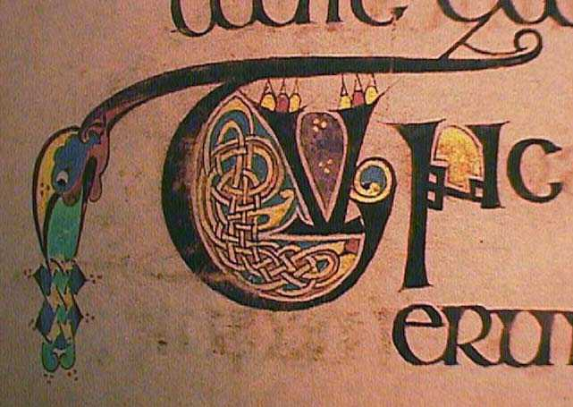
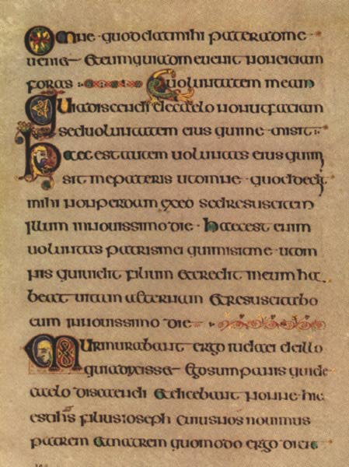
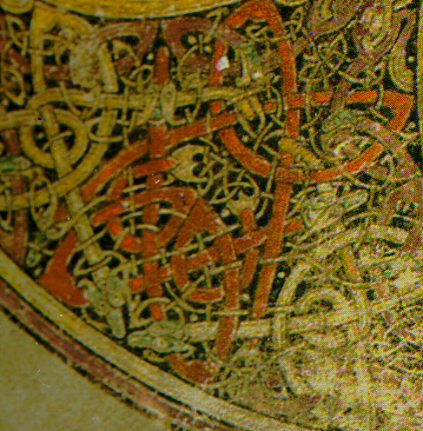
Book of Kells

Slide 22
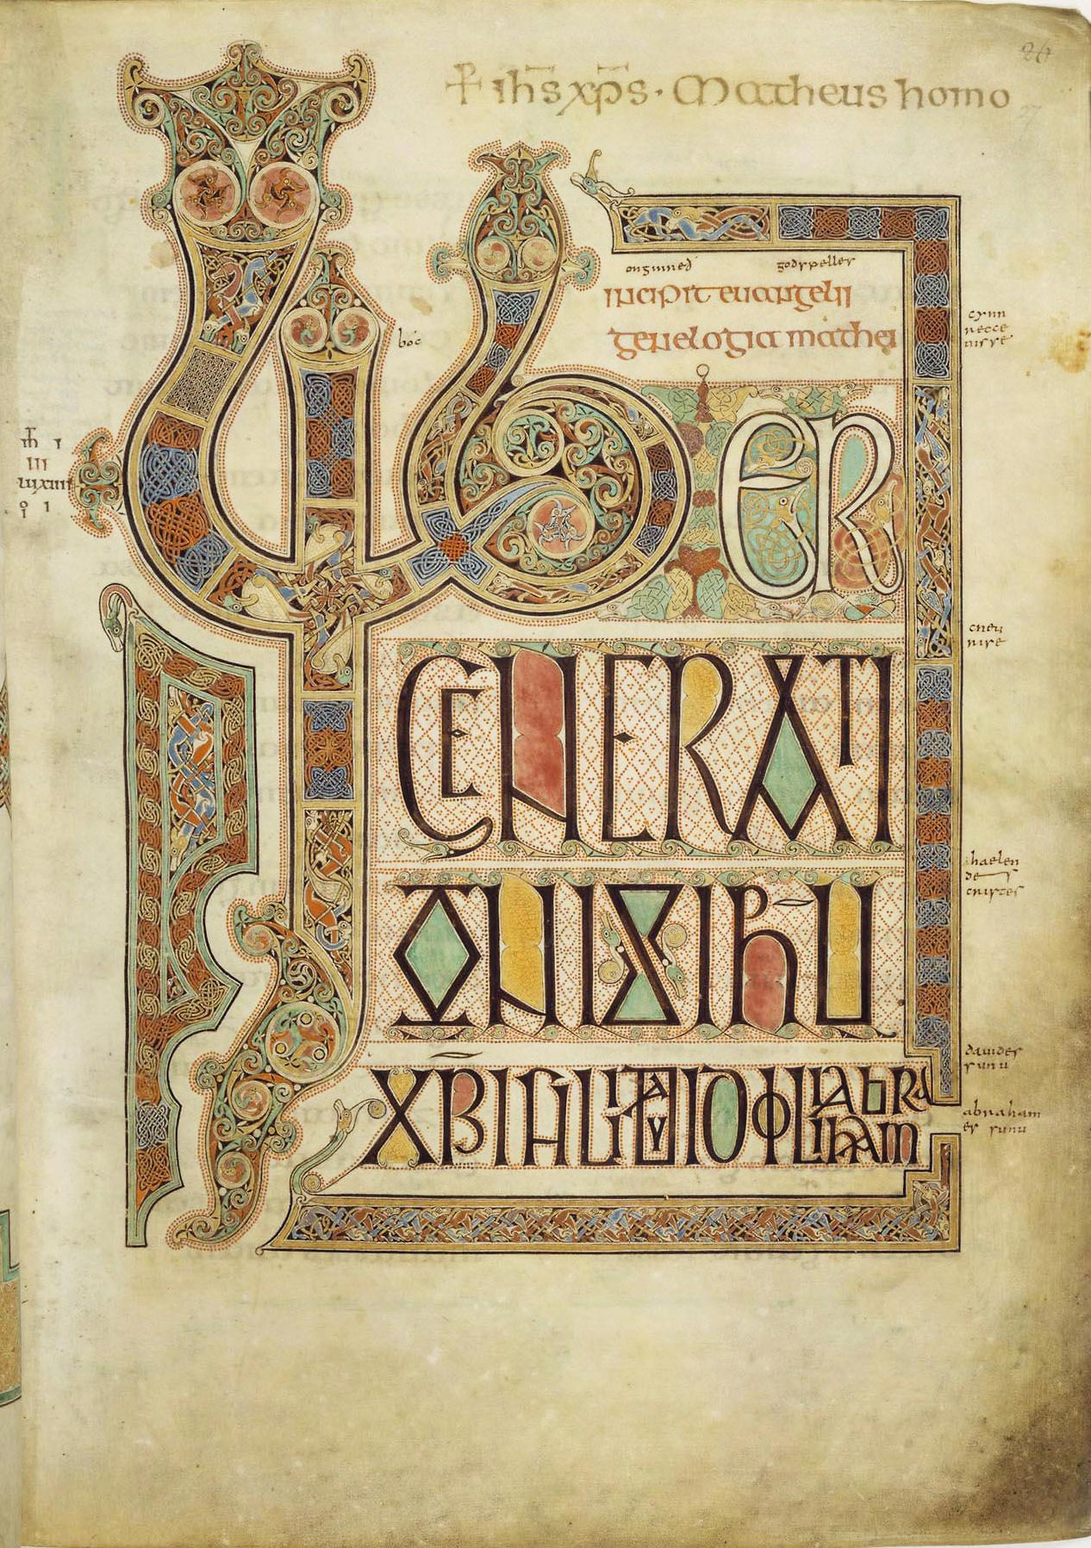
Lindisfarne Gospels
illuminated Latin manuscript of the four Gospels
the work of a single scribe and illustrator, probably St. Eadfrith, bishop of Lindisfarne, around 715
in the 10th century an Old English translation of the manuscript was made – the first translation of the Gospels to English

Slide 23
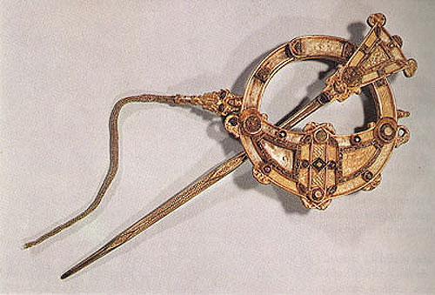
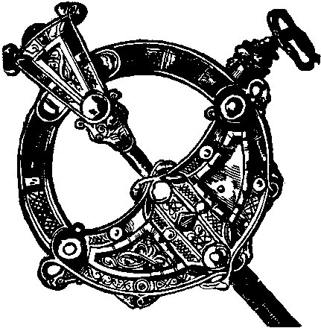
Tara Brooch
created in ~ 700
composed primarily of silver gilt, but gold, silver, copper, amber and glass are also used for decoration
intricate abstract decoration both on the front and the back
a purely decorative function, not meant to hold a piece of clothing in place
no religious motifs, either pagan or Christian

Slide 24
Late Anglo-Saxon Art
survives mainly in the form of:
illuminated manuscripts
architectural works
ivory carvings
metalwork
embroidery:
Opus Anglicanum – a form of embroidery typical of the Isles and thought for all around Europe in the period and after
The Bayeux Tapestry – the most famous piece of Anglo-Saxon embroidery, with a technique different from that of Opus Anglicanum

Slide 25
The Bayeux Tapestry
50 cm x 70 m (!) piece of embroidery
shows the history of the Norman invasion
it is not properly speaking a tapestry:
tapestry: the design is woven into the fabric
embroidery: the design is embroidered onto the fabric, using a needle and colored yarn
modern authors writing about comic strips as a predecessor of the genre
numerous references in contemporary popular culture:
Shrek III
The Simpsons
Diablo II

Slide 26
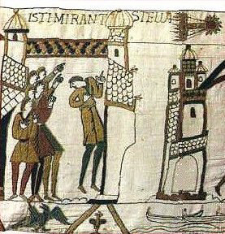
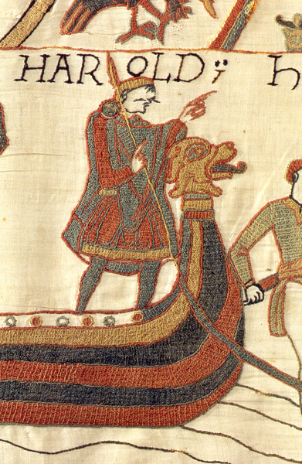
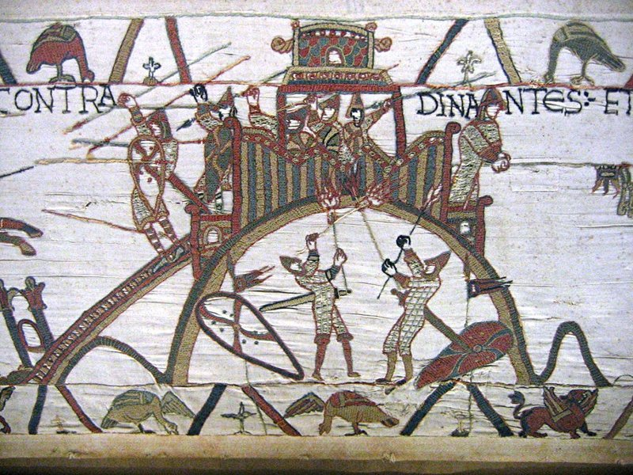
The Bayeux Tapestry

Slide 27
Anglo-Saxon Architecture
mid-5th century to the Norman conquest
Anglo-Saxons generally lived in simple buildings:
timber construction
thatched roof
most surviving buildings are churches made of brick and/or stone with one exception: St Andrews Church in Greensted
earliest stone buildings built without mortar: Gallarus Oratory
later techniques influenced by monasticism
heavy, strong walls, crude finish (using an axe, not a chisel)
small windows
rather small and low buildings

Slide 28
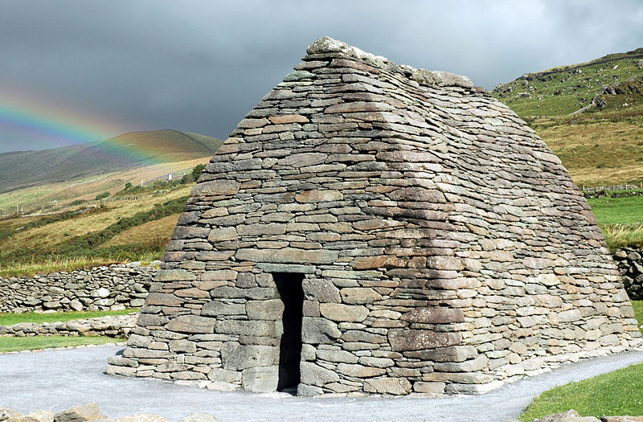
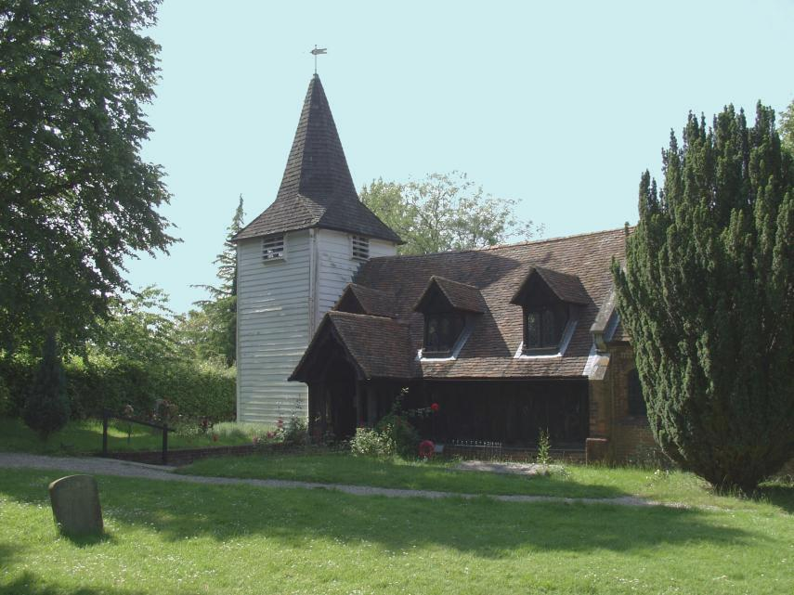
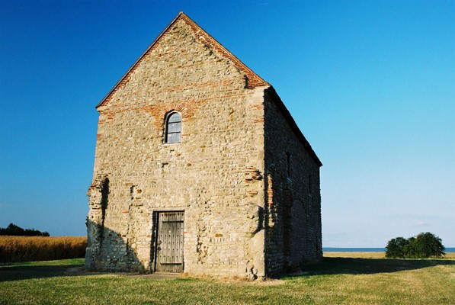
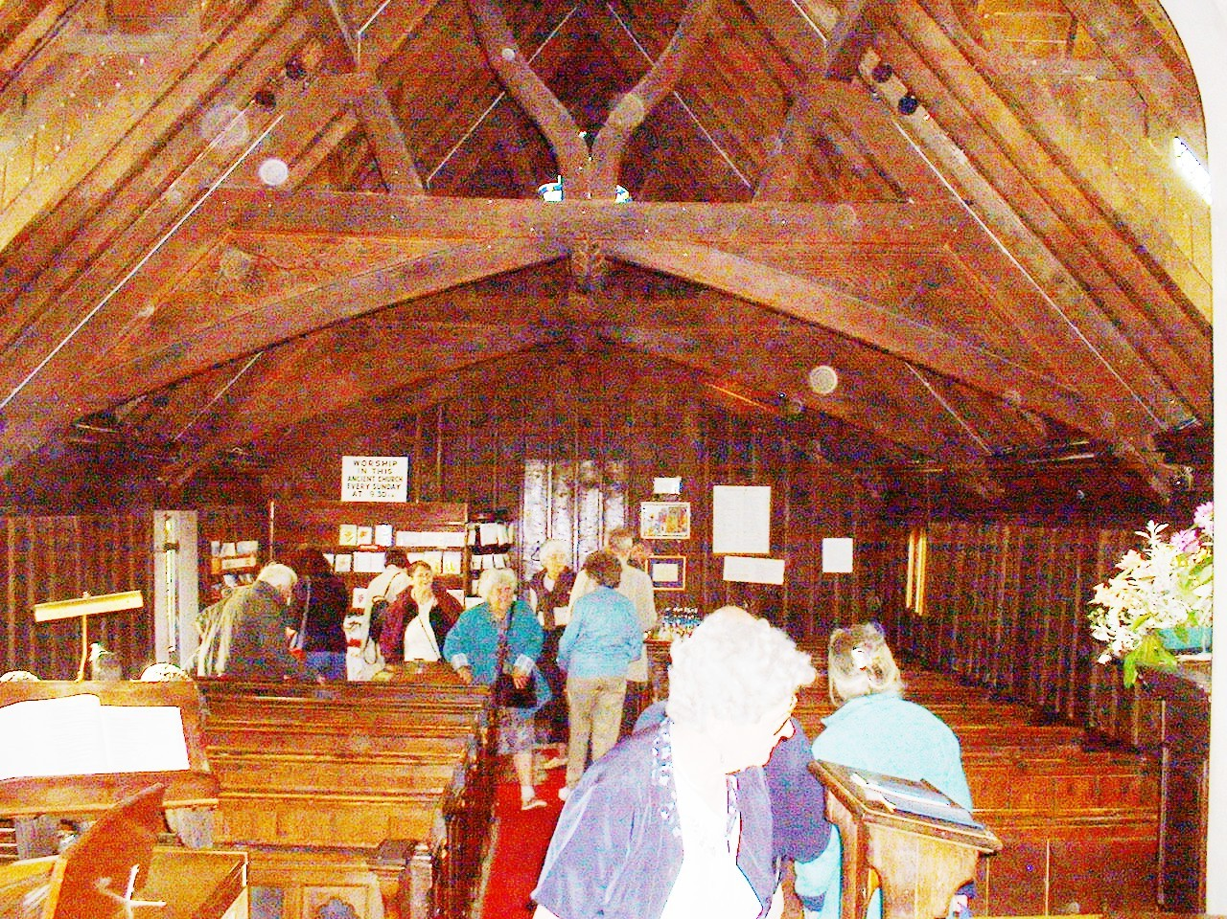
Anglo-Saxon Architecture

Slide 29
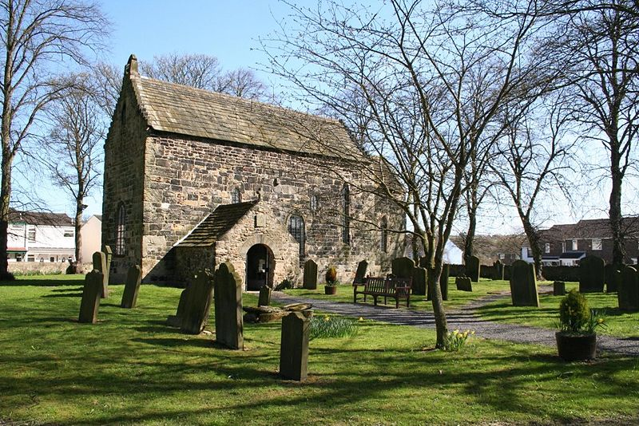
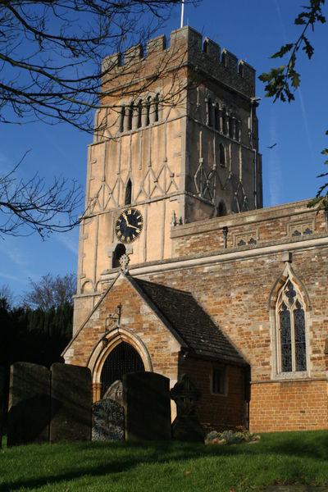
Anglo-Saxon Architecture

