Slide 1
Jazykový seminář fonetický (AJ)
Tutor: Alexey A. Tymbay (PHD)

Slide 2
Plan
Objectives of the course
Literature: Adam Brown/Peter Roach
Phonetics/phonology/pronunciation
Practical class: [i:] sound + focus words

Slide 3
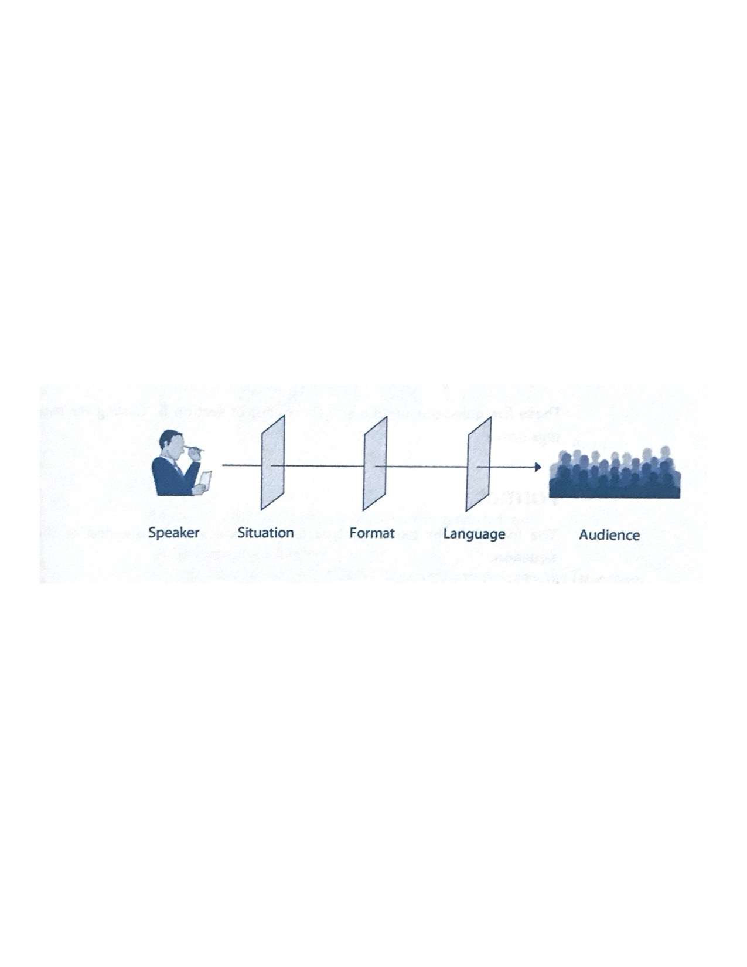
Phonetics can be defined as the scientific study of all aspects of the spoken form of language.
Three distinguishable phases of the communication process:
1 The speaker uses his/her vocal organs (lungs, vocal cords, tongue, lips, etc.) to produce sounds. This aspect is known as articulatory phonetics.
2 The sounds are vibrations of air particles (sound waves), that travel from the speaker’s mouth to the listener’s ear. The technical study of these vibrations is known as acoustic phonetics.
3 The sound waves reach the listener’s ear, travel along his/her ear canal and cause the ear drum to vibrate. This movement is transmitted to the brain and ultimately interpreted. This aspect is known as auditory phonetics.

Slide 4
Phonology, on the other hand, describes the way these sounds function in particular languages.
Exercise
Decide whether the following statements relate primarily to phonetics or phonology. In answering this, you might want to ask yourself:
Your vocal cords vibrate when you say the [m] sound.
In English, the [v] sound is always spelt with the letter v.
At the beginning of English words, the [s] sound can be followed by [p, t, k]
sounds, but not [b, d, 􏰁].
You make an [f] sound by putting your lower lip against your upper teeth.
At the ends of English words, an [m] sound cannot be followed by a [k] sound.
Your lips are spread when you say the vowel in seek.
The vowel in seek is a long vowel.
During an [n] sound, air escapes through your nose.
English has two different vowels in seek and sick, while Italian has only one
vowel of this type.

Slide 5
The components of pronunciation

Slide 6
Phonetic segmentation of speech:
I wandered lonely as a cloud
That floats on high o'er vales and hills,
When all at once I saw a crowd,
A host, of golden daffodils;
Beside the lake, beneath the trees,
Fluttering and dancing in the breeze.

Slide 7
A hierarchy of components

Slide 8
Summary
(Articulatory) phonetics is the study of how speech sounds are produced.
Phonology is the study of how sounds function in particular languages.
Pronunciation teaching uses this fundamental knowledge to teach the production
of the sounds of another language in an informed way.
Pronunciation is composed of many features, all of which are present at the
same time.
Suprasegmentals should be not be overlooked in favor of segmentals.
There is a hierarchical structure to the functional units of pronunciation.

Slide 9
Let’s practice
There are various ways of checking if a sound is voiced. Make a loud, strong [z] sound (which is voiced), and:
put your fingers lightly on your Adam’s apple and feel the vibration
put your fingers in your ears, and hear the booming sound
put your hand on the top of your head, and feel the vibration (which is essentially
your skull vibrating)
produce a [z] on a rise in pitch; that is, go from a low pitch to a high pitch.

Slide 10
Home assignment
Adam Brown, Pronunciation and Phonetics. Ch. 1-3 (pp. 3 -19)
Phonology ( How Languages are Learned) on E-learning site.
Peter Roach, Phonetics pp. 3-15

