Slide 1
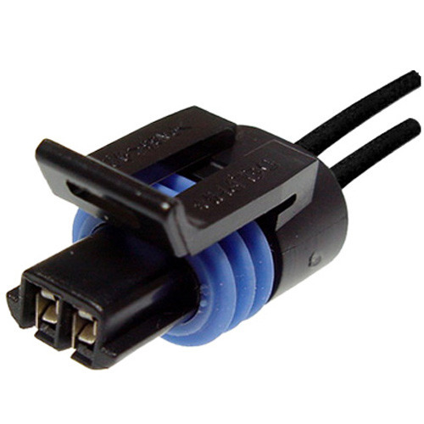
ETG 07 Relay/contactor/switch contacts © 2022, rev. 2022
Miroslav Novák
Department of Mechatronics and Technical Informatics
Faculty of Mechatronics, Informatics and Interdisciplinary Studies
Technical university of Liberec

Slide 2
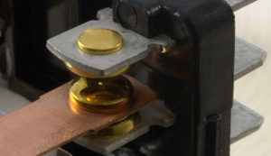
Content
Switching contact on / off under current: overview of basic phenomena, limitations for contact construction
Inrush currents and their effect on contact functionality
Load categories
Extinguishing the arc during switch off, the effect of the arc on the contacts
Contact material selection (relay type selection)

Slide 3
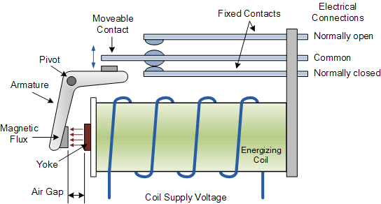
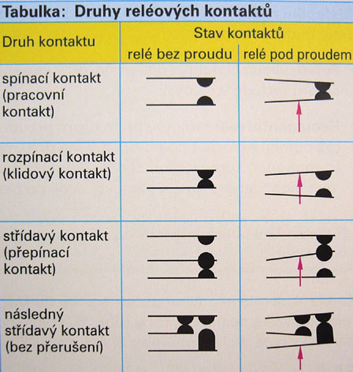
Types of switching devices
Due to current contacts
DC
AC
According to voltage (5, 12, 24, 50 V…)
According to the number of poles: 1, 2, 3, 4…
According to the category of use (type of load in terms of inrush current and arc burning)
By climate category (indoors, outdoor installation)
Basic parts of the switchgear
Contacts
Current path (internal connections up to connector)
Insulators
Mechanism
Extinguishing chamber (if any)
Suspension (auxiliary contacts, remote start, covers…)
1
Notes:
1
Metalické spoje obvykle dosahují nižších přechodových odporů a delší živostnosti.
U kontaktních spojů je nutné zajistit, aby byly plynotěsné.

Slide 4
Functional states
Static
Switch off (I = 0, Uk = Un) Insulation distance between contacts - no breakdown must occur (Test with increased voltage 1 min, shock wave 1.2 / 50 μs)
Switch on (I = In, Uk = 0) transient resistance, isolation of the current path from the surrounding parts
Dynamic
Switching on (I: 0 → In) As you approach, the intensity of el. field - the arc is ignited, contact bounces
Switching off (I: In → 0) fast zoom out - minimize arc burning time, arc extinguishing
1
Notes:
1
Výpočet z kontaktní síly je empirický, dobře popisuje makroskopický náhled a potvrdila ho řada experimentů [1, 2].

Slide 5
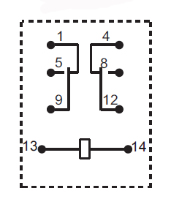
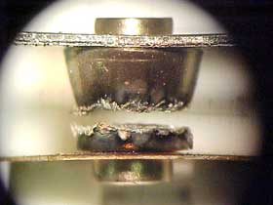
Switch of
The basic parameter is the insulation state between the contacts, contact groups and the insulation state against the control circuit
Sufficient voltage can cause in the gas environment to "break through" and ignite the arc
Another inconvenience is the creeping discharge on the surfaces or the leakage current on these surfaces
The complication is contamination of the contact area
Dirt from outside (from the environment)
Artifacts after arc burning (deposited oxides and metal vapors)
Dirt from assembly (soldering, cleaning)
The contact-coil insulation strength is <1000 V, often much lower (always stated in the catalog sheet)
It can be improved by a partition separating the coil from the contact space
We can test by measuring the insulation resistance (megaohmmeter) or by the endurance voltage test (hi-pot tester)
1
Notes:
1
Pokovení může kontaktní odpor snížit nebo zvýšit [1].
Samotné hledisko kontaktního odporu není jediné, důležité jsou ostatní provozní vlastnosti.

Slide 6
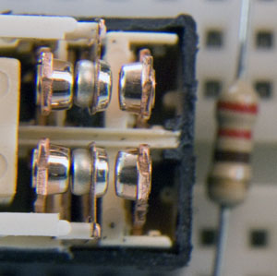
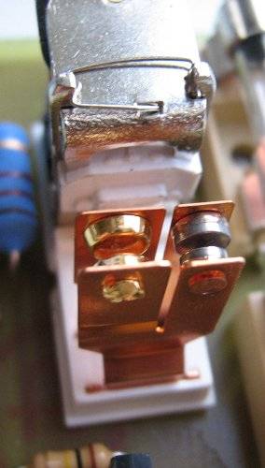
Switch on state
Good conductivity is required
The conditions and problems are the same as for the connectors
the lower pressing force (ten in connectors)
in addition, pollution from the arc
pay attention to the reserve of holding force in applications with vibrations during operation
Strait phenomenon occurs = contact point heating
Surface adhesion always occurs, at higher currents up to welding = the relay mechanism must provide sufficient force to tear off the contacts to turn off the relay (return spring)
We can test the quality by measuring the contact resistance (milliohmmeter)
1

Slide 7
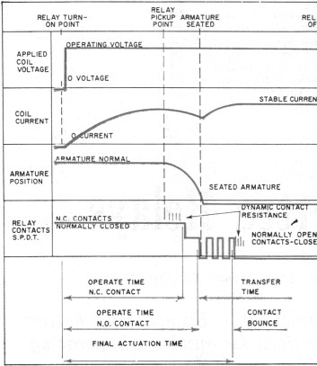
Switning on
As the contacts approach, the arc ignites (distance decreases to zero - the potential increases to infinity = air breaks out)
An activation voltage> 1V is sufficient to ignite the arc
The formation and stabilization of the arc takes units up to hundreds of ns
Burning time can be determined from the time of application (eg t_{on} = 1 ms, l = 1 mm means movement speed 1 μm / μs, arc burning time for 24 V 24/3000 = 8 μm [V / (V / mm)] .. Arc burns 8 μs)
The arch helps to clean the contact surface
A current limited by the impedance of the load + source + arc
After a metal contact, the current is limited only by the impedance of the load + source
Inrush current given by the load
After the contacts hit, the contacts often bounce
1
Notes:
1
Problematika je komplikovaná. Některé vrstvy jsou téměř neškodné. Jiné vedou k vážným defektům funkce. Vrstvy tlustší než 2 um mohou být problém.

Slide 8
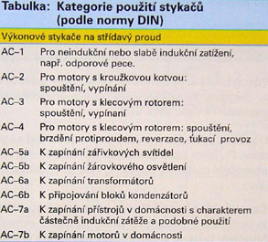
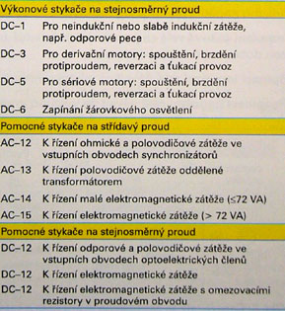
Load categories - inrush currents
Motors - magnetizing peak, starting current (10*I_{n} and more)
Capacitors - charging current (100*I_{n} or more), switching is problematic, special relays / contactors = initial pre-charging via auxiliary contacts and input impedance
Electronics - often a filter capacitor at the input = the same effect
Bulbs - cold filament (approx. 10* I_{n})
Resistive load - no
Transformers (AC only) - given by the moment of switching on and retentive current (according to the standard <12 I_{n}, but in practice 50 times or more)
Different nature of the course and more than 100 times the rated current = stresses the Joue contacts - possible welding
According to standards - application category = limit current defined for different loads differently
It can be limited by including impedance (choke, resistor, NTC), switching at the appropriate time
1
Notes:
1
Růst závisí na teplotě. Bývá selektivní – pod kontaktními body, kde je vyšší teplota.
Při pokojové teplotě je dosažení škodlivé tloušťky záležitostí měsíců až let.
Vyšší teploty zkracují až na několik sepnutí.
Efektivní ochranou je použití barierních mezivrstev.

Slide 9
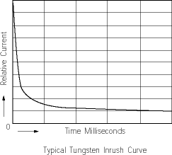
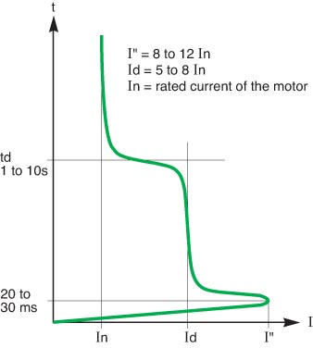
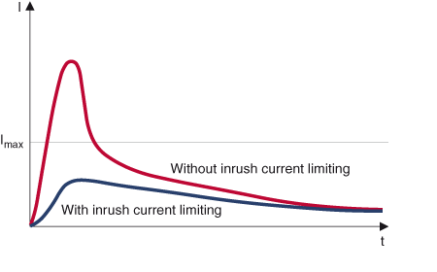
Inrush currents
Incadescent light bulb, cca 10 ms
Capacitor charging, limitation by NTC thermistor
motor
1
Notes:
1
[1]

Slide 10
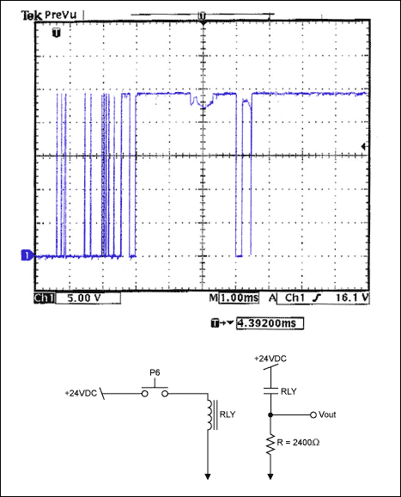
Contact bounce
It depends on the design of the mechanics (correct design - anchor weight - reduce the moment of inertia, force ratios, springs and dampers
Complete current breaking (even 1 ms) or decrease in contact force and increase in contact resistance (contact point overload)
When bouncing, the switch-off arc ignites (at the same time it can be in the area of intense inrush current = very unfavorable = contact erosion)
Secondary inrush current on re-impact
We must keep the rated operating conditions of the control coil !
Voltage range
The rate of its growth
Otherwise, we will affect the sequence of the attraction - it can significantly reduce the life-expectancy
1
Notes:
1
Při nárůstu napětí dojde k proražení povrchové vrstvy a prudkému poklesu rezistivity.
Při vyšší kontaktní síle je vrstva poškozena mechanicky.

Slide 11
Welding of contacts when closed / closed
Adhesion and micro-welds always occur!
As a result of the melting of the contact point, a weld is formed
More durable metals with higher melting point and lower thermal conductivity
Given the material and construction of contacts
Do not exceed the current limits
When switching as a result
forming a contact point with low pressing force,
burning arc during bounce
under the action of inrush current
permanent contact welding may occur
Perspective alloys of Ag with metal oxides CdO, SnO
1
Notes:
1
Pozor na povrstvené kontakty z teplotního pohledu je nutno je posuzovat komplexně.
Je třeba zajistit dobrou tepelnou vodivost vrchních vrstev.
Teplotně stabilní jsou materiály Cu, mosazi, Cu a Al bronzi.

Slide 12
Swithing off
When moving away even at minimum current, the contacts will melt (as the pressing force decreases = the contact resistance increases = the melting temperature is reached)
A conductive metal bridge is formed that connects the receding contacts
After breaking the bridge, a discharge occurs in the metal vapors of the molten contacts
Ignition cannot be prevented even by high acceleration of the contacts
The boiling metal evaporates and turns into a glow discharge
If a sufficient current flows at a sufficient voltage, it turns into an arc in ionized air (the transition is usually unstable)
The energy of the circuit is discharged and the current decreases, at the same time the arc lengthens (it needs a higher voltage to maintain)
The arc is extinguished - this will interrupt the current in the circuit
A recovery voltage is induced in the circuit
Re-ignition may occur
1
Notes:
1
Měrná síla potřebná k odtržení kontaktního bodu je velká, ale body jsou velmi malé.
To je hlavní kritérium pro konstrukci vratké pružiny.
Na snímku povrch po odtržení.

Slide 13
Ionizace N₂ za normálního atmosférického tlaku
Electric arc in the air
Ionized gas (electrons, ions)
Collision / temperature ionization
Arc between contacts at normal pressure 6-20 thousand. K = decomposition of gas molecules into ions
Dependence on pressure (in vacuum it is enough to accelerate to 20 thousand K voltage 1.7 V)
Sufficient voltage and current are required to maintain the arc (to maintain cathode thermal emission)
1
Notes:
1
Rozebíratelné spoje jsou z pohledu koroze rizikovým místem.

Slide 14
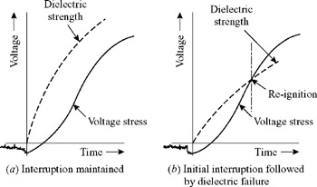
Extinguishing the arc
The basic way is to extend the arc length
Contact distance
Magnetic field repulsion (DC only)
Retraction into the extinguishing chamber
Blowing
Cooling (contact surface, extinguishing chamber)
For AC circuits by carrier recombination at current 0
After an interruption, a recovery voltage is induced in the circuit (given by parasitic and functional inductances)
At the same time, as the contacts move apart, their dielectric strength increases
If the circuit voltage is higher than the dielectric strength, the arc will re-ignite
We can reduce the recovery voltage of the circuit (zero diode, D + Dz, varistors, RC) - this will speed up the extinguishing of the arc and increase the life of the contacts
For low voltages (automotive), it is enough to move the contacts away, the voltage is low and the arc disappears spontaneously
1

Slide 15
Recovery voltage limiters
The energy of the discharging circuit is taken over by the relief circuit
We connect it in parallel to the load
Connection in parallel to the contacts possible only in some cases in others inappropriate
C over load
RC
RCD networks - different impedance during switching on and off
Flyback diode
Combination of Diode and Zener Diode
Varistors
The same circuits are used for the relay control coils
Beware of using a flyback diode - prolongs the waste time of the armature - longer arc burning - negative impact on the life of the contacts
It is better to use a combination of D + DZ at least twice the voltage
1

Slide 16
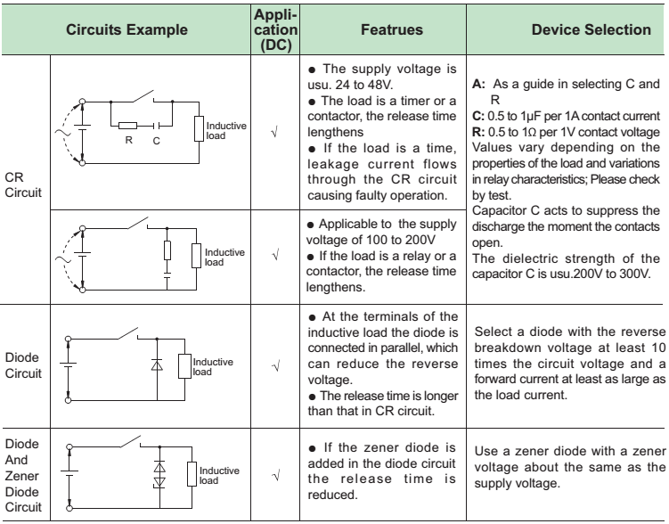
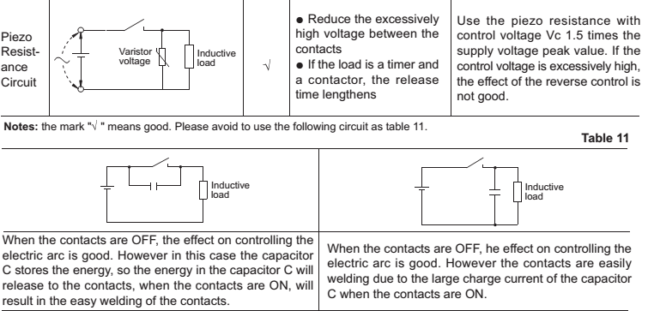
1
Notes:
1
Už po několika stovkách teplotních cyklů může dojít k prudkému nárůstu odporu.
Vede až k přerušení obvodu.
Úbytky napětí odpovídají natavení vrstev a následně až odpaření.

Slide 17
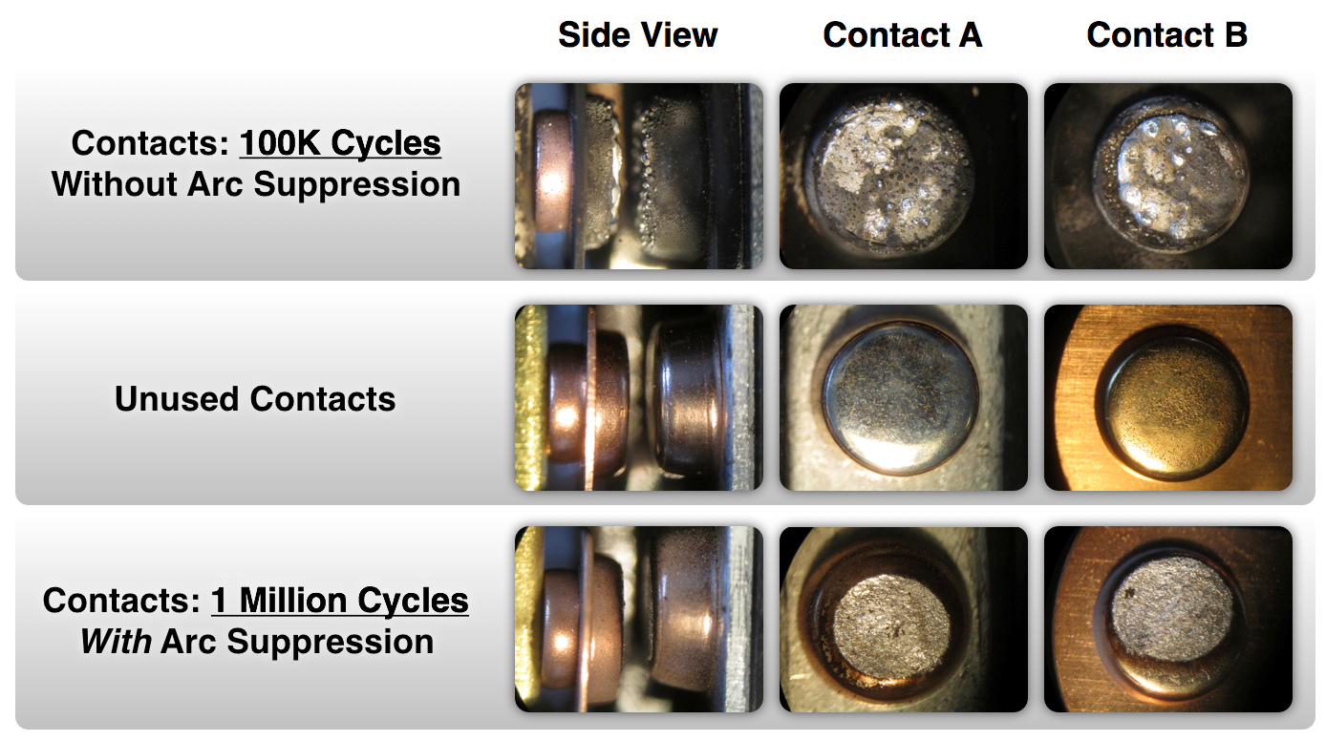
Consequences of burning the arc → contact damage
Depends on the
Circuit current
Arc burning time
Contact material
Contact size and shape
Speed of contacts separation
Bounces when switching
Contact distances
The movement of the arc in the contact space
Extinguishing chamber construction (flow, insulating partitions)
Consequences
Metal vapors evaporated from the - pole of the arc
Droplets of metal sprayed from the + pole of the arc
Deposition of metals back to contact
Material transfer from opposite contact
1

Slide 18
Contact surface changes
Formation of surface layers, erosion and surface damage
Mechanical and arc-burning damage to surface films is beneficial (cleaning ability of contact)
Interaction with the environment - modification of consequences (corrosion, arc products)
Carbon residues for the decomposition of organic material can be beneficial
Creation and disraption of AgCO₂ layer due to arc duration
1
Notes:
1
Volantový kabelový svazek
Malý počet kontaktů (jednotky %) vykazovali rychlý nárůst přechodového odporu při teplotních cyklech.
Bylo závislé na krimpovacím nástroji a stroji. Ale i s nejlepšími podmínkami stále zůstávali „vadné spoje“ – nedošlo k úplné ztrátě obvodu, ale přechodový odpor se blížil až k 1 Ohm – způsobovalu chybu funkce.

Slide 19
Contact erosion
The arc causes the material to transfer
For DC contacts, the direction of transfer is "the same" under the same conditions - significant damage
According to the conditions, the material is carried to the cathode (arc in metal vapors, small gap, the material is ejected from the anode by electrons)
or to the anode during a gas discharge (remote contacts, material ejected by accelerated gas ions)
1

Slide 20
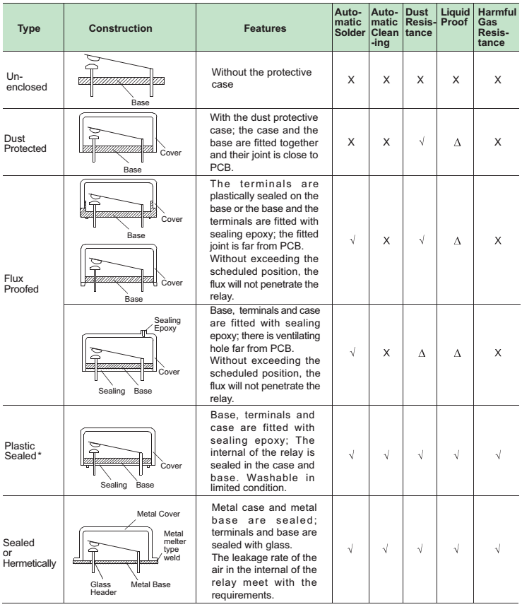
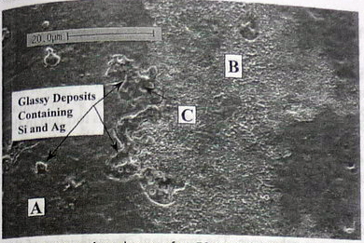
Enviromental influence
Temperature and humidity - prevent condensation (corrosion) and freezing of water (mechanical blocking of the relay, deceleration of the armature movement, poor conductivity of the contacts)
Dust, fumes - better reduce, watch out for SO₂, H₂S - use hermetic relays
Silicone (silicone rubber, oil, silicone potting compounds, seals and coatings) - loosens, quartz is formed in the contact area due to an arc - relay failure = no contact
Magnetism - strong magnetic fields around the relay can interfere with operation or reduce service life
Vibration - the PCB may increase the deflection
Impacts - if necessary, they should be in a direction perpendicular to the movement of the anchor
Water - use a hermetic relay, it can corrode the outlets
After 50 switch ons with 0,5 A
1

Slide 21
Relay contact selection (Automotive)
AgCu 2-20%
Higher hardness compared to Ag
High inrush current erosion with bounce = low resistance to welding compared to AgSnO
Suitable for currents <20 A
AgNi 10-40%
High thermal and electrical conductivity, prone to sulfide formation (Resistive loads)
Production of powder metallurgy
Better welding resistance better than Ag, worse than AgSnO
Medium contact resistance
Large erosion - contact material transfer
Cheap, suitable up to 50-100 A
Ag + metal oxides (AgSnO₂, AgSnO₂ / BiO, AgSnO₂ / In₂O₃, AgSnO₂ / WO₃, AgCdO)
Ag matrix with dispersion of oxide particles (production by internal oxidation)
excels in resistance to welding
standard material for most applications
prone to sulfide formation
Resistive load, bulbs, inductive and capacitive load - erosion / material transfer is small and depends on circuit conditions, voltage, load, current
1

Slide 22
Relay contact selection (Automotive) II
AgCdO - ROHS disabled
Ag + high temp. melting metals(W, Mo) sometimes Cu + high temp. melt. metals
+ High melting point, hardness / brittleness + high thermal and electrical conductivity Ag or Cu = erosion resistant, welding, high conductivity
W + O oxides and Ag₂WO₄ mixed oxides are non-conductive = increase in contact resistance
Suitable for high current applications
Produced by powder metallurgy (poor solubility in Ag)
Ag + precious metals (Pa, Pt, Rh)
Better chemical and corrosion resistance
Low and long-term stable contact resistance
Lower erosion resistance = suitable for current <5A and voltage <48V
Use in telecommunications
Expensive (10-100x than other alloys)
1
Notes:
1
Maximální síla nebývá zmiňována. Omezeno vytlačením vrstev, rozměry cenou.

Slide 23
Summary
We got through the basics of switch-on and off the electric arc by metal contacts
We have explained some methods for increasing the lifetime of contacts
We went through the degradation agents
Go through catalog sheets
https://www.te.com/usa-en/products/relays-contactors-switches/relays/automotive-relays.html
https://cz.farnell.com/c/spinace-rele/rele/automobilova-rele
1

Slide 24
Literature
Electrical Contacts, Principles and Applications. SLADE Paul G. New York: CRC Press, 1999. ISBN 0-8247-1934-4
HAMPL Josef a kol. Materiály pro elektrotechniku, 2. přeprac. vyd. Praha: ČVUT, 1999, ISBN 80-01-01544-0
Explanation To Terminology And Guidelines Of Automotive Relay & Module. Hongfa Relay.
Automotive Relay. User Guide. Panasonic Corp.: Osaka, 2013. ASCTB237E 201307-T
Automotive Relays. Application Notes. Tyco Electronics Corporation. 03-2018, Rev. 0315

