Slide 1
Children’s literature
Aims/Roles/Themes/
Historical development

Slide 2
Children’s literature
At the beginning of the 18th century very few enjoyable books for children had existed
By the end of the 18th century, children’s literature was a flourishing part of the publishing industry in Britain
Nathaniel Crouch - Winter-Evenings Entertainments (1687)
Fables, fairy stories, lengthy chivalric romances, and short, affordable pamphlet tales and ballads called chapbooks

Slide 3
Children’s literature

Slide 4
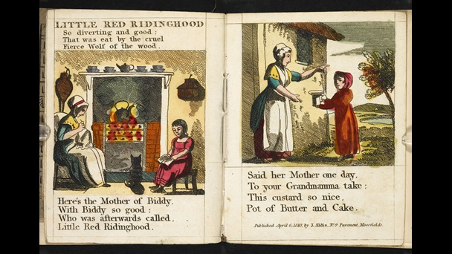
Children’s literature

Slide 5
Children’s literature
the books that were published especially for children before the mid-18th century were almost always instructional or deeply pious
(spelling books, school books, conduct books)
Thomas Boreman
Description of Three Hundred Animals
Gigantick Histories
Mary Cooper
Tommy Thumb's Pretty Song Book
‘Bah, bah, a black sheep’, ‘Hickory dickory dock’, ‘London Bridge is falling down’ or ‘Sing a song of sixpence’

Slide 6
Children’s literature

Slide 7
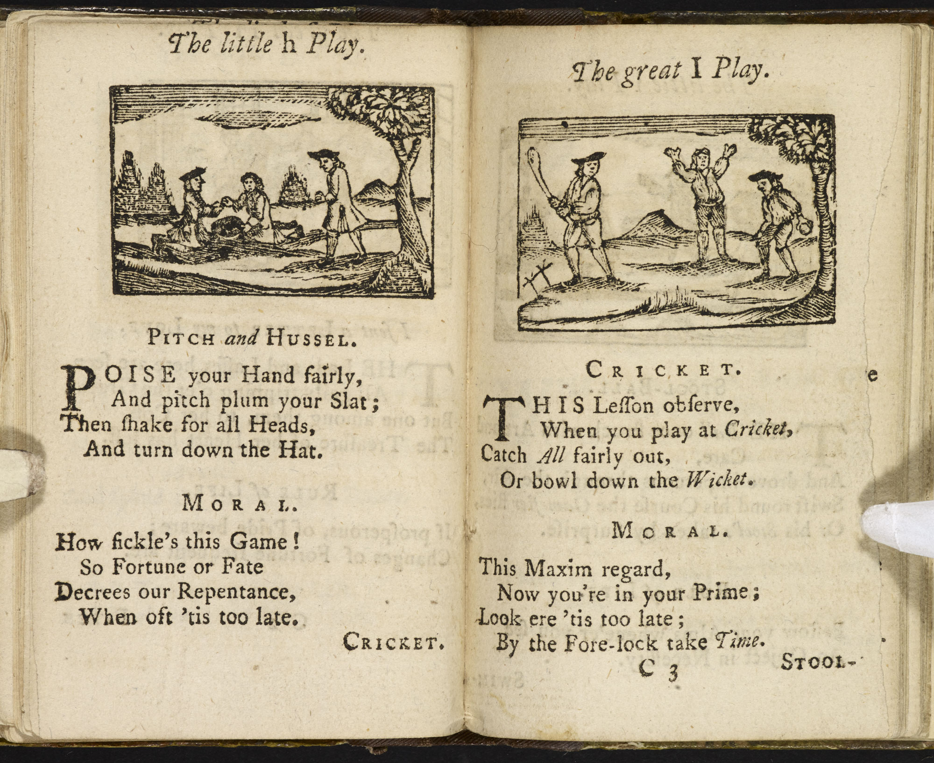
Children’s literature
John Newbery - A Little Pretty Pocket-Book Intended for the Instruction and Amusement of Little Master Tommy and Pretty Miss Polly

Slide 8
Children’s literature
Newbery:
his books embodied the educational ideas of John Locke
he has become known as the ‘father of children's literature’ chiefly because he was able to show that publishing children’s books could be a commercial success
The Lilliputian Magazine (1751-52), a miscellany of stories, verse, riddles and chatty editorials
The History of Little Goody Two-Shoes (1765)

Slide 9
Children’s literature
reasons for the sudden rise of children's literature:
the growth of a sizeable middle class, technical developments in book production, the influence of new educational theories, and changing attitudes to childhood

Slide 10
Children’s literature
Fantasy:
L. Frank Baum's Wonderful Wizard of Oz (1900)
A. A. Milne's Winnie-the-Pooh (1927)
P. L. Travers's Mary Poppins (1934)
J. R. R. Tolkien's The Hobbit (1937)
C. S. Lewis's "Narnia" series
E. B. White's Charlotte's Web (1952) and The Trumpet of the Swan (1970)
Lloyd Alexander's Book of Three (1964)
Brian Jacques's Redwall series (1987–)
J. K. Rowling's Harry Potter books (7 vol., 1997–2007)

Slide 11
Children’s literature
Kenneth Grahame - Wind in the Willows (1908)
Esther Forbes - Johnny Tremain (1944)
Joseph Krumgold - And Now Miguel (1953)
Scott O'Dell - Island of the Blue Dolphins (1961)
Irene Hunt - Up a Road Slowly (1966)
William Armstrong - Sounder (1970)
S. E. Hinton - The Outsiders (1980)
Robert Cormier - I Am the Cheese (1977)

Slide 12
Children’s literature
Ellen Raskin, Judy Blume, and Cynthia Voigt
Verna Aardema - African folktales
Yoko Kawashima Watkins - Asian oral traditions
Allen Say - the Japanese-American immigrant experience
the Newbery Medal, an award for the most distinguished work of literature for children
the Caldecott Medal, an award for the best picture book of the year

Slide 13
Children’s literature
The Christmass-Box, published by M Cooper and M Boreman in 1746 and written by ‘Mary Homebred’ (a pseudonym for the novelist Mary Collyer)
stories three or four pages long whose lessons can be easily summarised, e.g. ‘The History of Miss Polly Friendly’
Sarah Fielding - The Governess (1749)
‘An Adventure of Master Tommy Trusty and his Delivering Miss Biddy Johnson, from the Thieves who were going to murder her’ (in The Lilliputian Magazine, 1751–52)

Slide 14
Children’s literature
Middle-class values depicted in children´s literature:
commercial qualities like hard work, thrift and honesty;
moral virtues like solicitude for others;
social virtues like politeness, charity and obedience to parents;
and a rationality which disdained fear of the dark or ghosts and rejected sentimentality or excessive emotion

Slide 15
Children’s literature
Society for the Promotion of Christian Knowledge or the Religious Tract Society
Mary Martha Sherwood - The History of the Fairchild Family (1818–47)
Dorothy Kilner - The Life and Perambulations of a Mouse (1783)
Sarah Trimmer - Fabulous Histories (1786)

Slide 16
Children’s literature
The Happy Family; or, Winter Evenings’ Employment (1801)
an older brother explaining slavery to his six-year-old sister and urging a boycott of the sugar that keeps the slave trade going:
Perhaps if older Christians than we were to come to a resolution to break the fetters, to emancipate and kindly raise up these poor afflicted fellow-creatures, who are so sorely burthened,’ he tells her, ‘they would feel a more exquisite sensation that they had ever before experienced.

Slide 17
Children’s literature
Thomas Hughes - Tom Brown’s Schooldays (1857)
Isaac Watts - Divine Songs (1715)
James Janeway - A Token for Children (1671)
Christopher Smart - Hymns for the Amusement of Children (1770)
Sarah Trimmer
propose a respect for the simple and for the natural world

