Slide 1



Lomonosov Moscow State University
Dr. Lekhov Vladimir
v.Lekhov@gmail.com
EXPERIMENTAL STUDY AND SIMULATION OF DIFFUSION TRANSPORT OF POLLUTION IN HETEROGENEOUS FORMATIONS
AND
HYDROGEOLOGY IN MOSCOW STATE UNIVERSITY
Liberec - 2019

Slide 2
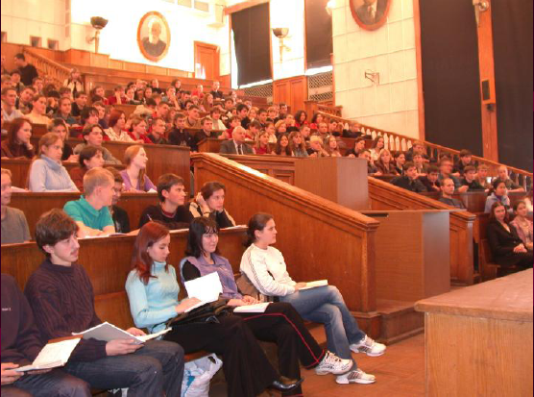
Geological faculty MSU
200 students per year
More than 13 000 geologists were graduated
Hydrogeological Division MSU
Created in 1953 year by professor Octavii Lange
Now it is a leading school in Hydrogeology in Russia
Staff:
  4 full professors
  6 associated professors
  scientific and engineering staff – 20 persons
Notes:
Admission per year is about 200 students
More than 13 000 geologists were graduated from Geological faculty up to day!

Slide 3

Hydrogeological Division MSU
Hydrogeological division is a part of Geological faculty of Moscow State University (MSU)
Geological faculty includes 16 divisions that are grouped in four schools:
  Geology
  Geochemistry
  Hydrogeology and Engineering Geology
  Geophysics

Slide 4
Students specialized in Hydrogeology
Teaching hydrogeology
Offered degrees:
  Bc. Sc – 4 years
  Ms. Sc – for Bs. Sc holders – 2 years
  Candidate of Sciences (eqv. Ph. D) – for Ms. Sc holders – 3 years
Annual admission for first grade to Bs. Sc. school is 12- 19 students
Annual admission to Ms. Sc school now is about 80% of graduated Bs. Sc students
Ph.D study admission is 1-4 students per year
Notes:
Bc. Sc – four years of study and thesis
Ms. Sc for Bs. Sc holders two more years study and thesis (six years totally)m
Candidate of Sciences (eqv. Ph. D) for Ms. Sc holders: three (four from 2012) years of study and public defense of dissertation (9-10 years totally)
Dr. Sc. – for experienced Candidate of Sciences holders – two years for writing Dr. Sc dissertation and public defense it

Slide 5
Teaching approach for 6 years study :
Solid background in basic sciences
Theoretical background in basic Earth sciences:
Field summer camp
Special training in hydrogeology, engineering geology and geocryology
Advanced study of hydrogeology
Summer practice in scientific or commercial organization
Notes:
Solid background in basic sciences (courses are offered by leading schools of math, physics, chemistry of Moscow State University)
Theoretical background in basic Earth sciences: physical geology, structural geology, oil&gas geology, geochemistry, mineralogy, petrology, geophycisics
Field summer camp in Crimea for study geological processes (1st field season) and geological mapping (2nd field season), etc.
Special training in hydrogeology, engineering geology and geocryology including summer field camp in Zvenigorod for study of field methods of research
Advanced study of hydrogeology: subsurface flow&transport theory and simulation, hydrogeochemistry, field methods of hydrogeological research
Summer practice in scientific or commercial organization for training and collection materials for research for degree work

Slide 6
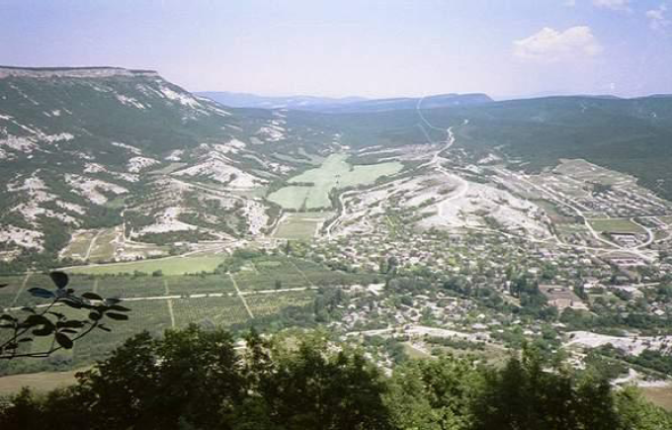
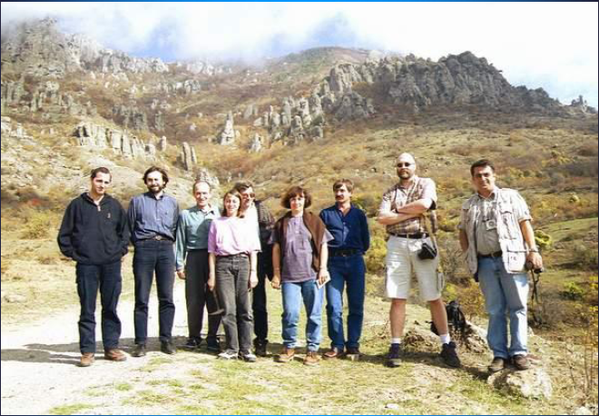
Field training camp in Crimea
200 million years of mapped rock age interval
Different types of surface geological processes

Slide 7
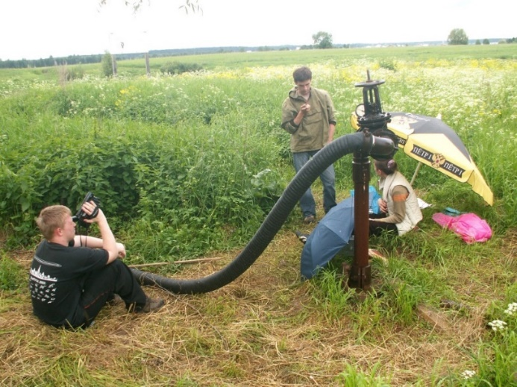
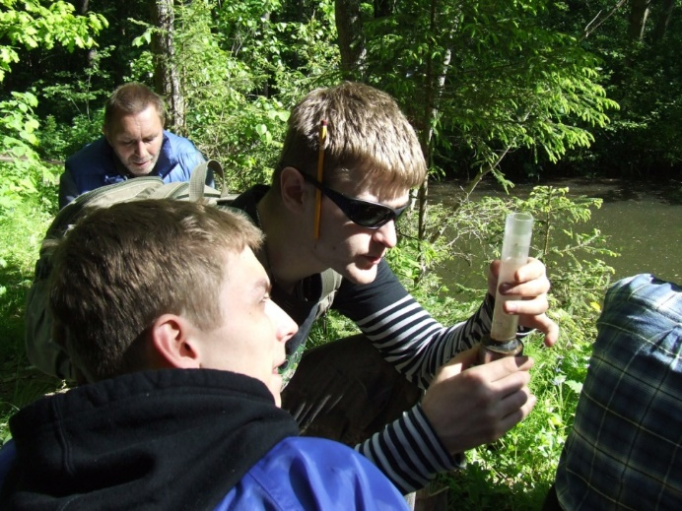
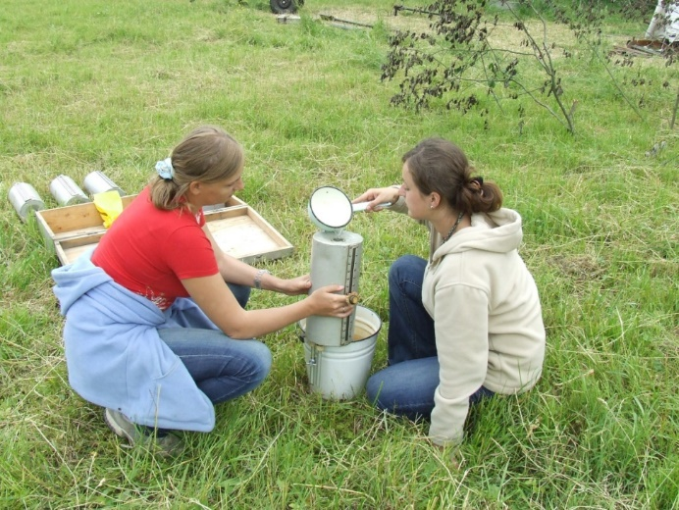
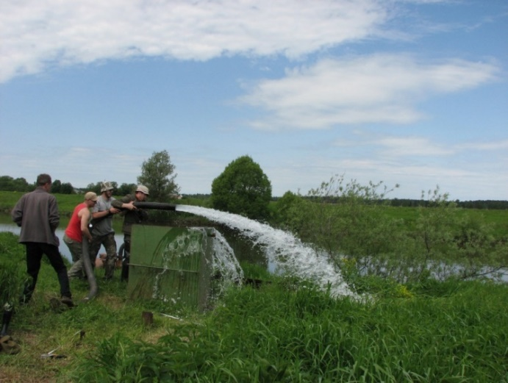
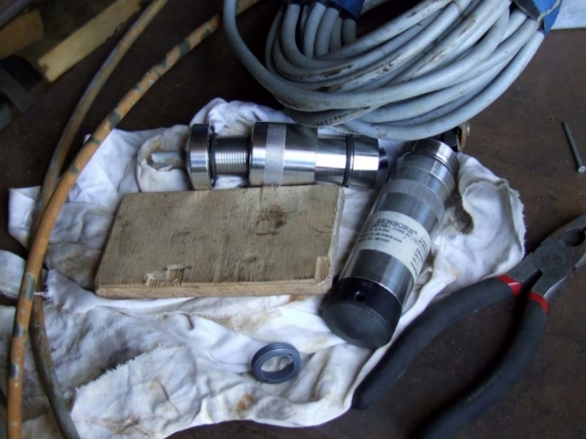
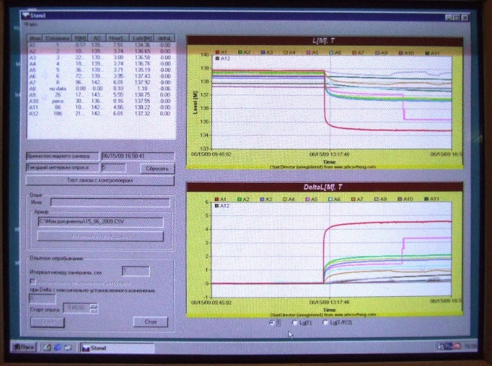
Zvenigorod research site (1)
Hydrogeology is not only simulation
Testing well
Testing hydraulic conductivity
Unsaturated zone test
Pumping test
Records of pumping test by sensors installed in wells

Slide 8
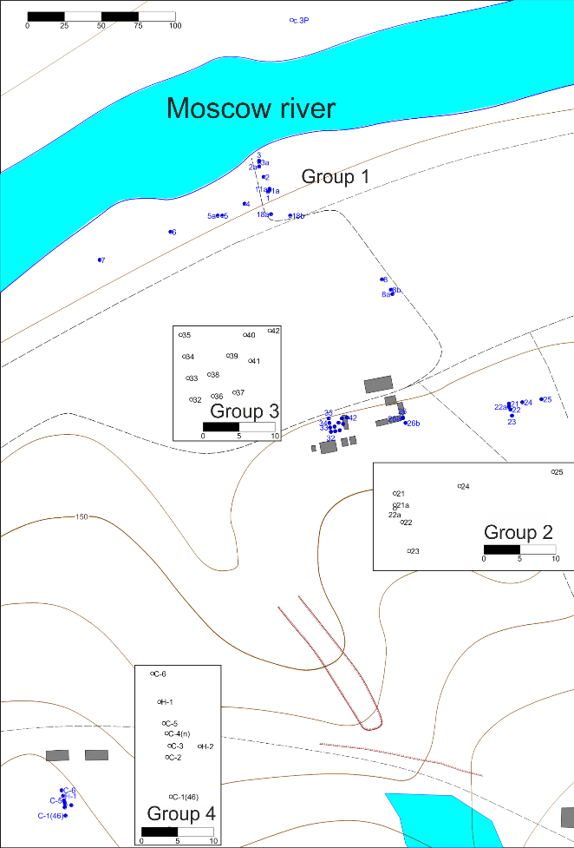
Zvenigorod research site (1)
Research into carbonate aquifer heterogeneity and karst zones development
Hydrogeology and geotechnics summer field school (bachelor)
27 wells installed into the aimed karstified carbonate aquifer
Divided into four groups to comprehend heterogeneity on different scales
Set of equipment to test aquifer properties in situ and from the surface
Tomography approach to determine hydraulic parameters fields

Slide 9
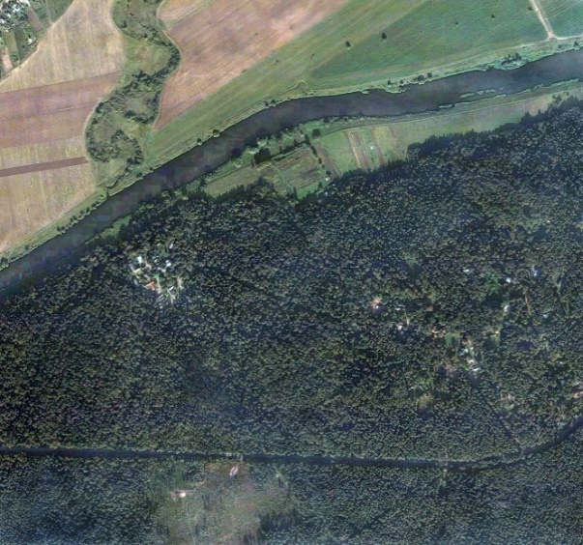
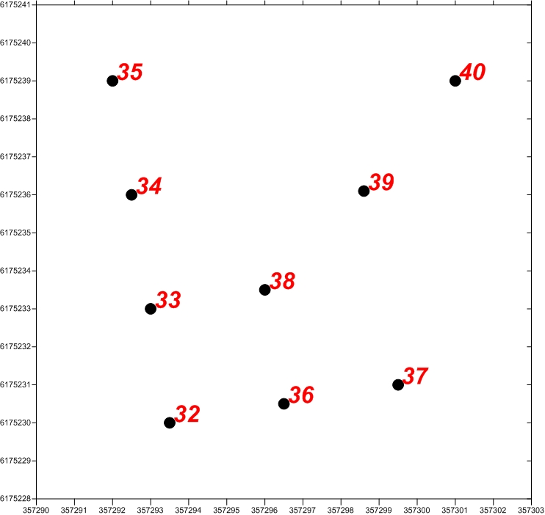
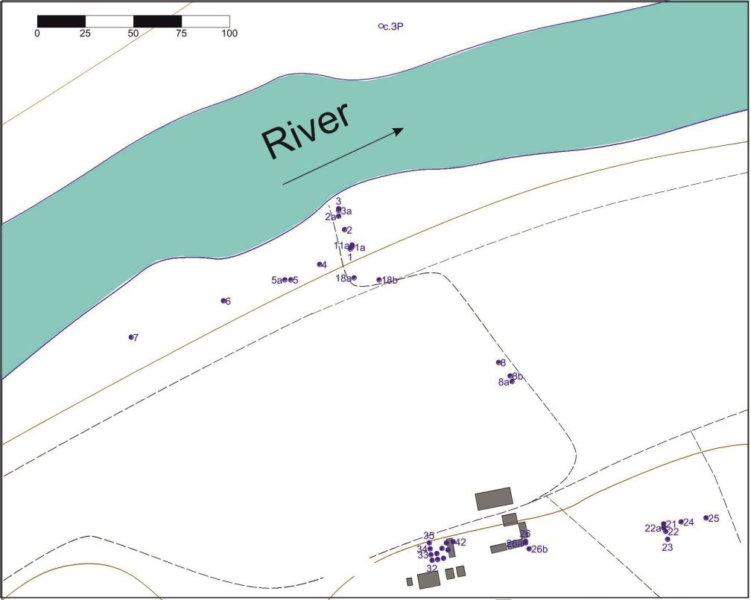
Zvenigorod research site (2)
Detailed electrical logging, resistivimetry, thermal logging, tele-logging, boreholes cores logging
Cross well injection tests: 35, 34, 33, 32, 36, 37, 38, 38
Large scale pumping test
Flowmeter logging static (fixed depth measurements) and dynamic (continuous recording with depth), well diameter logging: Lateral resistivity logging: all wells
Cross well solute and temperature tracer tests
13 meters
Wells and numbers
Moscow
N
13 meters

Slide 10
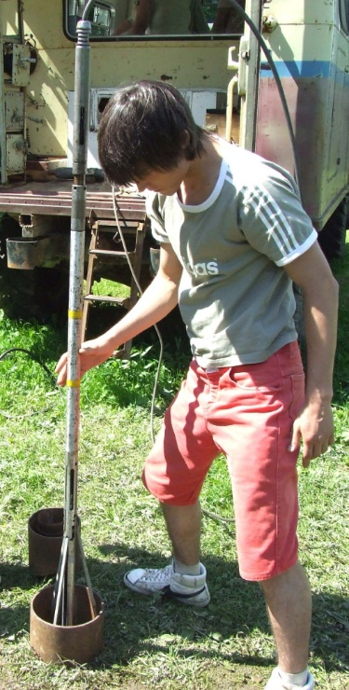
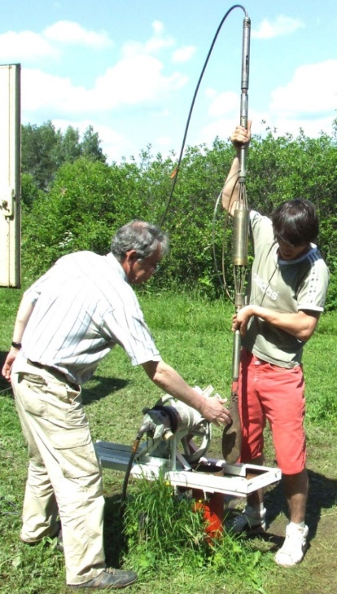
Flowmeter tests
Wells and numbers
We used the injection approach and measured
rate loss along the well
13 meters
13 meters
Rate-loss profile in 35 and 36 wells
Notes:
Sharp drop in flow rate indicates high permeability zones

Slide 11
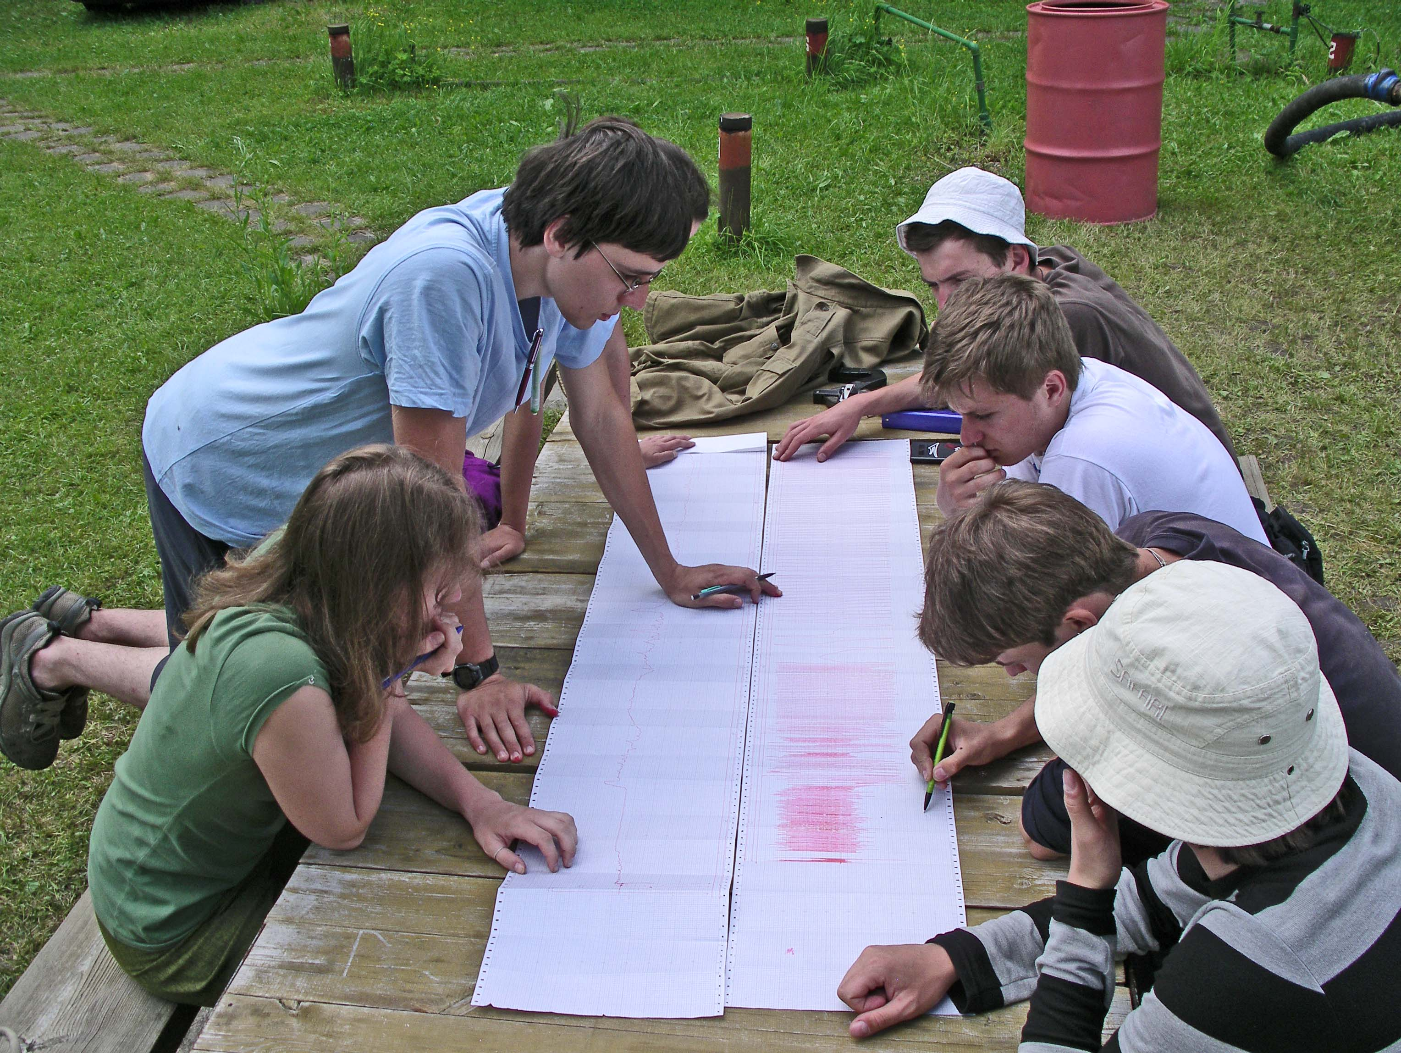
Flowmeter survey – results analysis
Interpretation

Slide 12
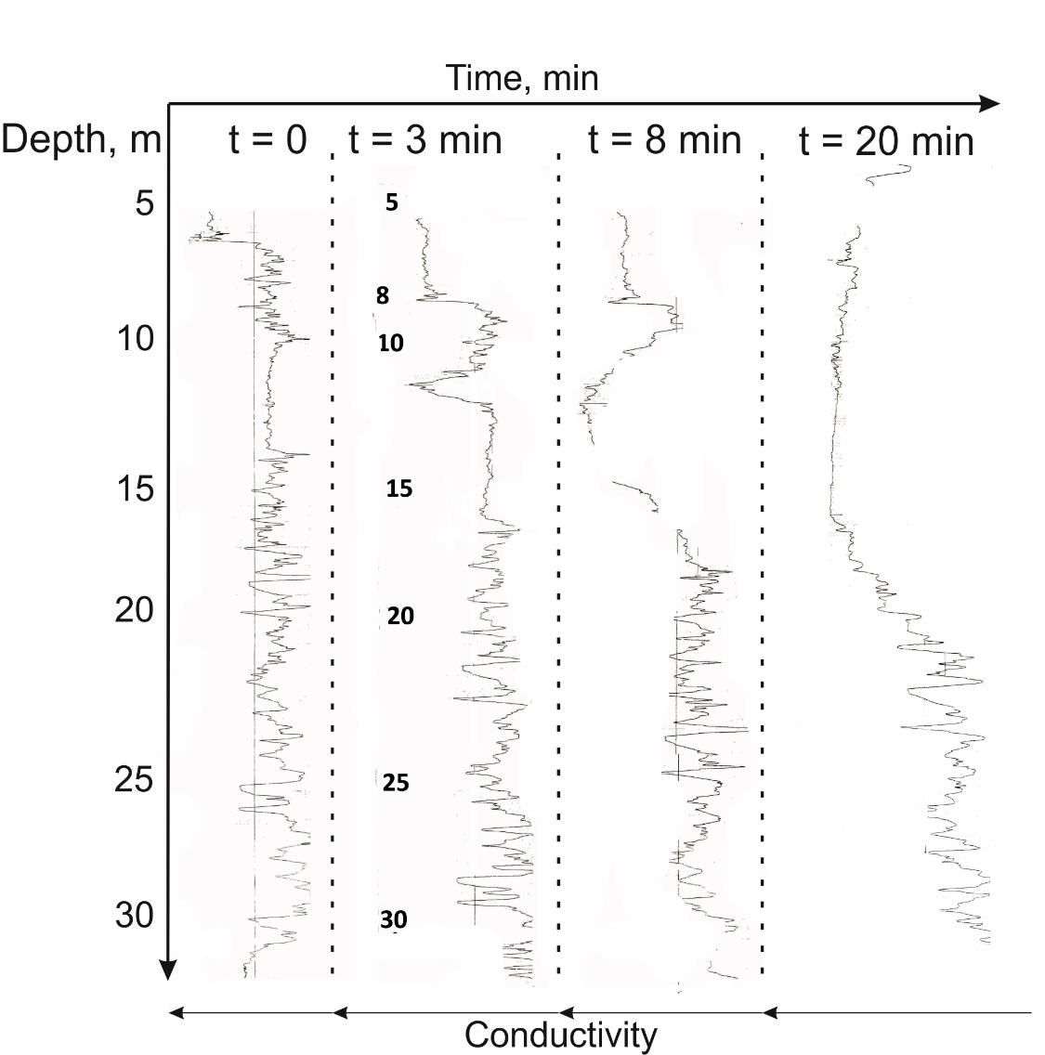
Tracer tests
Wells and numbers
13 meters
13 meters
Profiles of electrical conductivity in well 38 after tracer starting in well 33
Only one zone (most productive for this well) actually discharge water in the well (out of 7 recorded in this well)
Notes:
indicates high permeability zones

Slide 13
International cooperation last years
E.O. Lawrence Berkeley National Laboratory, USA
University Nancy, France <10 students from M to F
Scripps Institution of oceanography, UC San Diego, USA
Institute of Geography and Natural resources of Chinese Academy of Sciences
Curtin University of Technology in Australia
<5 Ph.D. students from M to A (its not double degree)
International students-hydrogeologists
Recent years:
  Few students from China
  Three of them got Ph.D degrees (2008, 2010, 2013)
Notes:
E.O. Lawrence Berkeley National Laboratory, USA – more than 10 years joint research in contaminant transport study
University Nancy, France - educational program
Utrecht University, the Nederland – cooperation in dense groundwater flow study and student exchange
Scripps Institution of oceanography, UC San Diego, USA –climate change impact on groundwater
Institute of Geography and Natural resources of Chinese Academy of Sciences joint project for water resources study

Slide 14
Scientific activities
Assessment of groundwater recourses
Assessment of sustainable groundwater use
Broad range of environmental groundwater problems
Geohydrological study
Deep well injection
Notes:
Assessment of groundwater recourses at different scales and for different regions
Assessment of sustainable groundwater use
Broad range of environmental groundwater problems related with groundwater contamination&rehabilitation
Geohydrological study including development of methods and models for vadose zone simulation, including recharge assessment and climate change impact on groundwater
Deep well injection – simulation of groundwater flow and transport for injection sites performance assessment

Slide 15
Lomonosov Moscow State University
Lekhov Vladimir
EXPERIMENTAL STUDY AND SIMULATION OF DIFFUSION TRANSPORT OF POLLUTION IN HETEROGENEOUS FORMATIONS
AND
HYDROGEOLOGY IN MOSCOW STATE UNIVERSITY
Liberec - 2019
Notes:
Захоронение отходов в глубокие горизонты привело к тому, что в течение длительного времени уже закаченные стоки будут представлять опасность для человека и биоты в целом. Поэтому оценка масштабов и прогноз долговременных последствий захоронения ЖРО является весьма актуальной проблемой. Прогноз долговременных последствий закачки за счет миграции загрязнения в подземных водах может быть выполнен только при помощи геомиграционных моделей. Ключевой особенностью таких моделей является то, что прогнозный период (тысячи лет) на порядки превышает период мониторинга миграции отходов в процессе закачки (десятки лет), поэтому обоснование параметров прогнозных моделей не может основываться только на данных мониторинга, а требует построения моделей неоднородности водовмещающей среды, в которой она происходит, и исследований доминирующих процессов миграции. Одним из таких процессов является диффузия, приводящая в неоднородных водоносных пластах к перераспределению мигрантов между хорошо и слабопроницаемыми разностями пород, роль которой возрастает при достаточно больших временах нахождения загрязнения в подземных водах.

Slide 16
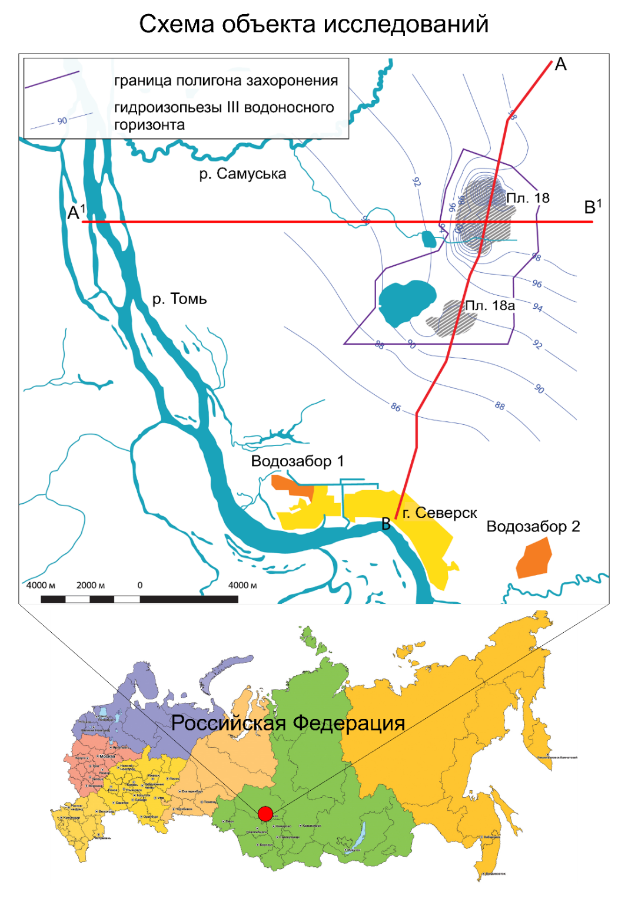
Scheme of underground disposal of liquid radioactive waste
Injection wells
45 - in all
12 - liquidated
28 - retired
5 - used
Start-up 1967 to now
Injected more than 45 mil. m³
Notes:
The burial of wastes in deep horizons has resulted in the fact that for a long time already injected wastes will be dangerous for humans and biota in general.
That is why the estimation of the scale and forecast of the long-term transport of liquid waste disposal is a very important problem.
The forecast of long-term injection due to transport of contamination in groundwater can only be made with the of transport models.
Specific for such models is the fact that the forecast period (thousands of years) is much longer than the monitoring period of waste transport (tens of years), so the reasons for the parameters of forecast models cannot be based only on the monitoring data, but needs to build models of litological heterogeneity media, and to study the dominant transport processes.
One of these processes is diffusion, which results in the distribution of contaminant between well and low permeable sediments in aquifers.
The SCK polygon is located 20 km north of Tomsk and is the largest in Russia. Since the 1960s, more than 45 million m3 of liquid waste with a total activity of 1 billion Ci has been buried at a depth of 270 - 400 m.

Slide 17
Goal:
Analysis of contaminant transport in the water containing environment with a difficult structure of heterogeneity, represented by the interlaying of sand-clay facies of variable thicknesses, determination of effective flow and transport parameters in low-permeable sediments, and evaluation of their effect on long-term contaminant transport
Notes:
Analysis of contaminant transport in the water containing environment with a difficult structure of heterogeneity, represented by the interlaying of sand-clay facies of variable thicknesses, determination of effective flow and transport parameters in low-permeable sediments, and evaluation of their effect on long-term contaminant transport

Slide 18
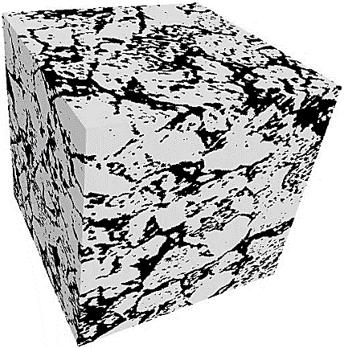
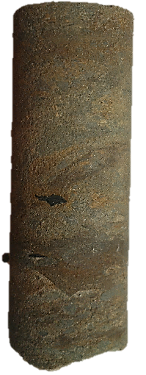
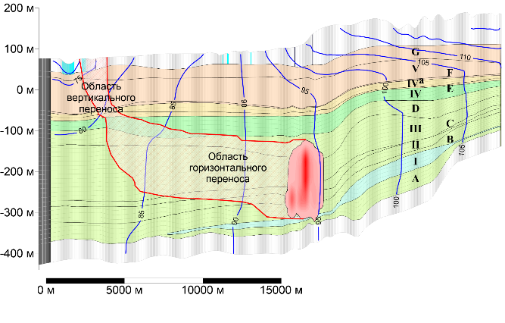
Research objectives:
Pore scale, 10⁻⁴ – 10⁻³ m
Determination of diffusion coefficient from data on microstructural analisis and simulated of diffusion process
3-D pore space model
8 cm
2. Sample scale, 10⁻² – 10⁻¹ m
Experimental determination of transport parameters of low-permeable sediments on real samples
Sample for experiment
3. Layer scale, 10¹ – 10² m
Analysis of contaminant transport on a high-resolution detailed model with a complex structure of flow heterogeneity
3-D flow heterogeneity model
4. Scale of regional model, 10³ – 10⁴ m
Justification of effective mass transfer parameters of the dual-domain model
Regional model
Notes:
In order to get there, 4 research objectives were formulated, each of which corresponded to a specific scale of research. And the transition from scale to scale was carried out.

Slide 19
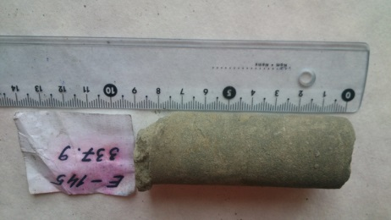
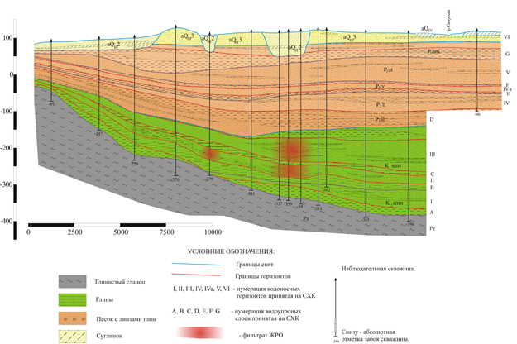
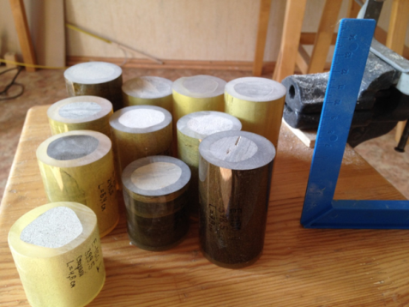
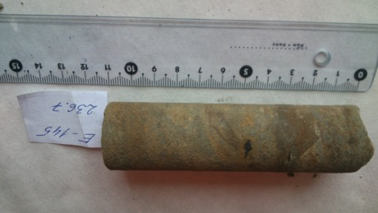
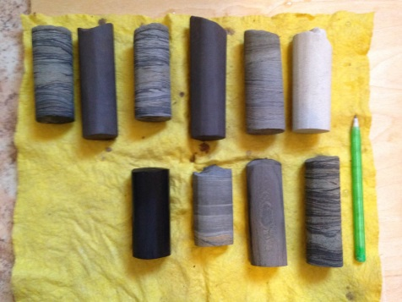
Samples for research
Core sampling interval
for experiments of 200-400 m
6 different types of sediments
16 samples for diffusion experiment 8×3 cm
Lab tests:
Microstructure analysis (μKT + SEM)
X-ray diffraction analysis
Grain size distribution
Bulk and particle densities
Background element concentrations (XRD)
Notes:
For experimental studies 16 samples of undisturbed structure were used, taken in the area of from the depth of 200-400 m from the 6 cores of monitoring wells. Different types of analyses were performed for each sample, shown on the slide. According classification, these rocks are called silty-clay rocks.

Slide 20
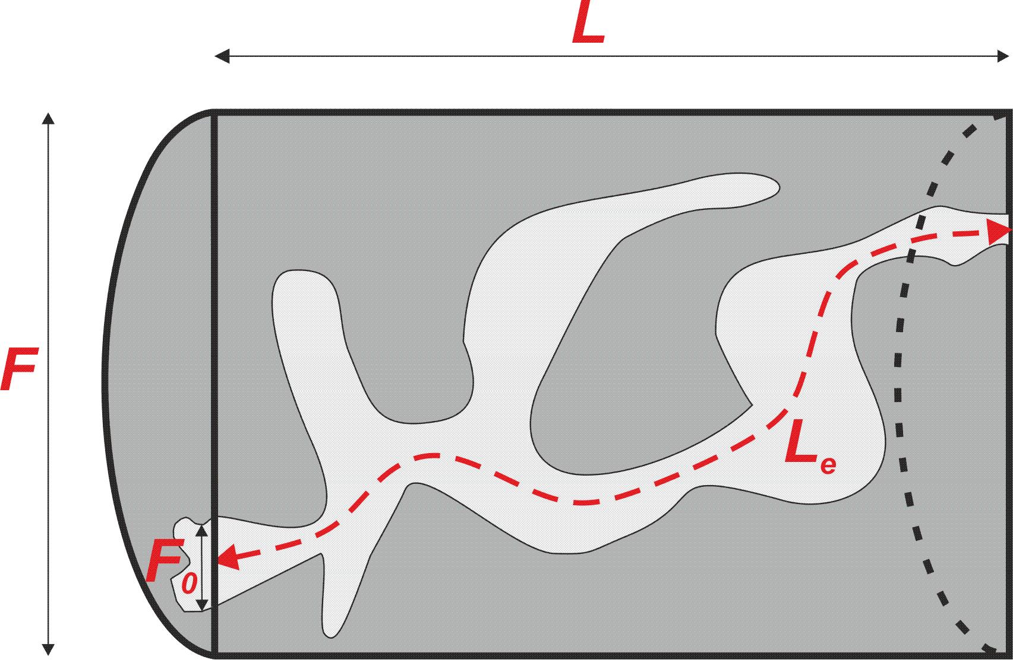
Diffusion coefficient relationship with porosity and microstructure
L – length of sample
L_{e} – minimum length of pore channel
χ – tortuosity (χ<1)
δ – constrictivity
φ – effective coefficient (D/D₀)
n – porosity
To forecast the diffusion coefficient, the empirical equation, analogous to the Archie law, is used [Petersen, 1958]
where, n – porosity, m – empirical exponent, for low-permeable sediments m = 1,8 – 2,4 [Grathwohl, 1998]
where, ρ – electrical conductivities of the rock in pore water, ρ₀ – electrical conductivities in water [Klinkenberg, 1951]
Notes:
The analysis of the published values of diffusion coefficients for low-permeability sediments has shown that experimentally determined values vary in the range of 3-4 orders of magnitude, which indicates the impossibility of using this parameter for forecasting modeling, based only on the literature data. The reason for such a wide range of changes in the diffusion coefficient in rocks is its dependence on microstructure of soils
i.e. that is to say

Slide 21
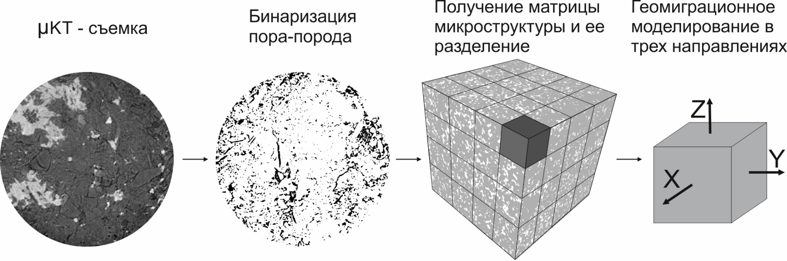
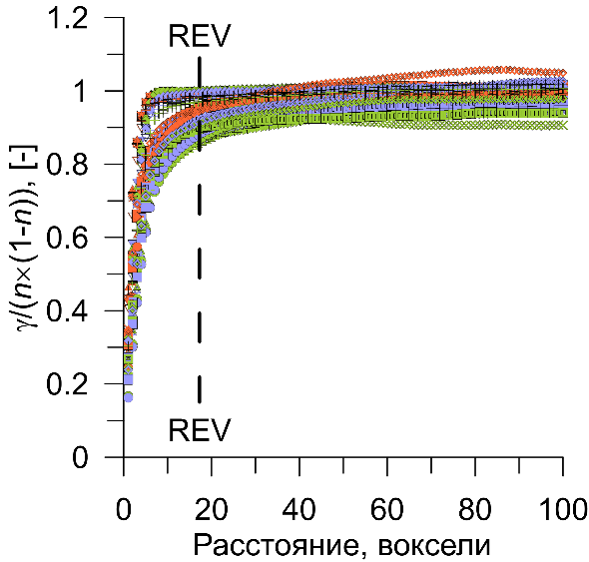
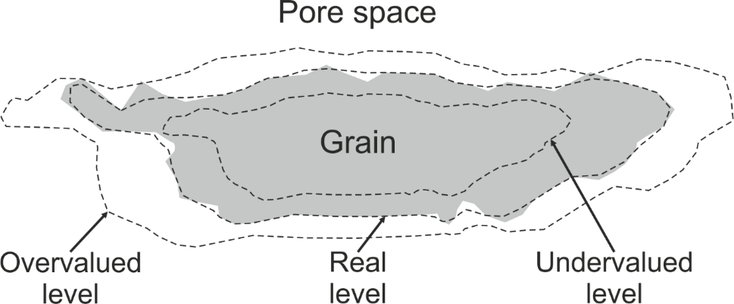
Diffusion steady-state simulation in pore scale
X-ray
microtomography
Pore – matrix binarization
Obtain the microstructure matrix and division
Diffusion simulation in X,Y and Z directions
700 vox≈0,9 mm
Three levels of binarization
Spatial correlation analysis
Distance, voxel
Notes:
Микротомографическая съемка производилась на шести образцах ненарушенного сложения размером 3³ мм³. Томографические данные бинаризовались для разделения трехмерных структур на твердый скелет и поровое пространство образца. В связи с существующими проблемами бинаризации использовались три пороговых уровня бинаризации: наиболее близкий к реальной границе раздела фаз, а также заниженный и завышенный.
Таким образом, для каждого образца были получены три схожие трехмерные структуры, которые трансформировались в бинарную трехмерную структуру, где вокселю попадающему в поровое пространство присваивалось значение 1 и если в скелет то 0.
Далее, для получения большей выборки модльных значений, определялся характерный масштаб пространственной корреляции исследуемых структур путем построения индикаторных вариограмм по трем ортогональным направлениям. Этот анализ позволил выделить элементарный представительный объем (REV) по определению масштаба корреляции исследуемых структур, который составил от 9 до 18 вокселей. Поэтому для последующего моделирования диффузии выбран минимальный размер бинарной структуры, на порядок превышающий линейный размер REV, который составил 175³ вокселей. Это позволило разделить каждую из 18 (6 образцов по 3 уровня бинаризации) трехмерных микроструктур на 64 врезки. Для оценки эффективных коэффициентов диффузии в каждой врезки осуществяллось стационарное моделирование процесса диффузии для каждой врезки и для каждого направления. Общее количество моделей более тысячи штук.

Slide 22
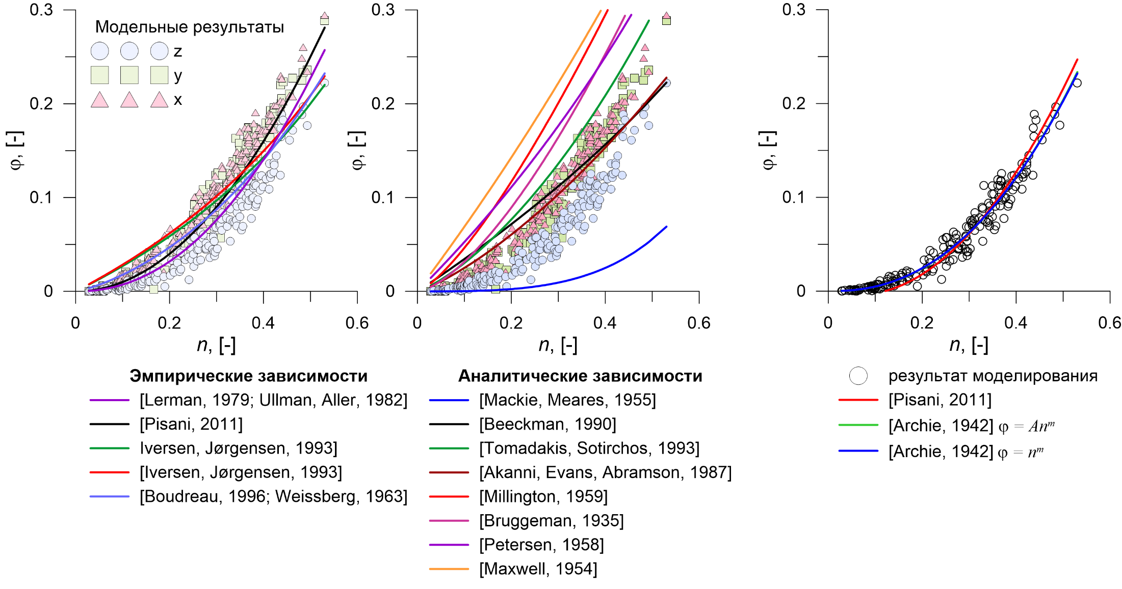
Comparison of simulated values of diffusion effective coefficients with the calculated by empirical and analytical equations
Computed data
Empirical models
Analytical models
computed results
As a result, 3 empirical models of the relation between the diffusion effective coefficient and porosity were selected
Notes:
To describe the relationship between certain model coefficients of diffusion efficiency and porosity, analytical and empirical models of different authors were used. As a result, it turned out that only three empirical models show the best approximation of the results: the Archie Law model (2) with a free and fixed coefficient A = 1 (Fig. 3), and the Pissani model [Pisani, 2011].

Slide 23
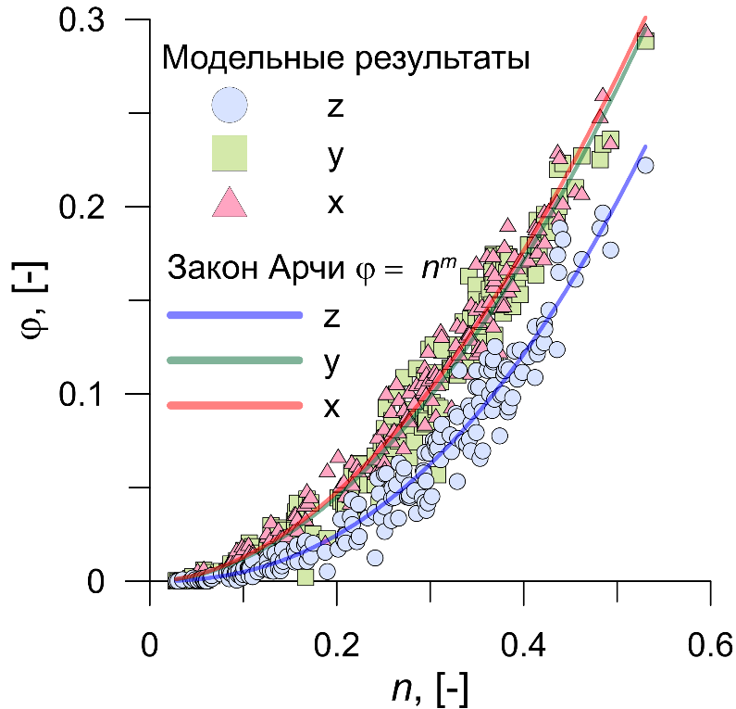
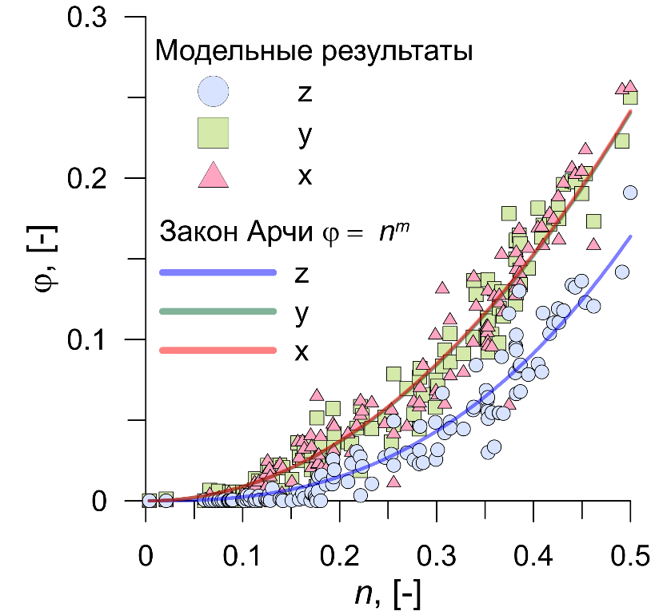
Determination of empirical parameters for calculating the diffusion effective coefficient
Archie
Archie
Pisani
A = 1,5 – 3,2
m = 2,5 – 2,8
m = 2,2 – 2,5
α = 1,07 – 1,18
Computed data
Computed data
Archie law
Archie law
Sample 1
Sample 2
Parameters match with literature limits
Possibility to calculate D in x, y and z directions (anisotropy account)
Notes:
The obtained average values of empirical coefficients for different directions are in good agreement with the data of other researchers. The analysis of the spatial structure of the correlation of the indicator function of the pores of the samples under study has shown that they have an anisotropy of microstructure, leading to anisotropy of tortuosity, and, as a consequence, to anisotropy of the diffusion coefficient

Slide 24
Research objectives:
Pore scale, 10⁻⁴ – 10⁻³ m
Determination of diffusion coefficient from data on microstructural analisis and simulated of diffusion process
3-D pore space model
8 cm
2. Sample scale, 10⁻² – 10⁻¹ m
Experimental determination of transport parameters of low-permeable sediments on real samples
Sample for experiment
3. Layer scale, 10¹ – 10² m
Analysis of contaminant transport on a high-resolution detailed model with a complex structure of flow heterogeneity
3-D flow heterogeneity model
4. Scale of regional model, 10³ – 10⁴ m
Justification of effective mass transfer parameters of the dual-domain model
Regional model
Notes:
In order to get there, 4 research objectives were formulated, each of which corresponded to a specific scale of research. And the transition from scale to scale was carried out.

Slide 25
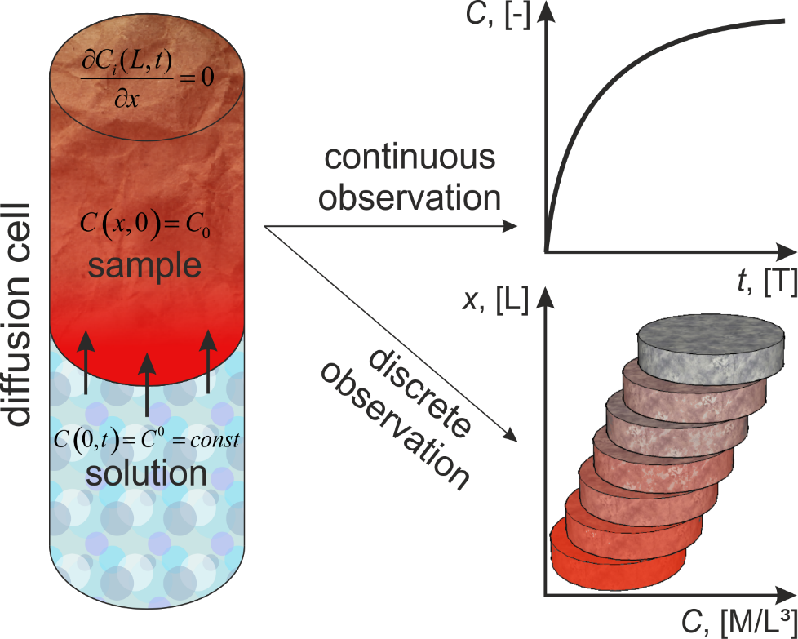
Determination of transport parameters in multicomponent experiment
D/n_{a} for main electrolyte
D/n
D/n_{e} for sorbing elements
K_{d}
D/n_{a} for non-sorbing Na⁺
n
Boundary and initial
conditions
Analytical solution [Lykov, 1967]
L – model length [L]
x – coordinate [L]
t – time [T]
Notes:
On the background of the analysis of the published literature on experimental determination of diffusion and sorption coefficients the method of migration experiment with multicomponent solution consisting of neutral migrant - basic salt and sorbed microcomponents is developed. Because of the different rate of diffusion migration of sorbed and unsorbed components it was proposed to use two types of observations: continuous (x = const) in time, recording the change in the concentration of the main salt at several points along the length of the sample by measuring the electrical conductivity in situ, and discrete (t = const) - the distribution of concentrations of all migrants along the length, obtained after the experiment.
it allows это позволяет

Slide 26
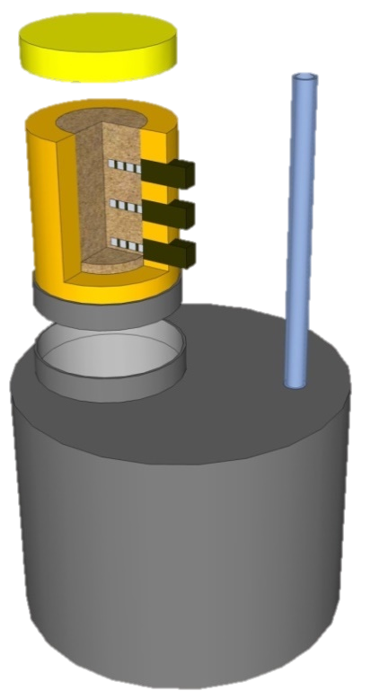
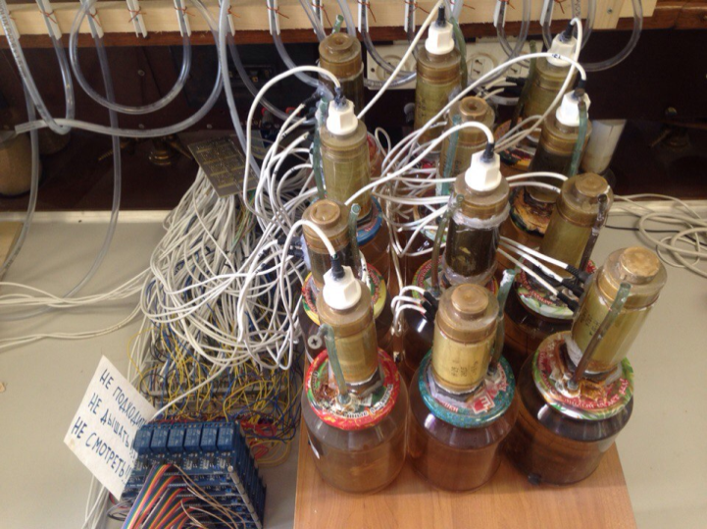
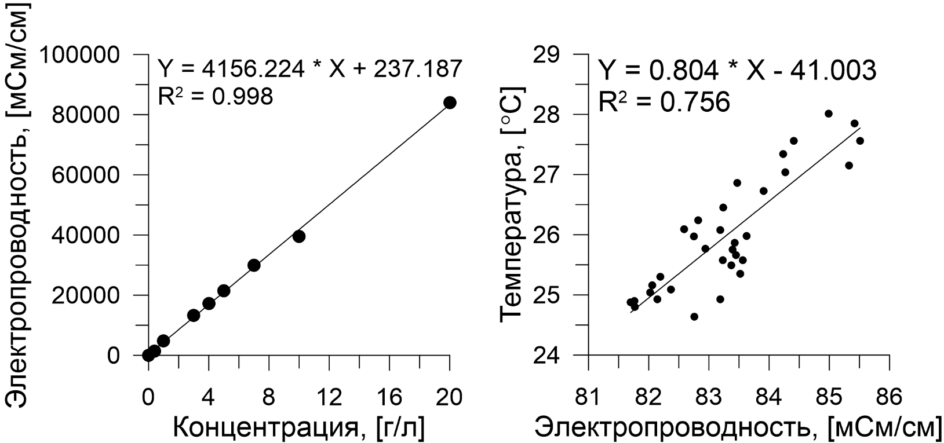
Methodology of the experiment
Paraffin
Diffusion experiment
Sample
Epoxy
Conductivity sensors
Piezometer
Threaded ring
Tank for the salt solution
Dependence of electrical conductivity on NaCl concentration and temperature
Solutions for diffusion experiment
Salt | Solution 1, g/l | Solution 2, g/l
«macrosalt»
NaNO₃ | 20 | 25
NH₄NO₃ | 5
«microsalt»
CsNO₃ | 0,145 | 0,145
Sr(NO₃)₂ |  | 0,241
Ni(NO₃)₂×6H₂O | 0,495 | 0,495
Co(NO₃)₂×6H₂O | 0,494 | 0,494
Ba(NO₃)₂ | 0,19
Electrical conductivity, [mSm/cm]
Temperature, [C°]
Concentration, [g/l]
Electrical conductivity, [mSm/cm]
Notes:
First, the prepared samples were coated with epoxy resin to prevent wall filtration and diffusion.
For registration of the sodium in the course of diffusion experiment 4 contact conductometry sensors were used.
Before the installation the sensors were calibrated, the result of which was obtained a linear relationship from the concentration and the relationship of electrical conductivity with temperature.
Sensors were installed along the length of the sample with a step of two centimeters.
The experimental end diffusion cell is designed and assembled from PFC fittings and consists of a container for diffusion solution and a piezometer to prevent the convective part in the experiment. After installation of the cage with the sample in the installation, the upper end of the cage was waxed to prevent evaporation, and the tank was filled with diffusion solution.
Solutions are represented by sodium nitrate salts in macro concentrations, and strontium nickel caesium... in micro concentrations.

Slide 27
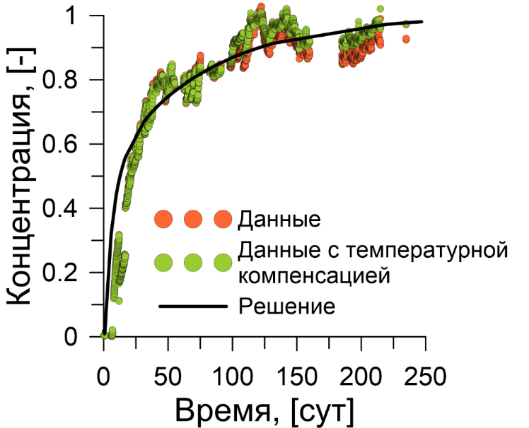
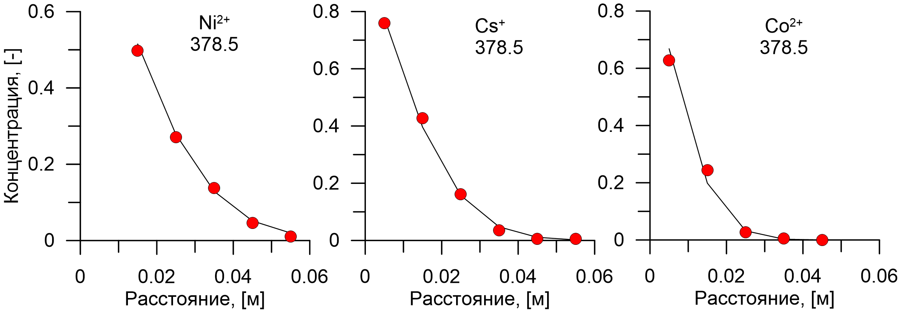
Conductivity curve processing
1. The experiment time is 247 days
2. Conductivity data from 18 sensors
3. Lab temperature change monitoring
4. Fixed distribution of a non-sorbing Na⁺ is obtained
Concentration, [-]
Data
Temperature compensated data
Model
Time, [days]
Concentration distribution of Ni²⁺, Co²⁺, Sr²⁺, Cs⁺, Ba²⁺ by sample length
Sample 1
Sample 1
Sample 1
Concentration, [-]
Distance, [m]
Distance, [m]
Distance, [m]
Notes:
During the experiment, for each conductivity sensor, a change in the electrical conductivity of the solution and the temperature in the laboratory was recorded every 30 minutes. At the end of the experiment the samples were cut 1 cm thick discs and the concentration of the studied substances was determined.
The obtained distributions of concentrations of substances in micro quantities allow to determine the distribution coefficients.

Slide 28
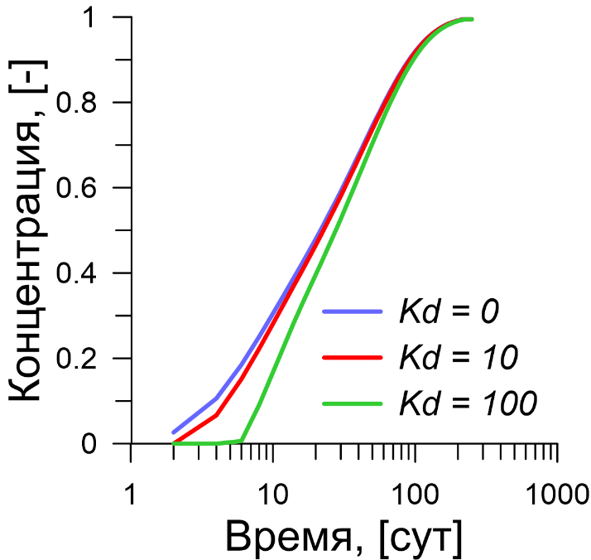
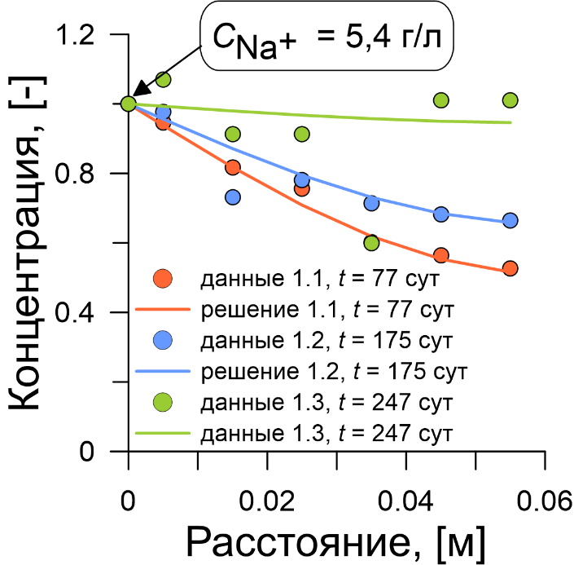
Processing of Na⁺ distribution by length and determination of effective porosity n
C [ML⁻³]
water extraction
C_{por} [ML⁻³]
pore space
С_{Na} – sodium concentration in water extraction
V_{w} – water volume used for water extraction
m_{s} – weight of the rock used for water extraction
С_{por} – concentration of sodium in the pore space of the sample
Concentration, [-]
Concentration, [-]
Time, [days]
Distance, [m]
Model output curves show that Na⁺ is an non-sorbing component at C = 5.4 g/l
Distribution of concentration Na⁺ by length

Slide 29
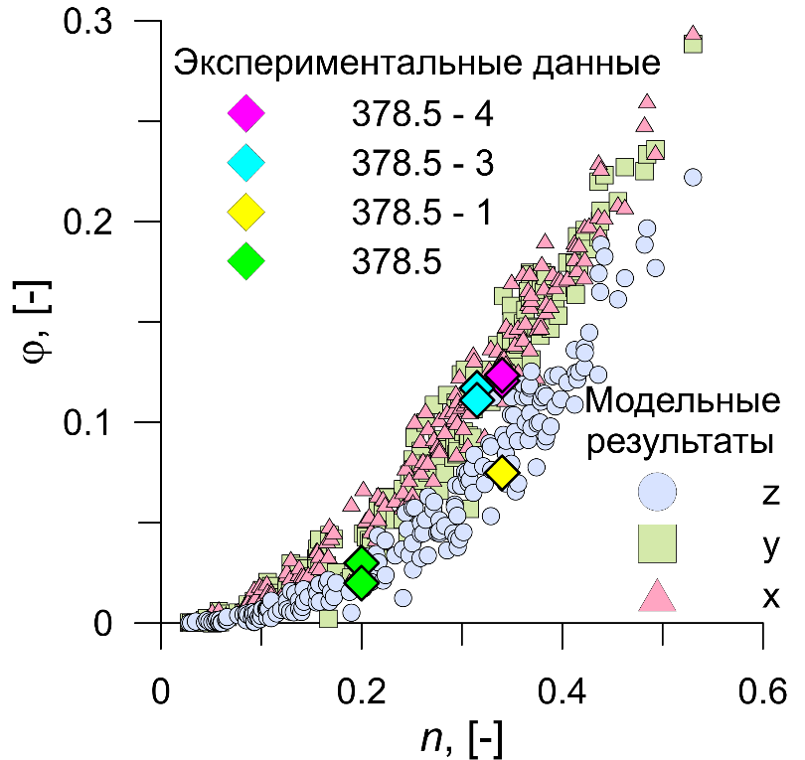
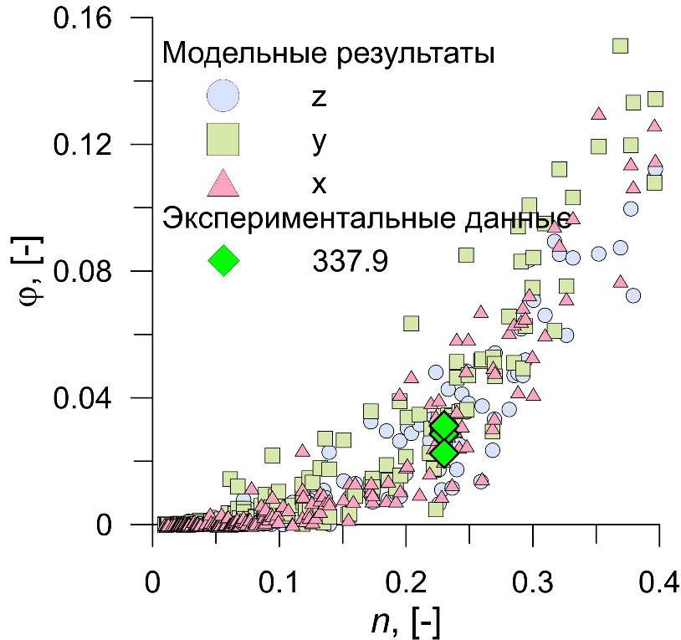
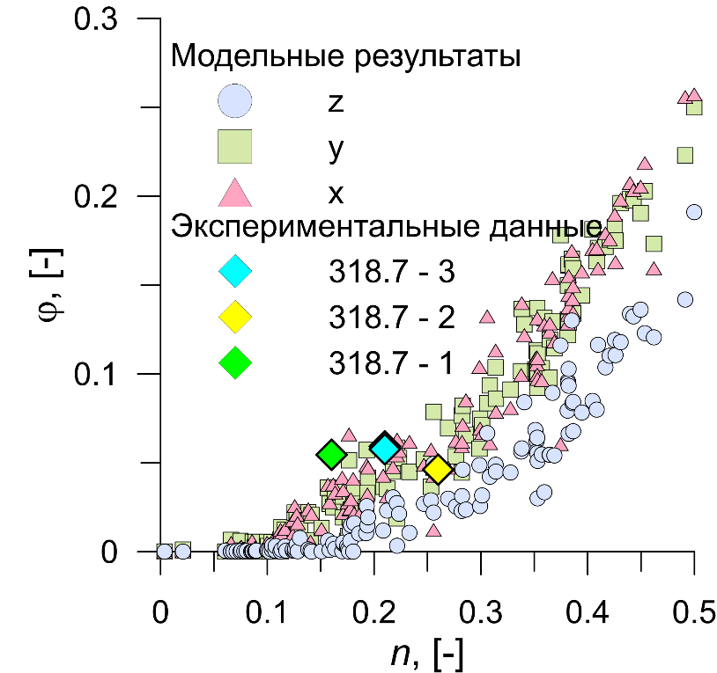
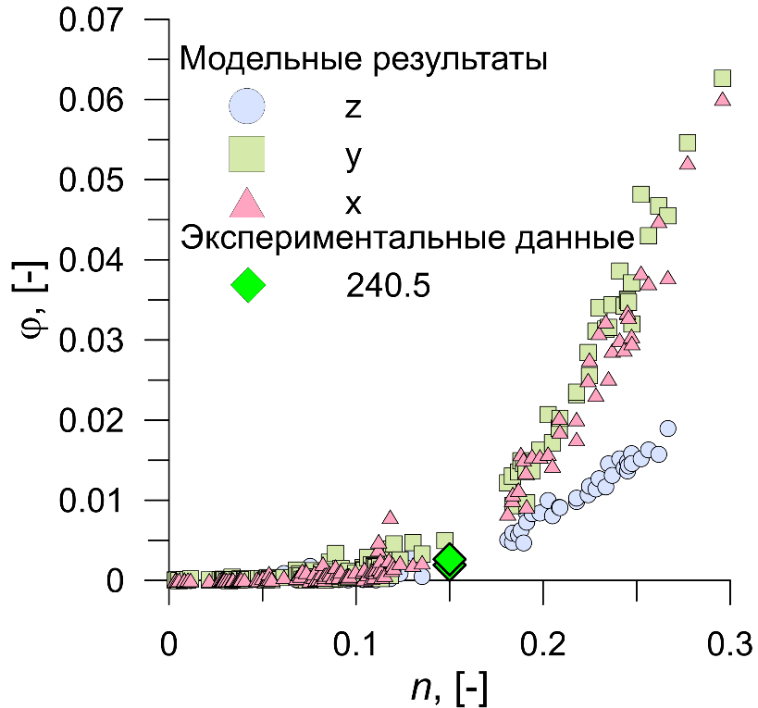
Comparison computed effective coefficient (D/D₀) and experimental effective coefficient for each samples
Experimental data
Computed data
1.4
1.3
1.2
1.1
Experimental data
3
Computed
data
Computed data
Computed data
Experimental data
Experimental data
2.3
2.2
2.1
4
Notes:
Comparison of laboratory studies and results of diffusion modeling at the microlevel. The obtained experimental values for different directions are well placed on the results of diffusion modeling on microstructural models for different directions.

Slide 30
Research objectives:
Pore scale, 10⁻⁴ – 10⁻³ m
Determination of diffusion coefficient from data on microstructural analisis and simulated of diffusion process
3-D pore space model
8 cm
2. Sample scale, 10⁻² – 10⁻¹ m
Experimental determination of transport parameters of low-permeable sediments on real samples
Sample for experiment
3. Layer scale, 10¹ – 10² m
Analysis of contaminant transport on a high-resolution detailed model with a complex structure of flow heterogeneity
3-D flow heterogeneity model
4. Scale of regional model, 10³ – 10⁴ m
Justification of effective mass transfer parameters of the dual-domain model
Regional model
Notes:
In order to get there, 4 research objectives were formulated, each of which corresponded to a specific scale of research. And the transition from scale to scale was carried out.
Для достижения поставленной цели, были сформулированы 4 задачи исследования, каждая из которых отвечала конкретному масштабу исследований. И осуществлялся переход с масштаба на масштаб.

Slide 31
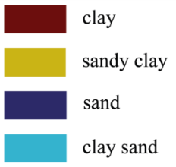
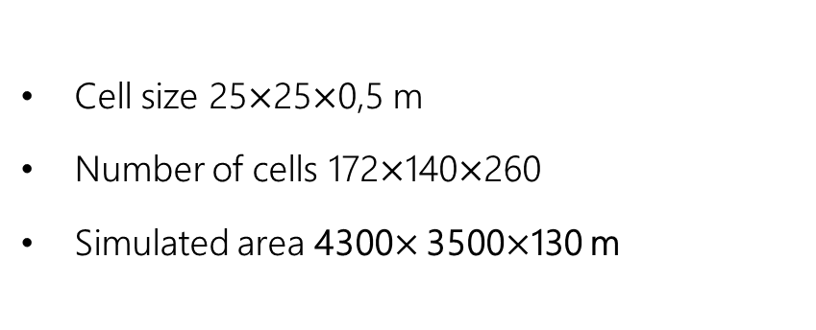
Geostatistical model of heterogeneous of the SCK injection zone [Bakshevskaya, Pozdnyakov, 2016]
295 well logs with 0.5 m separation step
Sand
P=42%
Clay
P=40%
Sand clay P=15%
Clay sand P=3%
1 m/day
0,000055 m/day
0,03 m/day
0,001 m/day
Cell size 25$×$25$×$0,5 m
Number of cells 172$×$140$×$260
Simulated area 4300$×$ 3500$×$130 m
Clay
Sand clay
Sand
Clay sand
Model | Average horizontal length of «clay» L, m | Average thickness of «clay» M, m | Gradient | Porosity | k «clay», m/day | D, m²/day
Base | 283 | 6,6 | 0,038 | 0,2 | 0,0001 | 3×10⁻⁶
Long | 430 | 6,9 | 0,038 | 0,2 | 0,00055 | 3×10⁻⁶
Notes:
As noted above, the interval of the section was chosen for the study, which included the III layer collector and the relative waterproofing D. The construction of the 3D model was based on the detailed lithological dissection of the sections of 295 wells (about 46 km) located in the area of SCK, obtained by drilling and geophysical logging. Dissection resolution is 0.5 m. Terrigenous deposits in the studied columns are clay, loam, sandy loam, sand and other fluvial types. The previous study of lithological sections of wells [6, 11] showed that the section under study has a complex heterogeneous structure and consists of sequentially interlaying well and poorly permeable areas - hydrophages. On the basis of a complex analysis of the data and taking into account the characteristic values of permeability of rocks, all lithological types found in the interval of the section, chosen for modeling, were attributed to one of the hydrophages: sand, clay sand, sandy clay, clay.
For quantitative characterization of heterogeneity and determination of parameters of the Markov chain model, data on lithological columns of wells were transformed into indicator variables (1 - sand, 2 - clay, 3 - sandy clay, 4 - clayey sand) with vertical pitch of 0.5 m. Statistical analysis of the data showed that the shares and thicknesses of sand and clay hydrophages in the section are approximately the same (42 and 40%; 6 and 6.6 m). Distributions of interlayered thicknesses are described, as noted above, by the exponential distribution law, which indicates the applicability of the Markov chain to describe the probabilities of transition of one hydrophase to another. At the accepted assumptions on the basis of the transition probability matrix it is possible to construct a 3D model of heterogeneity. Calculation of empirical and theoretical probabilities of transition of one hydrophage to another in the vertical and horizontal directions allowed to obtain the characteristic vertical and horizontal dimensions of hydrophages for the studied interval of the section (Table 3). Two 3D models of lithological heterogeneity of water-bearing sediments were constructed using the T-PROGS software package [12]: with basic (basic model) and maximum (long model) heterogeneity dimensions (Table 3). The models had the sizes of 4300x3500x130 m3 with the block size: 25x25x0,5 m3. Mesh sizes were selected so that the size of the block was much smaller than the characteristic hydrophage size, and the size of the model in the plan was several times larger than the characteristic size of hydrophages. To control the results of modeling, the area-averaged fractions of hydrophages in the section were calculated from empirical data and from the model of lithological heterogeneity of the SCK area.
Transformation of lithological models in the model of geofiltration heterogeneity was carried out by means of setting the values of filtration coefficients for each lithological hydrofaction, determined for the conditions of the disposal site of SCK [8] and the results of processing data on the granulometric composition of samples of wells located within the limits of the deep burial site (DBF). Thus, for hydrophages of sand, clayey sand and clay sandy filtration coefficients were 1 m/day, 0.03 m/day and 0.001 m/day, respectively, and for clayey hydrophages the experimentally determined average filtration coefficient was used of 5.5×10---5 m/day (Section 1). The environmental porosity for the entire modelling area was taken from the studies generalized in [8] and amounted to 0.2.
Geofiltration modeling was carried out on three-dimensional models of geofiltration heterogeneity for vertical and horizontal directions and typical sizes of clay hydrophage correlation using the program MODFLOW-2005 [17], using finite difference approximation. All four models considered stationary geofiltration flow. For two opposite boundaries, in the case of vertical flow - upper and lower, in the case of horizontal flow - left and right, a constant pressure with a difference of 5 m was set, which approximately corresponds to the natural gradient in the study area in the vertical and horizontal directions [19]. Other boundaries of models were set as impenetrable. The MODFLOW program calculates the pressure field used further to solve migration problems and evaluate the effective filtration factor keff.
Three-dimensional convective-diffusion transport was modeled using the MT3Dms program [13] by reducing the general variations of the third order TVD (total variation diminishing), and three-dimensional convective transport was modeled using the Pollack semi-analytical method implemented in the PMPATH program [13]. The modeling time of the convective-dispersive mass transfer was set with the expectation of removing all or most of the contamination from the models and was 13,700 years for horizontal direction and 2,300 years for vertical direction.

Slide 32

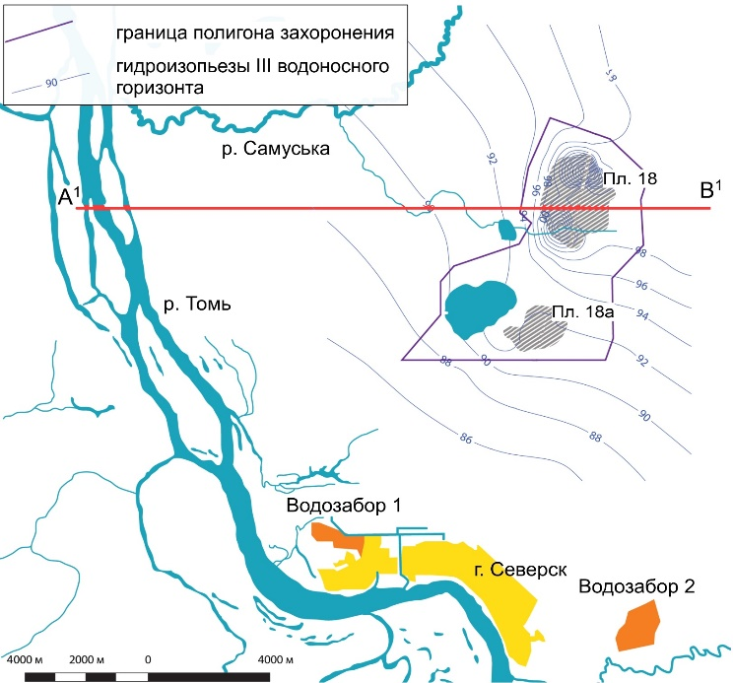
Post-injection transport of contaminant
[Glinsky et al., 2014]
riv. Tom
injection area
Notes:
A number of forecast models for long-term waste migration have been developed for the site, which indicate that injected waste will migrate to the groundwater discharge area of the Tom River valley.
Pollution will first migrate horizontally to the groundwater discharge area and then vertically to the Tom river
Для исследуемого объекта разработан ряд прогнозных моделей долговременной миграции отходов, которые показывают, что закаченные отходы будут мигрировать в зону разгрузки потока подземных вод - долину реки Томь. Загрязнение сначала будет мигрировать в горизонтальном направлении к зоне разгрузки подземных вод, а далее вертикально разгружаться в русло р. Томь

Slide 33
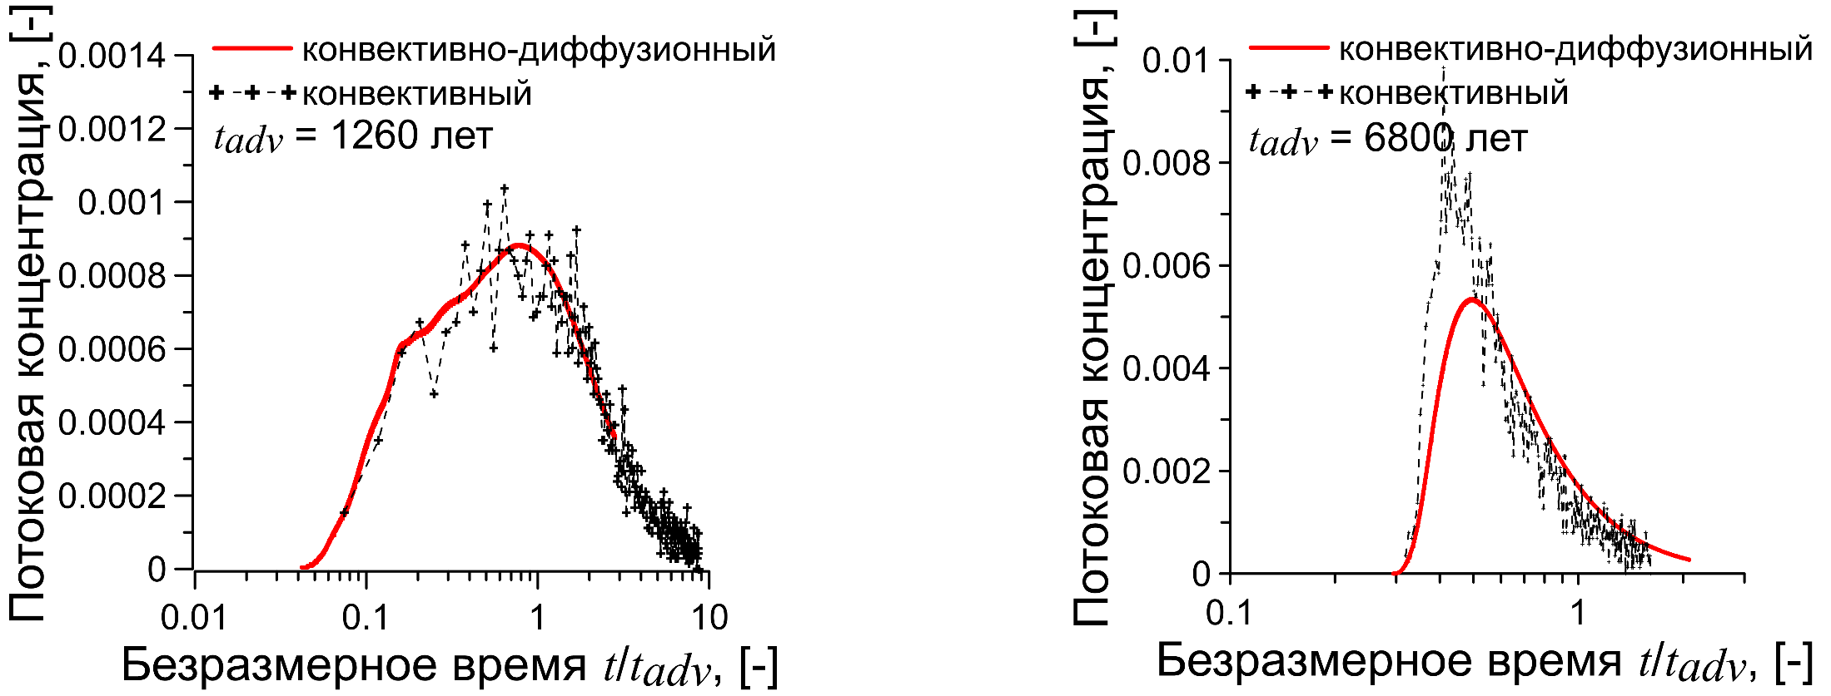
Comparison advective and advective-diffusion simulation results
where, Q – total flow out [L³/T], t – time [T], M_{out} – total mass leaving the model [M]
v
v
Base model
advective-diffusuion
advective
advective-diffusuion
advective
years
years
Flowing concentration, [-]
Flowing concentration, [-]
Dimensionless time t/t_{adv}, [-]
Dimensionless time t/t_{adv}, [-]
Dimensionless time t/t_{adv}, where t_{adv} is the characteristic time of advective transport through the model Time of advective transport t_{adv}=(L·n)/v, where L is the model length , n porosity
Notes:
Understanding the role of diffusion in the convection-dispersion flow was determined by comparing the output curves of two types of mass transfer.
The output curves reflect the mass ejection through the boundary of the model opposite to the impulse start (Figs. 3, 4). For this purpose, the mean flux concentrations in the output sections of the models were calculated by expression. The output curves of both models of geofiltration heterogeneity for vertical transport (see Fig. 3) show that the curves for the two types of mass transport are almost identical. Such behavior of the curves shows the absence or rather low influence of diffusion on the ascending migration. For the horizontal transport (see Fig. 4) the situation is different, for both models the peak flow concentration for the convective-diffusion transport is 20% less than for the convective transport, which indicates the accumulation of migrant's share in the permeable parts of the models.
Понимание роли диффузии в конвективно-дисперсионном потоке определялось путем сравнения выходных кривых по двум типам массопереноса. Выходные кривые отражают вынос массы через противоположную от импульсного запуска границу модели (рис. 3, 4). Для этого рассчитывались средние потоковые концентрации в выходных сечениях моделей по выражению. По выходным кривым обеих моделей геофильтрационной неоднородности для вертикального транспорта (см. рис. 3) видно, что для двух типов массопереноса кривые практически идентичны. Такое поведение кривых показывает отсутствие или довольно низкое влияние диффузии на восходящую миграцию. Для горизонтального переноса (см. рис. 4) ситуация отличается, для обеих моделей пиковая потоковая концентрация для конвективно-диффузионного переноса на 20% меньше, чем для конвективного переноса, что свидетельствует о накоплении доли мигранта в слабопроницаемых частях моделей.

Slide 34
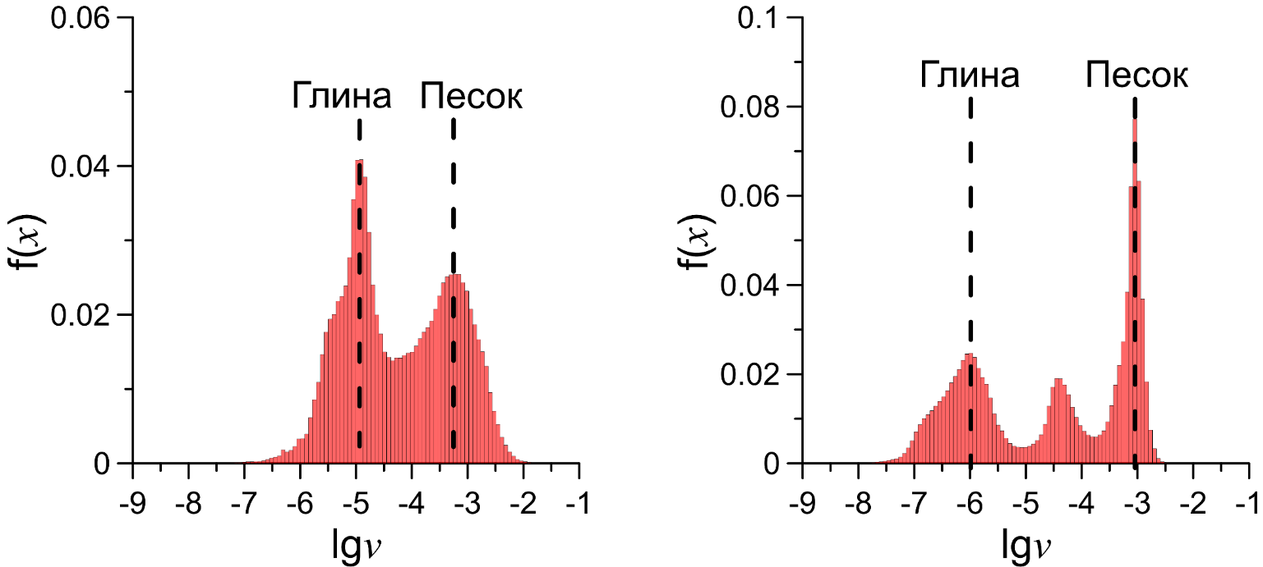
Estimation of mass transfer type in the low-permeable facies
where, v_{x}, v_{y}, and v_{z} are flow velocity [L/T] in the directions x, y и z
clay
sand
clay
sand
v
v
where, v is average velocity in facies [L/T], M is typical thickness of facies [L], D is diffusion coefficient [L²/T]
Direction | Model | Pe, [-] | Type of mass transport in «clay»
Vertical | Base | 27 | Advective
 | Long | 1 | Advective
 | Perfectly-layered | 12 | Advective
Horizontal | Base | 0,55 | Diffusion
 | Long | 0,65 | Diffusion
Notes:
to test that fact, we built a model
For an accurate assessment of the effect of diffusion, the Peckle criterion was assessed individually for clayey and sandy hydrophages, thus determining the dominant types of mass transfer in the model hydrophases under consideration. The expression for calculating the criterion (number) of the Peckle Pe [ - ] looks like [9]:
where v is the average velocity in the facies [L/T], M is the characteristic thickness of the facies [L]. It can be seen from the expression that, knowing the prevailing velocity (velocity module for three-dimensional flow) in each hydrophase, it is possible to calculate an individual value of the Peckle criterion. According to [9], the criterion of transition of the convective type of mass transfer to the convective-diffusion type is the number of Pecklais equal to 1.
Speed modules for the models under study were calculated by expression:
As a result, speed modules for each model block were obtained. Further on, histograms of the distribution of velocity modules (Fig. 5, 6) were built according to the obtained values, on which two peaks responsible for the prevailing velocities in clay hydrophasing - the left peak and in sand hydrophasing - the right peak - are clearly distinguished. The reason why the remaining two hydrofacies, sandy clay and clay sand, did not appear is the small share of these hydrofacies in the total volume of 3 and 15%, respectively. Assuming that the extremum of the velocity modulus of each hydrophage corresponds to the prevailing velocity in this lithological difference, the velocity modulus in the clayey and sandy hydrophages were determined for all models.
Using the obtained values of velocity modules for each lithological type, as well as experimentally determined average diffusion coefficient by expression (3), the intervals of Peckle criterion for each of the models were calculated (Table 4). The obtained calculations show that in case of vertical transfer for both models, convective mass transfer dominates in clay hydrophation. In order to exclude the influence of through well-permeable canals, a horizontal-layered model was considered. The thicknesses of the interlayers for it were set according to the characteristic thicknesses obtained during the geostatistical analysis (see Table 3). Thus, this model reflects the most protected environment, which is characterized by the absence of vertical permeable channels
Для точной оценки влияния диффузии оценивался критерий Пекле индивидуально для глинистой и песчанистой гидрофаций, тем самым определялись доминирующие типы массопереноса в рассматриваемых модельных гидрофациях. Выражение для расчета критерия (числа) Пекле Pe [ - ] имеет вид [9]:
где v -- средняя скорость в фации [L/T], M -- характерная мощность фации [L]. Из выражения видно, что, зная преобладающую скорость (модуль скорости для трехмерного потока) в каждой гидрофации, можно вычислить индивидуальное значение критерия Пекле. Согласно работе [9] критерием перехода конвективного типа массопереноса в конвективно-диффузионный является число Пекле, равное 1.
Модули скорости для исследуемых моделей вычислялись по выражению:
В результате были получены модули скорости для каждого модельного блока. Далее по полученным значениям строились гистограммы распределения модулей скорости (рис. 5, 6), на которых явно выделяются два пика, отвечающие за преобладающие скорости, в глинистой гидрофации -- левый пик и в песчаной гидрофации -- правый пик. Причиной, по которой не проявились оставшиеся две гидрофации, песчанистая глина и глинистый песок, является малое долевое участие этих гидрофаций в общем объеме -- 3 и 15% соответственно. Полагая, что экстремум модуля скорости каждой гидрофации соответствует преобладающей скорости в данной литологической разности, были определены модули скорости в глинистой и песчанистой гидрофациях по всем моделям.
Используя полученные значения модулей скорости для каждого литологического типа, а также экспериментально определенный средний коэффициент диффузии по выражению (3), рассчитывались интервалы критерия Пекле для каждой из моделей (табл. 4). Полученные расчеты показывают, что при вертикальном переносе для обеих моделей в глинистой гидрофации доминирует конвективный массоперенос. Чтобы исключить влияние сквозных хорошо проницаемых каналов, была рассмотрена горизонтально-слоистая модель. Мощности прослоев для нее задавались согласно характерным мощностям, полученным в ходе геостатистического анализа (см. табл. 3). Тем самым такая модель отражает максимально защищенную среду, которая характеризуется отсутствием вертикальных проницаемых каналов

Slide 35
Research objectives:
Pore scale, 10⁻⁴ – 10⁻³ m
Determination of diffusion coefficient from data on microstructural analisis and simulated of diffusion process
3-D pore space model
8 cm
2. Sample scale, 10⁻² – 10⁻¹ m
Experimental determination of transport parameters of low-permeable sediments on real samples
Sample for experiment
3. Layer scale, 10¹ – 10² m
Analysis of contaminant transport on a high-resolution detailed model with a complex structure of flow heterogeneity
3-D flow heterogeneity model
4. Scale of regional model, 10³ – 10⁴ m
Justification of effective mass transfer parameters of the dual-domain model
Regional model
Notes:
In order to get there, 4 research objectives were formulated, each of which corresponded to a specific scale of research. And the transition from scale to scale was carried out.
Для достижения поставленной цели, были сформулированы 4 задачи исследования, каждая из которых отвечала конкретному масштабу исследований. И осуществлялся переход с масштаба на масштаб.

Slide 36


Justification of forecast long-term transport models
Effective parameters
n⁰, n*, D, α
Mass transfer equation for such media - model with one capacity
Usually used model to describe such media – dual-domain model
?
=
Piece of
regional
model
v
n⁰, n*, D, α
v
If yes, then the mass transfer parameter α = ?
Notes:
The use of regional models that take into account detailed lithological heterogeneity is currently excluded due to the lack of sufficient provision with parameters. Therefore, an attempt was made to reduce the three-dimensional model of geofiltration heterogeneity to the model with double capacity, assuming that the size of the three-dimensional model roughly corresponds to the fragment of the regional model. The double-capacity model implies convective mass transfer along the well-permeable part of the section and diffusion mass transfer with the poorly-permeable part, in which the intensity of this process is controlled by the mass transfer coefficient.
Использование региональных моделей, учитывающих детальную литологическую неоднородность, на данный момент исключено по причине отсутствия достаточной обеспеченности параметрами. Поэтому была предпринята попытка редукции трехмерной модели геофильтрационной неоднородности к модели с двойной емкостью в предположении, что размер трехмерной модели грубо может соответствовать фрагменту региональной модели. Модель с двойной емкостью подразумевает конвективный массоперенос по хорошо проницаемой части разреза и диффузионный массообмен со слабопроницаемой частью, в которой интенсивность этого процесса контролируется коэффициентом массообмена.

Slide 37


Parameters definition of dual-domain model
3-D model
1-D model
k_{eff}, n, ΔH
v
v
4300$×$ 3500$×$130 m
4300m×25m×0,5 m
n*, n⁰, D, α
n*+ n⁰=0,2
Comparison of results
3D model
1D model
Initial approximation - method of statistical moments
Arrival times distribution f_{t} (t, L), [-]
PEST
optimization
Time, [years]
Notes:
Determination of the mass transfer parameter was carried out by obtaining an effective output curve from a one-dimensional model, taking into account the double capacity, and comparison with the output curve, determined during three-dimensional modeling. The comparison was made for the horizontal version of the model with the basic size of lithological heterogeneity.
Определение параметра массообмена осуществлялось путем получения эффективной выходной кривой по одномерной модели, учитывающей двойную емкость, и сравнения с выходной кривой, определенной в ходе трехмерного моделирования. Сравнение осуществлялось для горизонтального варианта модели с базовым размером литологической неоднородности.

Slide 38


Estimated parameters for long-term forecasting at SCС
Calculation of mass transfer coefficient for 10,000 years using the multi-rate exchange model [Fernandez-Garcia и Sanchez- Vila, 2015]
Selected parameter sets for dual domain model
set 1
set 2
set 3
Arrival times distribution f_{t} (t, L), [-]
Long tail due to dual domain
(blocks)
Mass transfer coefficient α, [day⁻¹]
Time, [years]
Time, [years]
*1 – all observations are equal ; 2 – peak weight 0,5 ; 3 – peak weight 0,1
Estimated parameters
Parameter set | Chanels porosity n⁰, [-] | Blocks porosity n*, [-] | Dispersion D, [m²/day] | Mass transfer coefficient α, [day⁻¹]
1 | 0,12 | 0,06 | 0,43 | 9,68×10⁻⁸
2 | 0,14 | 0,06 | 0,84 | 5,77×10⁻⁸
3 | 0,13 | 0,06 | 0,70 | 6,42×10⁻⁸
Notes:
The impossibility to describe the output curve of three-dimensional modeling completely by means of the model (5) is most likely connected with the fact that the process of diffusion filling of low-permeability lenses is determined not only by the diffusion coefficient, but also by its power. Thus, for a horizontally layered bed with a constant thickness of low-permeability interlayers, parameter α is directly proportional to the diffusion coefficient and inversely proportional to the power square [9]. Since the thicknesses of the interlayers of the investigated complex, according to the analysis of well cores [6], have an exponential distribution, it is obvious that due to diffusion the least powerful interlayers are filled faster and then more powerful. Such a character of filling leads to the fact that in time the current exchange coefficient should decrease. The influence of this process is shown in Table 5, from which it follows that the greater the weight of the "tail" points of the output curve, the smaller the value of the calculated parameter α. Such behavior of the exchange coefficient in time was noted earlier in the published works, in which on the basis of the analysis of the experiments of different authors [16] and the theoretical analysis of the model with multi-rate exchange [15] it is shown that the value of parameter α in the model (5), as a rule, is inversely proportional to the time of the experiment. Taking into account the above mentioned, as an effective parameter for long-term and ultra-long-term prediction of pollution migration in the medium in question, the variant, in which the weight of observations was set as the maximum for the "tail" output curve (curve 3), was chosen. The parameters obtained with the help of PEST were: mobile porosity 0.13; immobile porosity 0.06; dispersion coefficient 0.7 and mass transfer coefficient 6.42×10---8 days---1.
Невозможность описания выходной кривой трехмерного моделирования полностью при помощи модели (5), вероятнее всего, связана с тем, что процесс диффузионного заполнения слабопроницаемых линз определяется не только коэффициентом диффузии, но и ее мощностью. Так, для горизонтально-слоистого пласта с постоянной мощностью слабопроницаемых прослоев параметр α прямо пропорционален коэффициенту диффузии и обратно пропорционален квадрату мощности [9]. Поскольку мощности прослоев исследуемого комплекса, согласно анализу кернов скважин [6], имеют экспоненциальное распределение, то очевидно, что за счет диффузии быстрее заполняются наименее мощные прослои, а затем более мощные. Такой характер заполнения приводит к тому, что во времени текущий коэффициент обмена должен уменьшаться. Влияние этого процесса продемонстрировано в табл. 5, из которой следует, что чем больше вес точек «хвоста» выходной кривой, тем меньше значение расчетного параметра α. Такое поведение коэффициента обмена во времени отмечалось ранее в опубликованных работах, в которых на основе анализа данных опытов различных авторов [16] и теоретического анализа модели с многоскоростным обменом [15] показано, что величина параметра α в модели (5), как правило, оказывается обратно пропорциональной времени эксперимента. Учитывая вышесказанное, в качестве эффективного параметра для долгосрочного и сверхдолгосрочного прогнозирования миграции загрязнения в рассматриваемой среде выбран вариант, вес наблюдений в котором задавался максимальным для «хвоста» выходной кривой (кривая 3). Полученные при помощи PEST параметры составили: пористость мобильная 0,13; пористость иммобильная 0,06; коэффициент дисперсии 0,7 и коэффициент массообмена 6,42×10⁻⁻⁻⁸ сут⁻⁻⁻¹.

Slide 39
Results
Non-sorbing contaminant diffusion coefficient
Estimates of distribution coefficients
Determined effective coefficients
Determined empirical coefficients m in Archie law
Determined mass transfer coefficient for SCC
For the used head gradient in the flow unloading area, longitudinal and basic models of flow heterogeneity show that advctive mass transfer prevails over diffusion mass transfer in blocks. A similar result is obtained on the perfectly layered model
Most likely, in a zone with a smaller vertical head gradient, diffusion in low-permeability sediments will play a more important role
Notes:
Коэффициент диффузии нейтрального мигранта в диапазоне (3,06 – 4,64)×10⁻⁶ м²/сут, при активной пористости исследуемых образцов 0,18-0,35.
Оценки коэффициентов распределения для сорбируемых элементов составили для Cs⁺ от 0,21 до 22,1, Ba²⁺ от 1,1 до 1,45, Ni²⁺ от 0,3 до 16,4, Co²⁺ от 1,98 до 24,7, Sr²⁺ от 1,9 до 14,3.
Определенные коэффициенты эффективности диффузии по эксперименту хорошо согласуются с данными моделирования диффузии на микромоделях.
Эмпирические коэффициенты m для закона Арчи определены по трем направлениям x, y (по напластованию) и z (перпендикулярно), попадают в диапазон значений для слабопроницаемых отложений, приведенных в литературных источниках, и варьируют от 2,2 до 2,5.
Для используемого градиента напора в области разгрузки потока, модели геофильтрационной неоднородности протяженная и базовая показывают что, конвективный массоперенос преобладает в блоках над диффузионным массопереносом. Аналогичный результат получен на слоистой модели.
Вероятнее всего в зоне с меньшим вертикальным градиентом напора диффузия в слабопроницаемых отложениях будет играть более важную роль.
Рекомендуемое значение коэффициента массообмена для полигона СХК 6·10⁻⁸ сут⁻¹.

Slide 40



Compacted bentonite study
Dispersion
Diffusion
piece of homogeneous media
Advective-dispersion transport equation
in a homogeneous media

Slide 41

Prototype bentonite test set-up
Creation of a compact sample
Determination of swelling pressure
Determination of hydraulic conductivity
Determination of diffusion coefficients and distribution coefficients
Sample diameter 3 cm
Possibility to set the height of the sample from 0,5,1 and 1,5 cm

Slide 42






Measurement equipment for swelling pressure
Calibration of load cell
Microcontroller ATmega328 8-bit
Analog-digital converter 24-bit HX711
Analogue load cell CAS MNC-500
Precision controller
GDS pressure/volume

Slide 43


Diffusion in compacted bentonite
When using a peristaltic pump, it is important to prove the non-convective component
Correct observation of boundary conditions - distribution of constant concentrations over the entire sample area, i.e. minimisation of lateral diffusion
Conducting a two-chamber experiment
Proof of "pure" diffusion
Diffusion experiment scheme
Bentonite
Porous filter
Chanel “snake”

Slide 44







Porous metal filter
Sample thickness should be at least 5 filter thicknesses.
It is necessary to know the diffusion coefficient of the filter
Filter material must be inactive to the model solutions
X-ray
microtomography
Data reconstruction
3D Pore – metal binarization
Spatial correlation analysis
Average porе size 8mkm
Thickness
0,2 mm
REV
To be continued...

Slide 45
Thank you for your attention!

