Slide 1

Climatic change, data analysis
Ondřej Nol

Slide 2
Climatic change
Climatic change - change of climate, which is attributed directly or indirectly to human activity that alters the composition of the global atmosphere and which is in addition to natural climate variability observed over comparable time periods;
Topic of presentation – based meteo and hydro data available is climatic change visible?
Can we define any change on data available?
How can be used the data for description of climatic change in shallow ground water in the study areas?

Slide 3
Climatic change
We should find any unusual changes of water entering to the hydrogeological aquifer, flowing through hydrogeological aquifer and leaving hydrogeological aquifer;
This can be described by 3 historical changes of hydrological variables: entering volume = recharge; water content; outflow = base flow.

Slide 4
Climatic change
Input – recharge is not possible to measure directly, we have to analyze precipitation - there are available precipitation data from 11 meteo stations;
Water content – regular and long term observations of GWL fluctuation are not available, experience from more than 40 years measurement in Czech Republic will be shown;
Outflow – discharge data - there are available discharge data more than 30 gauging stations (recession curves and minimal monthly discharges).

Slide 5
Precipitation
Long-term rainfall norms are the average annual rainfall values over a 30-year period, currently between 1961 and 1990. These values are then used for 30 years, i.e. until 2020. This is the standard procedure used by the WMO;
However, this definition could not be met using the data available for study area. Consequently, efforts were made to identify at least the most comparable norms both in terms of the length and the beginning of the norm period.

Slide 6
Precipitation
The first step was to complete the data for the period between 1992 and 2016 and create a 1992 rainfall norm. The period between 1992 and 2016 was selected because data from most of the stations were available and it is also of sufficient length for the given purposes.
Longer periods could only be relevantly completed from 1963 for the Gore, Gondar and Jimma stations. In the case of these three stations, it is possible to compare the total annual rainfall between 1992 and 2016 with the 1963 norm (i.e. the norm for the previous period 1963 - 1991). ;

Slide 7
Precipitation

Slide 8
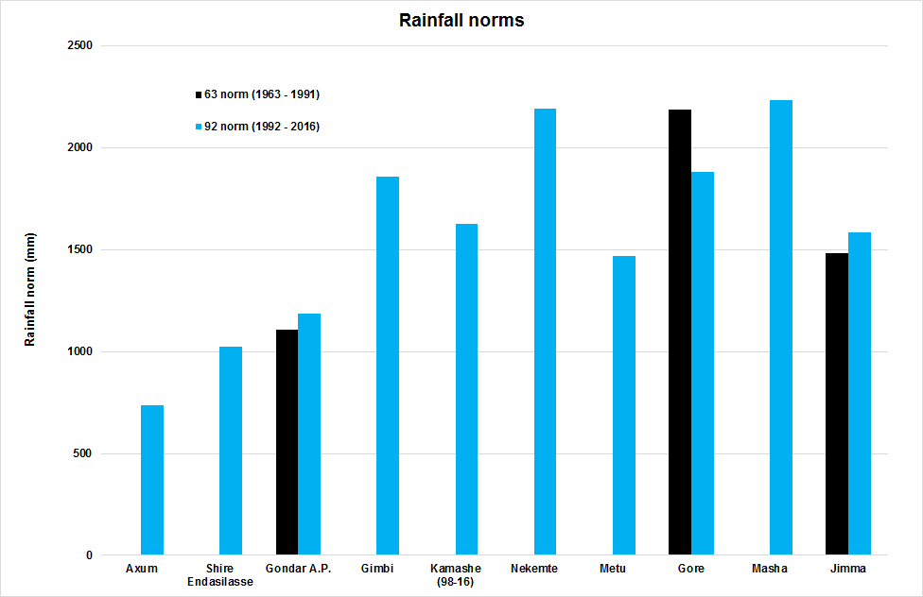
Precipitation

Slide 9
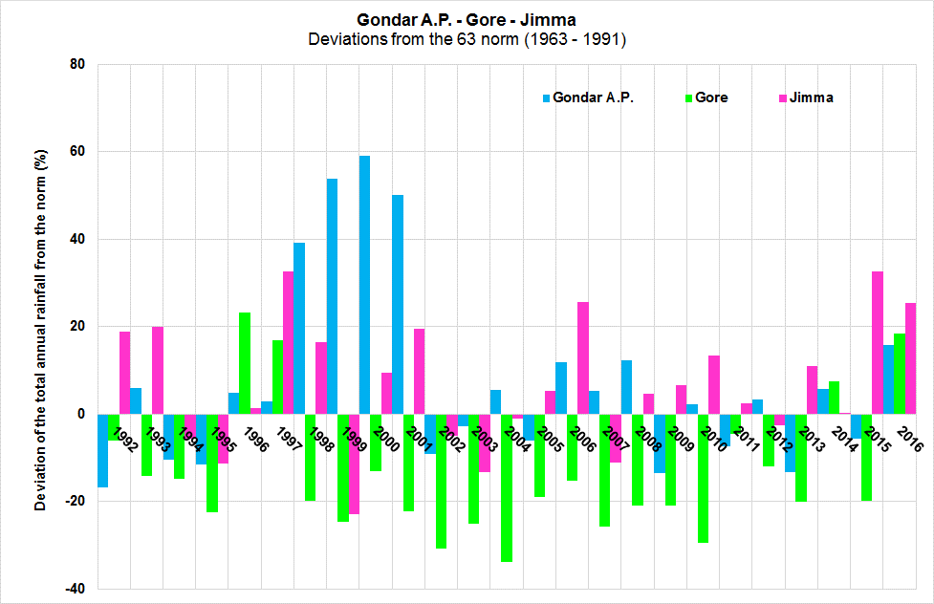
Precipitation

Slide 10
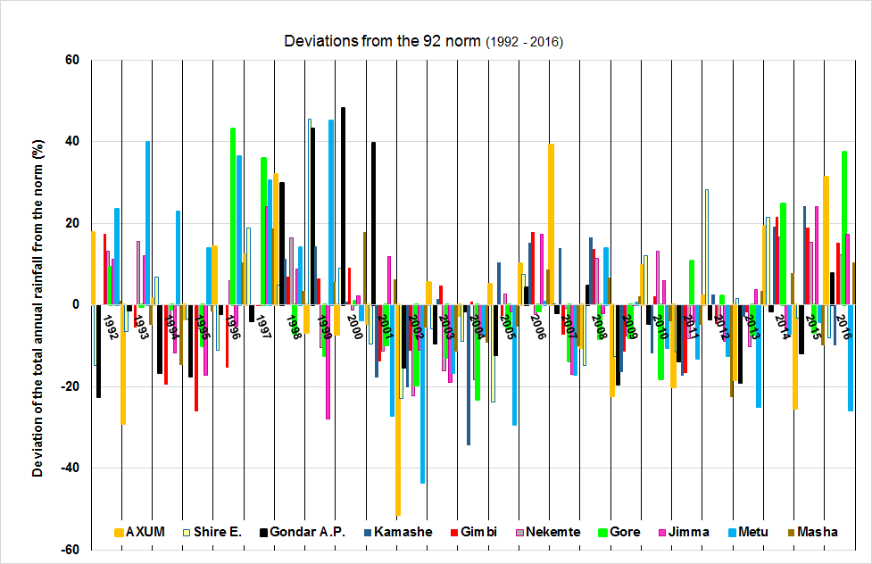
Precipitation

Slide 11
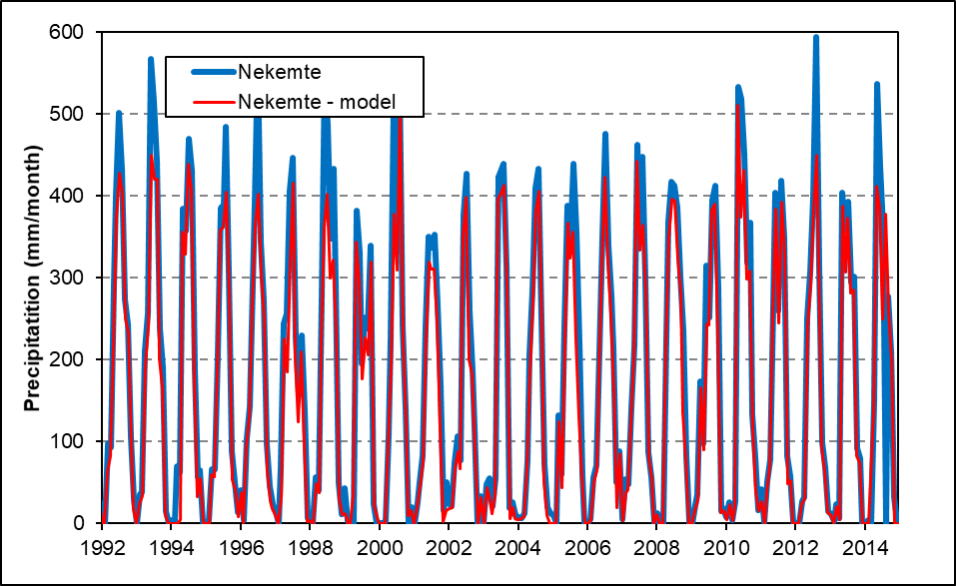
Precipitation

Slide 12
Baro at Gambela, Area: 23 461.0 sq km

Slide 13
Didesa nr. Arjo, Area: 9981.0 sq km

Slide 14
Beg woha, Area: 125.0 sq km

Slide 15
Awaitu at Jimma, Area: 72.0 sq km

Slide 16
Gojeb Shebe, Area: 3577.0 sq km

Slide 17
Indris nr. Sirie, , Area: 49.0 sq km

Slide 18
Gatchab nr. Mizantereri, area: 79 sq km

Slide 19
Kuni nr. Chanka, area: 88 sq km

Slide 20
Ouwa nr. Guliso, area: 288 sq km

Slide 21
Sore nr. Metu, area: 1622 sq km

Slide 22
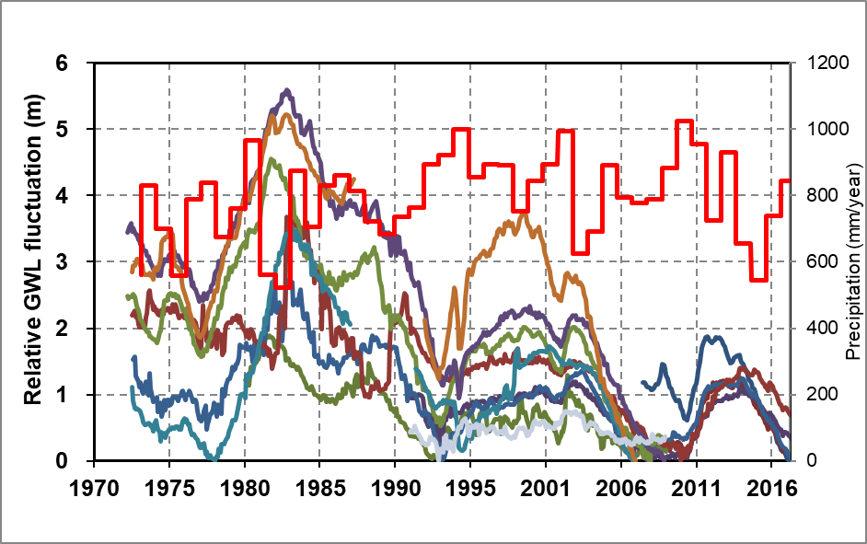
GWL fluctuation

Slide 23
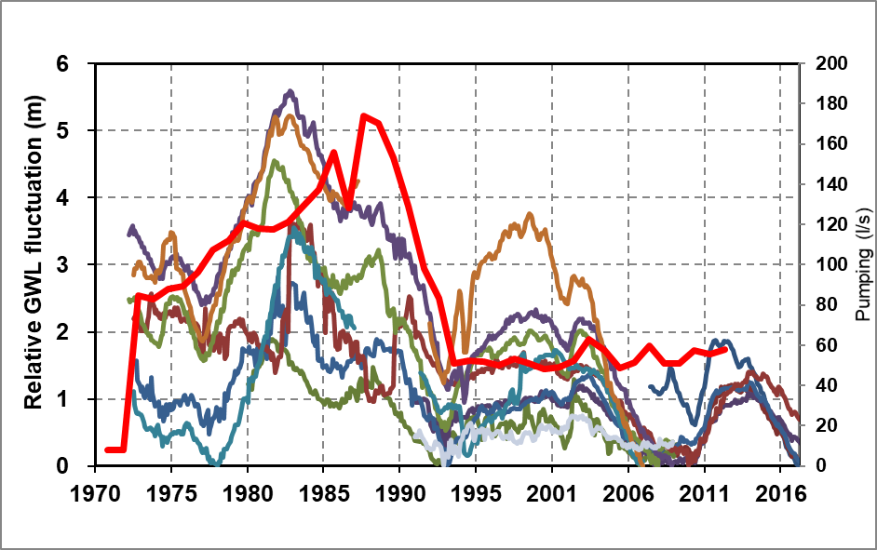
GWL fluctuation

Slide 24
Hydrology - sub-basin data, BILAN calculation

Slide 25
Hydrology - sub-basin data, BILAN calculation

Slide 26
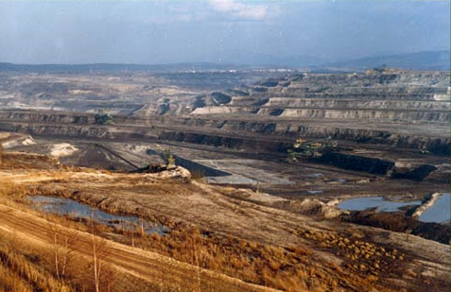
Pokles hladin podzemní vody v terciéru hrádecké pánve
Vlivem těžby na dole Turów hladiny podzemní vody poklesly v nejvíce ovlivněné části o více než 60 m v terciérních kolektorech a o 20 m
V pánevní struktuře jsou zastoupeny tři hlavní terciérní kolektory: spodní (podwenglovy), střední (medziwenglovy), svrchní (nadwenglovy) a kvartérní kolektor v glacifluviálních sedimentech

Slide 27
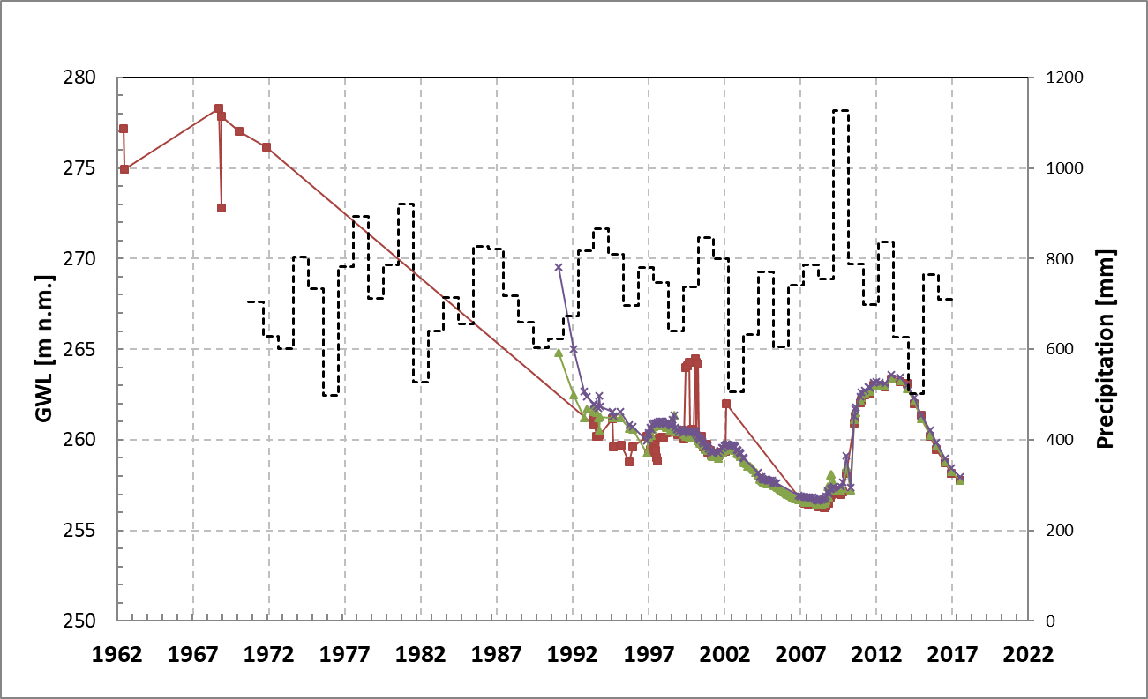

Slide 28
Conclusions and recommendations
On data available, impacts climatic change on ground water levels is not clear and is highly subjective, because of insufficient data, data gabs and small reliability for this evaluation;
For descriptions and observations (predictions) of impact climatic change (and of course future water use for irrigation) is neccesssary to established monitoring system of ground level observations;
Special effort for consumption curves for minimal discharges are essential.

