Slide 1
Computation of groundwater flow
Derivation of simple hydrogeological
models created on the basis
of hydrogeological maps, parallel flow
Simple calculations of groundwater flow
in EXCEL, testing of key parameters
Ondrej Nol

Slide 2
Content:
Case problem – introduction to the hydrogeological problem;
Dupuit aassumptions and derivation of governing equation; Determination of boundary conditions and resulted equations;
Derivation key input data from explanatory notes: hydraulic heads, hydraulic gradient, hydraulic conductivity, aquifer base, aquifer thickness and aquifer width.

Slide 3
Computation of groundwater flow
Content:
Estimations of groundwater volume flowing through the aquifer for given hydraulic conductivity, water saturation and aquifer geometry, Calibration;
Comparisons of groundwater flow derived from different approaches;
Discussions, uncertainity;
Evaluation of quality.

Slide 5
Asela sheet

Slide 6
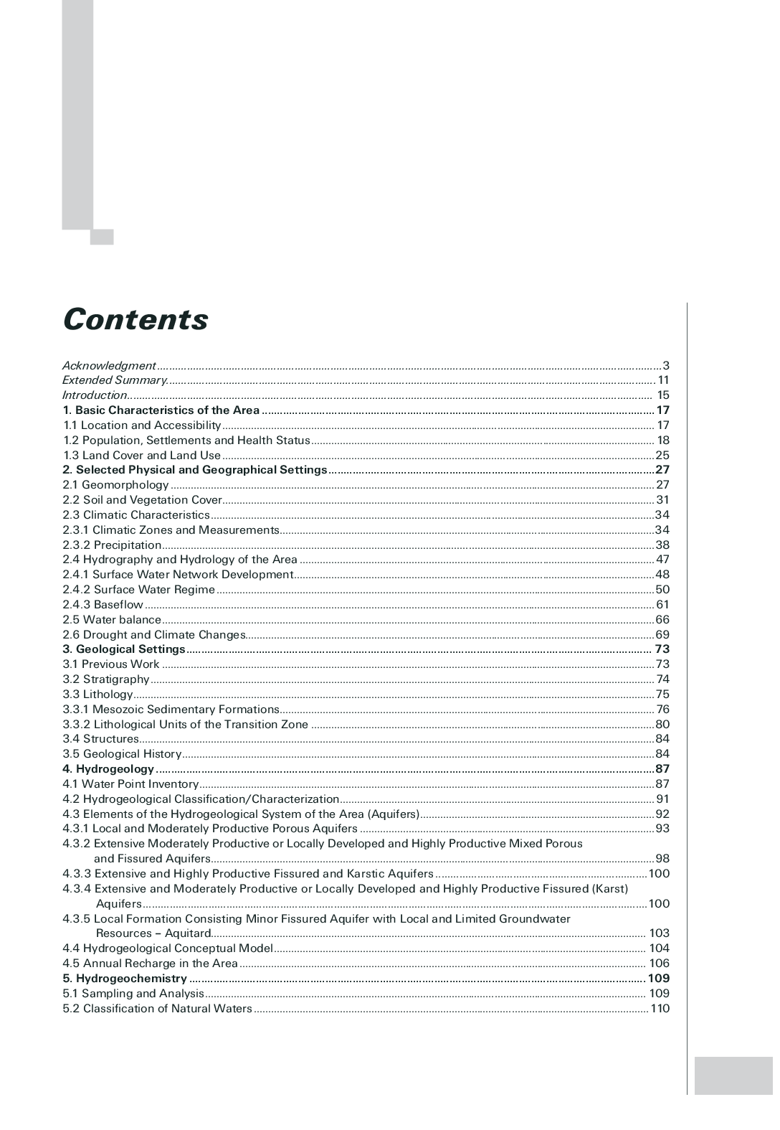
Contents

Slide 7
Annexes

Slide 8
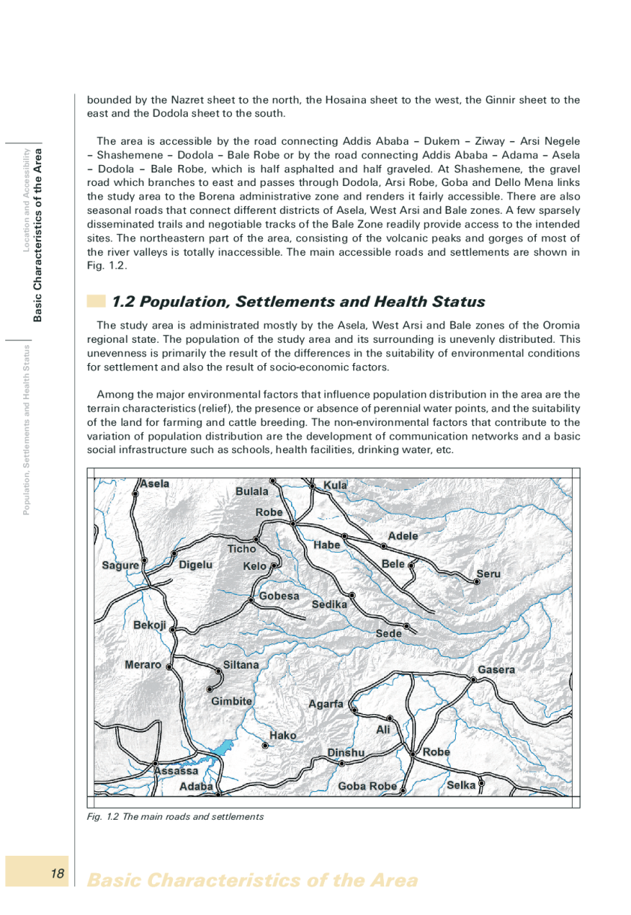
Page 18

Slide 9
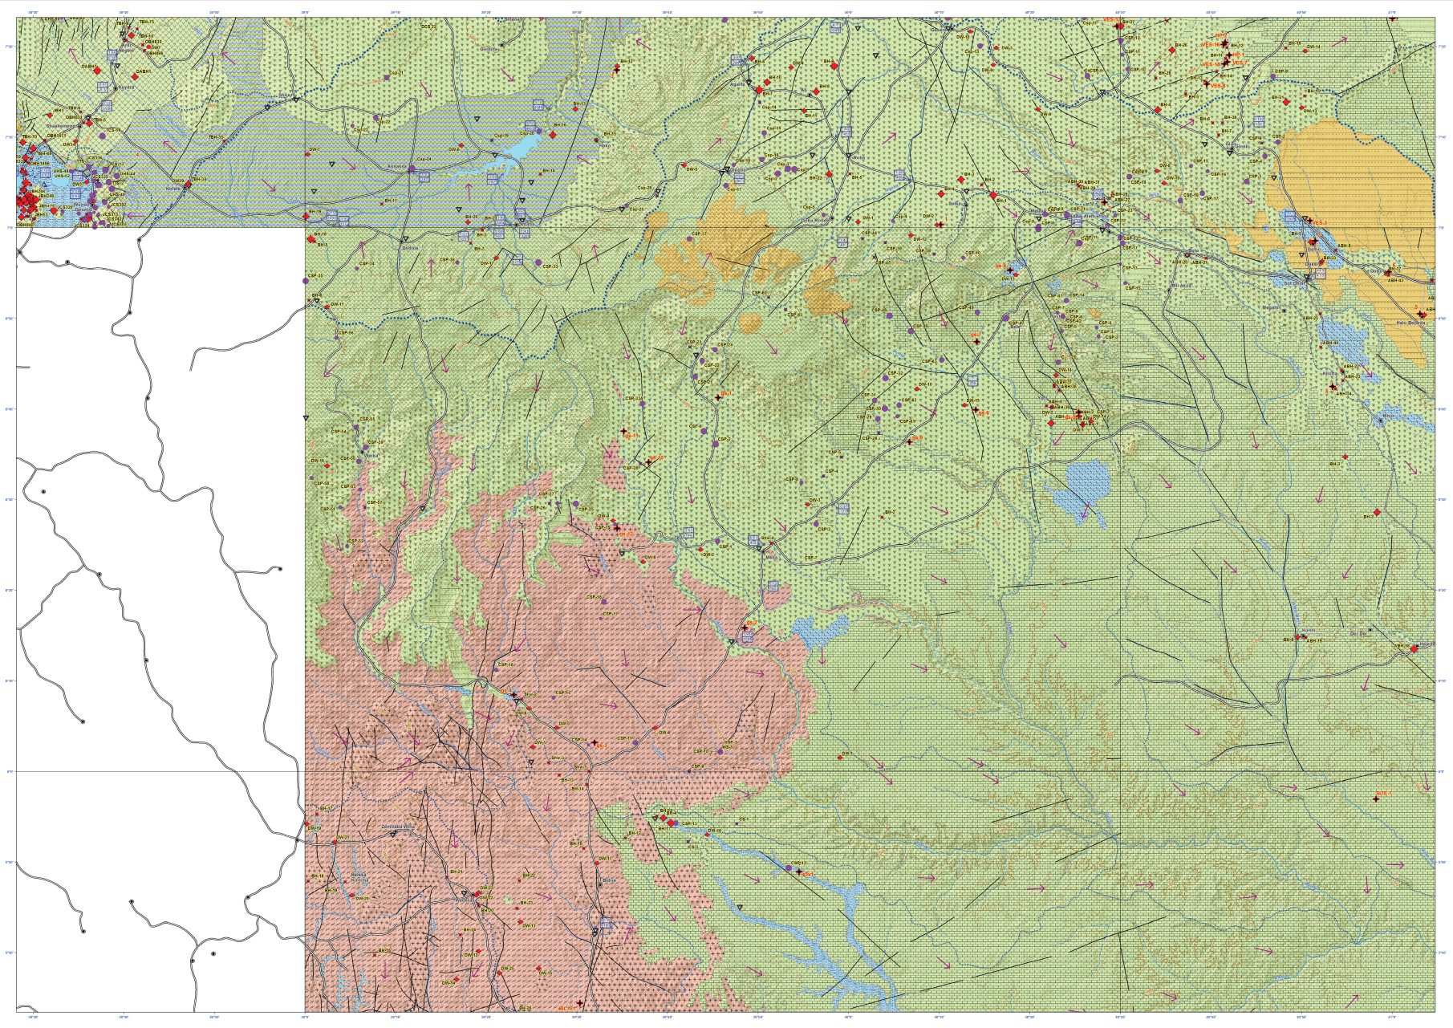
Asela sheet
Dodola sheet

Slide 10
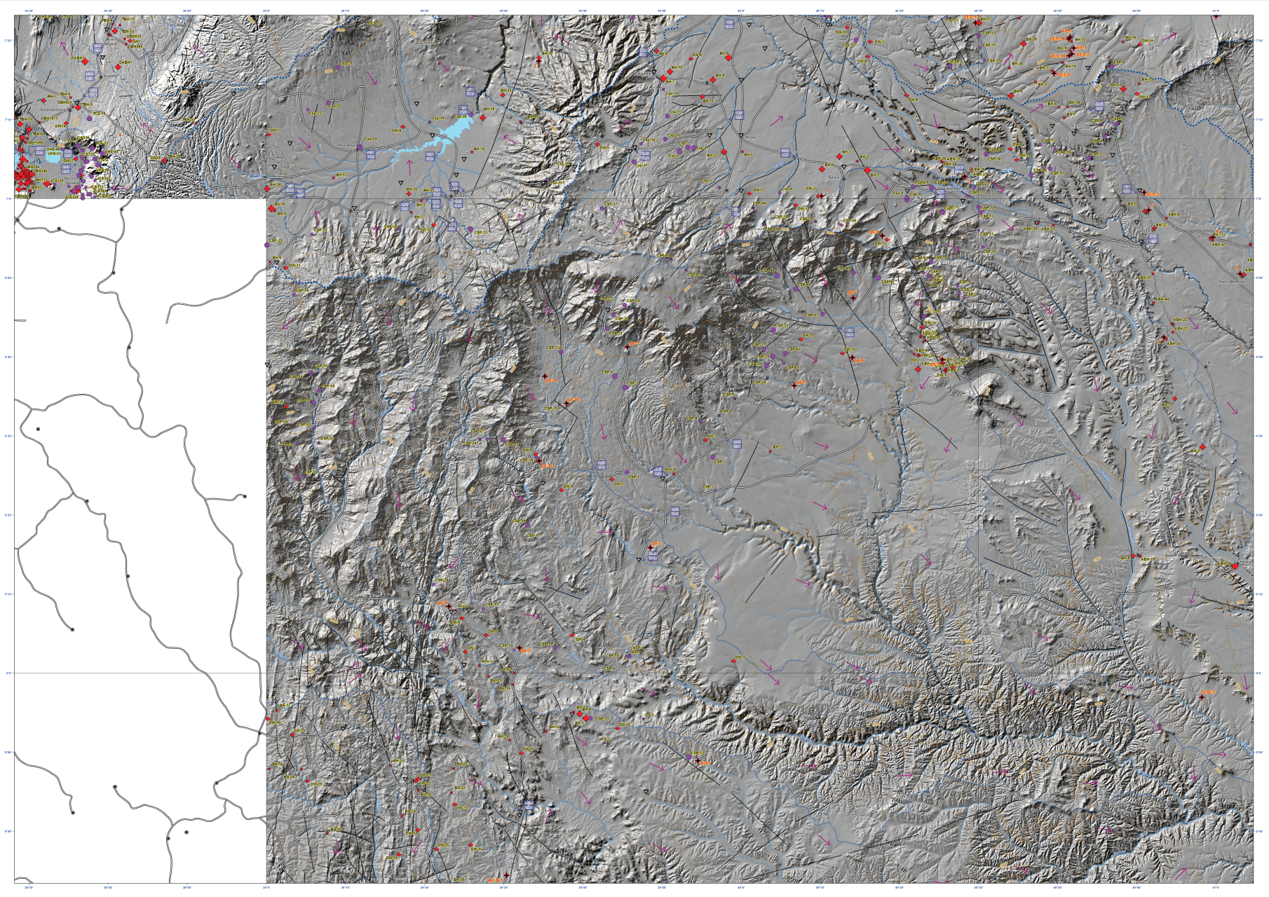
Weyb River

Slide 11
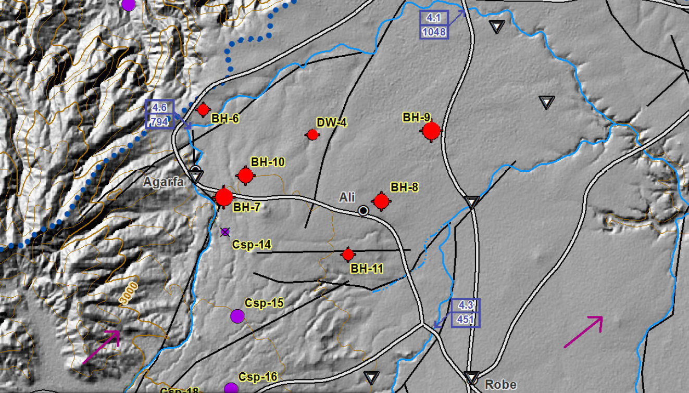
Weyb River

Slide 12
Weyb River
Direction of ground water flow

Slide 13
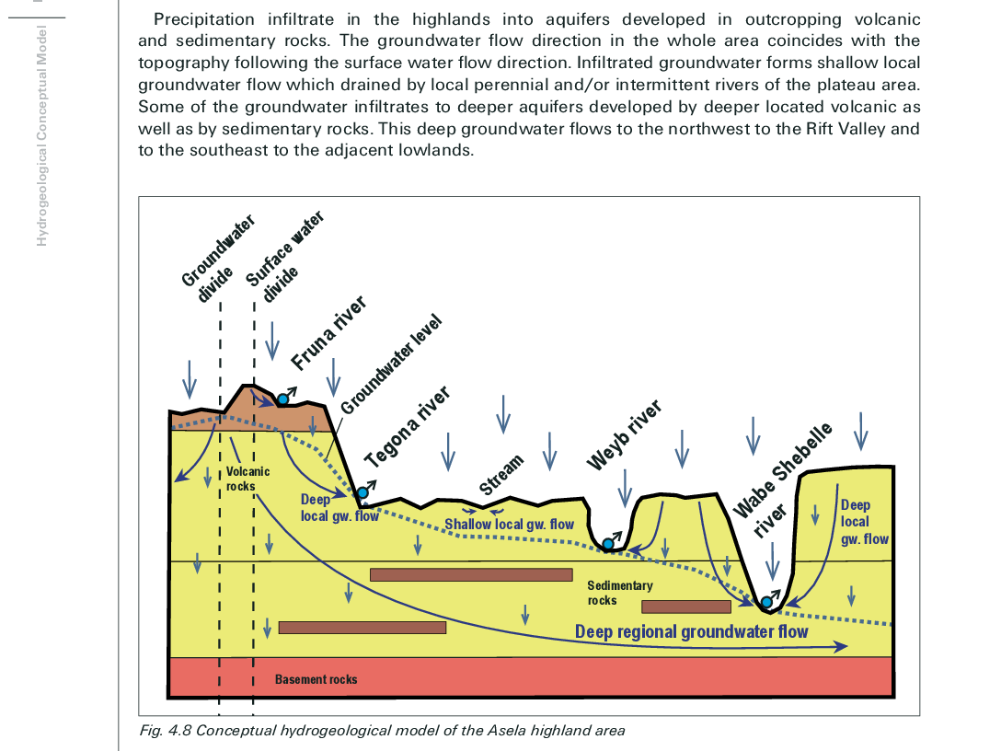
Page 104

Slide 14
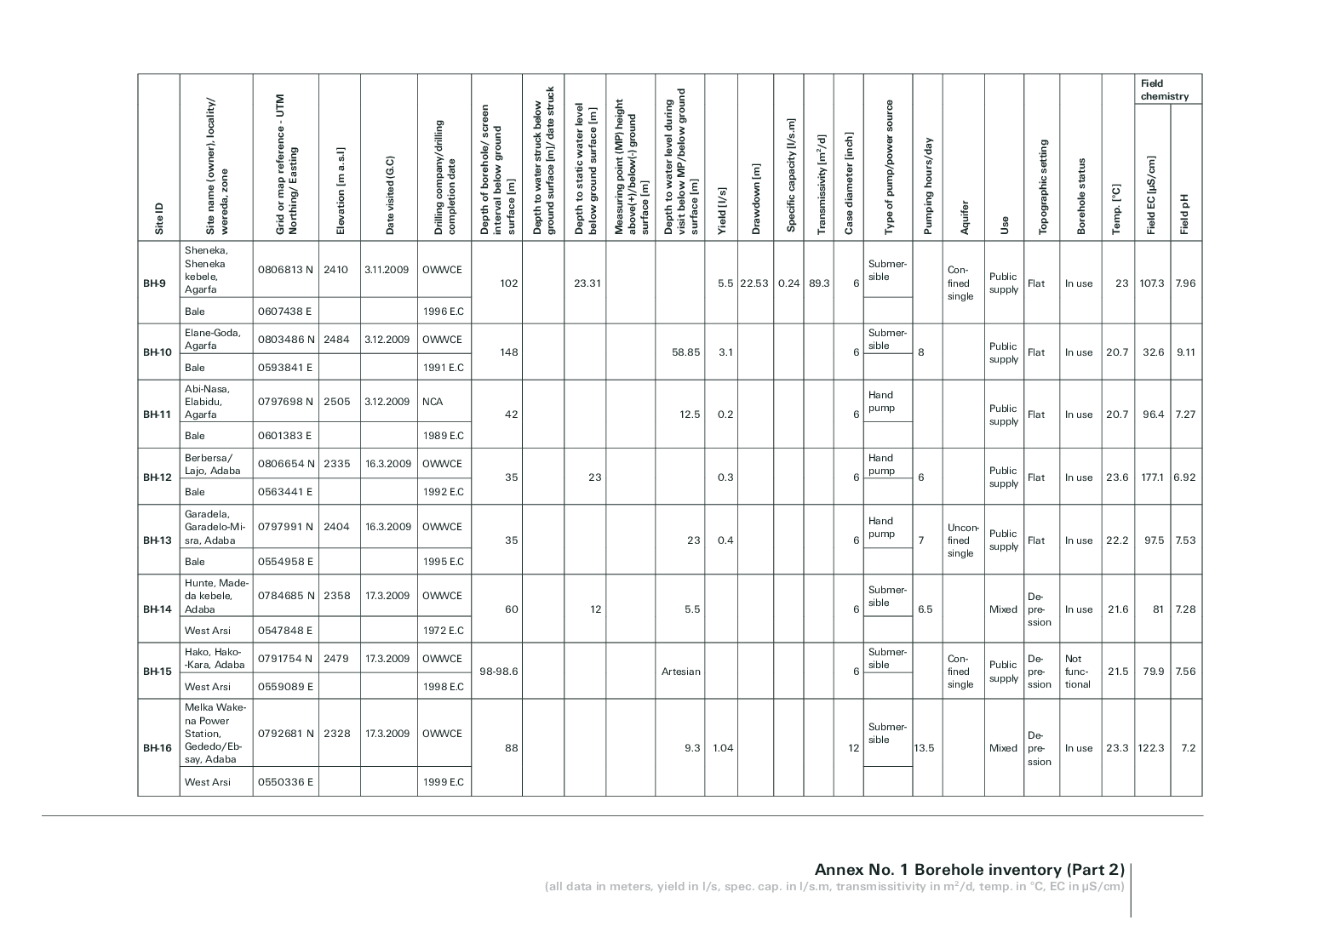
Annex No. 1 Borehole inventory (Part 2)

Slide 15
Annex No. 1 Borehole inventory (Part 2)

Slide 16
Width = 5 km
Length = 27 km

Slide 17
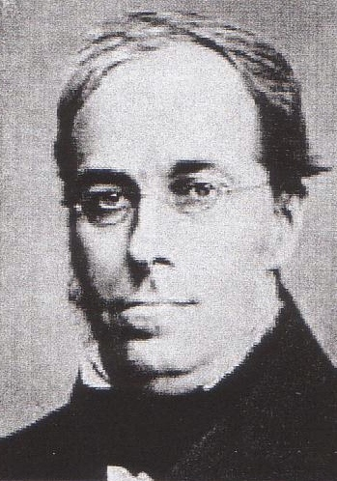
Computation of groundwater flow
Dupuit Assumptions:
For unconfined ground water flow Dupuit developed a theory that allows for a simple solution based of the following assumptions:
1) The water table or free surface is only
slightly inclined
2) Streamlines may be considered horizontal
and equipotential lines, vertical
3) Slopes of the free surface and hydraulic
gradient are equal

Slide 18
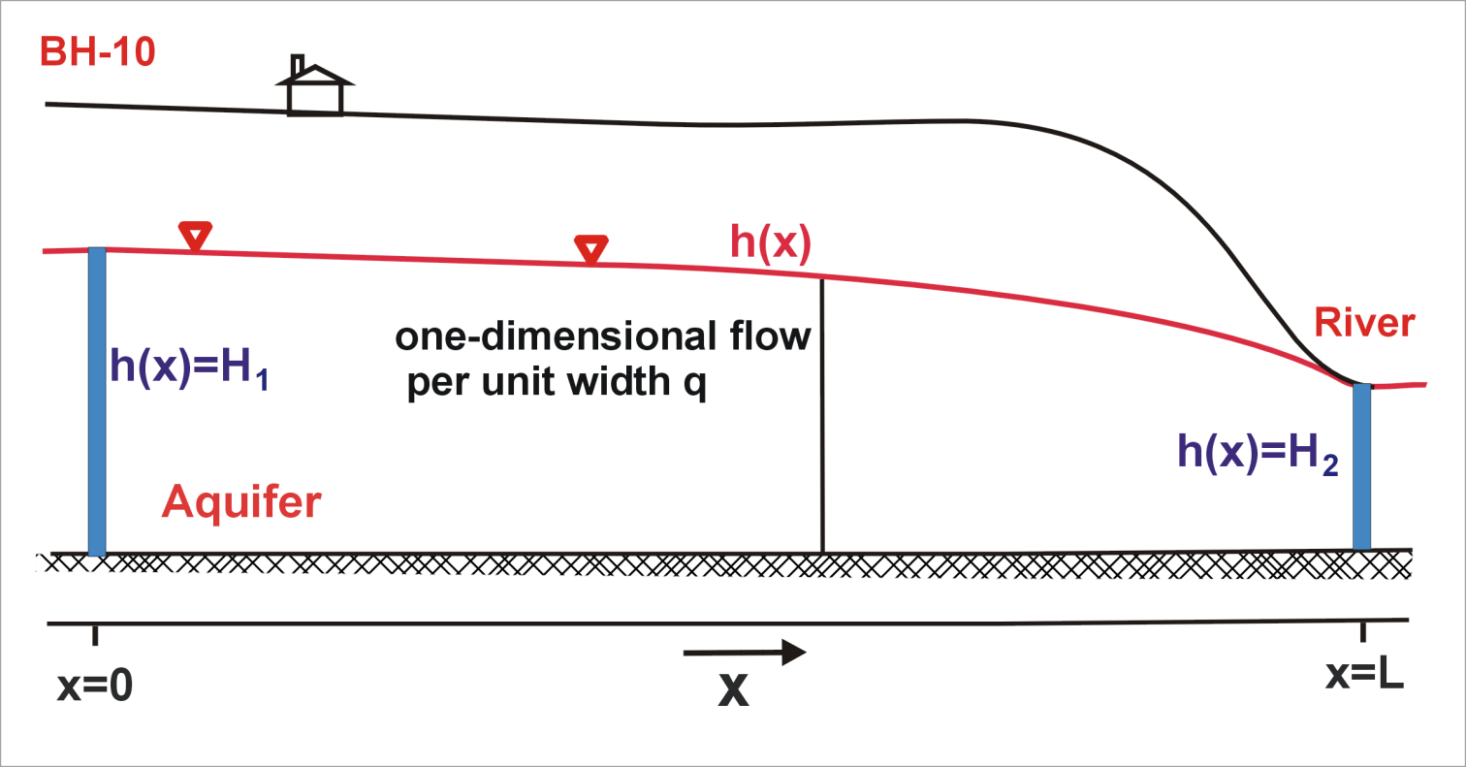
Computation of groundwater flow
Derivation of the Dupuit Equation - Unconfined Flow

Slide 19
Computation of groundwater flow
Derivation of the Dupuit Equation - Unconfined Flow

Slide 20
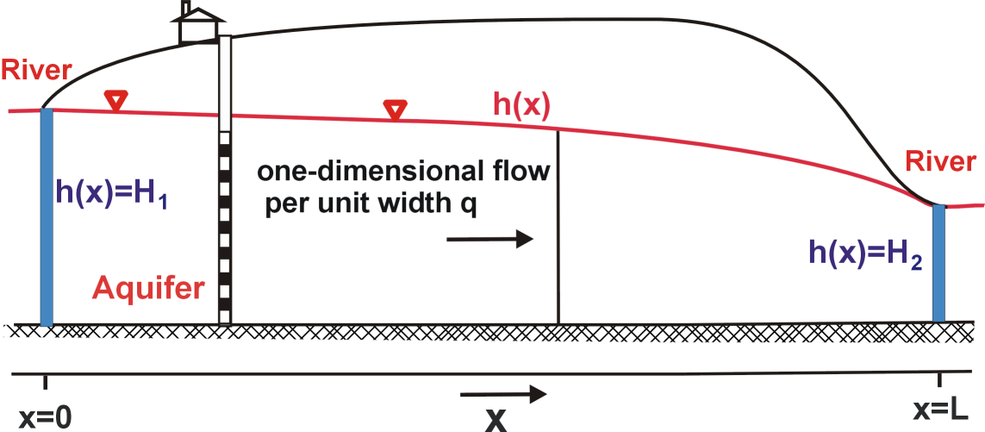
Computation of groundwater flow
Derivation of the Dupuit Equation - Unconfined Flow
h(0)=H₁
h(L)=H₂

Slide 21
Computation of groundwater flow
For given one-dimensional
flow yields:
However, this example does not consider recharge to the aquifer.

Slide 22
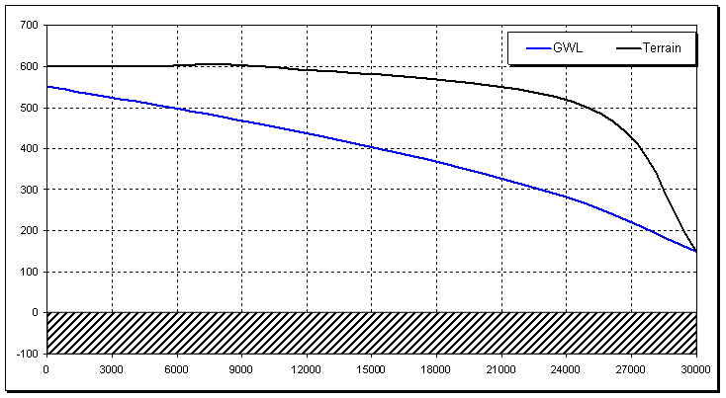
Well siting strategy
Inflow hydral. Head H1 is known, no infiltration

Slide 23
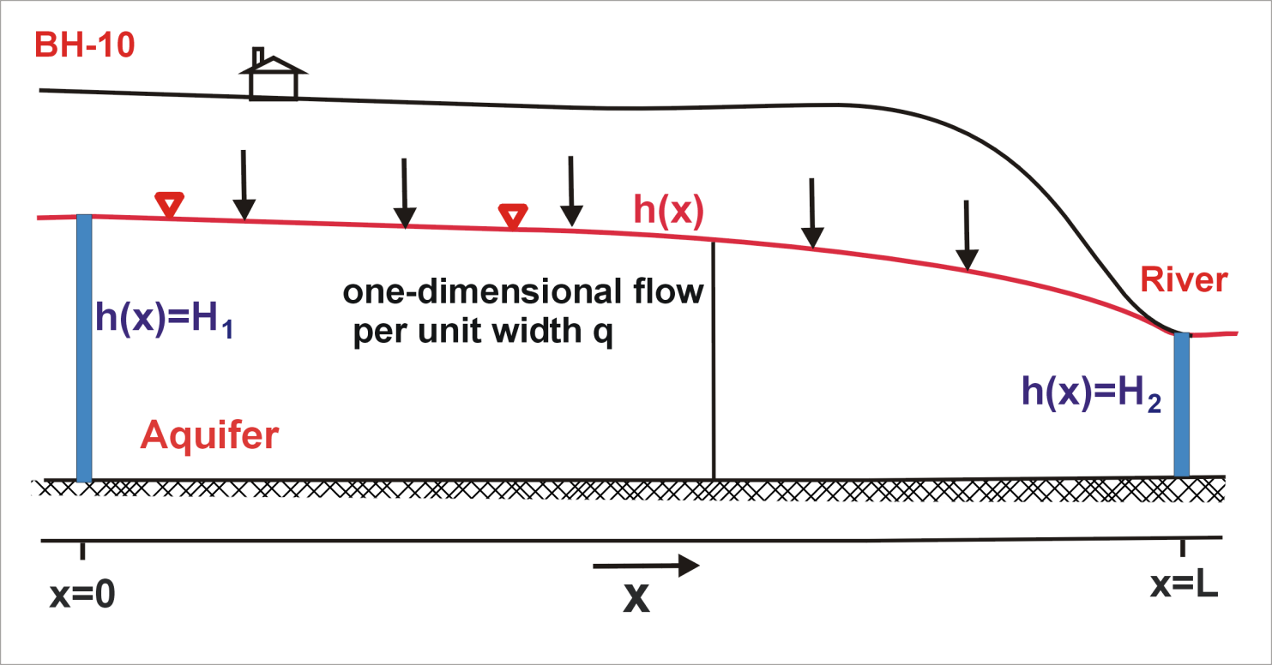
Computation of groundwater flow
Derivation of the Dupuit Equation - Infiltration

Slide 24
Computation of groundwater flow
Derivation of the Dupuit Equation - Infiltration
h(0)=H₁
h(L)=H₂

Slide 25
Computation of groundwater flow
Derivation of the Dupuit Equation - Infiltration

Slide 27
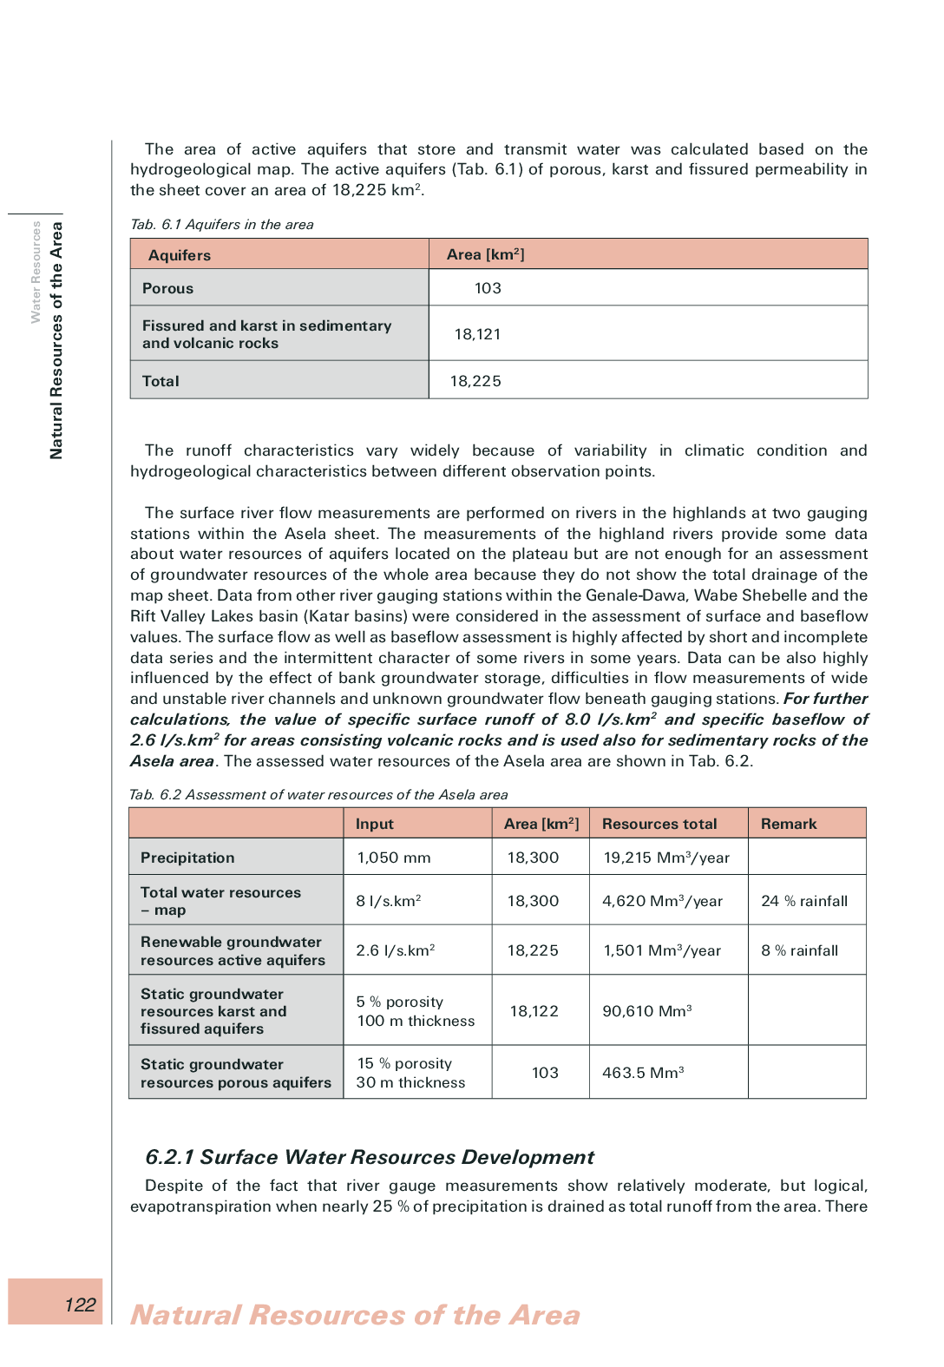
Page 122

Slide 28
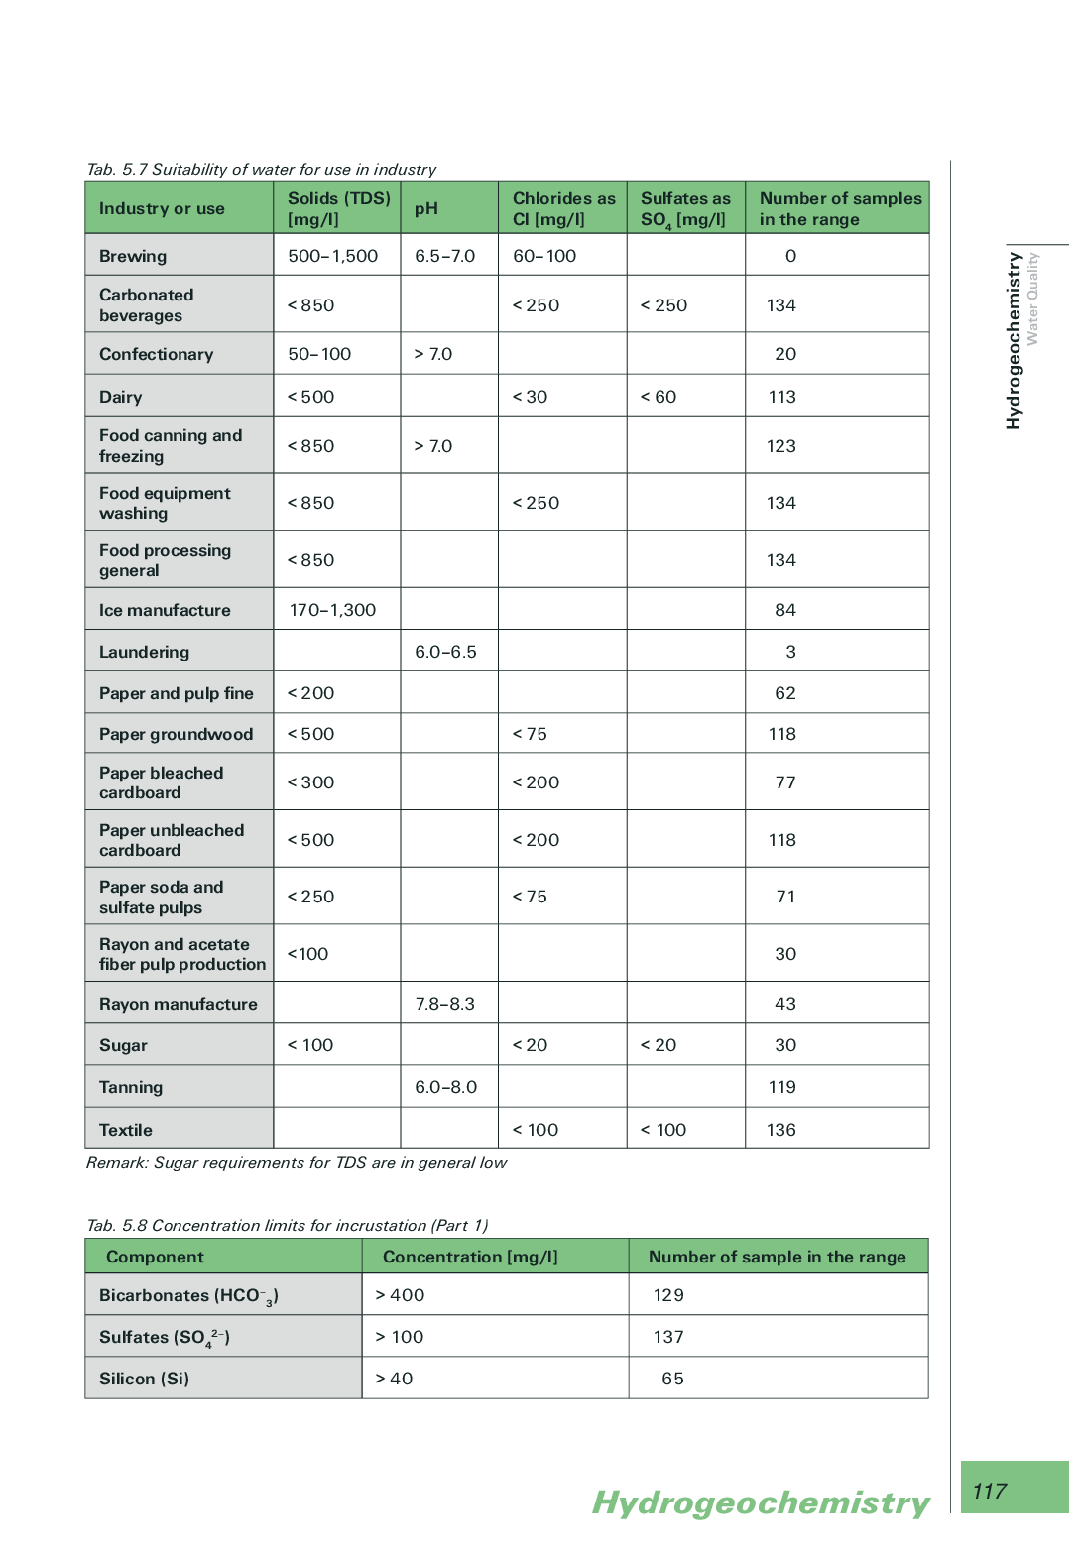
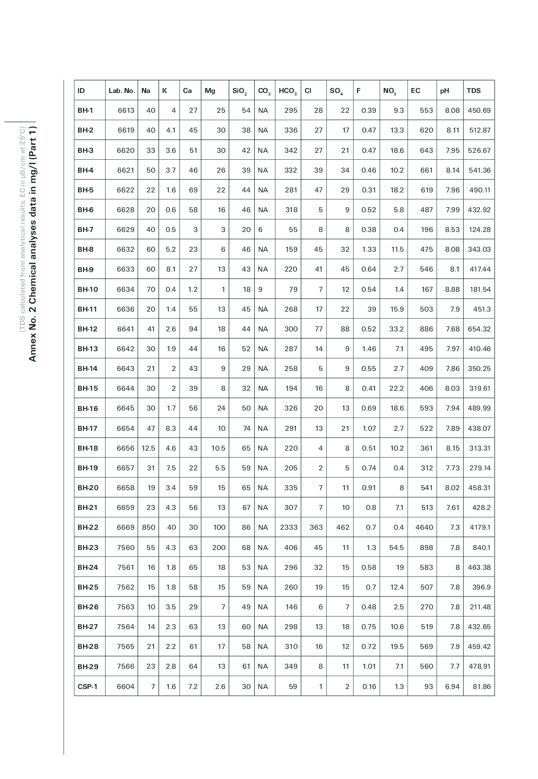
Page 117
Annex No. 2 Chemical analyses data in mg/l (Part 1)

