Slide 1
Textile Spreading
Lecture 2
Adnan Mazari, Ph.D

Slide 2
Buyer
Tomy Hilfiger
Merchandizer
Sampling
Production
Spreading/Cutting manager
Coordination with owner and buyer
Production manager
Stitching In-charge
Quality/ Shipment

Slide 3
Flow Chart
PATTERN MAKING
GRADING
MARKER MAKING
FABRIC SPREADING
IRONING
SEWING
SORTING & BUNDLING
CUTTING
INSPECTION
PACKING
SHIPMENT

Slide 4
Spreading and cutting flow process
Planning
Spreading
Cutting
Preparation for sewing

Slide 5
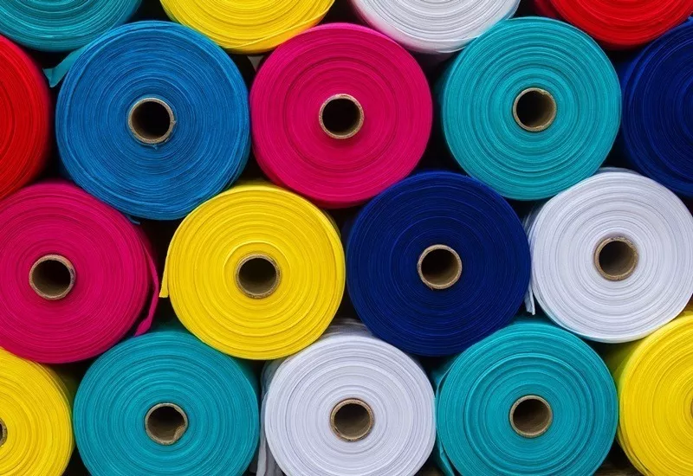
Fabric in roll form

Slide 6
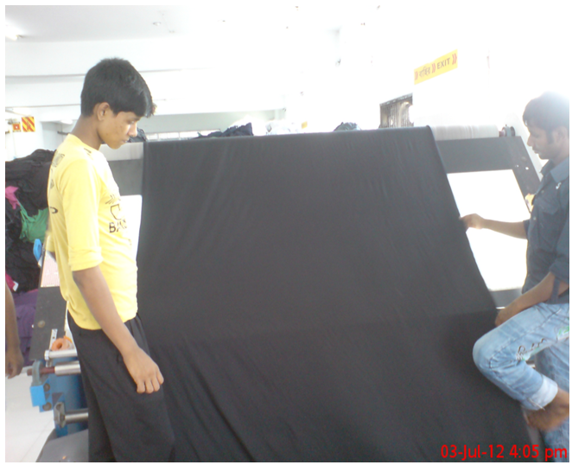
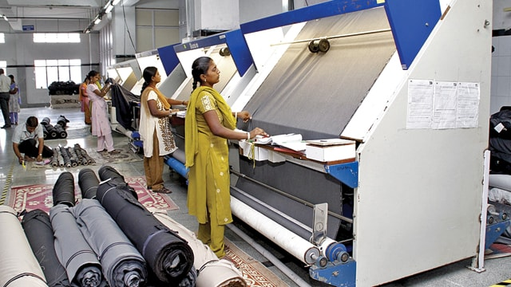
Before we spread
Fabric Inspection:

Slide 7
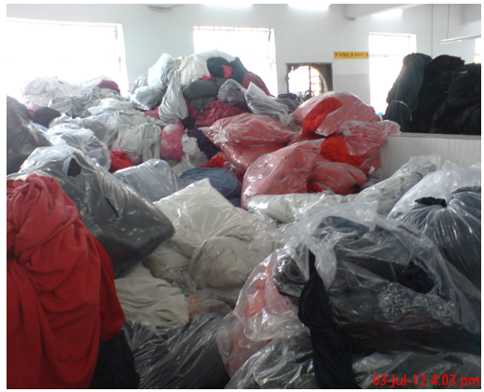
Fabric Relaxation:
Relaxation Period:
Fabric relaxation is performed for a certain period. This time is varied from fabric to fabric. But the minimum time of relaxation is twelve (12) hours. This time also may vary according to the buyer’s recommendation.

Slide 8
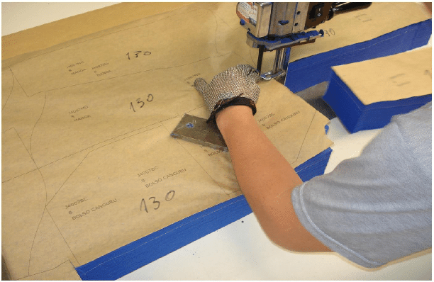
Fabric Spreading:
Fabric spreading is a method where piles of fabric are spread a specific length and width wise according to the garment marker measurement.
Marker??

Slide 9
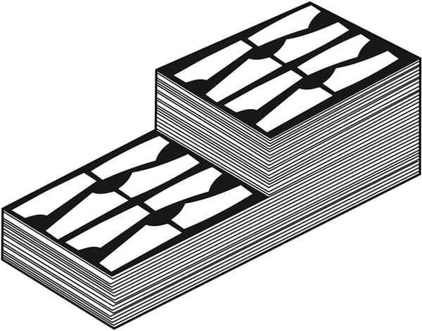
Number of plies depends on: Capacity of the cutting machine,
Volume of production,
Type of fabric itself (rough or slippery) and
Thickness of fabric.
Types of Fabric Spreads

Slide 10
Fabric Spreading Process
There are two methods applied in garment industry for fabric spreading process.
Manual Method
Totally hand spreading method therefore this process is quite slow.
. By hand b. By hook Mechanical Method
They are semi-automatic and full automatic

Slide 11
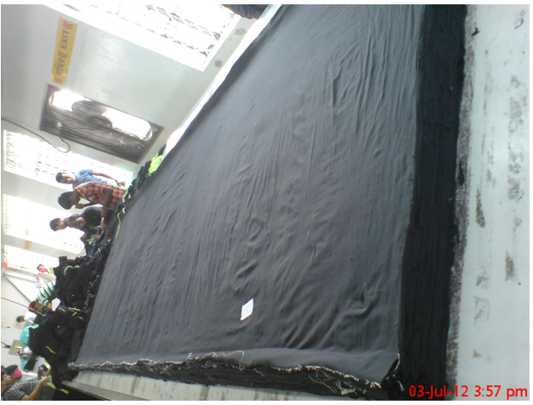

Slide 12
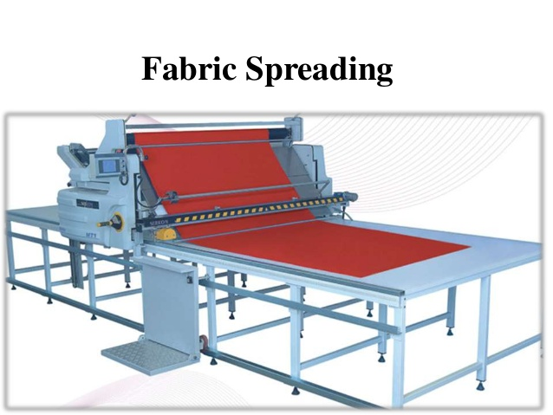

Slide 13
Preparation before spreading
Fabric Length and Weight:
Fabric Tension:
Fabric Splicing:
Static Electricity:
Fabric Ply Direction:
Ply Number
Stripe and Check Matching:
Fabric Faults removing

Slide 14
Fabric Splicing

Slide 15
Fabric Splicing
Splicing is the technique used in the cutting room during the process of spreading. It basically incorporates cutting the fabric across its width to overlap layers in between the ends of the lay. It can be used for different reasons
1. Firstly, to accommodate for fabric defects,
2. Splicing is also used when the fabric roll being spread ends in the middle of the marker, and the end bit length is sufficient to cut one complete garment piece.
Lastly, it is used when there is a change in the size, i.e. the pattern pieces of each

Slide 16
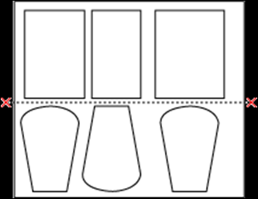
Type of Splice marks
1. Straight splices:
A straight splice line is marked across the marker width on the spreading table. This is used in cases where pattern pieces meet edge to edge across the fabric width, with no pieces sticking out of the straight line. For this method, the fabric is overlapped, 5cm on either side of the splicing line

Slide 17
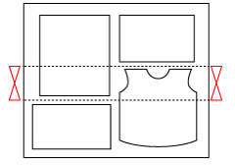
2. Interlock splices:
These crossed marks indicate the ends of the pattern pieces overlapping on the marker. The start and finish of the pattern pieces sticking put are marked with two splice lines, and the fabric is overlapped 5cm on both sides of interlock splice mark.
Splicing Loss
The fabric that is used as the spicing overlap is a waste generated during the process. This overlapped fabric waste is known as the Splicing Loss
Splicing should preferably be done for smaller pattern pieces and should be avoided for larger garments like trousers. For bigger garments, adjustments using end bits prove more efficient than splicing.

Slide 18
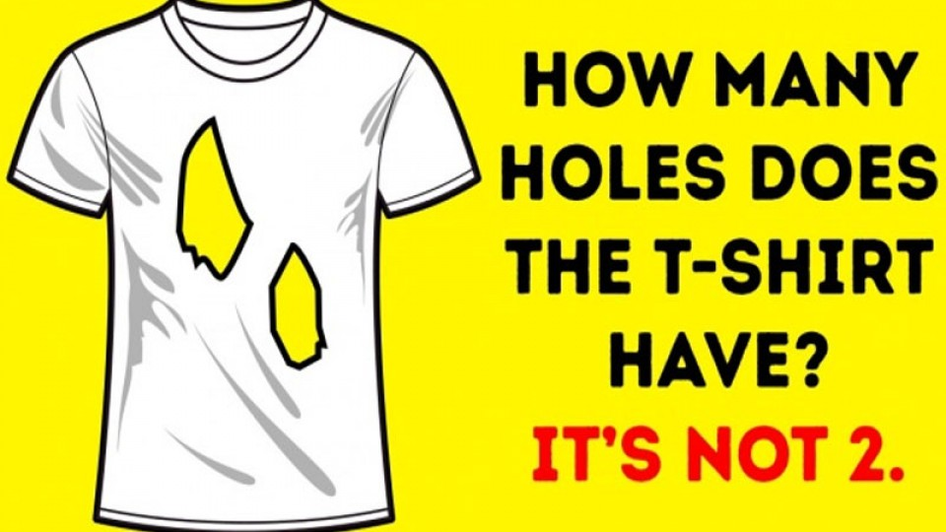
Wake Up Question!!

Slide 19
Loss at Spreading section
1. Marking Loss
2. Spreading Loss
1. End of Ply Loss
2. Edge Losses
4. Splicing Losses
5. length Losses

Slide 20
Avoid during spreading
Fabric must be flat
Elimination of fabric faults:
Correct ply direction and adequate lay stability
Avoidance of fusion of plies:
Mixing pieces

Slide 21
Types of Lay Plan/marker
Single Size Lay is used using all garment pieces of one single size. Disadvantageous as the consumption of fabric is higher.
multiple Size Lay
Whole Garment Lay includes garment pieces, left and right sides. Generally used for Open width fabrics.
Half Garment Lay includes only half of the garment pieces, for example, one side left or right. Generally used for tubular fabrics.

Slide 22
Types of Spreading
Single Ply is a single layer of fabric generally to make samples
A multiple Ply is a number of fabric layers stacked on one top of other
Stepped Lay is multiple lays in which groups of layers have different lengths generally used for getting best utilization and consumption of fabric.
Objectives:
i. To place the number of plies of fabric to the length of the marker plan correctly aligned as to length and width and without tension.
ii. To cut garments in bulk and saving in fabric through the use of multi garment marker plans and the saving in cutting time per garment that result from cutting many plies at a time.
iii. To make every ply plain and flat.

Slide 23
Forms of Spreading
One Way Cutting is when the fabric is laid the same way up with grain or print pattern running in the same direction. The fabric has to be cut at the end of each ply.
The fact to Face Cutting is when the plies are laid in pairs face to face. The grain or pattern runs in the same direction.
Two Way Cutting is when plies are laid continuously from left to right and right to left without cutting at the end. Most Efficient method of spreading. Cannot be used with grain restrictions or one-directional printed fabric.

Slide 24
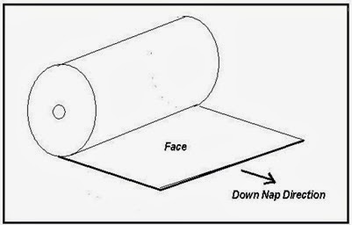
1. Fabric Put-up; Open and Rolled

Slide 25
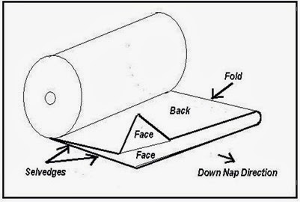
Fabric Put-up; Folded and Rolled

Slide 26
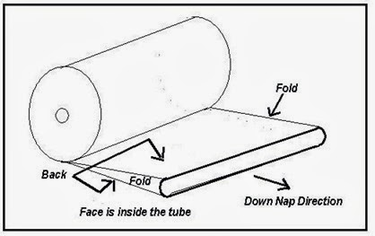
Fabric Put-up; Tubular Fabric Rolled

Slide 27
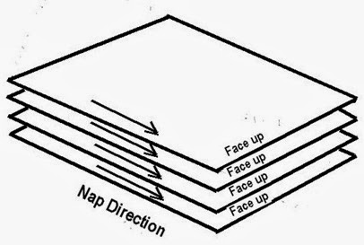
Spreading Mode; Open Fabric, Face One Way, Nap One Way (F/O/W, N/O/W)

Slide 28
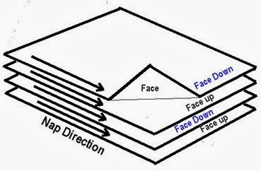
preading Mode; Open Fabric, Face to Face, Nap One Way (F/F, N/O/W)

Slide 29
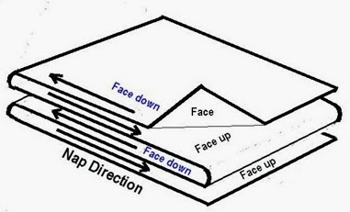
Spreading Mode; Open Fabric, Face to Face, Nap Up and Down (F/F, N/U/D)

Slide 30
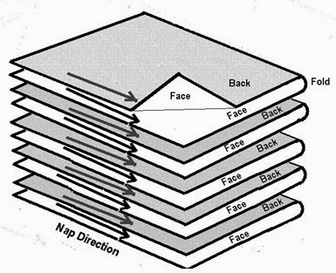
Spreading Mode; Folded Fabric, Face to Face, Nap One Way (F/F, N/O/W)

Slide 31
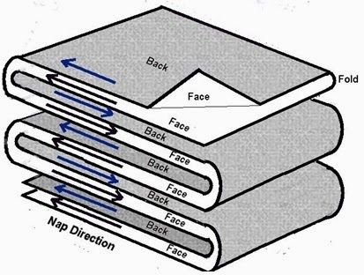
Spreading Mode; Folded Fabric, Face to Face, Nap Up and Down (F/F, N/U/D)

Slide 32
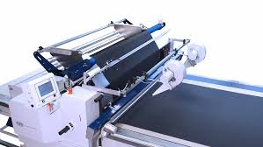
Automatic Programmable Spreading Machines:
All the requirements of spreading process can be fulfilled by fully automatic spreading machines. Their features include:Automatic loading/unloading and threading/rewinding device for fabric rolls.
Automatic roll turning arrangement for face to back lay.
Automatic leveling device for fabric edge alignment.
Automatic cutting device (one way or two way cutoff) at the end of a run.
Automatic tensioning device to control fabric tension.
Automatic lay height sensing elevator.
Programmable lay length, ply height and step-laying.
Spreading seeds up to 140 m/min.

Slide 33
valuation of Spreading Cost:
The two cost determinations related to spreading are The labour cost for the time to spread
The cost of fabric engaged in the spreading of garments as well as the fabric cost of ends and damages

Slide 34
Labor cost per garment during spreading
= labor cost(hourly) *time required for each spread( hours)
Number of garment obtained from each spread
Example:
A marker has 7 garments(all patterns) on 70 layers of fabric, the worker took 3 hours to do the spreading process and receives 2USD per hour.

Slide 35
cost of ends and damages
= Fabric cost (per meters)X (1-marker efficiency)* total fabric used for spreading
Number of garment obtained from each spread
Example:
Total number of garments obtained from spreading process are 1000, the total fabric consumed in 150 meters and cost of fabric per meter is 2USD. The marker efficiency is 95%. Calculate cost of ends per garment.

