Slide 1
Clothing Production Systems
Clothing Production Systems
Dr. Adnan Mazari

Slide 2
Garment Production Systems
A ‘garment production system’ is a way how textile material is converted to complete garment using technique for better production and productivity.
Production and Productivity ??

Slide 3
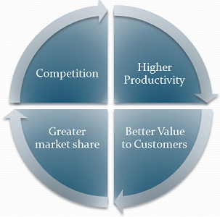
Production: Process of combining inputs ( natural, manmade and human sources) to create output (goods or services) to satisfy customer needs
Productivity: Efficient Utilization of available input sources for improved output.

Slide 4
Lead Time
Lead Time is measured by elapsed time (minutes, hours, etc.)
Lean Manufacturing
lean production, often simply "lean", is a systematic method for the elimination of waste within a manufacturing system.

Slide 6
4 Ps of Marketing

Slide 7
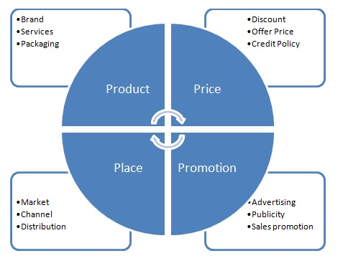

Slide 8
Factors Influencing Productivity in Textile Industry
(A) Controllable or Internal Factors:
Factory and equipment
Technology
Material and energy
Human factors
Management style
(B) Uncontrollable or External Factors:
Natural resources
Government policies
Workforce

Slide 9
Choice of system
Number of machines
Quantity of product
Efficiency of worker
Processing time + Transportation time + Temporary storage time + Inspection time = Total Production Time.

Slide 10
Wake Up Question!!!

Slide 11
Types of Systems
Make Through System
Piece Rate Production System
Overhead Production System (UPS -Unit Production system)
Modular Production System
Progressive Bundle System
Section Production System

Slide 12
Make through System
When a tailor alone makes a complete garment, then it is called as make though systems. The tailor even makes pattern (use ready-made pattern), cuts fabric and does finishing of the garment. For example, tailors in the tailor shops do all jobs from cut to pack. In this system tailors are not depended to others.

Slide 13
Piece rate production system
Concept And Meaning Of Piece Rate System Of Wage Payment The piece rate system is that system of wage payment in which the workers are paid on the basis of the units of output produced.
Total Wages Earned= Output x Piece Rate

Slide 14
Advantages Of Piece Rate System
1. Wages linked to efforts
2. Increase in production
3. Better utilization of equipment/machines
4. Distinction between Efficient and Inefficient
5. Less supervision required

Slide 15
Disadvantages Of Piece Rate System
1. No guarantee or minimum wage
2. Poor quality of goods/products
3. Not suitable for beginners
4. Deterioration in health
5. Cause of dissatisfaction
6. Difficulty in fixing piece-rates

Slide 16
Suitability
Piece rate system is suitable under following situations:
(1) Where production quantity is more important than the quality of the product.
(2) When the work is of repetitive nature.
Types of Piece Rate System
Straight piece rate
Increasing piece rate
Decreasing piece rate

Slide 17
Modular Production System
A Modular Production System is a contained, manageable work unit that includes an empowered work team, equipment and work to be executed.
The number of teams in a plant varies with the size and needs of the firm and product line.
Usually there are 4-15 labors in one team depending upon the type of garment to be stitched and skills of labor.
Teams may be used to perform all the operations (whole garment production) or certain portion of assembly operations.
Team is responsible for maintaining a smooth work flow, meeting production goals, quality level.

Slide 18
Advantages of MPS
High Flexibility.
Fast throughput times.
Low wastages.
Reduced absenteeism.
Empowered employees.
Improved Quality.

Slide 19
Dis-advantages of MPS
A high capital investment in equipment.
High investment in initial training.
No compatibility between team members can cause problems thus loss in production…
Dependency on the Team for whole Production.

Slide 20
Progressive Bundle System (PBS)
Also Called Material Handling System.
As name implies the bundle of garment parts move from operation to operation.
Traditional Production system.
Widely used by apparel manufacturers for several decades and still today.
80% apparel manufacturers use the Bundle system (PBS).
Bundles are assembled in the cutting room, where cut parts are matched up with corresponding parts and bundle tickets.
Workers (labour) transport and move Bundles of cut parts to sewing room via trollies.
Operator scheduled to complete the operation and perform same operation on all pieces in the bundle, retie the bundle, remove Bundle ticket and move bundle for next operation.

Slide 21
Advantages of PBS
Labor of all levels ie unskilled, skilled, semi skilled labors are involved. Small simple operations.
Quantity of each operation is checked during every single operation thus quality is good.

Slide 22
Dis-advantages of PBS
Time Consuming due to assembling, moving and un-tieing of bundles.
More labor…More labor cost.
Needs efficient supervisor.
Labor absentees can effect production due to incompletion of contracts.
Variety of styles and less quantity is not effective in this system.
Proper planning is required for each style, each batch.
Improper planning causes labour turnover, poor quality, less production, etc.

Slide 23
Overhead Production System (UPS -Unit Production system)
A Unit Production System is a type of layout that uses an overhead transporter system to move garment components from work station to work station for assembly.
In UPS, there are hangers. One hanger have multiple clips containing all parts of the single garment.
All parts for the single garment are advanced through stitching line together by means of hanging carrier that moves along an overhead conveyor.
Hanging carrier can be moved manually by the operator using button after completion of single operation or By computerized system that move the conveyor after a specific fed throughput time.

Slide 24
Advantages of UPS
Bundle Handling completely eliminated.
The time involved in the pick-up and disposal is reduced to minimum.
Output is automatically recorded, eliminates the operator to register the work.
The computerized system automatically balance the work between stations.
Improved lead times-less work in process.
Improved space utilization (more machines can be adjusted)
Increased Productivity.
Throughput time can be drastically reduced.
Indirect labor costs are reduced (by elimination of bundle handling and requiring fewer supervisors)
Improved production and quality.

Slide 25
Dis-advantages of UPS
Unit Production system requires high investment.
Proper planning is required to be effective.
Specialized training for the system.
Labor DON’T LIKE IT

Slide 26
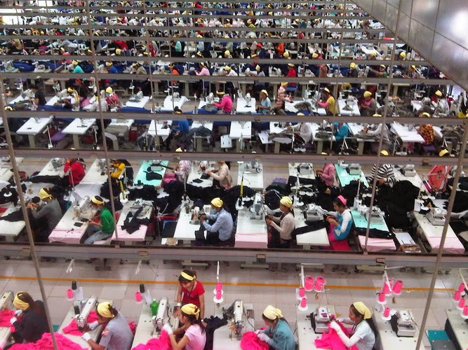
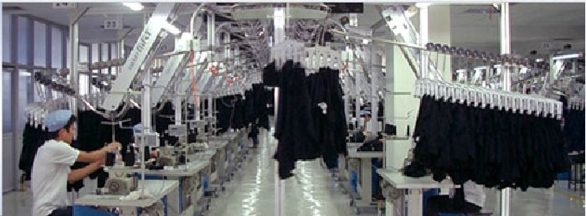
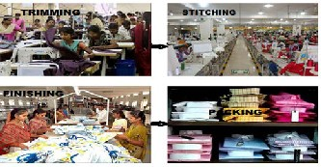
Types of garment productıon systems
I. Progressive Bundle System
II.Unit Production System
III.Modular garment production

Slide 27
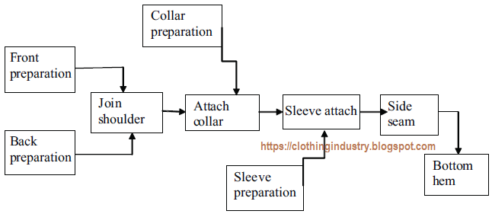
Section Production System
This system is similar to the progressive bundle system. But the difference is that, instead of one line, work is divided into sections. Machines of similar operations are clubbed together instead of spreading over in all lines. For example, when a man’s formal shirt is being made in a section layout – collars, cuffs and sleeves are in the preparatory sections and then send to the assembly section. This system is popular to improve line balancing and utilization of human resources.
The product can be made at different companies too and work on the Just in time approach.

Slide 28
Evaluation of Production Systems
Any production system has four primary factors, which make up the system. Processing Time + Transportation Time + Temporary Storage Time + Inspection Time = Total Production Time. Processing time is sum total of working time of all operations involved in manufacture of a garment. Transportation time involves the time taken to transport semi-finished or finished garments from one department to another or from one operation/machine to another. Temporary storage time is time during which the garment/bundle is idle as it waits for next operation or for completion of certain parts. Inspection time is time taken for inspecting semi-finished garments for any defects during manufacturing or inspecting fully finished garments before packing.
The main aim of any production system is to achieve minimum possible total production time. This automatically reduces in-process inventory and its cost. The sub-assembly system reduces temporary storage time to zero by combining temporary storage time with transportation time.

Slide 29
Conclusion
The choice of best apparel production system will depend on the product and policies of the company and on the capacities of manpower. Where style changes are frequent and lot sizes small, it may be advantageous to use skilled labour who can make whole garment and use one of the whole garment system. As the lot size increases it is advisable to use section production system. The sub-assembly system is superior to the progressive bundle system as it takes less time. That is the processing time for a garment in both system is same but sub-assembly system has less waiting or temporary storage time. However the space requirement, machinery requirement and labour costs are high for sub-assembly system. In most cases the choice of a production system depends on the cost of the inventory-in process. Inventory-in process is the total number of garments in the production line. This consists of all garments being processed at sewing machines, under inspection and in temporary storage between operations. When material, labour, space and interest costs are high, synchronized sub-assembly system which yields the least possible in-process inventory is more suitable. One of the aims of any production system is to make total production time as minimum as possible. This automatically reduces inventory cost to a minimum. Sub-assembly system provides many opportunities to economise on temporary storage and transportation space and time. No definite answer can be given as to which is the best, as it depends on garment style, specifications, machinery and manpower and manufacturing policies.

Slide 30
References: http://www.indiantextilejournal.com/articles/FAdetails.asp?id=28
Industrial engineering in apparel production by V Ramesh Babu
Apparel Manufacturing Technology by T. Karthik, P. Ganesan, D. Gopalakrishnan
Garment Manufacturing Technology Edited by Rajkishore Nayak and Rajiv Padhye

