Slide 1

Introduction Lecture
Teacher
Ing. Adnan Mazari, Ph.D.

Slide 2
My Profile
Bachelor: Textile Engineering ( specialization in Clothing)
Master: Textile and material Engineering ( specialization in non woven and Clothing)
Ph.D.: Textile Engineering( specialization in clothing comfort, productivity and sewing process)
Working experience in Clothing and sewing department, focus on technical clothing,
car seats and sewing improvement.
Teaching:
Subjects related to Clothing, comfort, or garment machinery
Research:
Published multiple research articles and supervise
4 PhD students,
2 Master and
2 bachelor students
Internship students.

Slide 3
Objectives
The main aim of this course is to give overview about Clothing technology and Clothing production. The subject areas are mentioned: textile technology, Clothing technology and Clothing production and equipment in clothing production. The course will include overall knowledge of the garment production. The course will be taught in English. Students will also enhance their terminology.
Credit Exam:
Submission of all exercise. There will be task every practical lesson for students.
Examination:
Written report + verbal
Content
Lectures:
1. Introduction. Importance, history and function of the garment
2. Basic knowledge of production technology. (Spinning, weaving, knitting processing into garment production)
3. Flow chart of production processes in the clothing industry. (From Fabric to Clothing)
4. Spreading and cutting process in garment production.
5. Design of clothing and comfort of clothing.
Sewing processes. Basic principles and analysis of stitching. Sewing machine parts, types of sewing machines. Unconventional bonding: gluing, welding, riveting and ultrasonic welding.
7. Application of advanced production systems in clothing manufacturing technology.
8. Shaping process; Ironing and shaping of clothing materials. Types of irons, presses and ironing mannequins.
Exercises:
1. Clothing materials. Features of clothing materials. Types of garment materials. Special materials. Sewing threads, their types, properties and parameters.
2. Cutting and marker making efficiency.
3. Consumption of material and calculation of costs for the creation of clothing.
4. Evaluation of fabric parameters.
5. Theoretical calculation of fabric costings.
6. Economical calculation of clothing production.
7. Sewing threads, yarn consumption calculations and seam strength.
8. Economic aspects of clothing. The amount of material, time requirement and cost of producing clothing.
9. Stitches, ISO standards, basic principles of stitching. ISO standards, apparel in apparel.
10. Unconventional ways of joining.
11. Use of thermo camera and high-speed camera for evaluation of sewing processes.
12. Using Microsoft Excel in the clothing industry. (practical examples)
13. Writing reports on garment production. (practical examples)
14. Discussion on professional topics for oral presentation of semester paper.

Slide 4
Practical lessons
The focus of exercises will be COSTING of garments and productivity.
Exercises will also be uploaded to E-learning.

Slide 5
USE following link to see details about the subject
www.stag.tul.cz
The lectures will be uploaded on the E-learning system.
AJC/2021
https://elearning.tul.cz/
In case of any questions, contact me at
adnan.ahmed.mazari@tul.cz. Or Call office phone 3677
The office is located on the right side of building L, 4rth floor next to the lift.

Slide 6
Exam
The Final exam will be completely ONLINE and OPENBOOK, you can keep all notes, slides or even use internet.
Still many fail the exam, please attend my lesson, just from reading presentation you will not be able to get highest grades.

Slide 7
Lessons & Exercises to be finished before Christmas
27.12.2021
Credit Exam Physical
11.1.2022
Final exam ONLINE
13.1.2022

Slide 8
What you know about textile
Which textile material you know?
Fiber?
Yarn?
Thread?

Slide 9
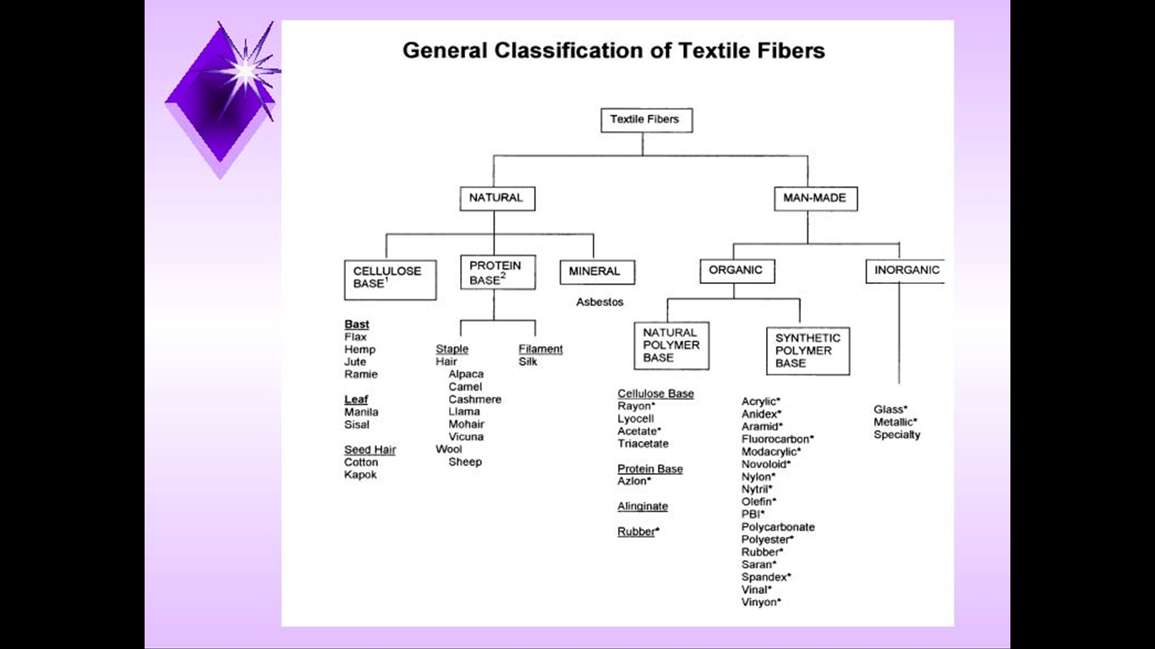
A fibre is a material which is several hundred times as long as its thickness.

Slide 10
Textile Production Flow

Slide 11
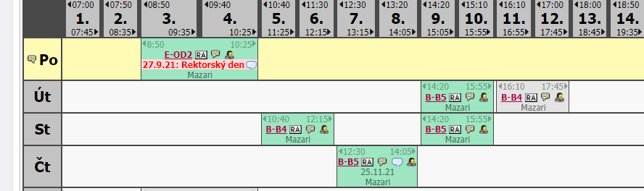
TOMORROW 6.10.2021
There will be NO exercise lesson

Slide 12


