Slide 1
Blended learning
Is online teaching here to stay?
What is it that we don’t like about our online teaching?
What can we use in the f2f classroom?

Slide 2
Hardware – software - liveware Virtual learning environment symmetrical vs asymmetrical teaching tools
Sense of community + deadlines

Slide 4
reading
Resources:
https://www.quora.com/Are-boys-always-smarter-than-girls
https://www.theguardian.com/lifeandstyle/2021/apr/15/married-job-long-hours-working-culture-single-lonely-love
https://time.com/5752951/lying-kids-santa/
https://www.littlefox.com/en/readers/contents_list/DP000942
Challenge?
https://hemingwayapp.com/
https://cefr.duolingo.com/
https://tagcrowd.com
Vocabulary work?
https://www.vocabulary.com/lists/7726384/practice#
Integration?

Slide 5
Writing
Blogs
Comments
Subtitles
https://clideo.com/ru/add-subtitles-to-video
https://www.mindmeister.com/folders
Challenges?
https://www.grammarly.com/
Feedback
Public access.

Slide 6
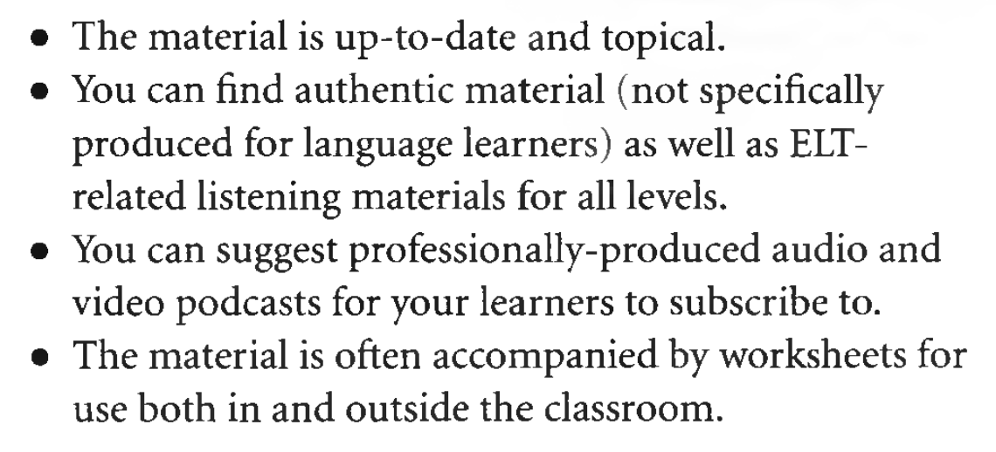
Listening
Listening or Viewing?
Language learning/ authentic
Level/ topic / age
Subtitles – no subtitles
Integration skills
Watch 2 Gether : https://w2g.tv/rooms/e54rtp54xx8ezhitw6?lang=ru
Finding a word: https://getyarn.io/yarn-clip/3e05224f-10e7-468f-bc2b-3c1257352593
https://ororo.tv/en/channels
https://www.bbc.co.uk/learningenglish/
https://podcasts.apple.com/gb/podcast/once-upon-a-time-in-zombieville/id1487653809

Slide 7
Speaking
Dubbing
https://www.english-room.com/english-singsing-dialogue-youtube-videos/
Detectives
https://www.youtube.com/watch?v=rsHZhu7uXdw
Ted.com
https://www.youtube.com/watch?v=yFVXsjVdvmY
Discussion questions;
http://iteslj.org/questions/
Jubilee discussions:
https://www.youtube.com/channel/UCJjSDX-jUChzOEyok9XYRJQ
Debate
https://elt-connect.com/debates/

Slide 8
Language and assessment
Concordance
https://www.english-corpora.org/bnc/
https://context.reverso.net/translation/english-german/care+for
Assessment
https://learningapps.org/createApp.php
https://quizlet.com/ru/523241576/unit-1-topic-vocabulary-mending-fences-flash-cards/
https://testmozusercontent.com/q/1/student
Sum up
https://kaf1.ru/

Slide 9
Things to explore
Search term ... ‘create blog’
Search term ... ‘concordance software’
Search term ... ‘create comics’
Search term ... ‘create guest map’
Search term ... ‘mindmapping software’
Search term ... ‘make movies online’
Search term ... ‘create online poster’
Search term ... ‘create online quiz’
Search term ... ‘online shared whiteboard’
Search term ... ‘online subtitle creator’
Search term ... ‘create online survey’
Search term ... ‘voice message board’

