Slide 1
Experiments and hypotheses
revision

Slide 2
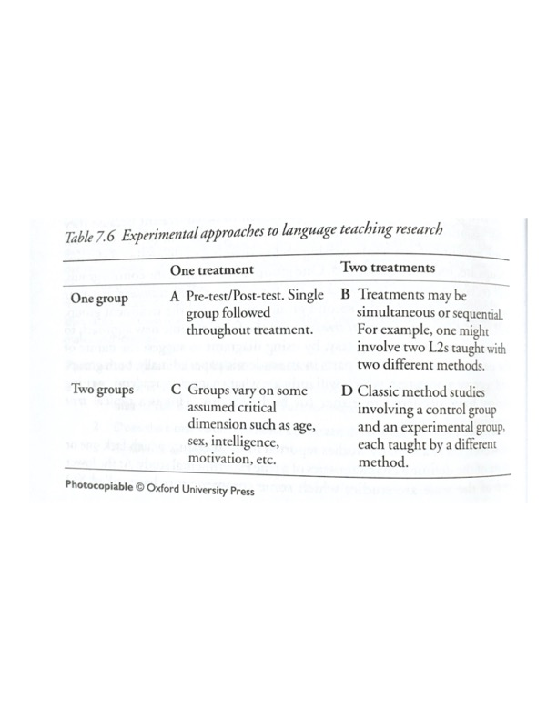

Slide 3
Procedure
1. Hypothesis/ research question
2. An experiment
- groups (experimental vs control)
- tests (pre vs post)
3. Results
- statistics
- correlation
- significance

Slide 4
Hipothesis vs Research Question
Example: learning foreign words
Research question:
Hypothesis A
Hypothesis B (alternative to A)
Hypothesis C ( Null )

Slide 5
Examples
1) Are some phonemes easier to learn/teach then others?
2) Are segmentals easier to teach/learn than suprasegmentals?
3) Does the variant you teach affect pronunciation?
4) Can… improve your pronunciation?
5) Do Czech ESL students need special methods to learn pronunciation?
6) Do we have to teach ESL students pronunciation?

