Slide 1
Architecture of the Middle Ages in Britain
Culture II: British Studies
Lecture 2

Slide 2
Anglo-Saxon Architecture
mid-5th century to the Norman conquest
Anglo-Saxons generally lived in simple buildings:
timber construction
thatched roof
most surviving buildings are churches made of brick and/or stone with one exception: St Andrews Church in Greensted
earliest stone buildings built without mortar: Gallarus Oratory (not Anglo-Saxon!)
later techniques influenced by monasticism
heavy, strong walls, crude finish (using an axe, not a chisel)
small windows
rather small and low buildings

Slide 3
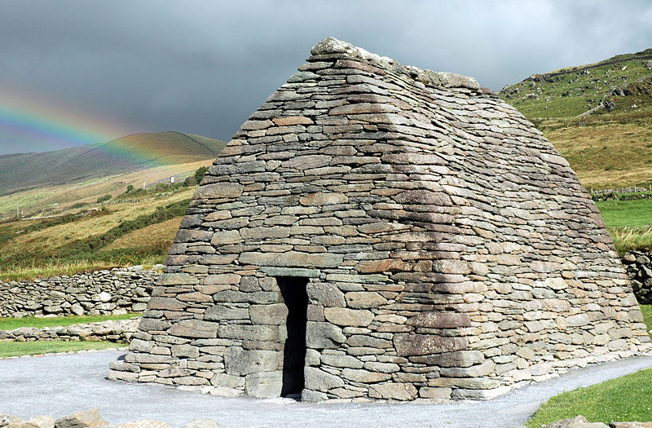
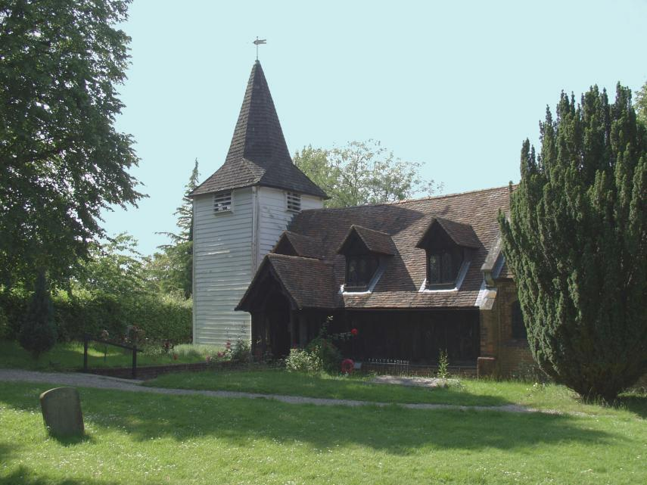
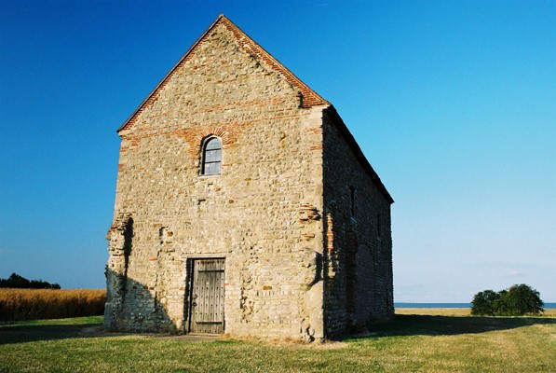
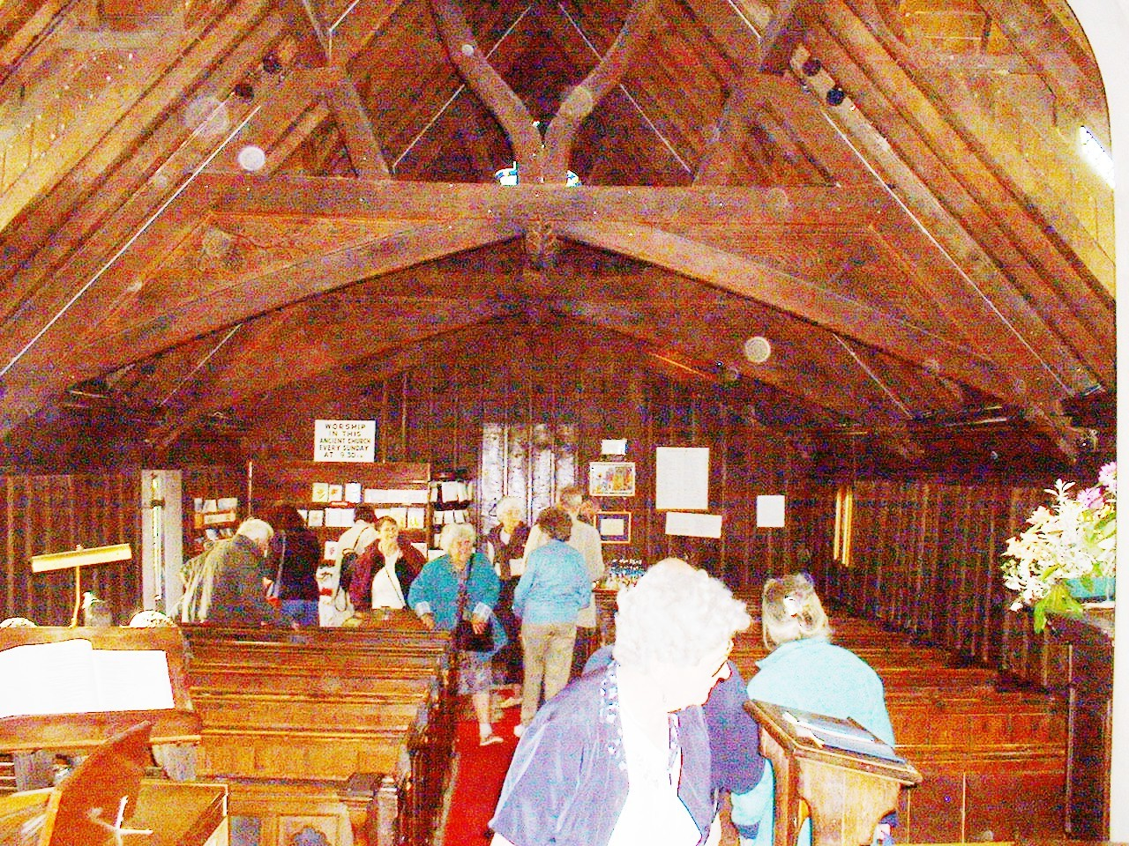
<- Gallarus Oratory, 7th c, 12th c?
St Andrew’s Church, Greenstead ->
<- St Peter-on-the-Wall, Bradwell-on-Sea, Essex, 7th c.

Slide 4
Norman Style
11th and 12th centuries
appears before the Norman conquest itself
a local derivative of the Romanesque style
mostly found in two spheres of life:
ecclesiastic architecture
fortresses and castles
robust, heavy, strong

Slide 5
Norman Style
massive proportions
simple geometry
thick walls
round arches
small openings
often cross-shaped (cruciform) plans, with a deep chancel and a crossing tower
wooden roofs or simple vaults

Slide 6
Norman Style (examples)
hard to find
constant rebuildings and modernizations
Durham Cathedral (the main structure)
Rochester Cathedral
The White Tower
Oakham Castle

Slide 7
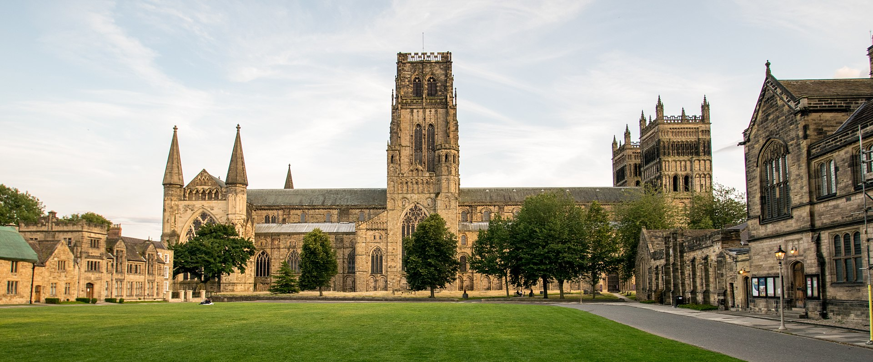
Durham Cathedral

Slide 9
Rochester Cathedral

Slide 10
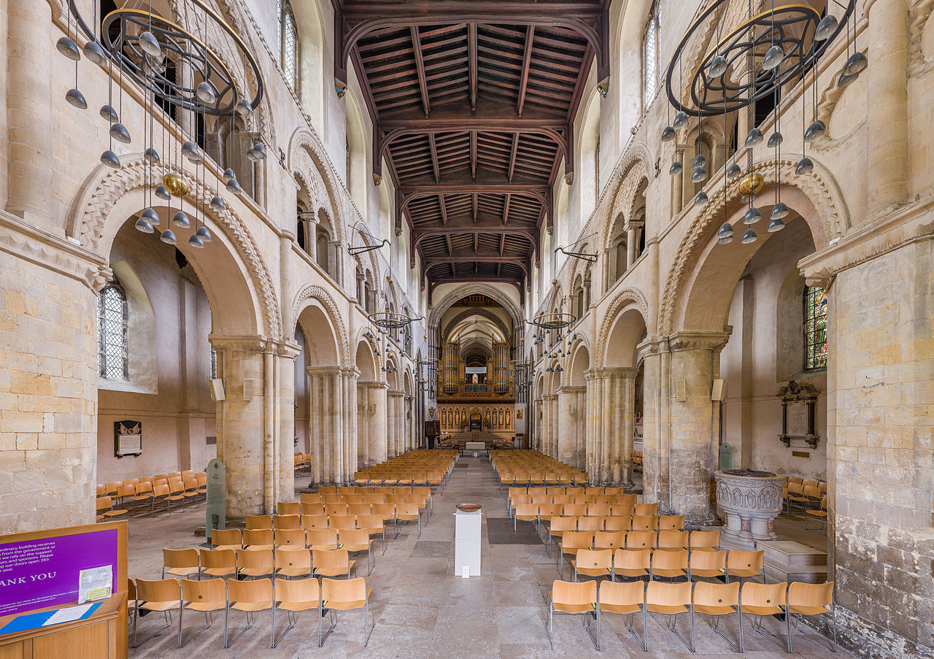

Slide 11
The White Tower

Slide 12
Oakham Castle

Slide 13
Gothic Style
originally a degrading term
used as uncivilized, barbarian (Renaissance perspective)
later lost this connotation (especially in the 19th century)
12th (13th) century onwards
most typically associated with the Middle Ages
dominant until the appearance of the Renaissance
highly impressive style

Slide 14
Gothic Style
pointed arches
huge, highly decorated windows
stained glass
wheel windows and rose windows
ribbed and more complex vaulting
thin walls
(flying) buttresses for support
very high structures
lot of light (huge windows)

Slide 15
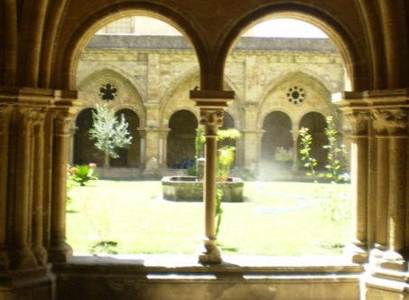
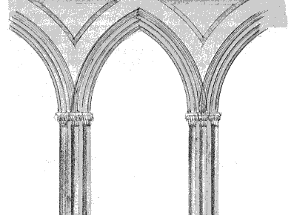
Arches

Slide 16
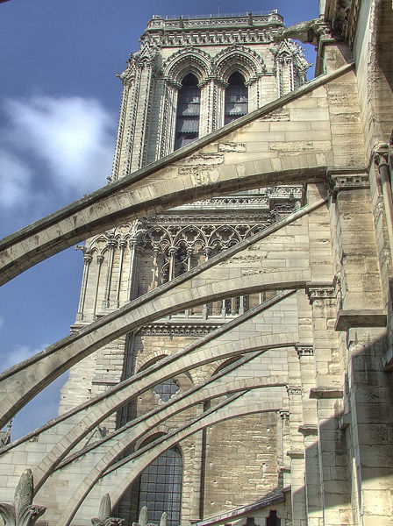
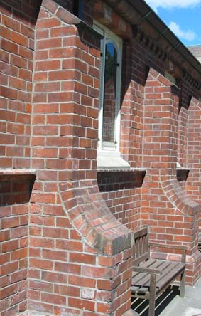
Buttresses
Flying buttress
Buttress

Slide 17
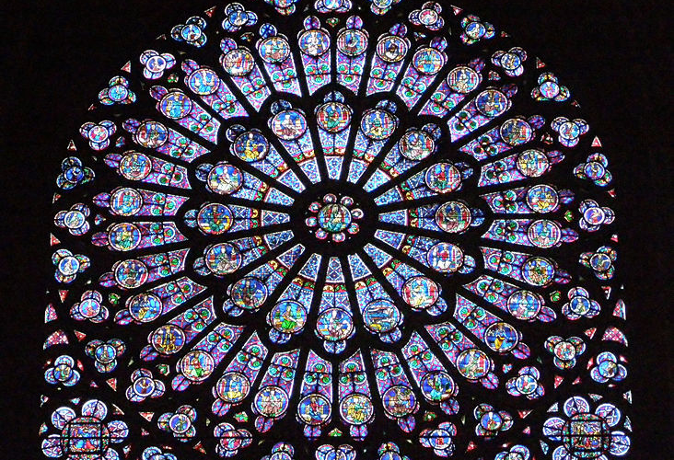
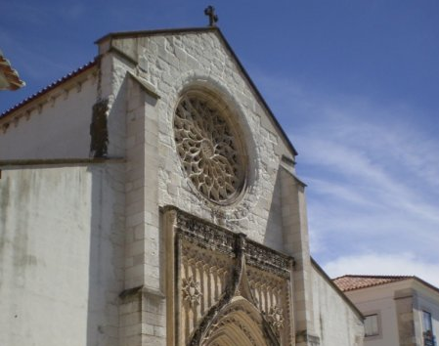
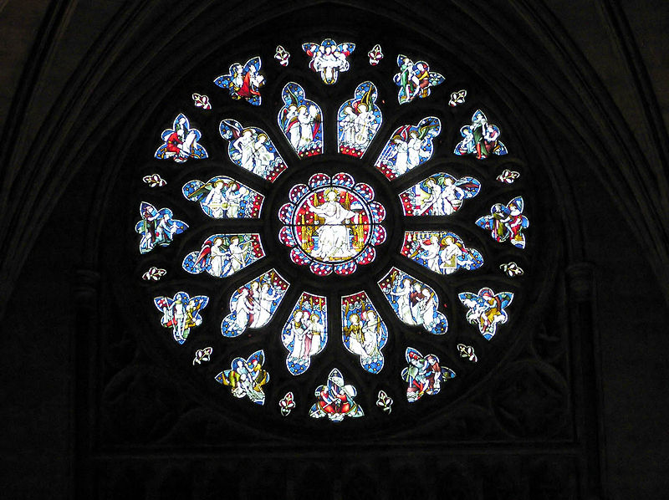
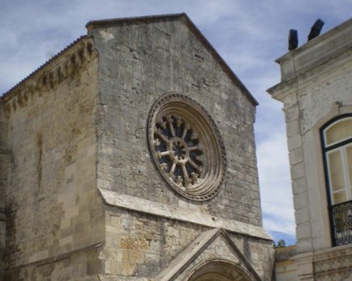
Rose and Wheel Windows

Slide 18
Gothic Style (examples)
Salisbury Cathedral (early gothic)
Cathedral Church of St Peter in Exeter
St George‘s Chapel @ Windsor Castle
Oxford Divinity School
Magdalen College, Oxford

Slide 19
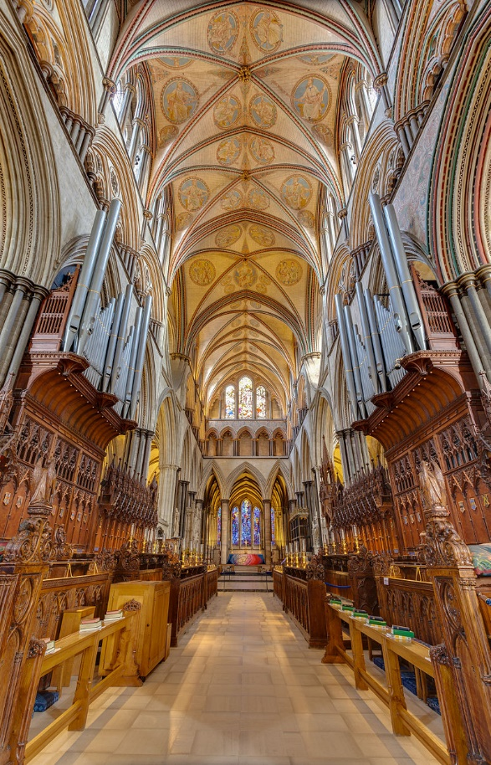
Salisbury Cathedral

Slide 20
Cathedral Church of St Peter in Exeter

Slide 21
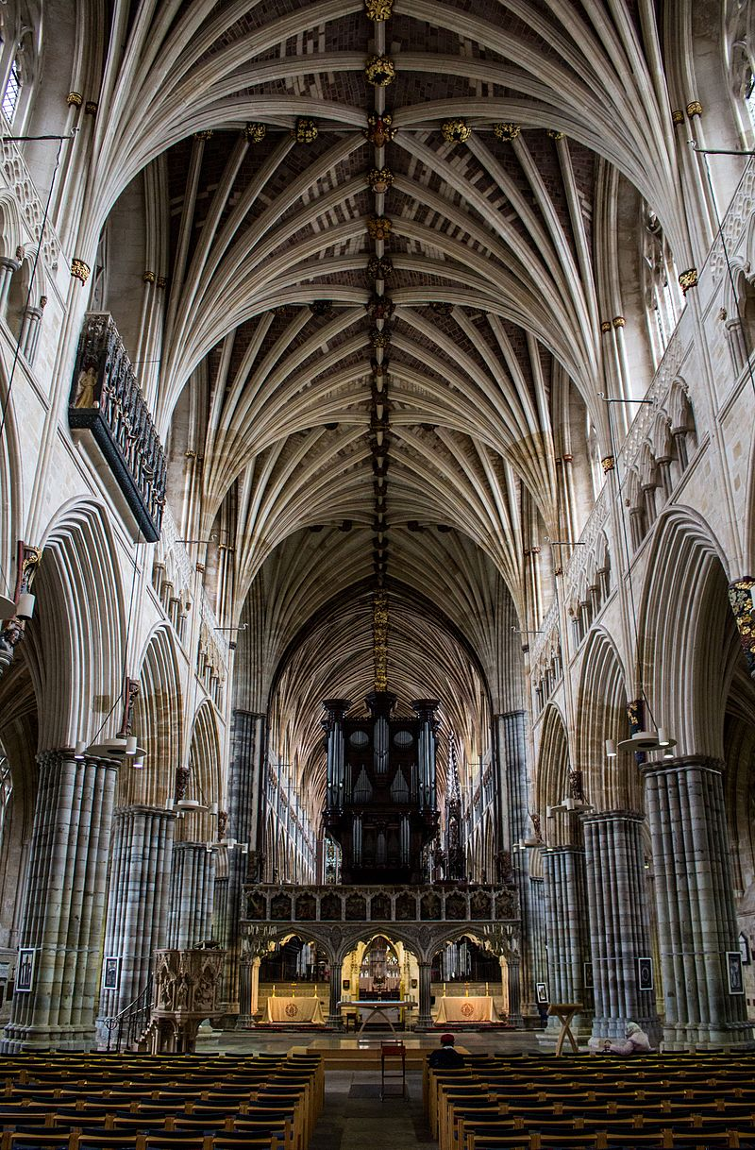

Slide 22
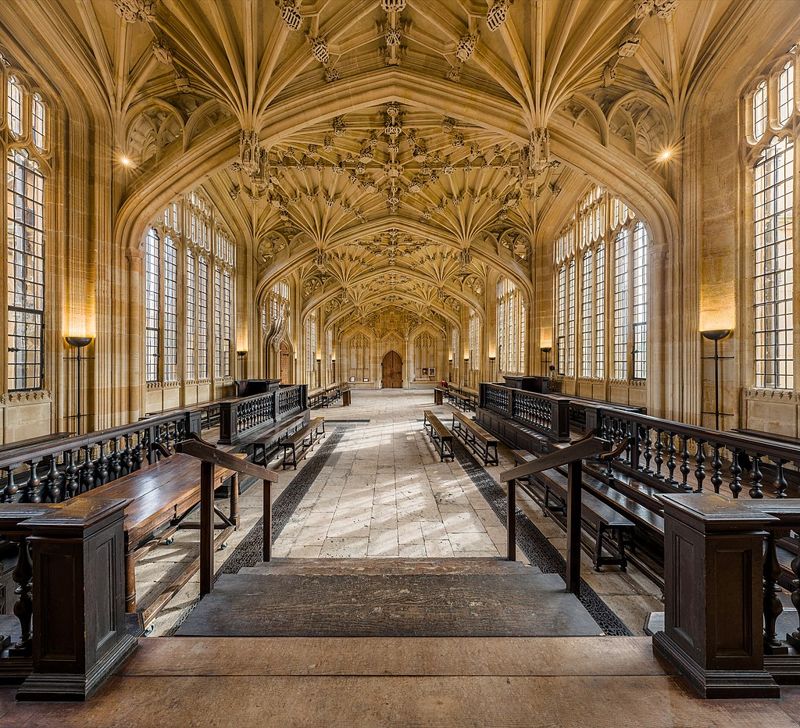
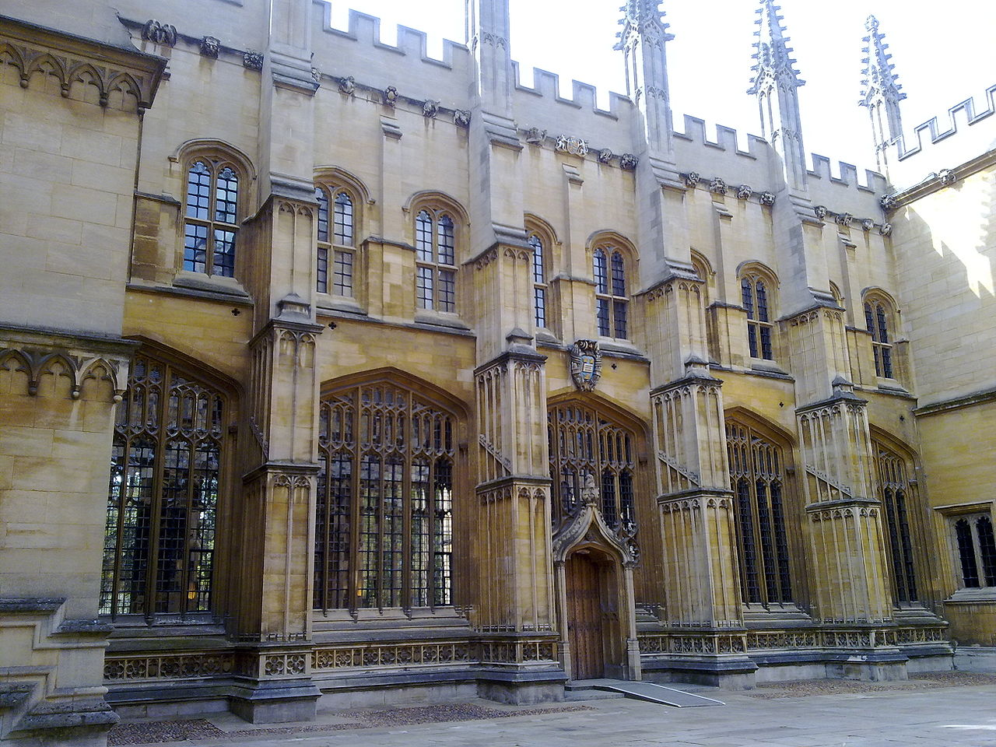
Oxford Divinity School

Slide 23
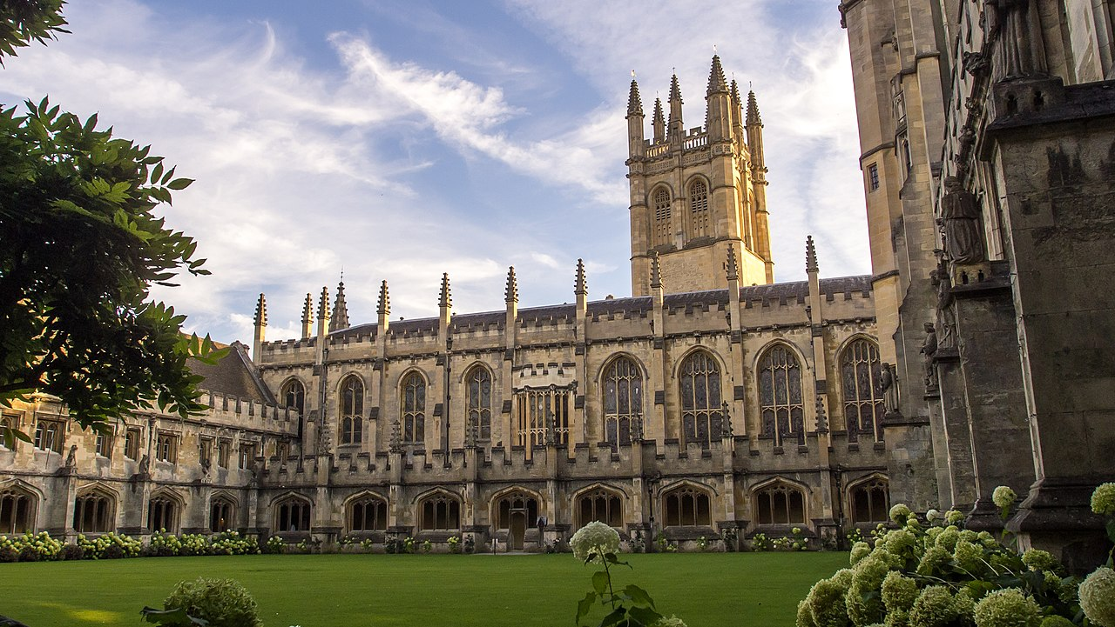
Magdalen College, Oxford

