Slide 1
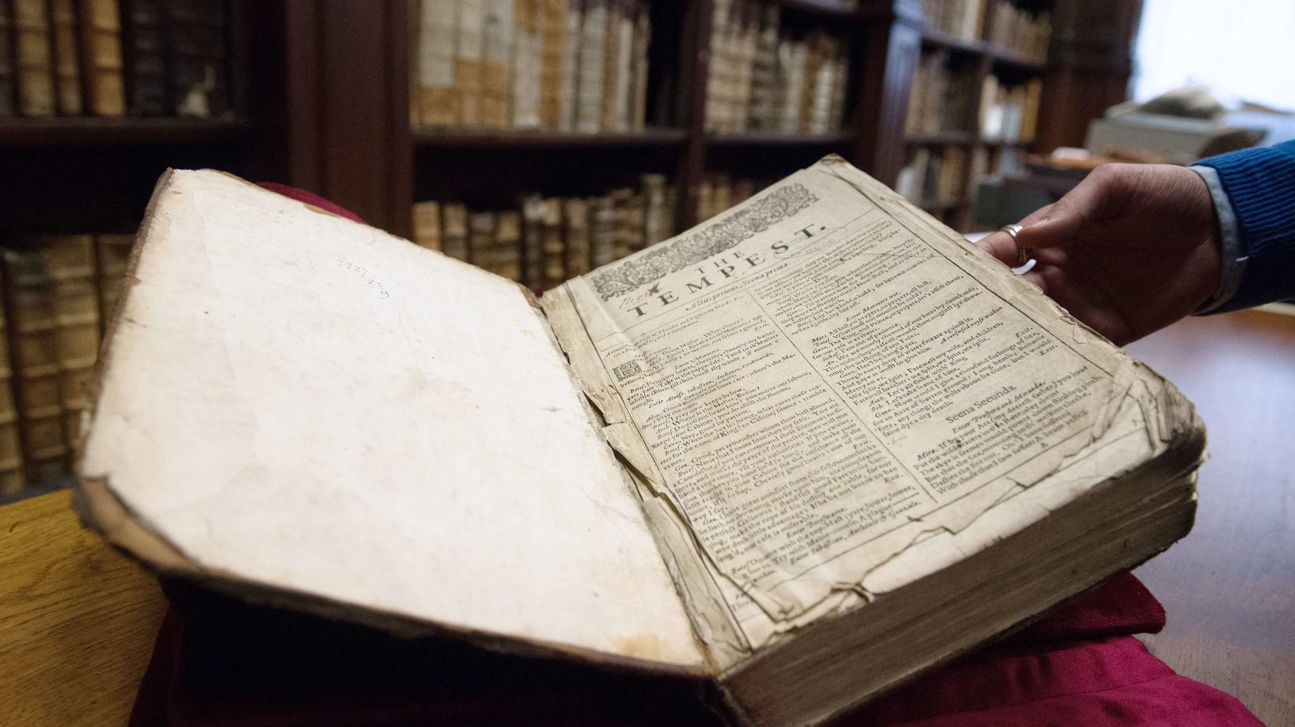
British Renaissance
Poetry and Prose

Slide 2
Renaissance Poetry – The Sonnet
The Italian Sonnet:
an octave (2 quatrains) + a sextet (2 tercets)
(a-b-b-a, a-b-b-a) + (c-d-e-c-d-e or c-d-c-c-d-c, ...)
The English Sonnet:
3 quatrains and a couplet
(a-b-a-b, c-d-c-d, e-f-e-f, g-g)
sharp turn in imagery or in content

Slide 3
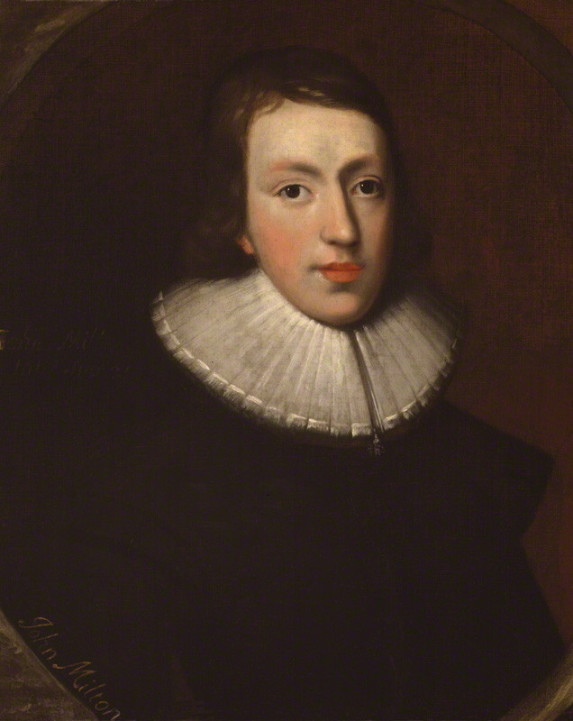
Renaissance Poetry – The Italian Sonnet
How soon hath Time, the subtle thief of youth, (A) Stolen on his wing my three and twentieth year! (B) My hasting days fly on with full career, (B) But my late spring no bud or blossom shew'th. (A) Perhaps my semblance might deceive the truth, (A) That I to manhood am arrived so near, (B) And inward ripeness doth much less appear, (B) That some more timely-happy spirits indu'th. (A) Yet be it less or more, or soon or slow, (C) It shall be still in strictest measure even (D) To that same lot, however mean or high, (E) Toward which Time leads me, and the will of Heaven. (D) All is, if I have grace to use it so, (C) As ever in my great Task-master's eye. (E)
John Milton, “On His Being Arrived to the Age of Twenty-three”

Slide 4
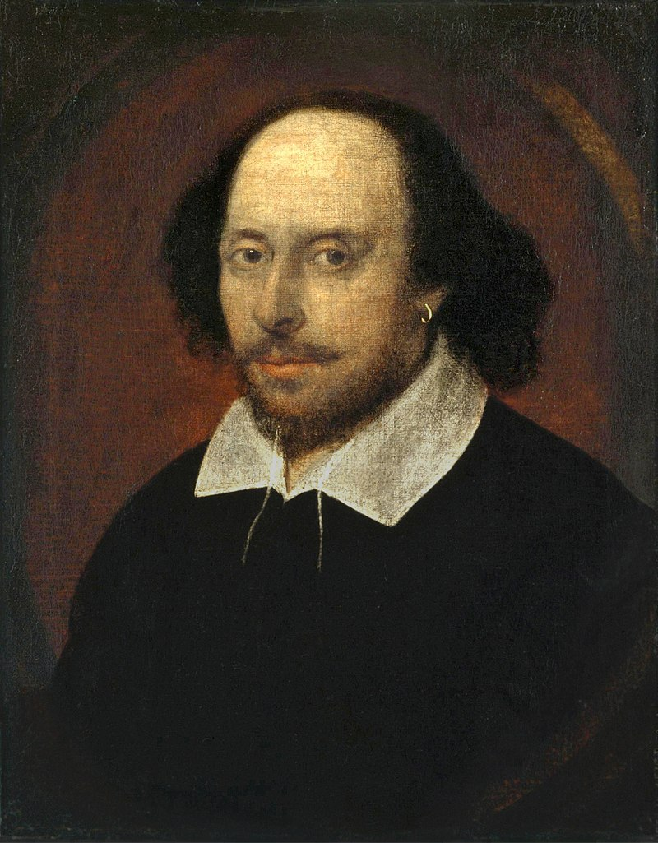
Renaissance Poetry – The English Sonnet
Let me not to the marriage of true minds (A) Admit impediments. Love is not love (B) Which alters when it alteration finds, (A) Or bends with the remover to remove. (B) O no, it is an ever fixed mark (C) That looks on tempests and is never shaken; (D) It is the star to every wand'ring barque, (C) Whose worth's unknown although his height be taken. (D) Love's not time's fool, though rosy lips and cheeks (E) Within his bending sickle's compass come; (F) Love alters not with his brief hours and weeks, (E) But bears it out even to the edge of doom. (F) If this be error and upon me proved, (G) I never writ, nor no man ever loved. (G)
William Shakespeare, “Sonnet 116”

Slide 5
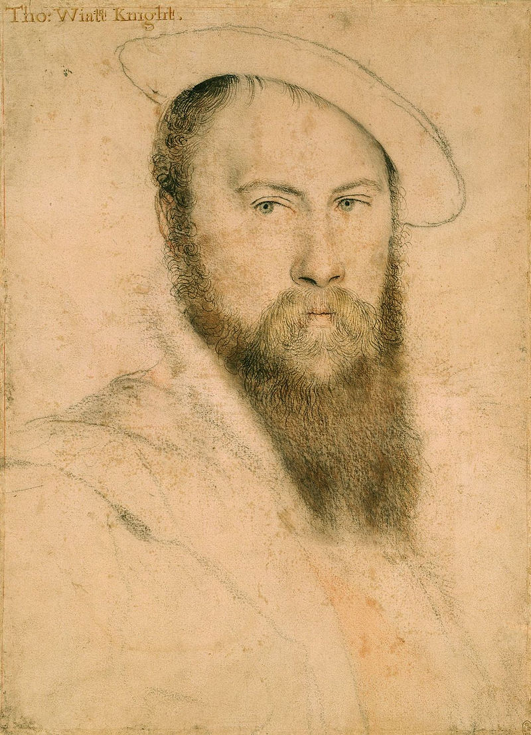
Sir Thomas Wyatt (1503 – 1542)
politician, ambassador, lyric poet
introduced the Italian/Petrarchan sonnet to England
modified the form, often finishing with cddc ee, introducing the closing couplet to sonnets early on
strongly influenced by Chaucer’s language
more intimate, personal and less ceremonial than Petrarch and other Italian models
also wrote in other genres: songs, satires, epigrams

Slide 6
Sir Thomas Wyatt (1503 – 1542)
Samples of poetry listened to and briefly discussed in the lesson:
“Innocentia Veritas Viat Fides Circumdederunt me inimici mei” (1536)
“My Lute Awake” (first published 1557)

Slide 7
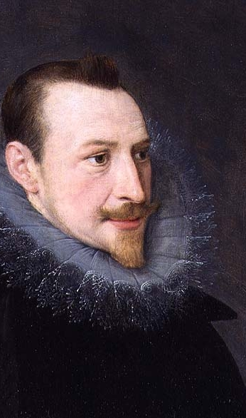
Edmund Spenser (1552 – 1599)
one of the prime masters of poetry in English
best known for his masterpiece, The Fairie Queene
an epic poem
allegorical work, possible to read on several levels
also wrote in other genres:
The Shepheardes Calender – a pastoral work of twelve eclogues for each month of the year
Amoretti and Epithalamion – sonnets written to/about his second wife

Slide 8
Edmund Spenser (1552 – 1599)
Sample of poetry listened to and briefly discussed in the lesson:
Sonnet LXXV, Amoretti vs. Shakespeare’s Sonnet XVIII

Slide 9
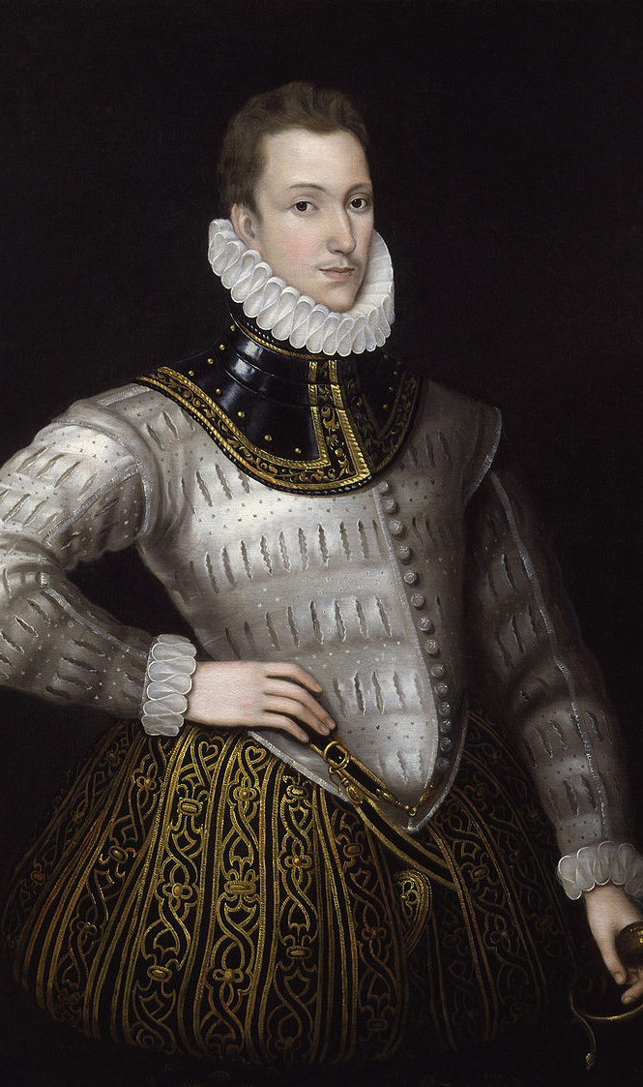
Sir Philip Sidney (1554 – 1586)
poet, scholar, politician and soldier
travelled widely throughout Europe:
Germany, Italy, Poland, Hungary, Austria, Bohemia
was an active MP in Parliament
Works:
Astrophel and Stella
The Countess of Pembroke’s Arcadia
An Apology for Poetry/A Defence of Poesie

Slide 10
Sir Philip Sidney (1554 – 1586)
Samples of poetry listened to and briefly discussed in the lesson:
Sonnet XXX, Astrophel and Stella
Sonnet XXXI, Atrophel and Stella

Slide 11
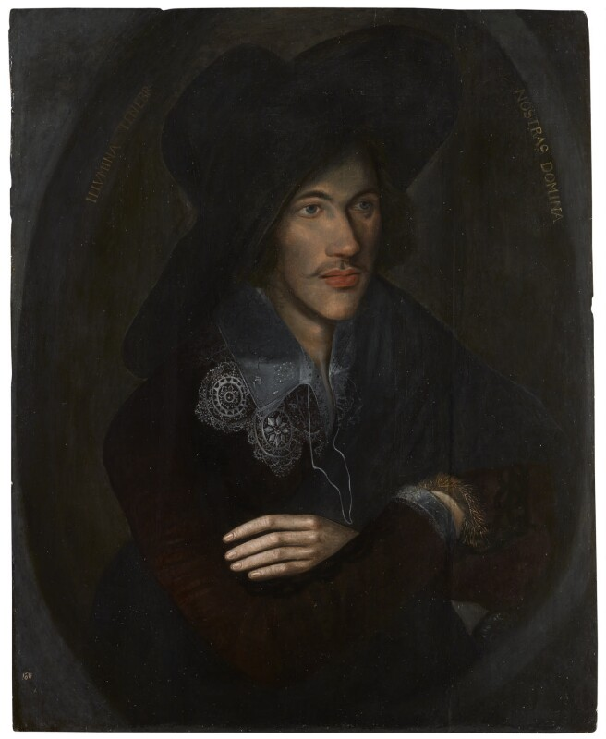
John Donne (1572 – 1631)
poet, scholar, soldier, later a minister of the Church of England
travelled abroad and fought in battles in Spain
womanizer turned married man turned minister
a masterful and versatile poet:
satire, elegies, erotic poetry, epigrams, religious poems
a catholic who converted to the Anglican faith, and got ordained as a minister in 1615
also important as a translator
Works (selection):
Songs and Sonnets (including the Holy Sonnets)
Devotions upon Emergent Occasions
Biathanatos

Slide 12
John Donne (1572 – 1631)
Sample of poetry listened to and briefly discussed in the lesson:
Holy Sonnet X (“Death, Be Not Proud”)

Slide 13
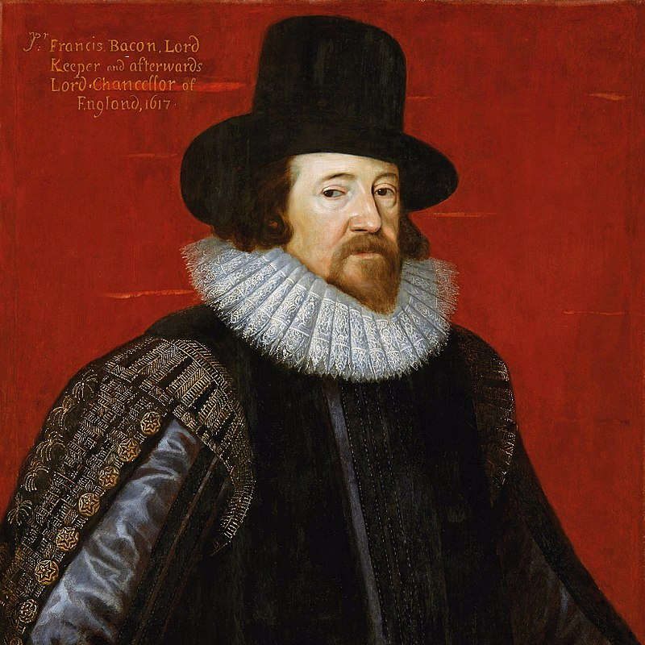
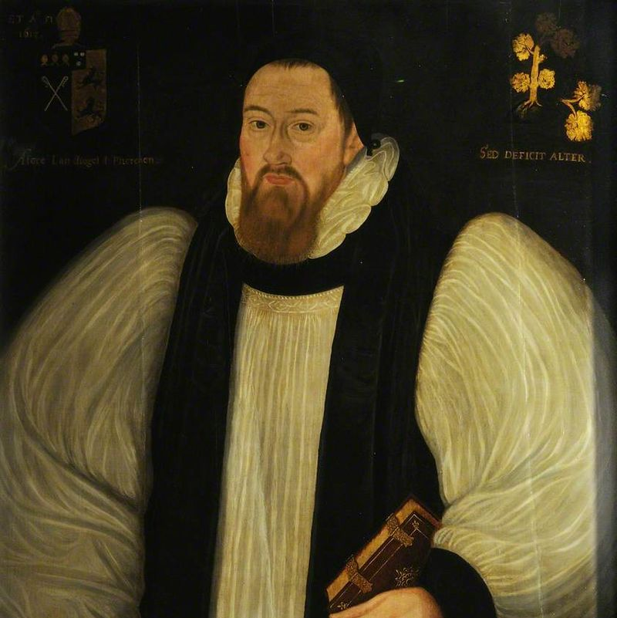
Further Important Figures
Sir Francis Bacon (1561 - 1626)
philosopher, statesman, scientist, writer
(some) works:
Novum Organum, sive Indicia Vera de Interpretatione Naturae
an “improvement” upon classical logic (Aristotle’s Organon)
Of the Proficience and Advancement of Learning, Divine and Human
in support of empirical philosophy
directly (structurally) inspired d’Alembert and Diderot’s Encyclopedia
New Atlantis
an unfinished utopian novel
Francis Godwin (1562 – 1633)
bishop, historian
(some) works:
important works on history and religious history
The Man in the Moone (1638)
the first work of science-fiction in English (and one of the firsts ever)
incorporates the theories of Copernicus, Kepler and Galilei

