Slide 1
The Road to the Age of Reason
The Commonwealth and Restoration

Slide 2
Renaissance in Britain
Humanism
controversial popular entertainment
big contrasts in lifestyle
various religious groups competing for influence
complicated political situation

Slide 3
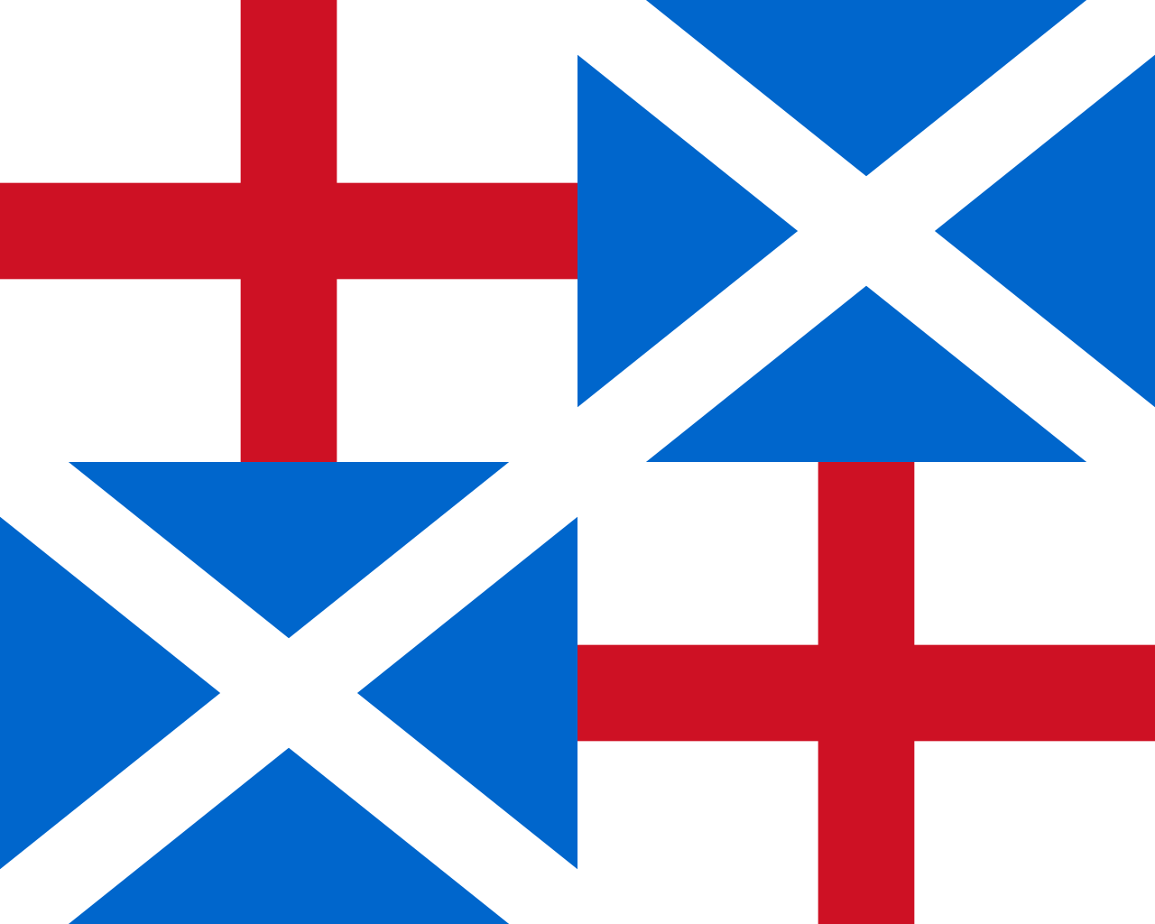
Attacks on the Status Quo
Gunpowder Plot (November 5, 1605)
Bishops’ Wars (1639, 1640)
British Civil Wars (1639 – 1653)
The Commonwealth (1649 – 53)
The Protectorate (1653 – 60)
The Cromwells
The Puritans

Slide 4
Cultural Life in the Interregnum Period
theaters banned
books banned and/or burned
strong censorship
books should be religious or directly useful
strict expectations of public and private morals
violent religious intolerance

Slide 5
Restoration Culture
theaters
draws more on the masques than the public theater
bawdy comedy
often political content
actresses are allowed for the first time
literature
very polarized:
the Puritan tradition: John Milton (Paradise Lost), John Bunyan (Pilgrim’s Progress)
sexually explicit texts: John Wilmot / Earl of Rochester, William Wicherley (The Country Wife)

Slide 6
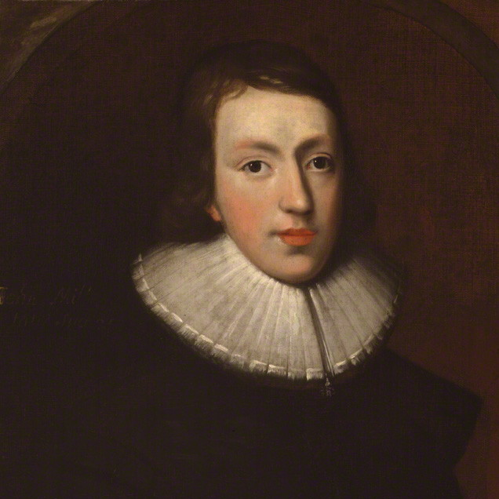
John Milton (1608 – 1674)
university educated (MA, Cambridge)
fluent in Latin, Greek, Hebrew, French, Spanish, Italian, Old English and Dutch
widely travelled (France, Italy)
a controversial man:
held a government post and acted as a censor under Cromwell – wrote Aeropagitica
was a strongly religious Puritan – openly advocated divorce and polygamy
best-known works:
Paradise Lost
Paradise Regained
Samson Agonistes

Slide 7
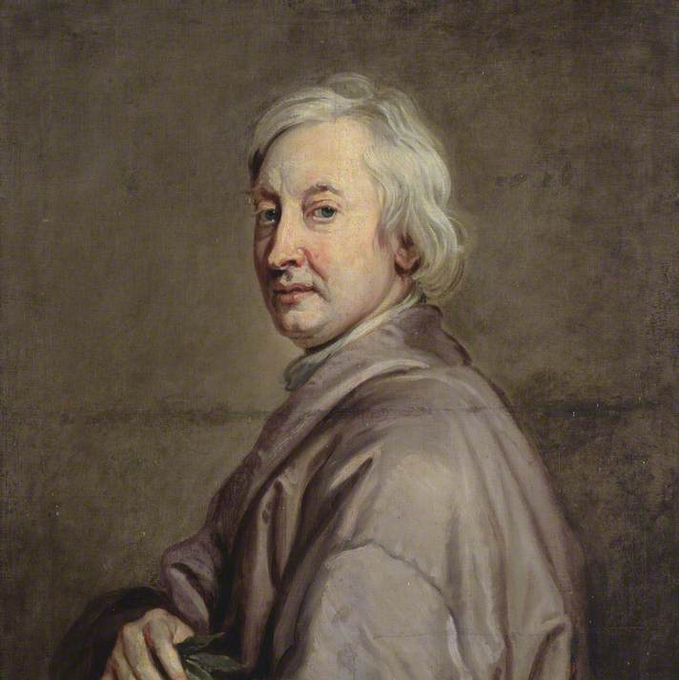
John Dryden (1631 – 1700)
university educated (BA, Cambridge)
poet, playwright, translator, literary critic
probably the most central figure of the literary life of Restoration England
precise concentrated style
aims to recapture the natural rhythm of the language*
works:
29 plays
An Essay on Dramatick Poesy
Absalom and Achitophel
Mac Flecknoe
The Hind and the Panther

Slide 8
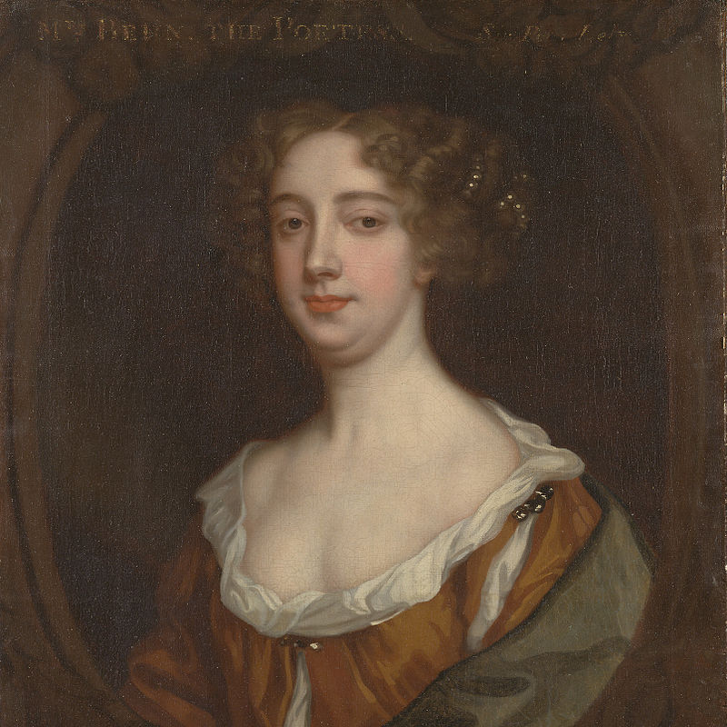
Aphra Behn (1640 – 1689)
first woman to have supported herself from writing in English
playwright, novelist, spy
widely travelled (Netherlands, Surinam)
best-known works:
The Forc’d Marriage
The Dutch Lover
The Rover
Love-Letters Between a Nobleman and His Sister
Oroonoko

