Slide 1
Artistic and Intellectual Groups
The Oxford Movement (The Tractarians)
Mainly intellectuals who studied or worked at the University of Oxford
Originally of Anglican Faith
Propagating a return to the ‘original’ Christian faith
Branch Theory: the Catholic Church, the Church of England and Orthodox Christianity form the 3 branches of the one unified ‘Christian Church’

Slide 2
Artistic and Intellectual Groups
The Oxford Movement (The Tractarians)
They had their series of publications discussing theological questions, entitled Tracts for the Times
Against:
secularization
theological liberalism
Several members decided at some point to convert to Catholicism

Slide 3
Artistic and Intellectual Groups
The Oxford Movement (The Tractarians)
Changes in the Church of England due to the Movement’s influence:
the establishment of Anglican religious orders
emphasis on liturgy and ceremony
Catholic practices introduced into worship
the role of the Eucharist became more central

Slide 4
Artistic and Intellectual Groups
The Oxford Movement (The Tractarians)
Leaders of the movement:
Edward Buverie Pusey
John Henry Newman, author of the era’s most widely read and influential autobiography: Apologia Pro Vita Sua
John Keble, author of The Christian Year

Slide 5
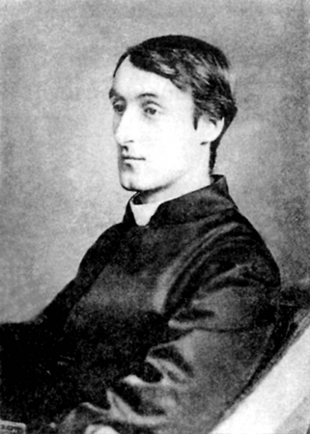
Artistic and Intellectual Groups
The Oxford Movement (The Tractarians)
Gerard Manley Hopkins (1844–1889)
Poet and Anglican then Jesuit priest
Introduced a more natural rhythm and rhyme pattern in English
Influenced by traditional Welsh poetic patterns
Poems strongly relying on sound patterns, hence a strongly ‘musical’ effect
Precursor of Modernist poetry

Slide 6
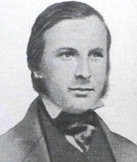
Artistic and Intellectual Groups
The Oxford Movement (The Tractarians)
Augustus Welby Northmore Pugin (1812–1852)
Architect, designer and theorist of design
Leader of the Gothic Revival Movement in architecture
In his book Contrasts he criticized the ‘pagan’ influence of Classical/Antique architecture, and set up Medieval society and style as ideal
True Principles of Christian Architecture

Slide 7
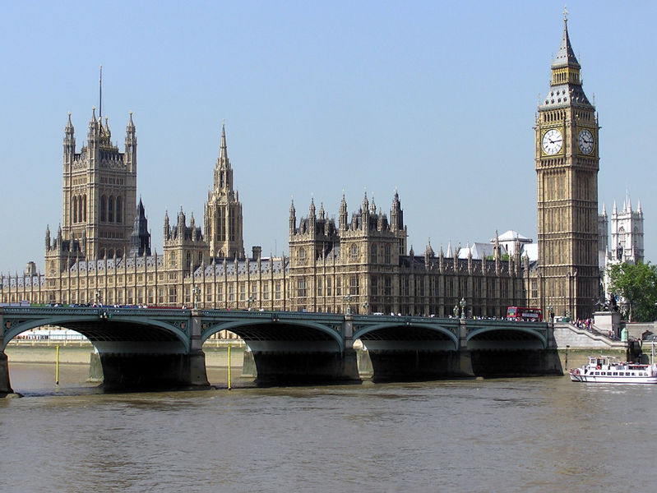
Augustus Welby Northmore Pugin (1812–1852)
Important projects:
Helping Charles Barry in Rebuilding The Palace of Westminster after the fire of 1834
(Finishing Barry’s general plans, designing decorations and interiors)

Slide 8
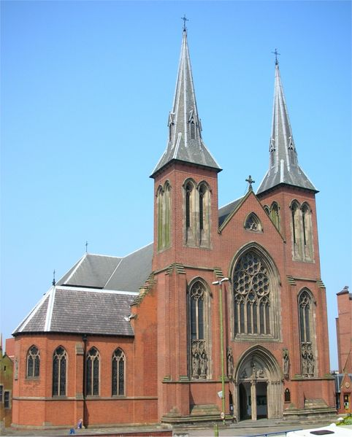
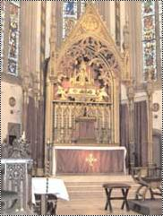
Augustus Welby Northmore Pugin (1812–1852)
Important projects:
St Chad’s Cathedral
Birmingham

Slide 9
Artistic and Intellectual Groups
The Pre-Raphaelite Brotherhood
a group of painters, poets and critics
founded in 1848
intention to reform art:
rejecting mannerism
rejecting mechanistic art
considering Raphael as a negative influence (his Classical poses and elegant compositions)
influenced by Medieval art

Slide 10
Artistic and Intellectual Groups
The Pre-Raphaelite Brotherhood
Principles:
To have genuine ideas to express.
To study Nature attentively.
To symphatize with what is direct and serious and authentic in previous art, and to reject what is conventional, self-parading and learned by rote.
To produce thoroughly good pictures and statues.

Slide 11
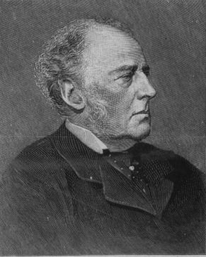
Artistic and Intellectual Groups
The Pre-Raphaelite Brotherhood
John Everett Millais (1829–1896)
Painter and illustrator
Founding member of the Brotherhood
Dense and elaborate pictorial surfaces
Integration of naturalistic elements

Slide 12
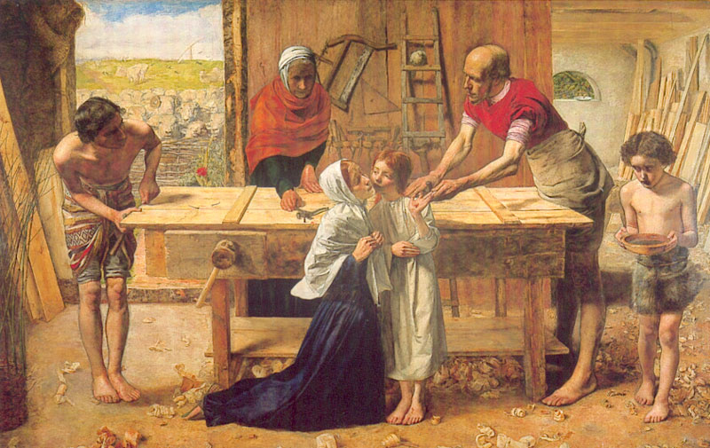
John Everett Millais (1829–1896)
Important paintings:
Christ in the House of His Parents, 1850

Slide 13
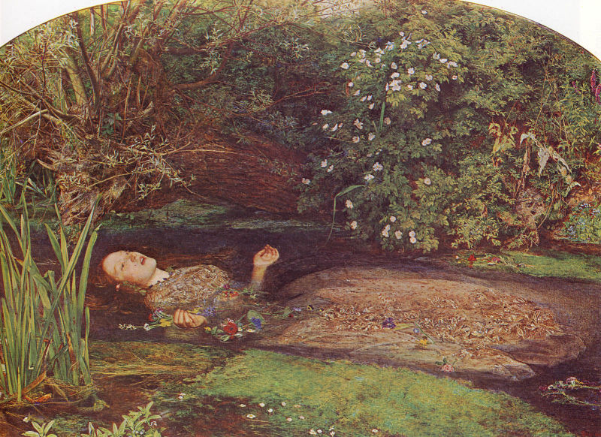
John Everett Millais (1829–1896)
Important paintings:
Ophelia, 1852

Slide 14
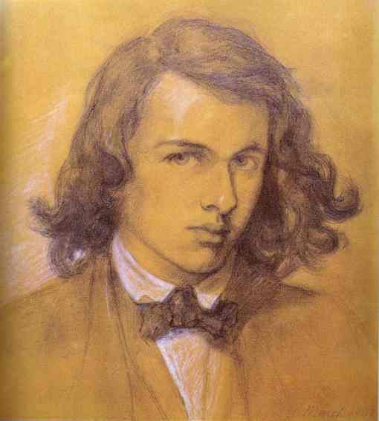
Artistic and Intellectual Groups
The Pre-Raphaelite Brotherhood
Dante Gabriel Rossetti (1828–1882)
Poet, painter, illustrator and translator
Founding member of the Brotherhood
Greatly interested in Medieval Italian art
Preferred symbolic and mythological themes to realistic ones
Translated Dante and other Medieval poets to English

Slide 15
Artistic and Intellectual Groups
The Pre-Raphaelite Brotherhood
Dante Gabriel Rossetti (1828–1882)
The Arthurian Legends and subjects from Dante are of central importance in his paintings
After the death of his wife, her image is idealized in the form of Dante’s Beatrice in the paintings
The Beatrice-images had a significant influence on the European Symbolist movement

Slide 16
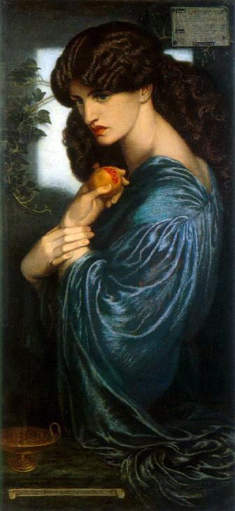
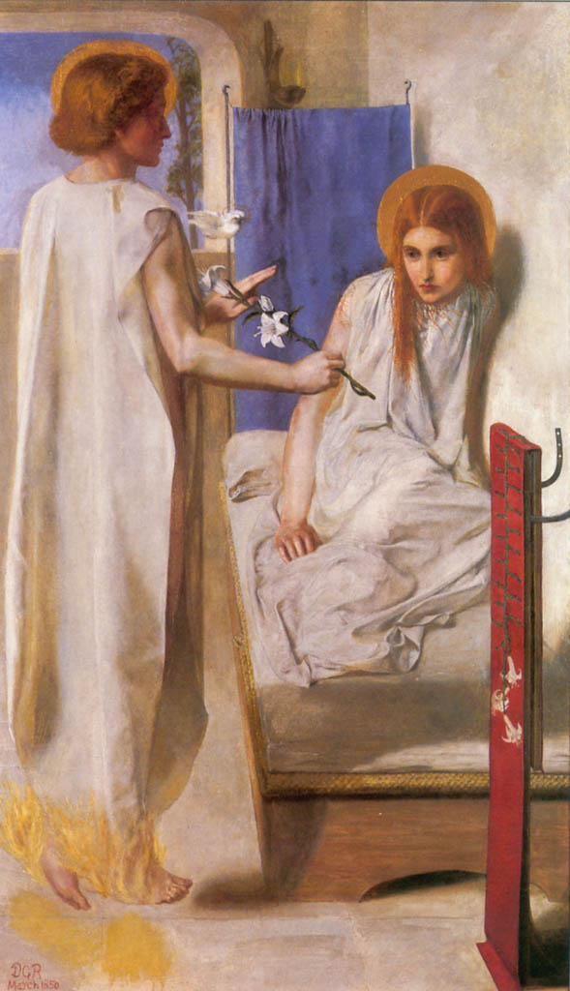
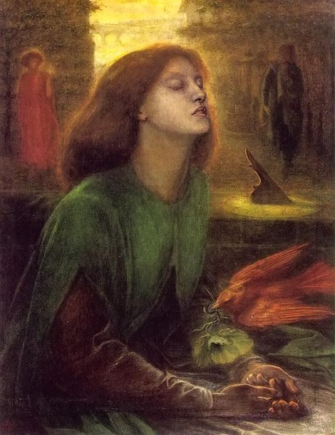
Dante Gabriel Rossetti (1828–1882)
Important paintings:
Beata Beatrix, 1863
Ecce Ancilla Domini! 1850
Persephona, 1873-77

Slide 17
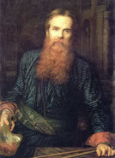
Artistic and Intellectual Groups
The Pre-Raphaelite Brotherhood
William Holman Hunt (1827–1910)
Painter
Founding member of the Brotherhood
Intensely naturalistic scenes of modern rural and urban life in his early works
Became famous through his religious works
Hard, vivid color
Great attention to detail
Complex, elaborate symbolism

Slide 18
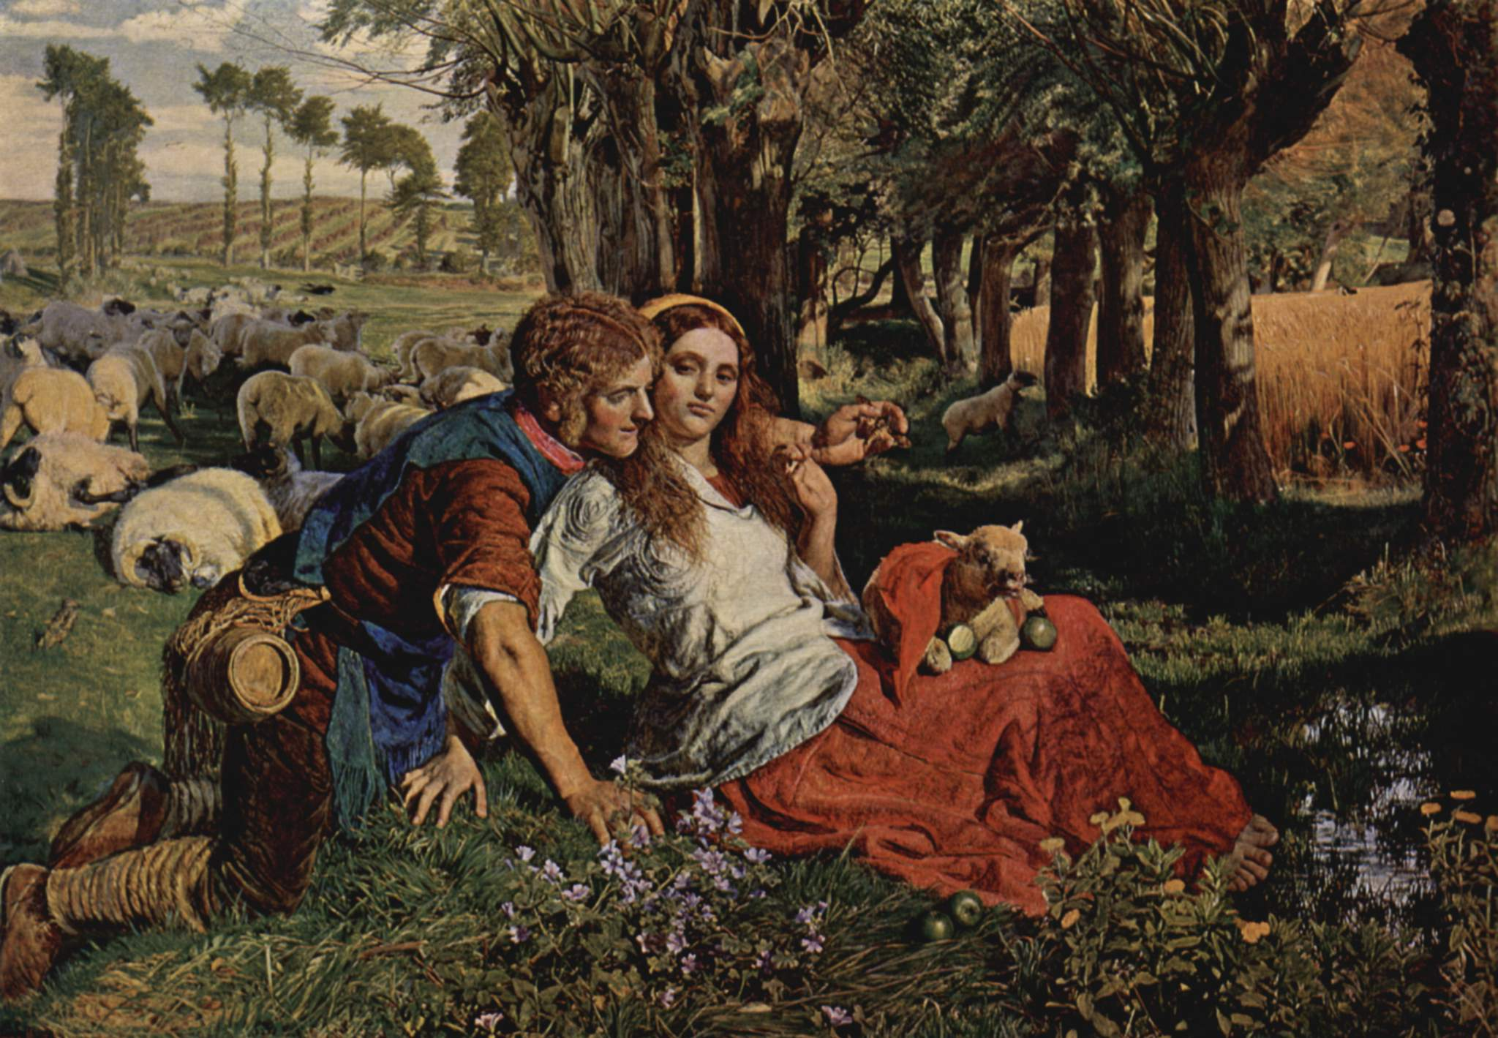
William Holman Hunt (1827–1910)
Important paintings:
The Hireling Shepherd, 1851

Slide 19
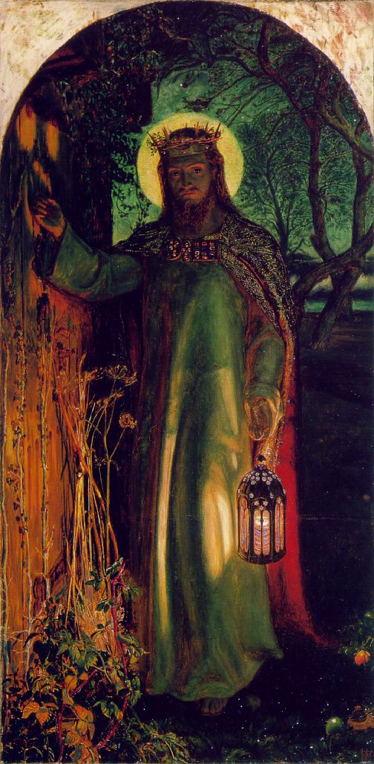
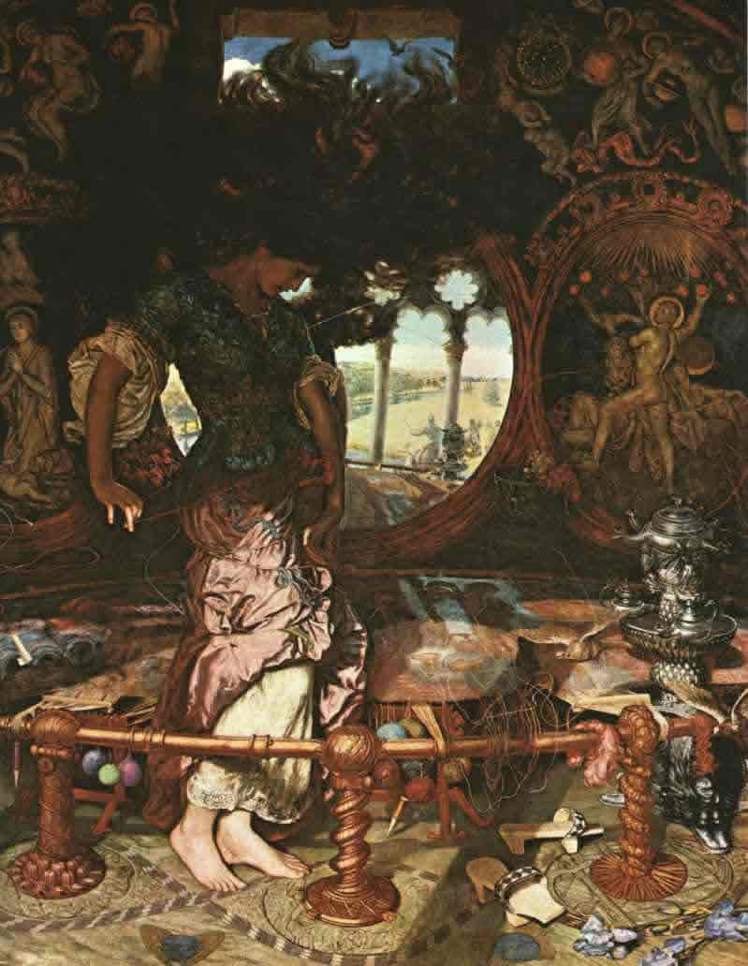
William Holman Hunt (1827–1910)
Important paintings:
The Lady of Shalott
The Light of the World

Slide 20
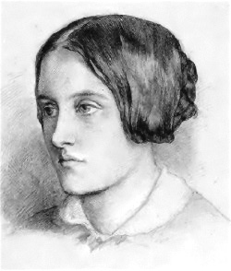
Artistic and Intellectual Groups
The Pre-Raphaelite Brotherhood
Christina Georgina Rossetti (1830–1894)
Poet
Sexually abused by his father
Went through a nervous breakdown, and a phase of severe depression at the age of 14
Interested in the Anglo-Catholic Movement
Began writing at an early age, but her first volume was published when she was already 31

Slide 21
Artistic and Intellectual Groups
The Pre-Raphaelite Brotherhood
Christina Georgina Rossetti (1830–1894)
Goblin Market and Other Poems, 1862
the poem ‘Goblin Market’ is the most widely discussed one in the volume:
allegory about temptation and salvation
commentary on Victorian gender roles
a work about erotic desire

Slide 22
Artistic and Intellectual Groups
The Uranians
a group of pederastic poets
many of them graduates of Oxford or Cambridge
they wrote between 1870 and 1930
their fame was limited by Edwardian and Victorian taboos, and by the small editions in which the poems were published
idealized appeal to ancient Greek history
sentimental infatuation for adolescent boys

Slide 23
Artistic and Intellectual Groups
The Uranians
a 19th century term referring to a person of a third sex
originally someone with a female psyche in a male body
later extended to include other varieties
the English form of the German word Urning termed by the German activist Karl Heinrich Ulrichs

Slide 24
Artistic and Intellectual Groups
The Uranians
Lord Alfred Bruce Douglas (1870-1945): poet, and the lover of Oscar Wilde
the Reverend Edwin Emmanuel Bradford (1860-1944): poet and clergyman, his work was outspokenly pederastic, but surprizingly also quite famous at the time
John Addington Symonds (1840-1893): poet and literary critic, chiefly remembered for his study on the Renaissance
Frederick Rolfe (Baron Corvo) (1860-1913): writer, novelist, artist, fantasist and eccentric; fascinating prose style and personality

Slide 25
Artistic and Intellectual Groups
The Uranians
The traditionally accepted circle of Uranian poets is challenged and exponentially expanded by Michael M. Kaylor:
identifies major Victorian poets, such as Walter Pater, Gerard Manley Hopkins and Oscar Wilde, as Uranians

