Slide 1
LT1SS
Imperial literature
Personification of colonial efforts
Fall of the Empire

Slide 2
Imperialism x colonialism
Imperialism: a policy of extending a country's power and influence through colonization, use of military force, or other means
Colonialism: “control by one power over a dependent area or people”
It occurs when one nation subjugates another, conquering its population and exploiting it, often while forcing its own language and cultural values upon its people

Slide 3
Britannia
The word ‘Britannia’ is derived from ‘Pretannia’, from the term that the Greek historian Diodorus Siculus (1BC) used for the Pretani people, who the Greeks believed lived in Britain
by the time of Queen Victoria, Britannia had been renewed:
Britannia was then "rooted in the rise of nationalism as people's sense of national identity emerged" (Matthews)
"she played a role in the transitional stages leading to nationalism and the transformation of a state into a nation-state and a nation-state into an Empire“
"Britannia represented no longer the English nation-state but the British national character"

Slide 4
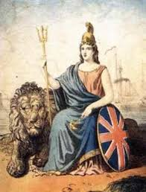
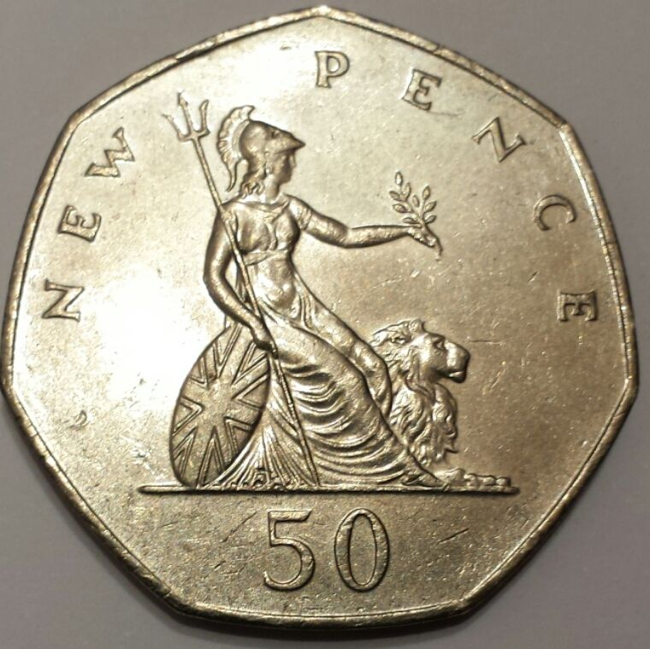
Britannia

Slide 5
Britannia

Slide 6
Britannia

Slide 7
Britannia

Slide 8
Britannia

Slide 9
Rule, Britannia!
Rule, Britannia! / Rule Britannia – a poem by JAMES THOMSON
The author had an interest in helping foster a British identity, including and transcending the older English, Irish, Welsh and Scottish identities.
The poem was set to music; the first public performance of ‘Rule, Britannia!’ was in London in 1745, and it instantly became very popular.
The patriotic song ‘Rule, Britannia!, Britannia rule the waves’, is traditionally performed at the ‘Last Night of the Proms’ which takes place each year at the Royal Albert Hall.

Slide 10
Rule, Britannia!
In 1836, Richard Wagner wrote a concert overture based on ‘Rule, Britannia!’.
Arthur Sullivan, who wrote comedy operas in Victorian times, quoted from the song too.
‘Rule, Britannia!’ became the Regimental March of the Royal Norfolk Regiment in 1881, and even today, some Royal Navy vessels are called HMS Britannia.

Slide 11
Jingoism
Conventionally, jingoism as a mode of thinking or feeling is understood as nation-obsessed, closed-minded, xenophobic, and inward-looking.
The OED definition of the ‘jingo’, which emerges in this period, denotes a ‘blustering patriot’ and is associated with war-mongering rhetoric.
Land of hope and glory

Slide 12
‘Cool Britannia’
a period of increased pride in the culture of the United Kingdom throughout most of the 1990s, inspired by 1960s pop culture
Tony Blair's Labour government in 1997, seen by some as young, cool and very appealing, received quite a lot of reflected glory of the feeling of euphoria and optimism.
“Our fashion, music and culture are the envy of our European neighbours. This abundance of talent, together with our rich heritage, makes 'Cool Britannia' an obvious choice for visitors from all over the world.” (J. Major)

