Slide 1
LT1SS
Literature 1: British and American Literatures

Slide 2
The British Empire – the early beginnings
What is an empire?
  Empire is a term used to describe a group of territories ruled by one single ruler or state. Empires are built by countries that wish to control lands outside of their borders.
In the 16th Century, Britain began to spread the country’s rule and power beyond its borders in a focused manner

Slide 3
The British Empire – the early beginnings
By 1670 there were British American colonies in New England, Virginia, and Maryland and settlements in the Bermudas, Honduras, Antigua, Barbados, and Nova Scotia.
The East India Company began establishing trading posts in India in 1600, and the Straits Settlements (Penang, Singapore, Malacca, and Labuan) became British through an extension of that company’s activities.

Slide 4
The British Empire – the early beginnings
Maritime expansion, driven by commercial ambitions and by competition with France, accelerated in the 17th century
James Island in the Gambia River – 1661
Sierra Leone – 1787
Cape of Good Hope (now in South Africa) – 1806

Slide 5
The British Empire – the early beginnings
In the 17th and 18th centuries, the crown exercised control over its colonies chiefly in the areas of trade and shipping.
  In accordance with the mercantilist philosophy of the time, the colonies were regarded as a source of necessary raw materials for England and were granted monopolies for their products, such as tobacco and sugar, in the British market.
The Navigation Act of 1651 and subsequent acts set up a closed economy between Britain and its colonies; all colonial exports had to be shipped on English ships to the British market, and all colonial imports had to come by way of England.

Slide 6
The British Empire – the end of the first empire
The years 1775-1783 were a turning point in British history, as the nation lost a huge part of its empire in the American War of Independence.
Feeling ‘American’ rather than ‘British’, and resentful of sending money back to Britain, 13 colonies in North America united and fought to be free from British rule.

Slide 7
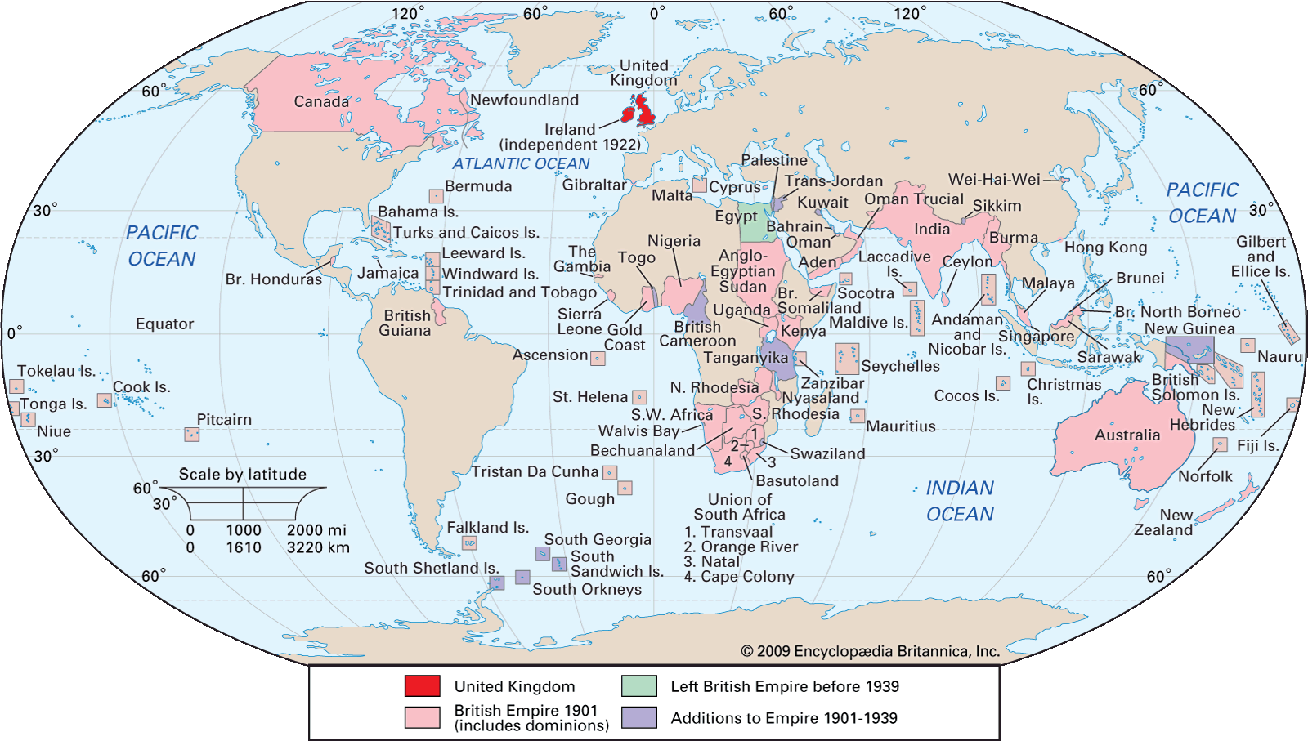

Slide 8
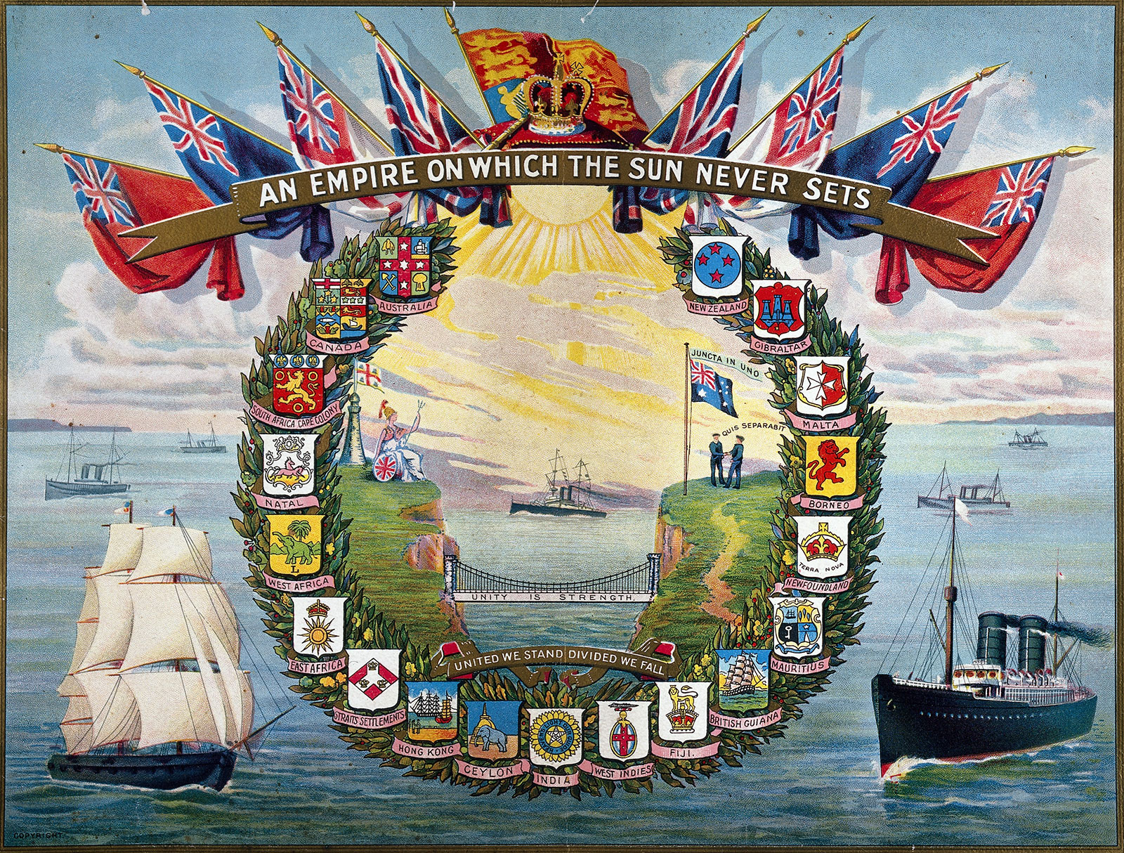

Slide 9
New acquisitions
new settlements in Australia from 1788
the spectacular growth of Upper Canada (now Ontario)
the Treaty of Amiens (1802) made Trinidad and Ceylon (now Sri Lanka) officially British
in the Treaty of Paris (1814) France ceded Tobago, Mauritius, Saint Lucia, and Malta.
Malacca joined the empire in 1795, and Sir Stamford Raffles acquired Singapore in 1819
Canadian settlements in Alberta, Manitoba, and British Columbia extended British influence to the Pacific

Slide 10
New acquisitions
the Colonial Office
It began in 1801, it first an appendage of the Home Office and the Board of Trade, but by the 1850s it had become a separate department with a growing staff and a continuing policy
Scramble for Africa - Egypt, Kenya, Nigeria and large areas of southern Africa came under the British rule
in 1877, the British High Commission for the Western Pacific Islands was created

Slide 11
New acquisitions
the British crown assumed the East India Company’s governmental authority in India after the mutiny there
Britain’s acquisition of Burma (Myanmar) was completed in 1886, while its conquest of the Punjab (1849) provided substantial new territory in the Indian subcontinent

Slide 12
“responsible self-government” ?
The system whereby some colonies were allowed largely to manage their own affairs under governors appointed by the mother country spread rapidly
In 1847 it was put into effect in the colonies in Canada, and it was later extended to the Australian colonies, New Zealand, and to the Cape Colony and Natal in southern Africa – in 1907, they were granted the new status of dominions
In 1931, the Statute of Westminster recognized them as independent countries “within the British Empire, equal in status” to the United Kingdom. The statute referred specifically to the “British Commonwealth of Nations.” When World War II broke out in 1939, the dominions made their own declarations of war.

Slide 13
Nationalism And The Commonwealth
Nationalist sentiment developed rapidly in many of these areas after World War I and even more so after World War II, with the result that, beginning with India in 1947, independence was granted them, along with the option of retaining an association with Great Britain and other former dependencies in the Commonwealth of Nations
The last significant British colony, Hong Kong, was returned to Chinese sovereignty in 1997. By then, virtually nothing remained of the empire.

Slide 14
