Slide 1
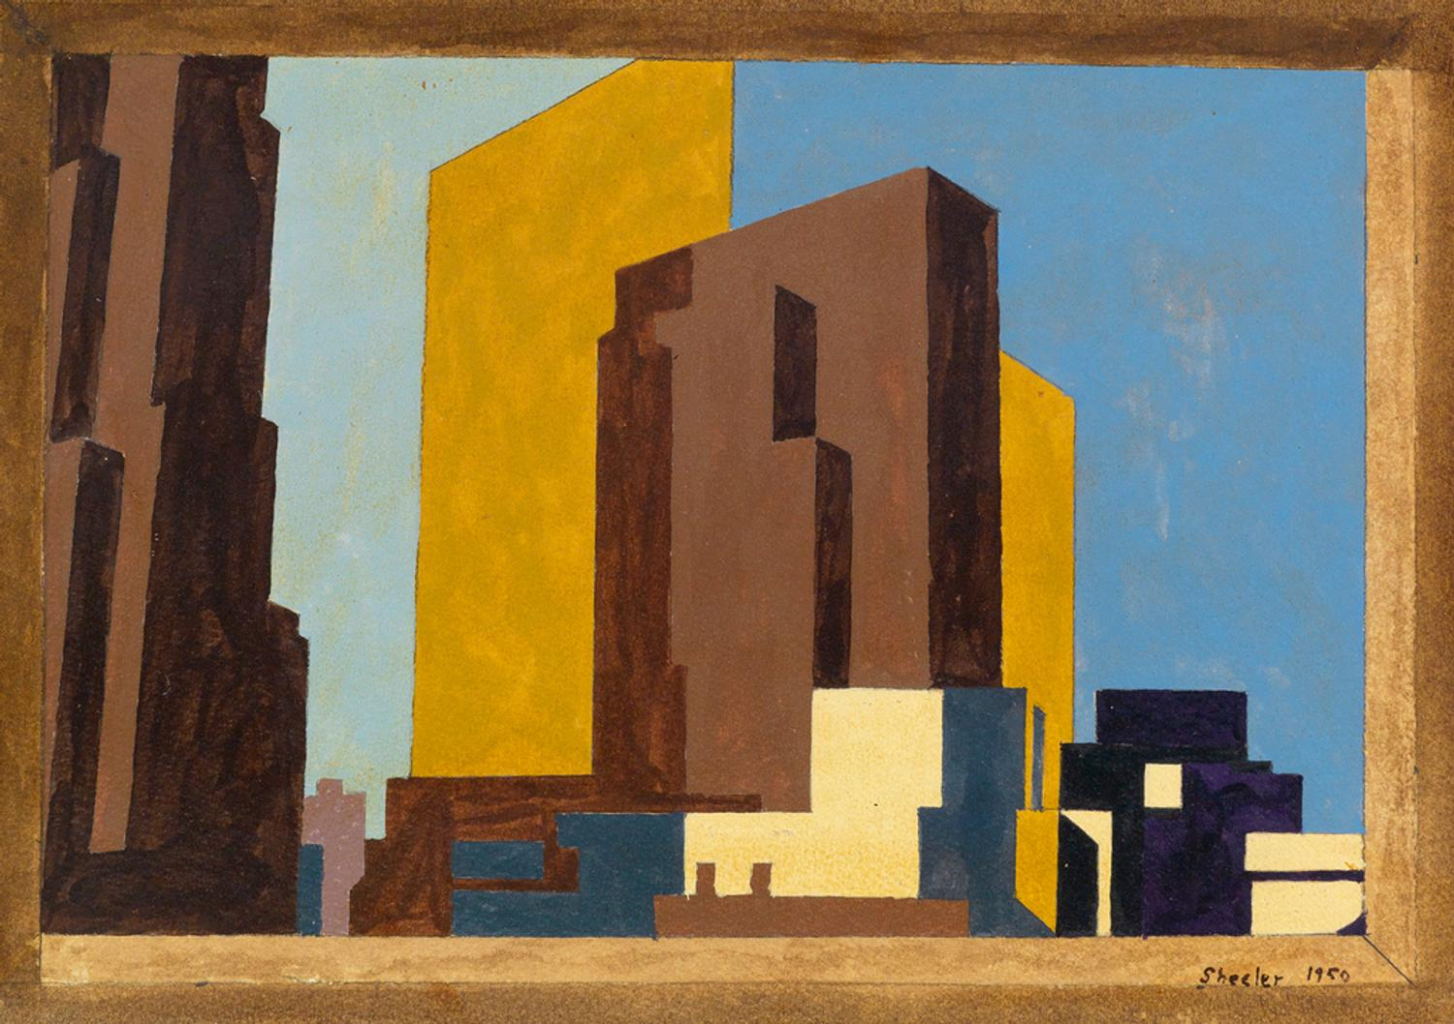
MODERNISM ROBERT FROST

Slide 2
MODERNISM
a reflection of American life in the 20th century
a dominant trend in American literature between World War I and World War II
highlighted innovation in the form and language of poetry and prose, as well as addressing numerous contemporary topics
many American modernists became expatriated in Europe during this time, often becoming stalwarts in the European movement, as was the case for T. S. Eliot, Ezra Pound and Gertrude Stein
many American authors and poets began a trend of 'nativism', seeking to represent the modern American experience in America (notable contributors to this trend include William Carlos Williams, Wallace Stevens and Marianne Moore)

Slide 3
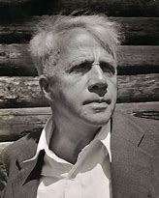
ROBERT FROST
March 26, 1874
January 29, 1963
Influenced by contemporary British poets as Edward Thomas, Rupert Brooke, and Robert Graves
Frost’s work is principally associated with the life and landscape of New England

Slide 4
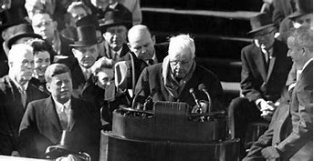
ROBERT FROST
“American Bard”: “He became a national celebrity, our nearly official poet laureate, and a great performer in the tradition of that earlier master of the literary vernacular, Mark Twain.”

Slide 5
"THE GIFT OUTRIGHT"
The land was ours before we were the land’s
She was our land more than a hundred years
Before we were her people. She was ours
In Massachusetts, in Virginia,
But we were England’s, still colonials,
Possessing what we still were unpossessed by,
Possessed by what we now no more possessed.
Something we were withholding made us weak
Until we found out that it was ourselves
We were withholding from our land of living,
And forthwith found salvation in surrender.
Such as we were we gave ourselves outright
(The deed of gift was many deeds of war)
To the land vaguely realizing westward,
But still unstoried, artless, unenhanced,
Such as she was, such as she will become.

Slide 6
ROBERT FROST

