Slide 1
Virginia Woolf (1882–1941)
born Adeline Virginia Stephen, writer and feminist icon
a pioneering novelist whose most famous works include Mrs Dalloway, To the Lighthouse, Orlando and her seminal essay on women and fiction A Room of One’s Own.
a key figure in the influential Bloomsbury Group and, alongside her husband Leonard, started the publishing house Hogarth Press, initially operating with a hand press out of the couple’s dining room.
https://www.youtube.com/watch?v=d1W7wqXD_b0

Slide 2
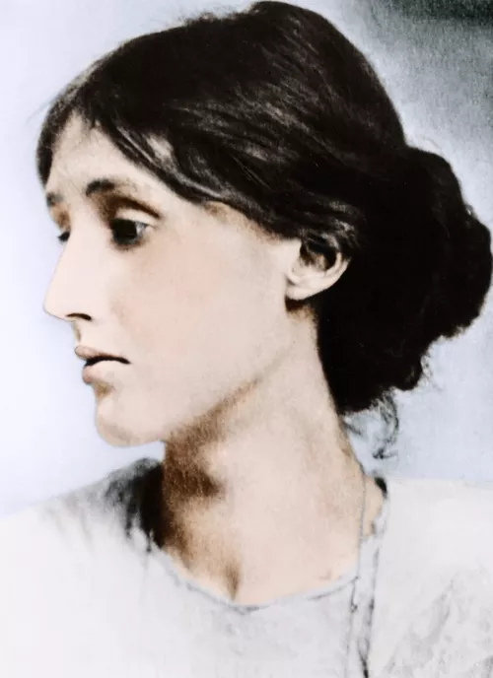
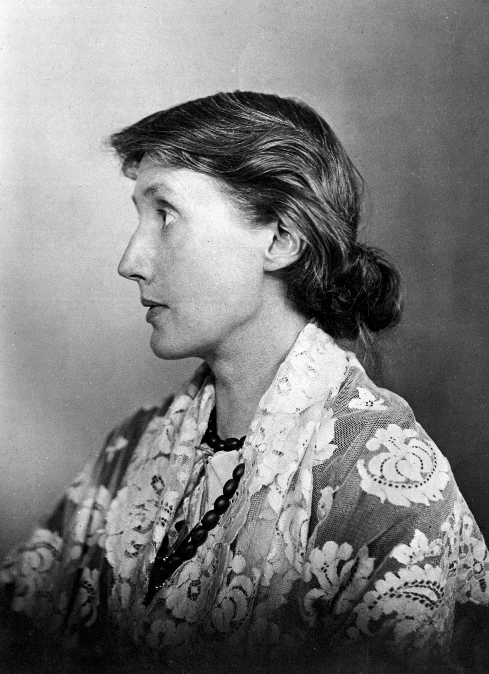

Slide 3
A Room of One's Own
"Imaginative work... is like a spider's web, attached ever so lightly perhaps, but still attached to life at all four corners.... But when the web is pulled askew, hooked up at the edge, torn in the middle, one remembers that these webs are not spun in midair by incorporeal creatures, but are the work of suffering, human beings, and are attached to the grossly material things, like health and money and the houses we live in."

Slide 4
Duncan Grant: portrait of James Strachey

Slide 5
Duncan Grant: Tub

Slide 6
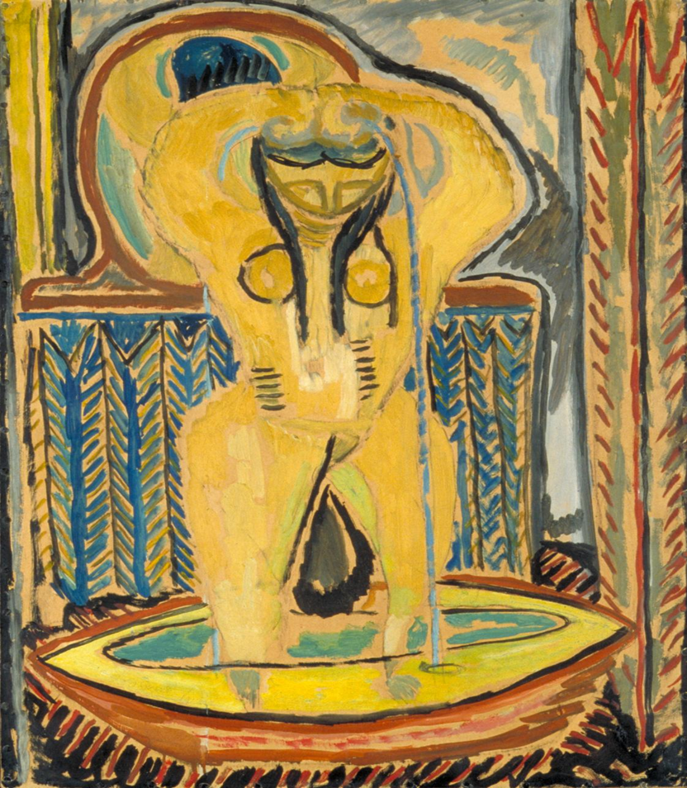

Slide 7
A Room of One’s Own (1929)
a book-length essay based on two lectures given by English author Virginia Woolf to the all-women colleges of Newnham and Girton at the University of Cambridge. Woolf weaves narrative devices, personal experience, and historical fiction to make a case for the financial independence of women to produce literary works.
For women to meaningfully participate in the literary tradition, they require access to the same resources on par with men to have the intellectual freedom men enjoy. It is considered feminist literature because of its focus on women and their denial from accessing resources that men take for granted. The meaning of the title is that women need their own room and living allowance to invest in themselves creatively.

Slide 8
A Room of One’s Own (1929)
…women and fiction might mean, and you may have meant it to mean, women and what they are like; or it might mean women and the fiction that they write; or it might mean women and the fiction that is written about them; or it might mean that somehow all three are inextricably mixed together and you want me to consider them in that light. But when I began to consider the subject in this last way, which seemed the most interesting, I soon saw that it had one fatal drawback. I should never be able to come to a conclusion. I should never be able to fulfil what is, I understand, the first duty of a lecturer—to hand you after an hour’s discourse a nugget of pure truth to wrap up between the pages of your notebooks and keep on the mantelpiece forever. All I could do was to offer you an opinion upon one minor point—a woman must have money and a room of her own if she is to write fiction…

Slide 9
A Room of One’s Own (1929)
Woolf encourages her audience of scholarly women to contribute to the legacy of women writers. She loves to read on a variety of subjects and wishes to see these topics elaborated upon from the perspective of women. So far, women have been able to become successful novelists. Within the scope of literature, novels are a relatively new form. Woolf believes this is why women have been able to participate more easily in novels than in other well-established literary forms by male authors. She hopes to change that with her essay.

Slide 10
Virginia Woolf & Vita Sackville West
Orlando (full movie)
https://www.youtube.com/watch?v=gphWi4N83qs

Slide 11
Love Letters: Virginia Woolf & Vita Sackville West
Somehow it’s dull and damp. I have been dull; I have missed you. I do miss you. I shall miss you. And if you don’t believe it, you’re a long-eared owl and ass.
Virginia to Vita, 1926
What else? I miss you horribly… The wish to steal Virginia overcomes me, — steal her, take her away, and put her in the sun among the objects mentioned alphabetically above. If I can get myself to Asia and Africa, why can’t you? (But with me, please.)
Vita to Virginia, 1926
Vita & Virginia Trailer:
https://www.youtube.com/watch?v=GXrE4Po8jj0

Slide 12
Mrs. Dalloway
She muddled Armenians with Turks; loved success; hated discomfort; must be liked; talked oceans of nonsense; and to this day, ask her what the Equator was, and she did not know.
All the same that one day should follow another; Wednesday, Thursday, Friday, Saturday; that one should wake up in the morning; walk in the park; meet Hugh Whitbread; then suddenly in came Peter; then these roses; it was enough. After that, how unbelievable death was! – that it must end; and no one in the whole world would know how she had loved it all; how every instant…
Mrs. Dalloway (full movie)
https://www.youtube.com/watch?v=fHMf_MbHLhI&rco=1

Slide 13
Mrs. Dalloway
"The word 'time' split its husk; poured its riches over him; and from his lips fell like shells, like shavings from a plane, without his making them, hard, white, imperishable words, and flew to attach themselves to their places in an ode to Time; an immortal ode to Time."

