Slide 1



Nové možnosti rozvoje vzdělávání na Technické univerzitě v Liberci
Specifický cíl A2: Rozvoj v oblasti distanční výuky, online výuky a blended learning
NPO_TUL_MSMT-16598/2022
Inovace stávajících nebo tvorba nových metodických a elektronických studijních materiálů v ČJ nebo AJ
Ing. Pavel Holec

Slide 2
Polymers
Introduction, basic terms
and
base materials for their synthesis

Slide 3
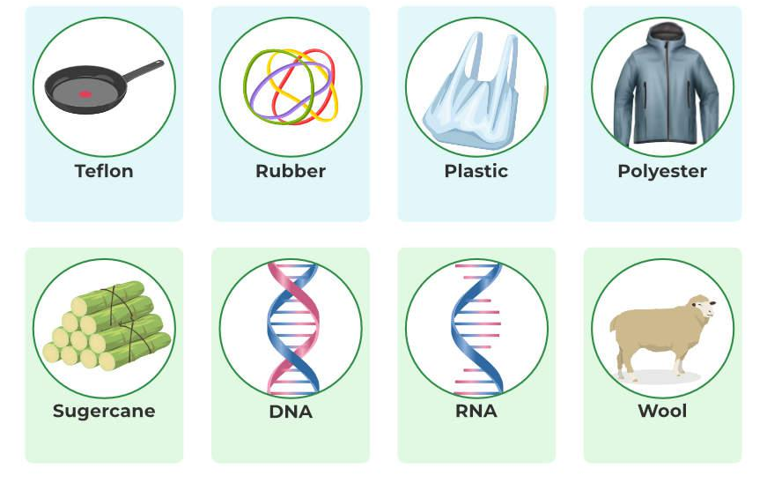
Polymers around us

Slide 4
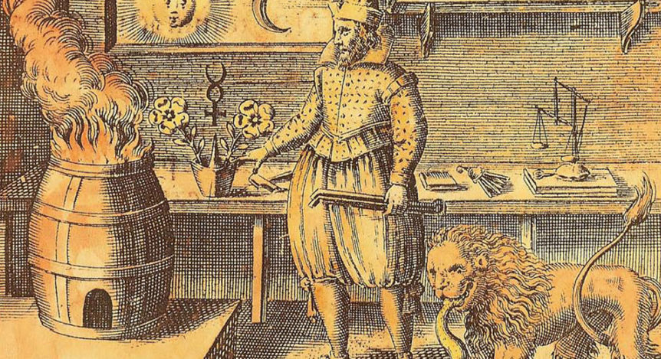
Macromolecular chemistry
The science about
  preparations
  structures
  properties
of macromolecular substances and systems in which these substances are the main component.

Slide 5
History of macromolecular chemistry
to the beginning of the 19th century – processing available natural polymers
1st half of the 19th century – attempts at scientific research into the structure of polymers
1811 – the first natural rubber processing factory (Vienna)
1839 – discovery of vulcanization of rubber (Goodyear)
1852 – concept of chemical bonding (Frankland)
1857 – tetravalent carbon and the theory of chemical structure (Kekulé and Kolbe)
1862 – celluloid (Hyatt)
1865 – artificial silk
1872 – synthesis of phenol-formaldehyde resins

Slide 6
History of macromolecular chemistry
2nd half of the 19th century – colloidal theory, stagnation of structure research
beginning of the 20th century – chain theory
1907 – industrial production of Bakelite
1909 – synthetic rubber
1920 to 1930 – PVA, PVC, PS, rubbers
1928 – unraveling the structure of proteins based on the chain theory
The 1930s – the definitive victory of the chain theory, the beginnings of macromolecular chemistry
1930 to 1940 – polyesters, polyethylene, chloroprene
1940 to 1950 – rapid development of polymer research
1954 – polypropylene (Ziegler-Natta)
so far – other new technologies, discoveries, possibilities, but also problems (e.g. plastic microparticles in drinking water)

Slide 7
Properties of polymers
extraordinary modifiability of input materials
high speed and volume of production
cheap (relatively) processing of raw materials
cheap (relatively) processing of products
usually not very heat resistant
often poorly degradable

Slide 8
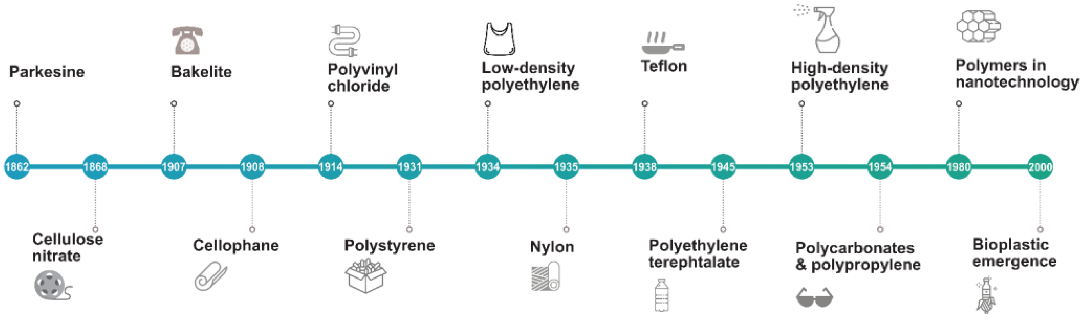
History of polymers timeline

Slide 9
Classification according to production
mass production
  packaging, construction, textiles, automotive, agriculture
  PE, PP, PVC, PS, PET, PA
special
  electrical engineering (insulation, batteries)
  liquid crystals
  polymer membranes
  medical technology

Slide 10
Polymers and price
LCP,
PEEK, PPS
PC, PET,
PBT, PA, PC, ABS,
POM, PPO, PMMA
HDPE, LDPE,
LLDPE, PP, PVC, PS
special
mass of production
price
structural
commodity

Slide 11
World consumption of polymers

Slide 12
World consumption of polymers

Slide 13
Raw materials
oil (60%)
coal (18%)
biomass (10%)
other

Slide 14
Utilization of raw materials
petroleum
+
natural gas
ethylene
propylene
styrene
vinylchloride
butadiene
cyklohexane
acetylene
plastomers
adhesives +
coatings
elastomers
fibers

Slide 15
Petroleum
a dark oily mixture of mostly organic substances
  accompanied by deposits of natural gas
it arises from dead parts of plants and animals in the absence of air, higher pressures and temperatures
a source of monomers for the polymer industry
  fractional distillation

Slide 16
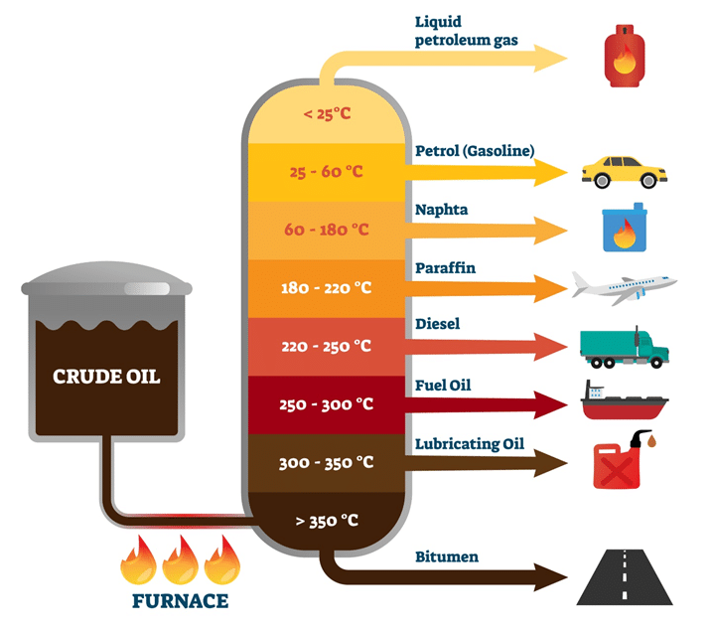
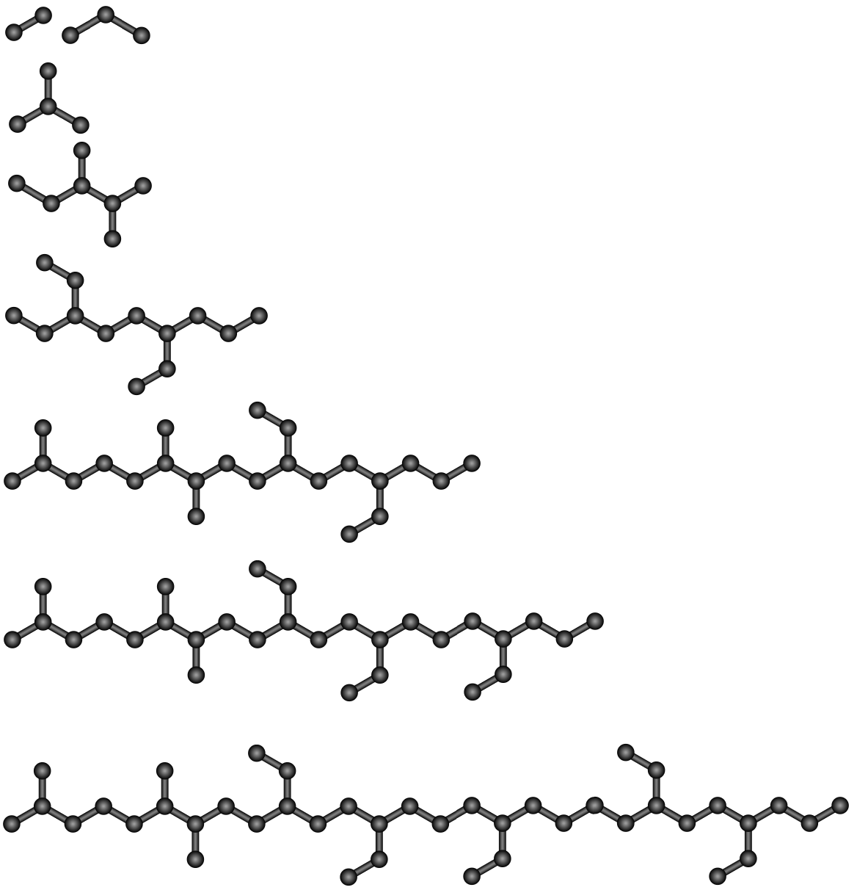
Fractional distillation of crude oil
Increasing molecular weight

Slide 17
Basic terms
POLYMER
  a substance consisting mainly or entirely of macromolecules
  is formed by a polyreaction
MACROMOLECULE
  a compound with a high molar mass formed by the repetition of one or more types of atoms or groups of atoms bonded to each other by a chemical bond in such a large number that the addition or subtraction of one or more units (from the ends of the molecule) does not change a whole range of properties
  molecular weight greater than about 10⁴ g/mol (there is no sharp transition between low and high molecular weight substances)

Slide 18
Basic terms
OLIGOMER
  a compound with a not too high molar mass formed by the repetition of one or more types of atoms or groups of atoms bound to each other by a chemical bond, whereby the properties are changed by the addition or subtraction of one or more units (from the ends of the molecule)
MONOMER
  a compound (most often organic) capable of forming macromolecules by reaction
MONOMER (STRUCTURAL) UNIT
  measure, measure
  the largest constitutional unit formed during polymerization from a single monomer molecule

Slide 19
Basic terms
degree of polymerization
  the total number of monomer units in the macromolecule
constitutional repeating unit (CRP)
  the smallest constitutional unit whose repetition describes a regular polymer
    a structure oriented from left to right is usually preferred, when the condition of the lowest locant of substitution according to the rules of nomenclature of organic chemistry is met
    from other point of view: in the formula, there will usually be a group with a heteroatom on the left, and then carbon chains and other heteroatoms

Slide 20
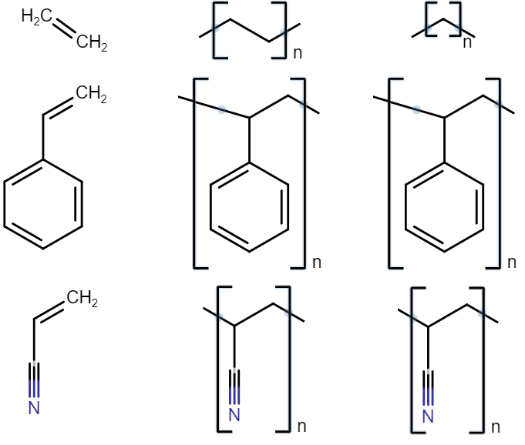
Monomer
Monomer unit
CRP

Slide 21
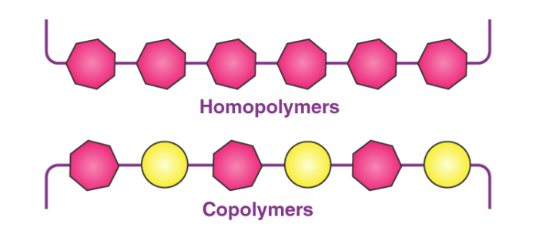
Basic terms
HOMOPOLYMER
  formed by only one type of mer
HETEROPOLIMER or COPOLYMER
  made up of several types of mers
  statistical -S-S-T-S-T-T-T-S-T-S-S-T-
  alternating -A-L-A-L-A-L-A-L-A-L-A-
  periodic -P-E-R-P-E-R-P-E-R-P-E-
  block -B-B-B-L-L-L-B-B-B-L-L-L-
  grafted -G-G-G-G-G-G-G-G-G-G-G-
-R-R
-R-R
-R-R

Slide 22
Basic terms
MAIN CHAIN
  the longest chain of a macromolecule
SUBSTITUTE
  structures bound to the main chain
LINEAR POLYMER
  consisting of only one simple string
BRANCHED POLYMER
  made up of one main chain and chemically bonded side chains (usually shorter)

Slide 23
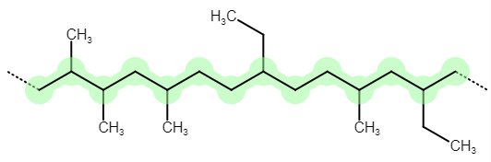
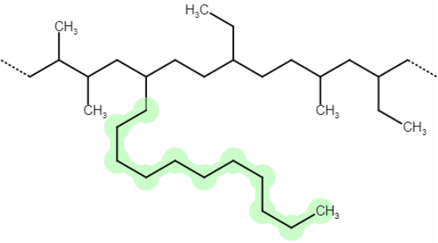
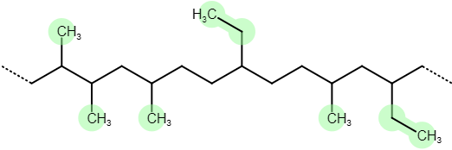
main chain
side chain
substituent

Slide 24
Exceptional behavior of polymers
the combined action of intermolecular forces
string entanglement
time-dependent movement
the disproportion between the length and the width of the chain
usually not all molecules (of the same polymer) are the same

Slide 25
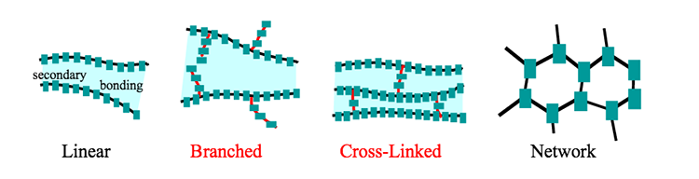
Structure of macromolecules
given by the functionality of the monomers
  linear
  branched
  cross-linked
linear
  soluble
cross-linked
  insoluble
  swell

Slide 26
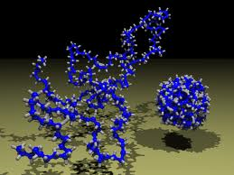
Shapes of macromolecules

Slide 27
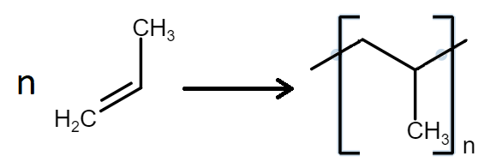
Polymerization
the reaction in which small molecules become macromolecules
the opposite is depolymerization (sometimes it can be traced back to the starting monomers)

Slide 28
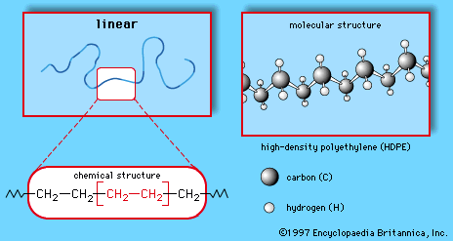
Polymers and chemical structures
polyolefins
vinyl polymers
polyethers
polyesters
polyamides and aramids
polyurethanes
butadiene polymers

Slide 29


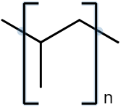
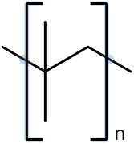
Polyolefins
PE
PP
PIB

Slide 30
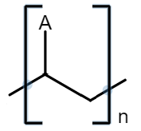
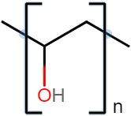
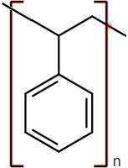
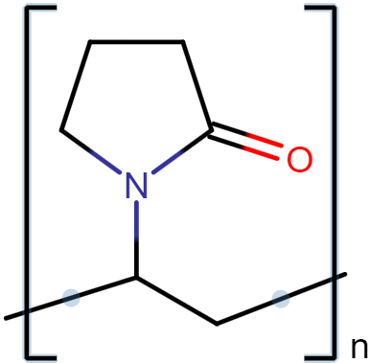
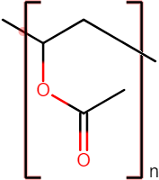
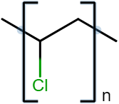
Vinyl polymers
PVA
PS
PVP
PVAc
PVC

Slide 31
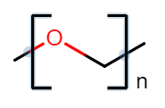



Polyethers
POM
POPh
POE

Slide 32
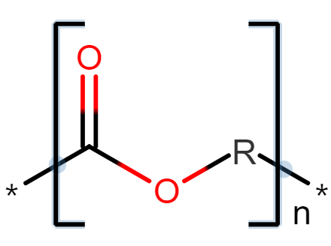
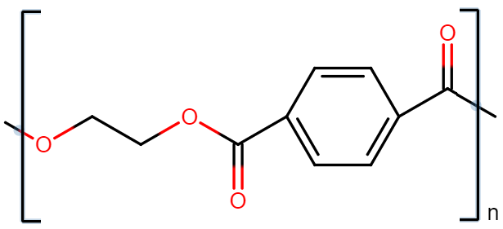
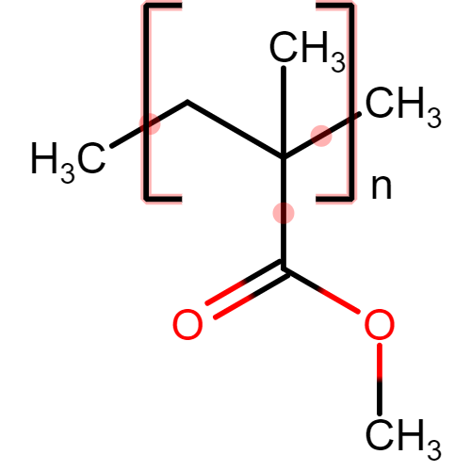
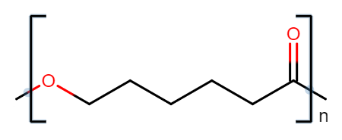
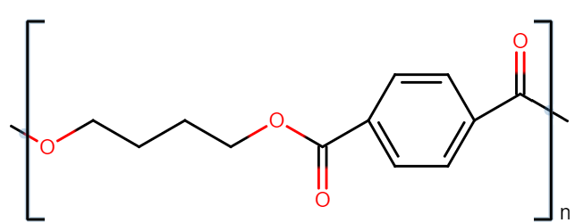
Polyesters
PET
PCL
PMMA
PBT

Slide 33
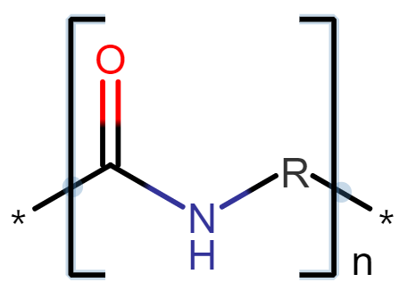
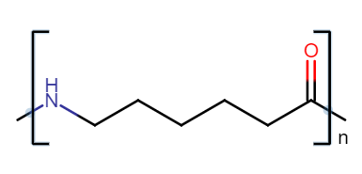
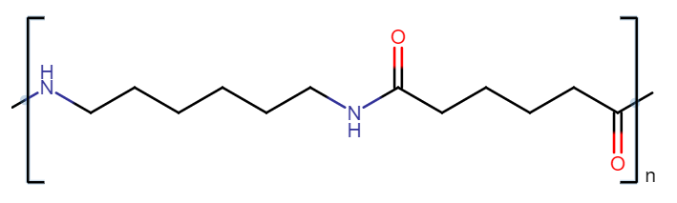
Polyamides
PA 6
PA 66

Slide 34
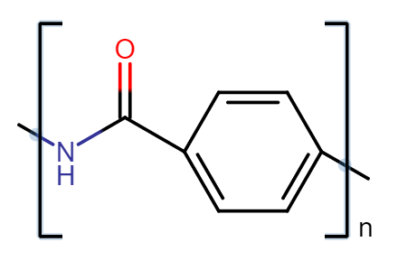
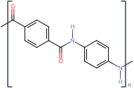

Aramides
(aromatic polyamides)
Kevlar
Nomex

Slide 35
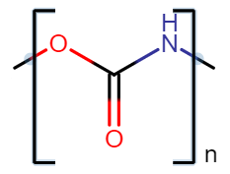
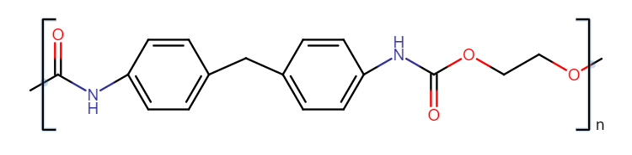
Polyuretans

Slide 36
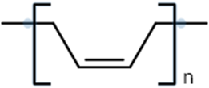

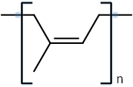
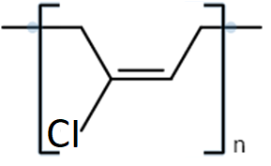
Butadiene polymers
BR
trans-
NR
CR

Slide 37
Polymers
occurrence in nature
natural
synthetic
production raw material
renewable
chemical composition
non-renewable (usually fossil)
anorganic
anorgano-organic
organic
mechanical properties
plastomers
elastomers

Slide 38
Plastomers - Thermoplastics
they soften and become malleable when heated
upon re-cooling, they solidify and lose malleability
the process can be repeated many times (recycling)
temperature changes here affect only intermolecular attractive forces
  they do not cause chemical reactions

Slide 39
Plastomers - Reaktoplasty
before final processing, they contain chains with reactive functional groups
  they harden chemically and form (most often spatially) cross-linked macromolecules
changes are irreversible
THERMOSETS
  a reasonably long heating is sufficient to cure

Slide 40
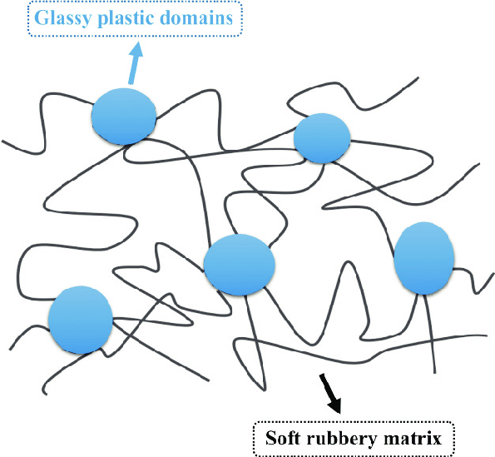
Elastomers
a weak force action causes a large reversible deformation
rubbers
  crosslinked rubbers
thermoplastic elastomers
  non-crosslinked linear molecules formed by alternating glassy and rubbery phases

Slide 41
Thank you for your attention

