Slide 1



Nové možnosti rozvoje vzdělávání na Technické univerzitě v Liberci
Specifický cíl A2: Rozvoj v oblasti distanční výuky, online výuky a blended learning
NPO_TUL_MSMT-16598/2022
Inovace stávajících nebo tvorba nových metodických a elektronických studijních materiálů v ČJ nebo AJ
Ing. Pavel Holec

Slide 2
Chemical structure of polymers

Slide 3
Effect of molecule structure on polymer properties
polymer properties given (among others)
  chemical structure
  shape of macromolecules
  by the number of interactions between macromolecules
generally two phases
  amorphous
    always present to some extent
    can be a completely amorphous polymer (common)
  crystalline
    great influence on mechanical properties, chemical resistance, resistance to solvents, etc.
    may not be present (depending on chemical structure)
    there cannot be a completely crystalline polymer (non-uniform)

Slide 4
Relationships between the chemical composition of a polymer and its properties
general feature |  | effect on the polymer property
bond strength | … | thermal stability
crystallinity | … | firmness, opacity
cross-linking | … | insolubility, rigidity
similarity of atoms, groups, polarity | … | solubility, miscibility
content of volatile substances (monomers, plasticizers) | … | flammability, toxicity
halogens in the structure | … | higher resistance to burning
conjugated systems | … | colour, sensitivity to UV, lower chemical resistance
conjugated systems along the backbone | … | electric conductivity

Slide 5
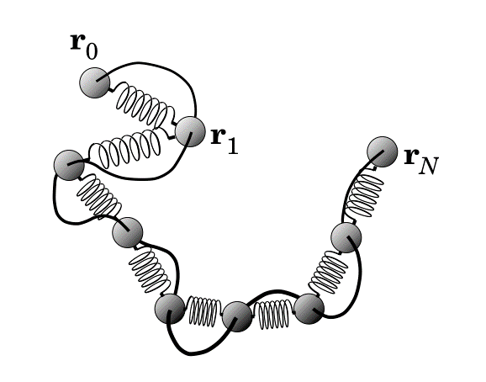
1. Models of the macromolecular chain

Slide 6
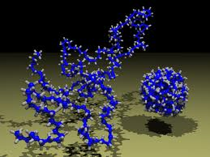
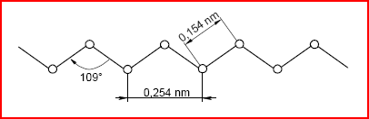
Shapes of macromolecules
What is the shape of the molecule?
  could be, but that's not usually how it looks like
molecules are mostly not straightened
  most often in the form of a statistic (Gaussian coil)
  given the ability to rotate around single bonds

Slide 7
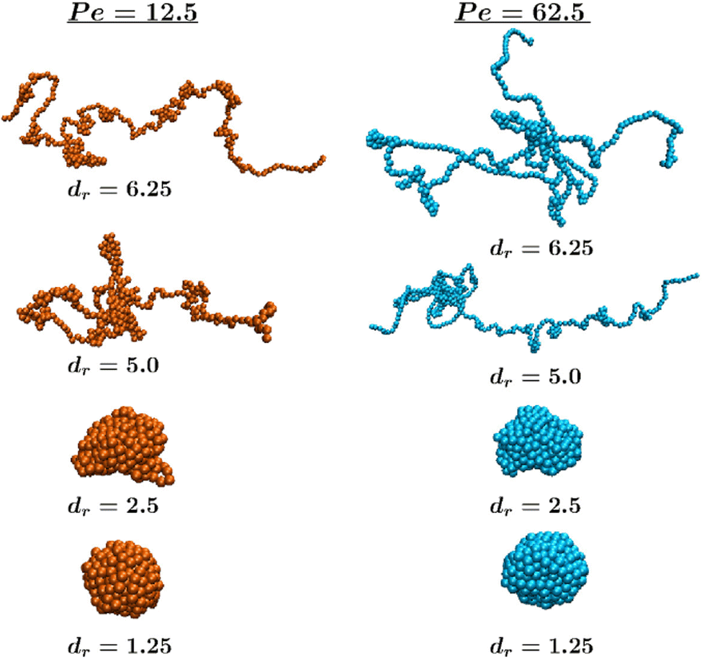
Shapes of macromolecules in solution
globules
  tightly coiled polymer chains
  interaction with the solvent only on the surface of the globule
  chemical or physical bonds ensure a more permanent shape of the globule
coil
  not very tightly coiled polymer chains
  polymer chains interact with other chains and with solvent molecules
developed chains
  polymer chains interact almost exclusively with solvent molecules (applies to good solvents – i.e. those that dissolve the given polymer well)

Slide 8

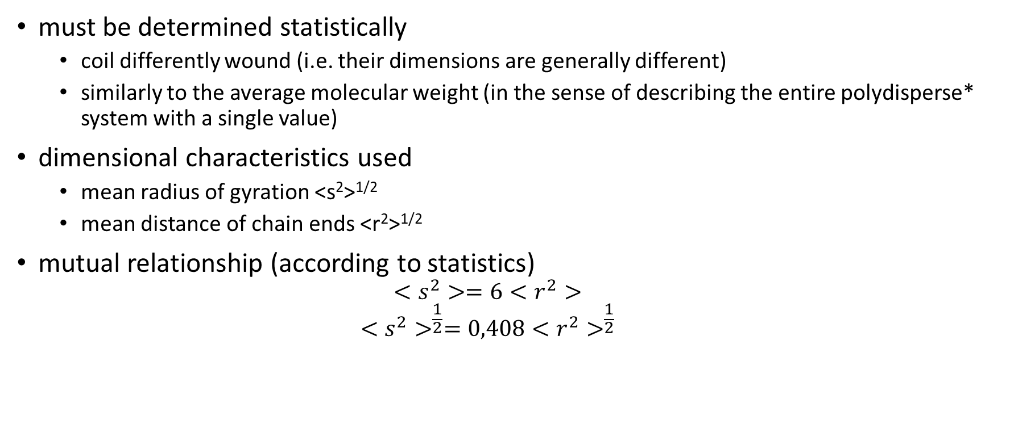
The size of the macromolecular bulcoil
must be determined statistically
  coil differently wound (i.e. their dimensions are generally different)
  similarly to the average molecular weight (in the sense of describing the entire polydisperse* system with a single value)
dimensional characteristics used
  mean radius of gyration <s²>^{1/2}
  mean distance of chain ends <r²>^{1/2}
mutual relationship (according to statistics)
  $$<s^{2}>=6<r^{2}>$$
  $${<s^{2}>}^{\frac{1}{2}}=0,408{<r^{2}>}^{\frac{1}{2}}$$
* of a system with generally different particles of the dispersion fraction

Slide 9
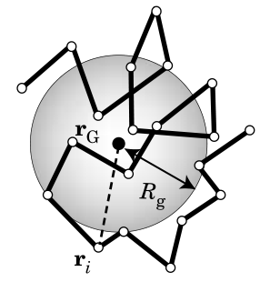
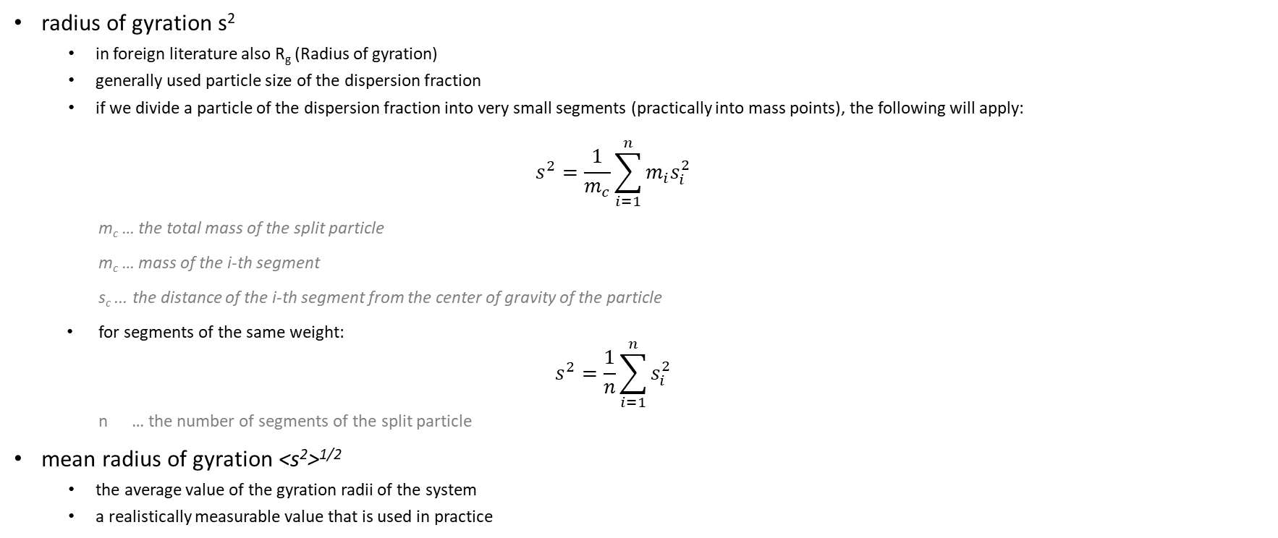
Mean radius of gyration
radius of gyration s²
  in foreign literature also R_{g} (Radius of gyration)
  generally used particle size of the dispersion fraction
  if we divide a particle of the dispersion fraction into very small segments (practically into mass points), the following will apply:
  $$s^{2}=\frac{1}{m_{c}}\sum_{i=1}^{n}{m_{i}s_{i}^{2}}$$
m_{c} … the total mass of the split particle
m_{c} … mass of the i-th segment
s_{c} ... the distance of the i-th segment from the center of gravity of the particle
for segments of the same weight:
  $$s^{2}=\frac{1}{n}\sum_{i=1}^{n}{s_{i}^{2}}$$
  n … the number of segments of the split particle
mean radius of gyration <s²>^{1/2}
  the average value of the gyration radii of the system
  a realistically measurable value that is used in practice
r_{G} … center of gravity of the macromolecule
R_{g} … radius of gyration (s)
r_{i} … the distance between the centroid and the i-th segment (s_{i})

Slide 10
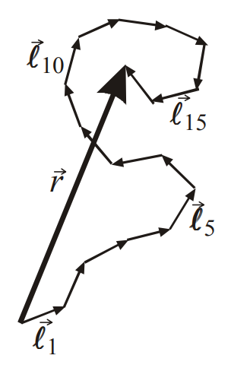
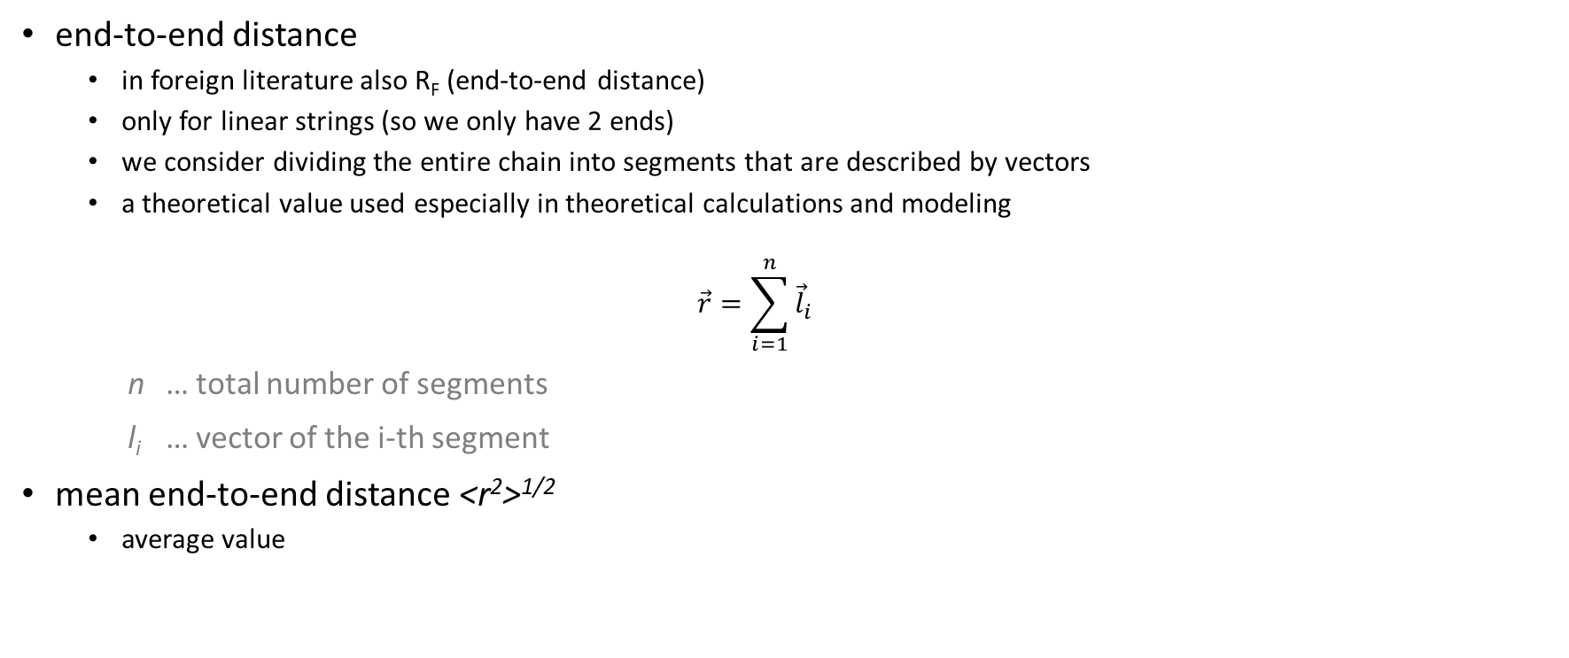
End-to-End distance
end-to-end distance
  in foreign literature also R_{F} (end-to-end distance)
  only for linear strings (so we only have 2 ends)
  we consider dividing the entire chain into segments that are described by vectors
  a theoretical value used especially in theoretical calculations and modeling
  $$\vec{r}=\sum_{i=1}^{n}{{\vec{l}}_{i}}$$
n … total number of segments
l_{i} … vector of the i-th segment
mean end-to-end distance <r²>^{1/2}
  average value
* for more on the issue of the ends of linear structures, see Werich+Voskovec – Pudr a benzín (link 2:07 to 2:59): https://www.youtube.com/watch?v=xluP9lIzBr8

Slide 11
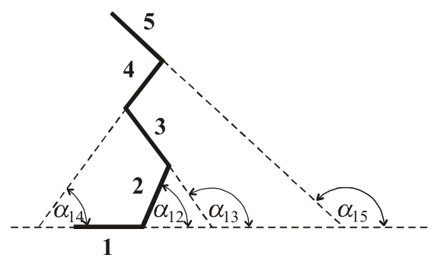
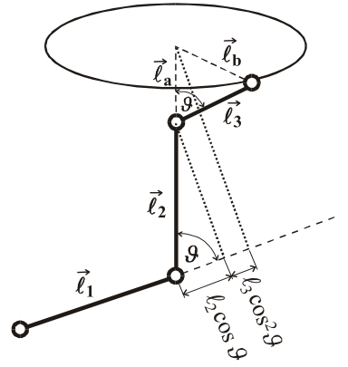
Macromolecular coil models
loosely coupled chain
  bonds of the same length l_{i}
  segments rotate with equal probability in the range α_{ij} (-180°; 180°)
freely rotating chain with a fixed valence angle
  bonds of the same length l_{i}
  free rotation with a constant valence angle between the bonds
a restricted rotatable chain with conformationally independent neighboring bonds
  bonds of the same length l_{i}
  rotation with a constant valence angle between the bonds
    limited by energy barriers of microconformations
a restricted rotatable chain with conformationally dependent neighboring bonds
  bonds of the same length l_{i}
  rotation with a constant valence angle between the bonds
    limited by energy barriers of microconformations
    limited by energy barriers microconformations of neighboring bonds

Slide 12
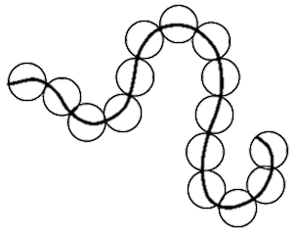
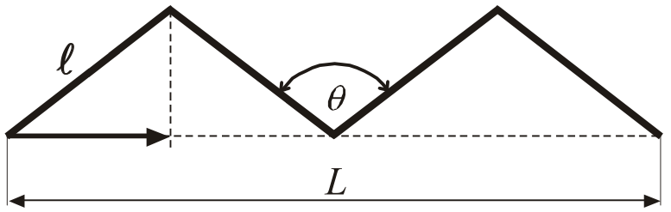
Macromolecular coil models
previous models valuable for theory, too complex for practice
equivalent chain
  replacement of individual bonds with imaginary larger segments
    they consist of as many adjacent links as possible so that even adjacent segments are mutually independent
    the whole then behaves again like a loosely jointed chain
  with the original loosely coupled chain, they match in:
    mean distances of chain ends <r²>^{1/2}
    contour length L
      the maximum length of a theoretically stretched chain

Slide 13
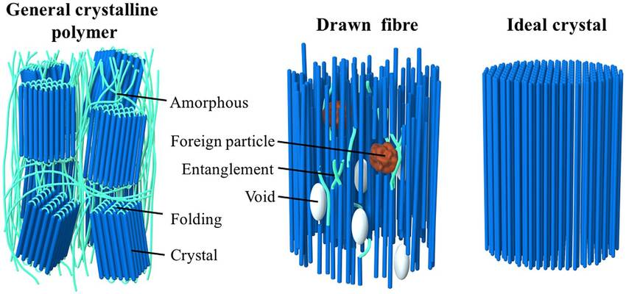
2. Amorphous and crystalline phase

Slide 14
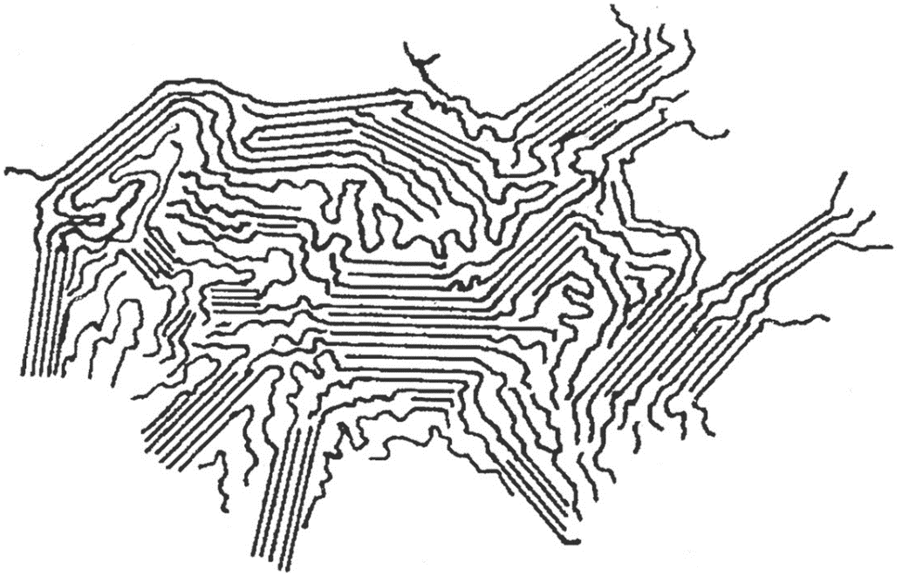
Morphology of polymers
deals with the mutual arrangement of macromolecules in the entire polymeric substance
two basic phases can be found
  amorphous and crystalline
  both phases differ significantly in their properties

Slide 15
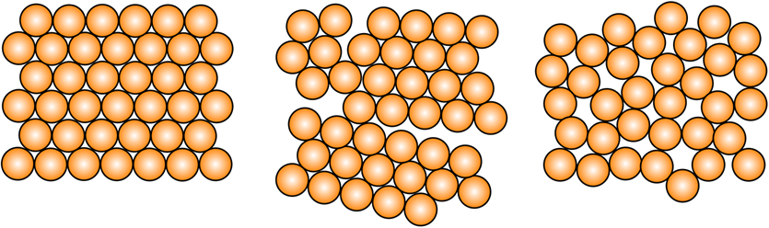
Crystallinity of polymers
shockingly, many polymeric substances are partially crystalline
  however, they are never 100% crystalline (maybe 99%)
  therefore they are referred to as semi-crystalline (i.e. partially crystalline)
  the individual crystalline structures in a given polymer are called crystallites
a crystal in general is a structure that is regular over long distances
amorphous
semicrystalline
crystalline

Slide 16
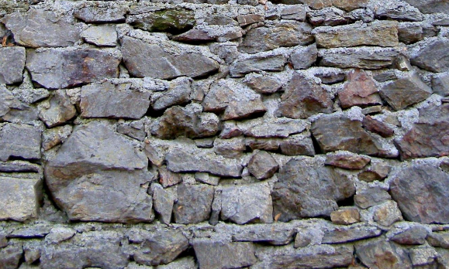

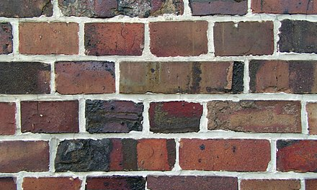

Crystallinity of polymers
in order for a regular structure to emerge, regular building blocks must be present
I need for crystallization
  regularity
  (optionally) tactical
  sufficiently strong secondary bonds
example: masonry
  regularity = bricks (stones) as similar as possible
  secondary bonds = enough mortar

Slide 17
Sufficiently strong secondary bonds
it is the sum of the forces (energies) of all secondary bonds holding the given crystallite together
  I can have several strong (polar) bonds (PA)
  or I may have many weaker bonds (PE, PP)
the dissociation energy of secondary bonds must be smaller than the energy of thermal motion of molecules (entropic character)
  thus, when the temperature increases sufficiently, the crystallites generally melt, because the thermal motions overcome the secondary bonds and the crystallite breaks up

Slide 18

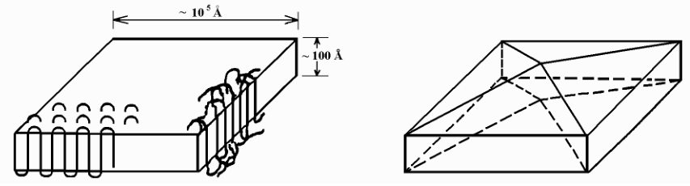
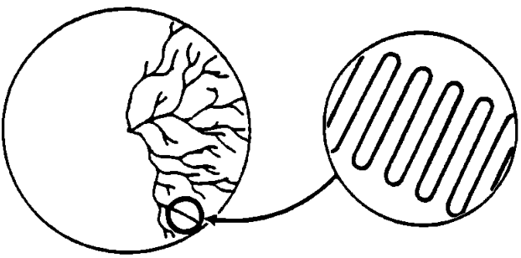
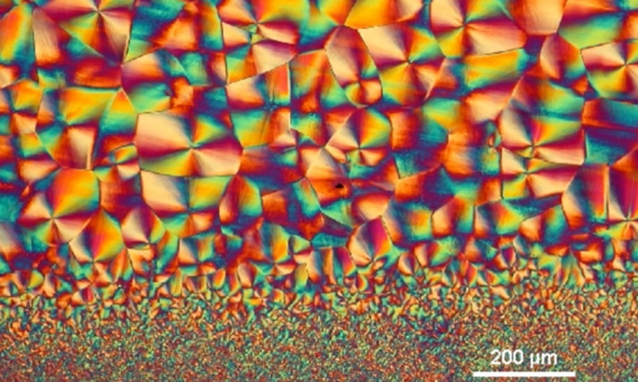
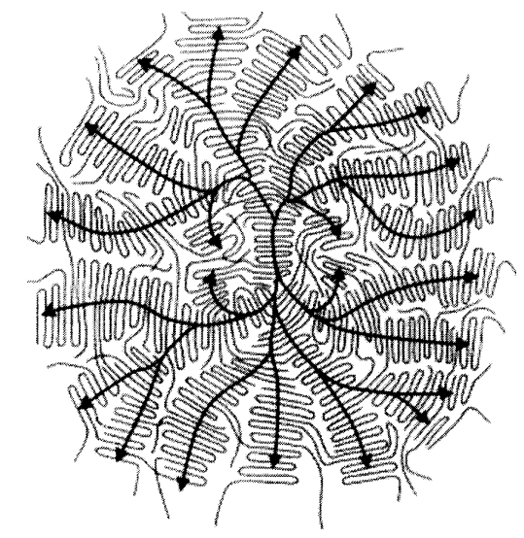
Crystallites structure models
lamellar fibrils
  the oldest, probably survived today
chain folded structure
  from dilute solutions
  broken pyramid
  bends about 5-6 carbons long
dendrites (tree-like)
  from more concentrated solutions
  crystallites grow more easily in folds, grooves and corners (need to cover less surface energy)
  that's why they start to grow everywhere, even on a different crystallite
spherulites
  crystallization from the melt
  least regular crystallites
  typical Maltese cross in section under a polarizing microscope
crystallites

Slide 19
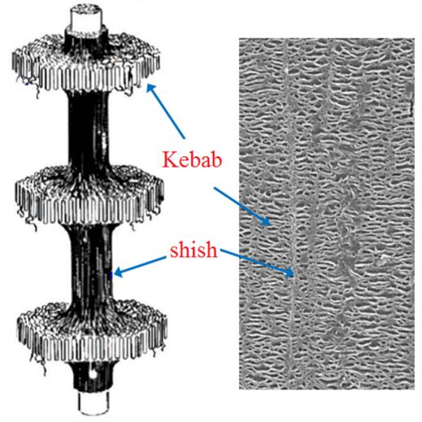
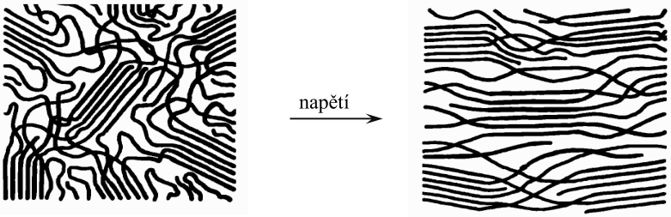
Orientation of crystallites
generally random
however, the external force is plural to orient them to some extent
  e.g. when in filament drawing
tensile stress
shishkebab

Slide 20
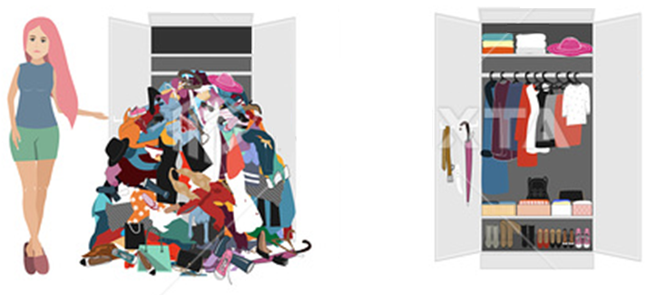

Effect of crystallinity on the properties of polymers
higher density of the crystalline phase
  macromolecules are regularly and tightly assembled (secondary bonds only act over short distances).
  if you clean your clothes in the closet, they usually take up less space, although the mass is still there
    i.e. the density is higher
one polymer can show several types of crystal structure (e.g. PA 6)
  similar to some inorganic substances

Slide 21
Effect of crystallinity on density
polymer | density (g/cm³)
 | crystalline phase | amorphous phase
PA 6 | 1,24 | 1,07
PA 6|6 | 1,23 | 1,08
POM | 1,54 | 1,25
PET | 1,50 | 1,33
PTFE | 2,35 | 2,00
PP (izotaktic) | 0,95 | 0,85
HDPE | 1,00 | 0,85

Slide 22
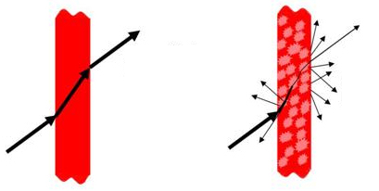
Effect of crystallinity on the properties of polymers
other molecules do not penetrate between tightly arranged chains (reactions thus take place mainly on the surface)
  higher resistance to chemicals (degradation)
  higher resistance to dissolution
crystalline polymer (without additives) is not clear, but only translucent
  individual crystalline domains refract and reflect light in different directions
  How is it that inorganic crystals tend to be clear and semi-crystalline polymers are not?
  caused by more phase transitions
    an amorphous polymer has only medium-polymer optical transitions, whereas a crystalline polymer has many transitions inside the polymer, amorphous-crystalline
    this causes multiple scattering and reflection (if we grind a clear amorphous polymer into a powder, it will no longer be clear but will appear white)
    e.g. foamed PS is completely amorphous and appears white only because of the large number of air-polymer transitions
amorphous
semicrystalline

Slide 23

Effect of crystallinity on the properties of polymers
as the degree of crystallinity increases, the strength of the polymer usually increases
  in crystallites there are a number of secondary bonds that must be overcome
  can completely change the character of the material
    e.g. tactical PP is very mechanically resistant, while atactic is a waxy (even oily at low molecular weights) substance
    LDPE is much less mechanically resistant than HDPE or even UHMWPE
Crystallinity really matters. Mainly it results in the difference between a PE bulletproof vest and a PE plastic bag for a snack.

Slide 24
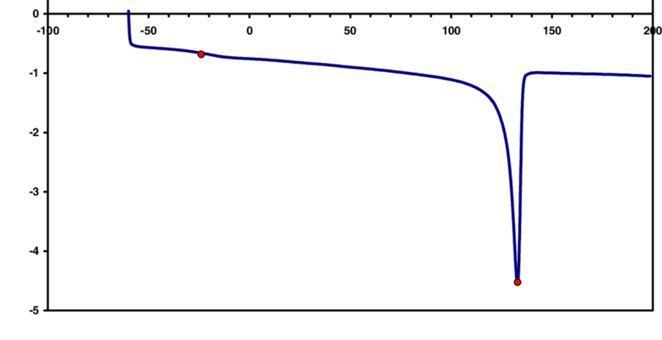
Melting temperature of crystallites T_{m}
crystallites are held together by secondary bonds
increasing the temperature of the polymer means supplying energy to its molecules
  if this is greater than the strength of the secondary bonds, they may split - the crystallite melts
  the melting point Tm of the crystallites means the temperature above which all the crystallites melt and the polymer becomes amorphous
differential scanning calorimetry (DSC)
T_{g}
heat flow [W/g]
T_{m}
T [°C]

Slide 25
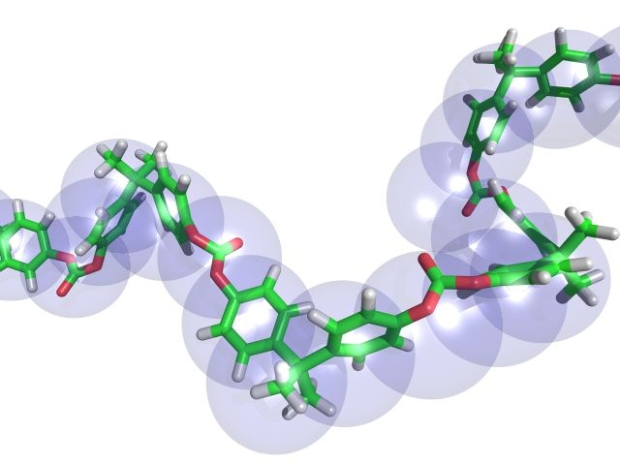
3. Chemical structure of polymers

Slide 26
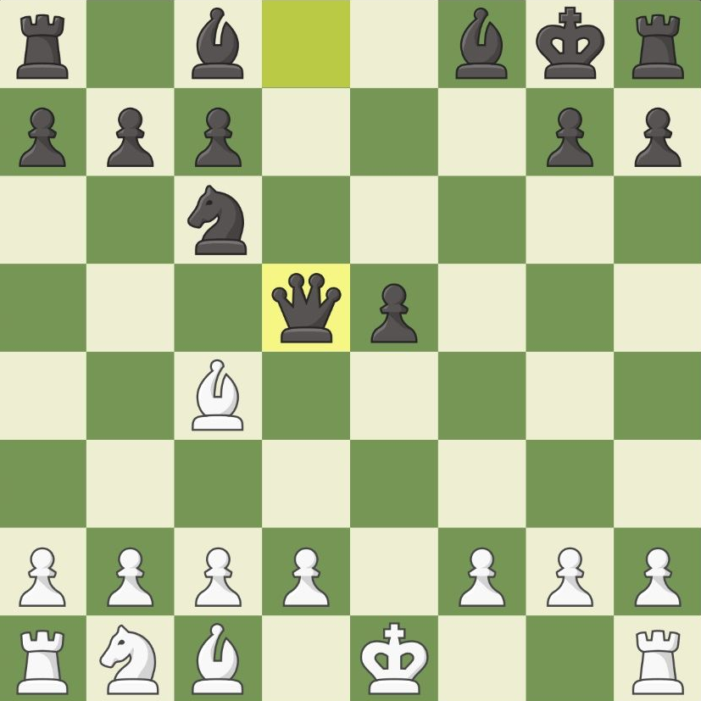
Chemical structure of macromolecules
3.
it is based on the structure of organic substances
  primary (constitution)
  secondary (configuration)
  tertiary (conformation)
  quaternary
example: chess
  the most important is the king (constitutional monarchy)
  the figure I'm currently pulling is also important (configuration)
  in the end, I decide what the layout of the figures is, what is the formation of my army
  I don't because it's an obscure biochemical matter
2.
1.

Slide 27
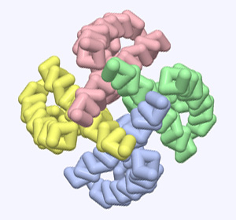
Structure and isomerism of organic substances
constitution (primary)
  the order of atoms and the types of bonds between them
configuration (secondary)
  spatial arrangement of the molecule
  cis-/trans-, c-/t-, Z-/E-
  regularity and tacticity of polymers
conformation (tertiary)
  the spatial arrangement of the atoms of a molecule around a single bond
  cause of internal rotation of macromolecules
supramolecular structure (quaternary)
  relative position of macromolecules to others
  can be found mainly in enzymes or proteins
supramolecular structure of sodium channel formed by four identical proteins (each color represents a different molecule)

Slide 28
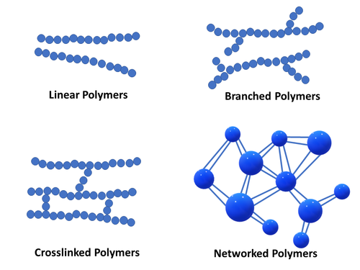
1. Constitution
given by the functionality of the monomers
  linear
  branched
  netted
    lightly
    strongly (or fully)
linear and branched
  can be soluble
cross-linked
  insoluble
  could swell

Slide 29
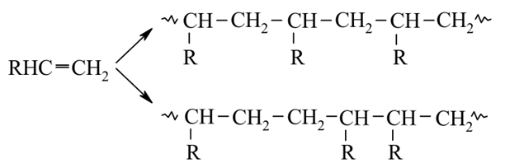
1. Constitution (regularity)
regular macromolecule
  obtained by regular repetition of the constitutional unit
  head-to-heel arrangement only
only regular polymers can (but don't have to) be semicrystalline
head-to-tail
head-to-head (or tail-to-tail)

Slide 30
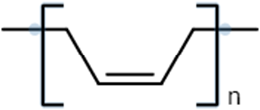

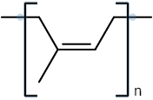
2. Configuration (cis- trans- arrangement)
characteristic of buta-1,4-diene polymers
depends on whether a cis- or trans- arrangement is formed at the double bond
  sometimes also marked Z (Zusammen) and E (Entgegen)
cis-
Z-
trans-
E-

Slide 31

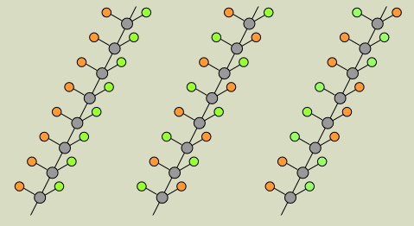
2. Configuration (tacticity)
the arrangement of stereoisomeric centers in the main chains of macromolecules
  stereoisomerism – occurs in asymmetric molecules with carbons with different substituents (marked by C*) on all four bonds
fundamentally affects crystallinity
  and thus also mechanical properties, temperature behavior, etc.
isotactic
syndiotactic
atactic

Slide 32
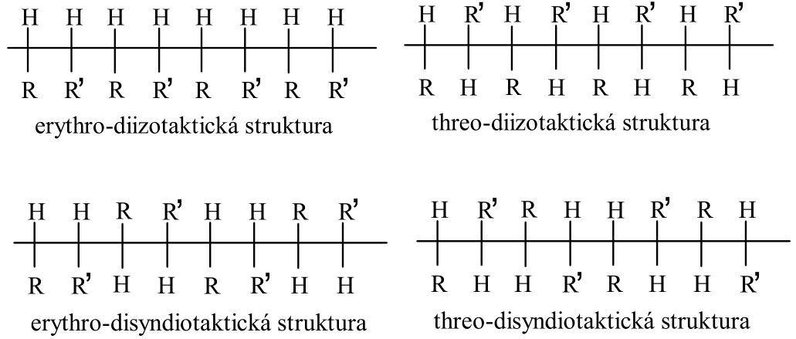
2. Configuration (multiple tactics)
several types of stereoisomeric centers alternate
  if there are two, it is ditacticity
  the prefixes erythro- and threo- are used
erythro-ditacticity
  the stereoisomeric centers are next to each other
threo-ditacticity
  the stereoisomeric centers are opposite each other
erythro-diisotactic
threo-diisotactic
erythro-disyndiotactic
threo-disyndiotactic

Slide 33
3. Conformation (internal rotation)
otherwise also intramolecular rotation
only for long flexible chains (e.g. cyclic structures or macromolecules)
rotation around single bonds
  in the case of macromolecules, we mainly examine the rotation of the atoms of the main chain (substituents and hydrogens do not bother us so much)
responsible for different chain conformations
  are refundable
  they generally cannot be isolated
it is described by the torsional (dihedral) angle φ (capital phi)

Slide 34
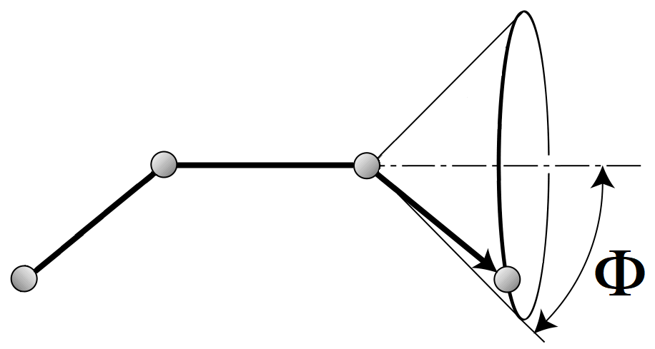
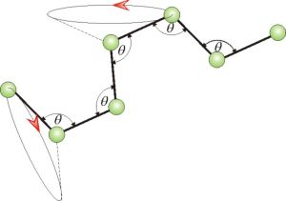
3. Conformation (torsion angle)

Slide 35
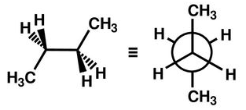
3. Conformation (local)
also microconformation
  describes only a certain part (segment) of the whole molecule
conformation affected by steric repulsion
  electricity the packages have a negative charge and when they get too close they start to repel each other
usually illustrated on butane in the Newman projection
torsion angle Φ | name | relative energy* (kJ·mol⁻¹)
0 | trans (antiperiplanar) | 0
± 120 ° | gauche (synclinal) | 2,1
± 180 ° | cis (coplanar) | > 15
* referred to the contractual minimum of 0 kJ·mol⁻¹ in the trans configuration (0 °)

Slide 36
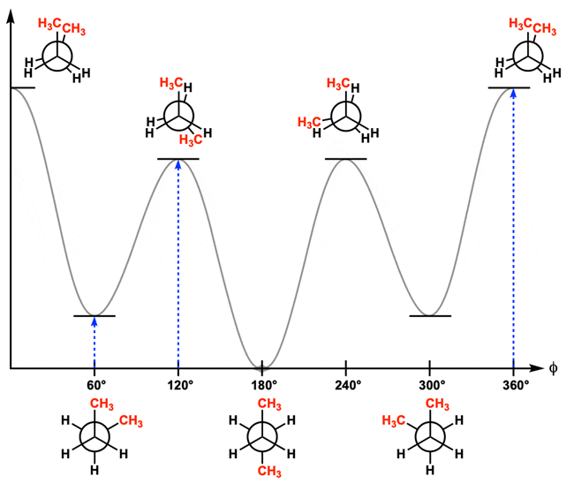
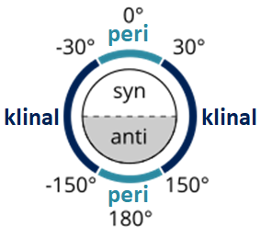

3. Konformace (stabilita lokálních konformací)
synperiplanární
synperiplanární
E (kJ·mol⁻¹)
antiklinální (+)
antiklinální (-)
energetická bariéra
koplanární
metastabilní konformery
synklinální = gauche (+)
antiperiplanární
synklinální = gauche (-)

Slide 37
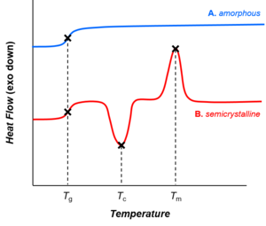
Thermal behavior of polymers

Slide 38
Thermal behavior of polymers
most polymers behave differently at different temperatures
  at a lower temperature they tend to be glassy
    less flexible
    more fragile
    harder
      at a very low temperature, for example, a rubber tube can be so hard that its fragments can be hammered into wood like a nail (it is possible, but to the disappointment of the audience and the demonstrator, these usually shatter)
  at higher temperatures they tend to be rubbery
    more flexible
    tougher
    less hard
  caused by the so-called glass transition temperature (T_{g})

Slide 39
Glass transition temperature T_{g}
temperature interval in which the state of the polymer changes from glassy to rubbery (and vice versa)
  refers ONLY to the amorphous phase of the polymer
the glassiness of the polymer is determined by the limited possibility of reaction of macromolecular chains to mechanical stress
  the chains are frozen and cannot move relative to each other
the rubber-like properties, on the other hand, is given by the possibility of movement of parts of the chains relative to each other
F
F

Slide 40

Glass transition temperature
mobility of parts of macromolecules made possible by temperature movements (overcoming secondary bonds)
  vibrations of atoms
  internal rotation
    movements of a pair of neighboring atoms of the molecule
  external rotation
    movements of larger segments of molecules
    allows to respond elastically to external influences
    rubbery behavior
  translation
    sliding of molecules over others
    the flow of molecules in the form of a melt
    plastic behavior
even outside these temperatures, movements may occur, but they are either unlikely or too slow
required energy

Slide 41
Glass transition temperature
the temperature at which the movement of segments of macromolecules begins in a reasonable amount and speed
  when exceeded, a large number of physical properties change
  fortress
  hardness
  tenacity
  thermal expansion
  heat capacity
  density
  refractive index of light
  dielectric constants
  …
it is not a specific temperature, but an interval (depends on the heating speed, etc.)
it is most simply determined by the differential calorimetric method (DSC)

Slide 42
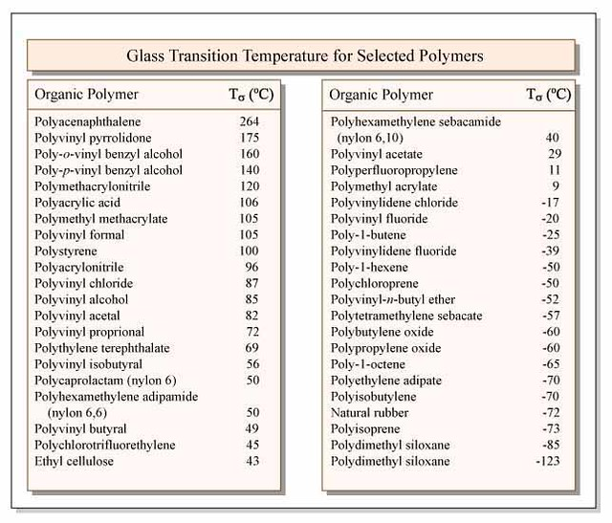
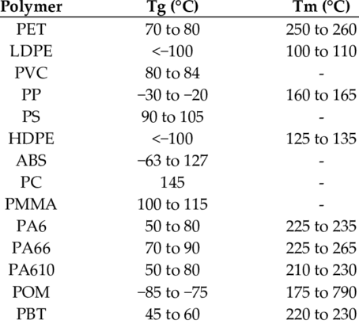

Slide 43
Effect of polymer structure on T_{g}
T_{g} grows with:
  backbone stiffness of the chain
    rigid chains, e.g. ladder-like, aromatic part of the backbone, multiple bonds in the backbone
  volume of substituents
    e.g., phenyl PS is quite bulky, as are the long side chains
  polarity
    the more polar bonds, the more strong secondary bonds restricting motion
    the more polar the bonds are, the harder they are to break
  by branching
    analogous to voluminous substituents
  by the length of the macromolecular chain
    multiple entanglements and secondary bonds (like branching)
  by networking
    preventing movement of macromolecules relative to each other
  increasing content of rigid structures
    e.g. PS blocks in SBS thermoplastic elastomer
    fillers (e.g. carbon black in rubber)
T_{g} decreases with:
  the flexibility of the backbone of the chain
  with decreasing size of substituents
  decreasing polarity
  with decreasing degree of branching
  with decreasing length of the macromolecular chain
  decreasing rate of cross-linking
  decreasing content of rigid structures
  increasing content of plasticizers
    low-molecular substances inside the polymer preventing the formation of secondary bonds between the chains (in short, they interfere there)
    e.g. water for cotton (cellulose has a high T_{g}, so it cannot be ironed dry very well, but after moistening it decreases dramatically)

Slide 44
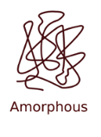
Amorphous polymer states
generally three basic ones
  glassy
  rubbery
  plastic
glassy state
  below T_{g}
  the movement of macromolecules is greatly restricted
  chain spines crack under stress

Slide 45
Amorphous polymer states
rubbery = viscoelastic
  between T_{g} and T_{f} (flow temperature) or T_{degradation}
  only for macromolecules with a sufficient number of nodes (whether chemical or physical)
viscous behavior (irreversible deformation)
  during long-term mech. stress, macromolecules are deformed and do not return to their original state after the stress is over (not completely)
  the macromolecules managed to flow into a different form and new secondary bonds are formed, which ensure a new changed shape of the polymer
elastic behavior (reversible deformation)
  during short-term mech. stress, macromolecules deform and return to their original (most probable) state after the stress is over
  the macromolecules did not have time to flow into another form and the secondary bonds did not fundamentally change (they keep their original shape)

Slide 46
Amorphous polymer states
plastic state
  occurs after the creep temperature Tf is exceeded
  secondary bonds between molecules are practically non-existent (too short-lived) and macromolecules flow after each other → I got a melt
  the deformation is completely irreversible
  not all polymers can reach a plastic state
    they either decompose before they flow
    or they are so cross-linked that they cannot flow

Slide 47
Amorphous polymer states
state | temperature range | deformation
glassy | 0 – T_{g} | reversible (to a small extent)
ruberry | T_{g} – T_{f} | partially reversible
plastic | T_{f} – T_{degradation} | irreversible
elastic behavior
F
F
viscoelastic behavior
F
F
time
F
plastic behavior
F

Slide 48
Dependence of modulus of elasticity on temperature for an amorphous polymer
glassy
9
ruberry
log E (Pa)
6
plastic
3
T_{g}
T_{f}
T

Slide 49
Dependence of modulus of elasticity on temperature for a semicrystalline polymer
glassy
9
ruberry
log E (Pa)
6
plastic
3
T_{g}
T_{m}
T_{f}
T

Slide 50
Dependence of the modulus of elasticity on temperature for a cross-linked polymer
glassy
9
strength increases slightly with temperature (entropy effect)
ruberry
log E (Pa)
highly cross-linked
6
lightly cross-linked
3
T_{degradation}
T_{g}
T

Slide 51
Thank you for your attention

