Slide 1



Nové možnosti rozvoje vzdělávání na Technické univerzitě v Liberci
Specifický cíl A2: Rozvoj v oblasti distanční výuky, online výuky a blended learning
NPO_TUL_MSMT-16598/2022
Inovace stávajících nebo tvorba nových metodických a elektronických studijních materiálů v ČJ nebo AJ
Ing. Pavel Holec

Slide 2
Special polymers

Slide 3
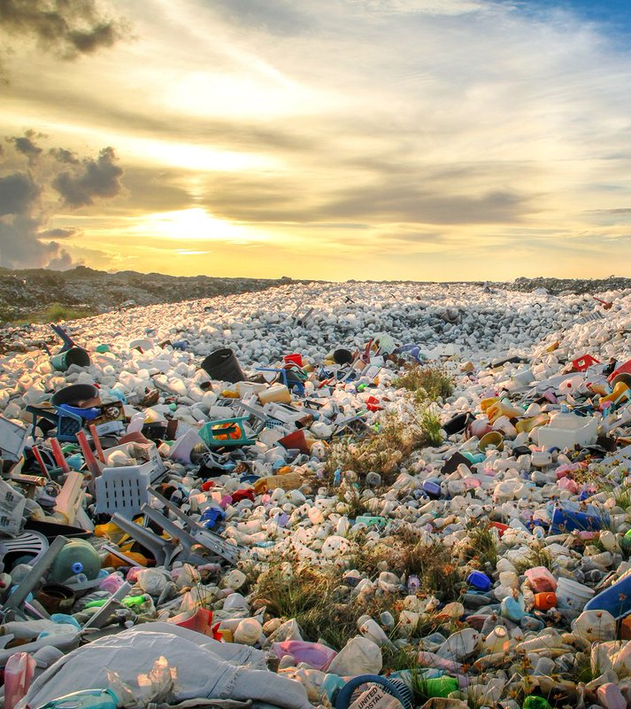
Production of special polymers
large tonnage
  most of the volume/mass of the polymers produced
  PE, PP, PS, PVC, PES, PA
special
  electrotechnics
  cosmonautics
  medicine
  the military
today the focus of polymer research
significant price difference between regular and specialty polymer

Slide 4
Production of special polymers
LCP,
PEEK, PPS
PET, PA
PBT, PC, ABS,
POM, PMMA
HDPE, LDPE,
LLDPE, PP, PVC, PS
mass produced
price
Notes:
PPS = polyfenylensulfid

Slide 5
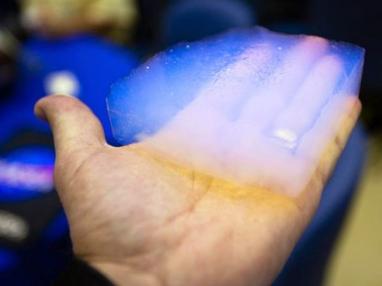
Special polymers
resistant to higher temperatures
super absorbent
liquid crystals
electrically conductive
photosensitive polymers
ion exchangers
self-healing
polymers in medicine
Notes:
Airloy – aerogel (polymerní, keramický, kovový aj.) (0,01 g až 0,9 g na ml) – nízká hustota + vysoká izolační odolnost
třeba polyimid, polyuretan, polyamid

Slide 6
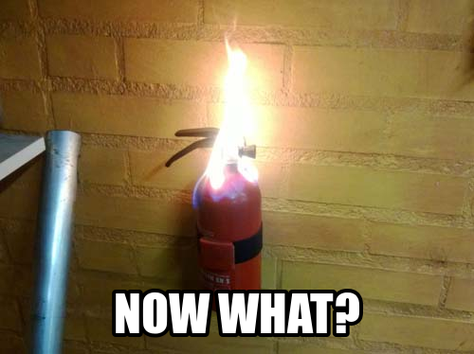
Polymers resistant to higher temperatures

Slide 7
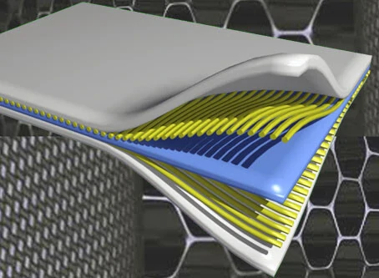
Examples of heat-resistant polymers
usually in fiberglass composite
polyphthalamide (PPA)
  T_{g} up to 127 °C, T_{m} up to 310 °C
  a relatively inexpensive temperature-resistant variation on PA6 or PA66
aromatic polyamides (aramids)
  Nomex – T_{m} around 350 °C, use up to 220 °C
  Kevlar – T_{m} around 330 °C, use up to 200 °C
polyetherimide (PEI)
  long-term stable up to 170 °C
polyimides (PI)
  long-term stable up to 260 °C

Slide 8
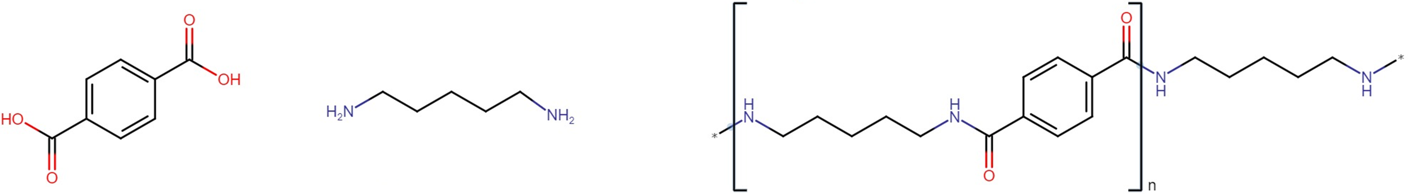
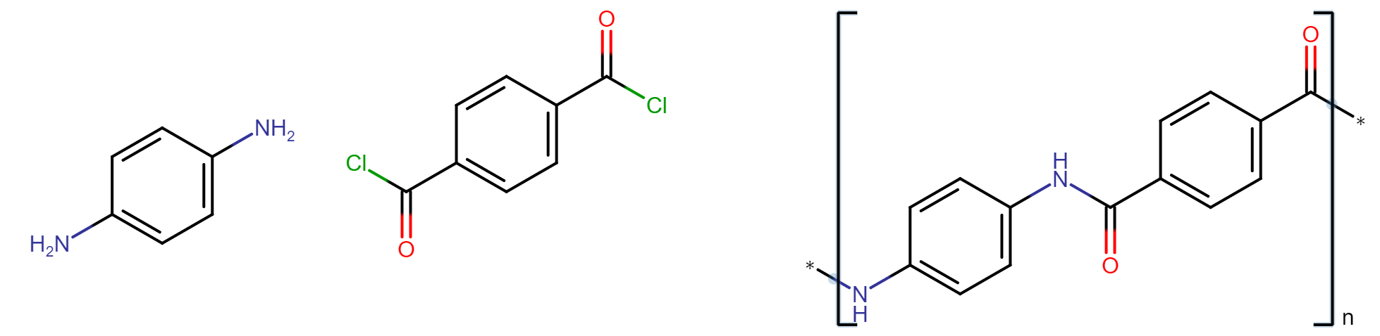
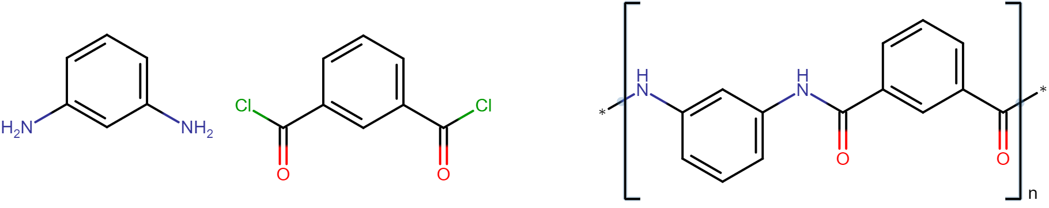
Polyphthalamide and polyaramids
terephthalic acid
pentane-1,5-diamine
building block of polyphthalamide (NILON 6T)
Nylon 5T
Kevlar
Nomex

Slide 9
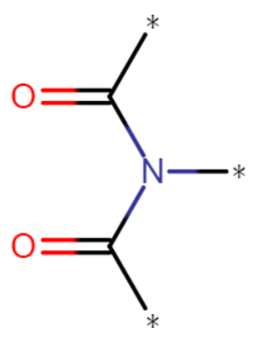
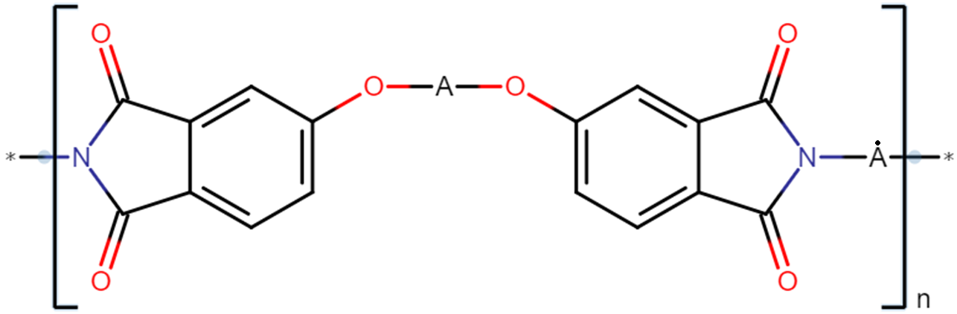
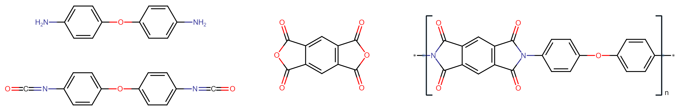
Polyetherimide and polyimide
amide of two carboxylic acids
PEI
imides in general
4,4'-diaminodiphenyletheroxydaniline
PEI
pyromellitic acid dianhydride
diphenylether-4,4'-diisocyanate
Notes:
A = obvykle bisfenol (obecně dihydroxydifenylmethan), ale lze i spousta dalších

Slide 10
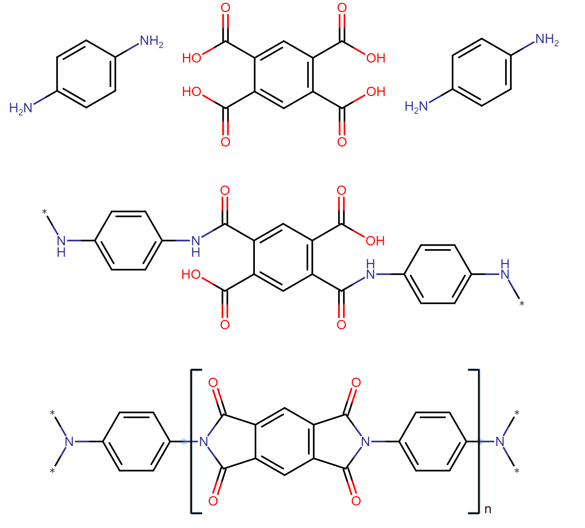
Preparation of polyimides
aromatic
diamine
pyromellitic acid
1. step
200 °C
2. step
250 °C
PI

Slide 11
Examples of heat-resistant polymers
polysulfones (PSUs)
  T_{g} up to 250 °C
  good mechanical properties, chemically resistant
polyphenylene sulfide (PPS)
  T_{m} around 290 °C
  easy processing of the melt (good flow properties)
polyether ether ketone (PEEK)
  T_{g} up to 145 °C, T_{m} up to 335 °C
  good mechanical properties, dimensional stability at higher temperatures, bioinert
polybenzimidazole (PBI)
  T_{g} around 430 °C, short-term withstand over 700 °C
  the highest temperature resistance of commercially produced polymers
  mechanically very resistant

Slide 12
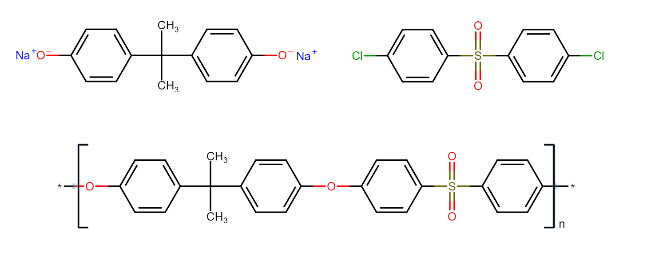
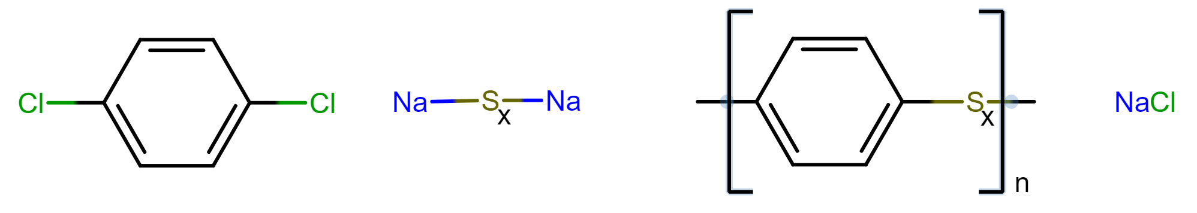
Polysulfones and polyphenylene sulfide
PSU
sodium polysulfide
(X is not higher than 5)
PPS

Slide 13
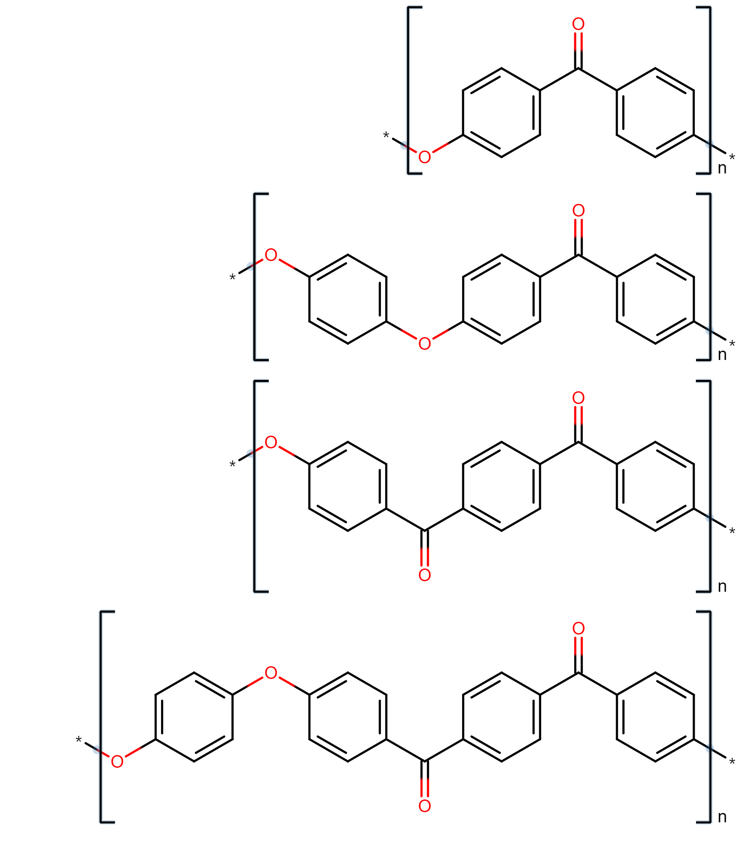
Polyetherketone
T_{g} [°C] | T_{m} [°C]
163 | 361
144 | 344
154 | 358
165 | 391
PEK
PEEK
PEKK
PEEKK

Slide 14
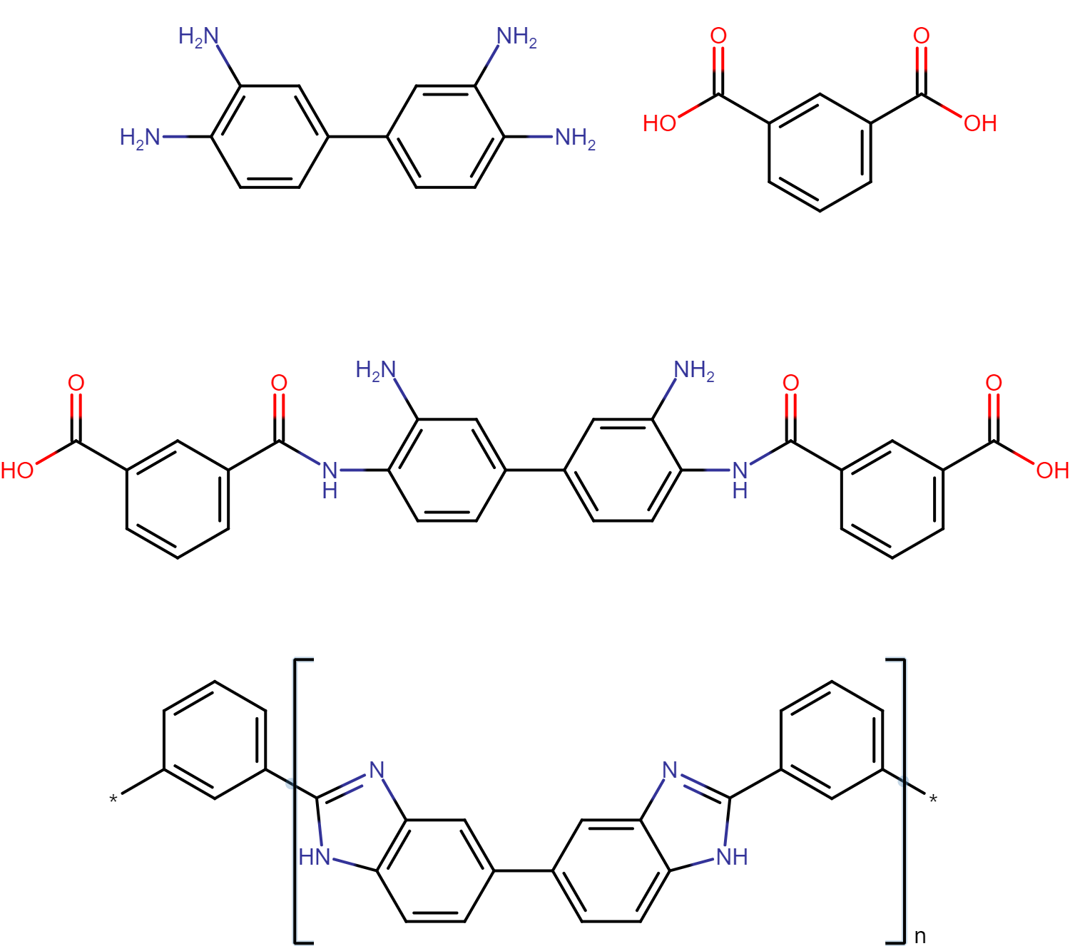
Polybenzimidazole
3,3',4,4'-tetraamin biphenyl
isophthalic acid
ΔT
ΔT
PBI

Slide 15
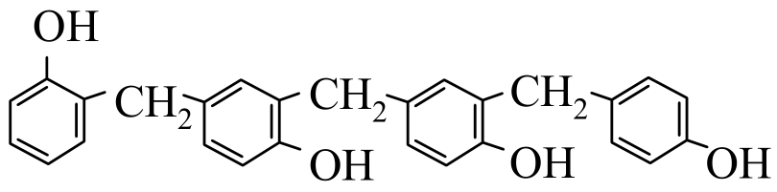
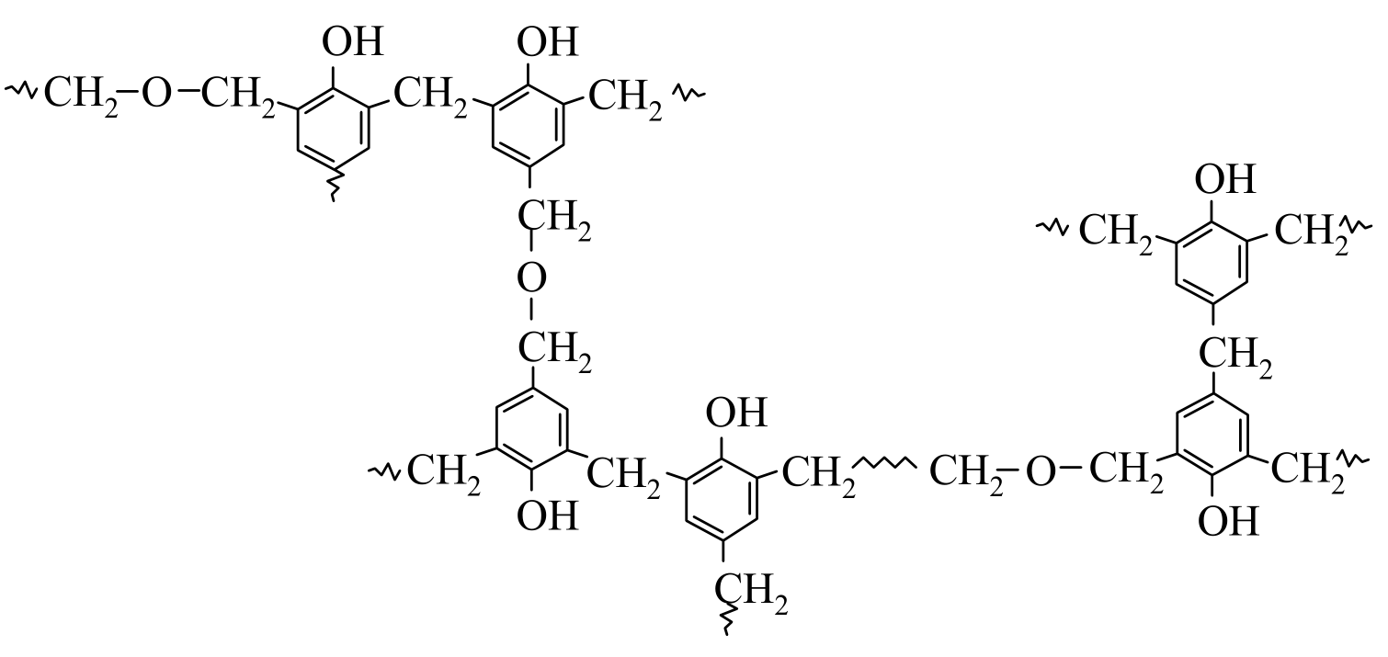
Novoloid (Kynol)
from melt-spun phenol-formaldehyde "resin" subsequently cross-linked to the maximum extent possible
  probably from slightly cross-linked novolacs = phenoplasts resulting from the reaction of phenol with formaldehyde, where there is an excess of phenol
the result is a three-dimensional amorphous network
further infusible, heat-resistant, but basically flammable
  relatively chemically resistant, but does not benefit from conc. H2SO4 or conc. HNO₃
  LOI 30 – 34 (PVC has 30 – 45, PTFE up to 98)
classified as novoloids, which are at least 85% cross-linked novolacs
  Kynol is the only representative so far 😂
very well described from commercial perspective:
  withstands up to 2500 °C for at least 12 s
  can withstand 200 – 250 °C for a long time in an oxygen-free atmosphere
  long-lasting up to 150 °C in air

Slide 16
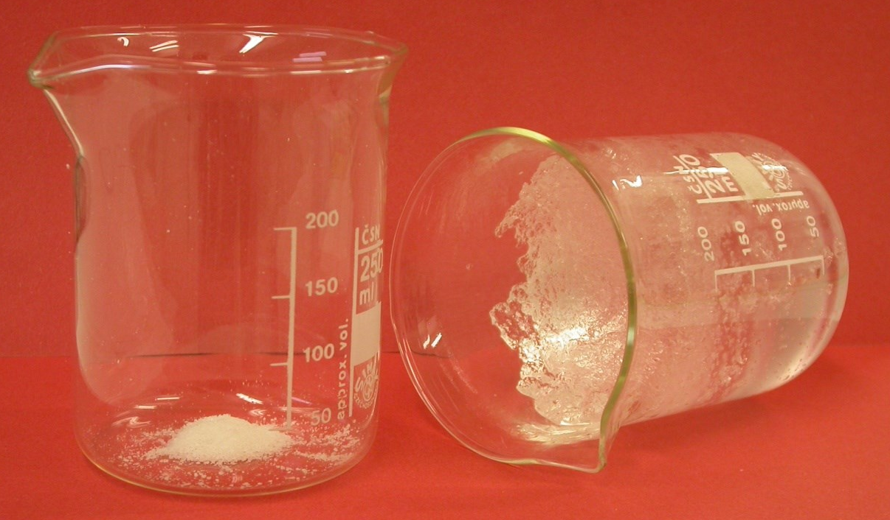
Super absorbent polymers

Slide 17
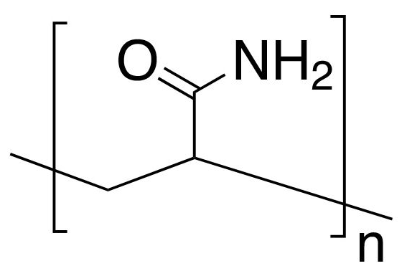
Super absorbent polymers (SAP)
polymers capable of binding more than 300 times their weight (in a dry state) of distilled water
they replace older cellulose sorbents (pulp, cotton)
two ways of sorption
  to polar groups (-OH, -O-, -CO-NH₂)
    older SAPs from derivatives of cellulose, starch, gelatin (gummy bears), PVA, PEO or PAM (polyacrylamide)
    they sorb less, but are not as sensitive to liquid composition
  per ionic charge
    today mainly slightly cross-linked polyacrylic acid
    they absorb a lot, but are sensitive to the composition of the liquid
PAM

Slide 18
Sorptive capacity
dry SAP (sorbing by ion mechanism)
  distilled water ... up to 300 times the weight
  physiological solution (0.9% NaCl) ... up to 50 times
ions in water reduce the sorption capacity
pressure on the SAP reduces the sorption capacity
  like wringing a wet rag
swelling creates a hydrogel (substance made up mainly of water, which, however, retains certain mechanical properties, shape, etc.)

Slide 19
Polyacrylic acid (PAA)
it is not a homopolymer, but a copolymer of acrylic acid and a cross-linking monomer (N,N'-methylene-bis-acrylamide)
a high molecular weight polymer is to be obtained
  otherwise, the insufficiently cross-linked part could wash out
  the mass of PAA that can be extracted in this way is usually 5 to 20% by weight
production process:
  copolymerization of acrylic acid with a cross-linking comonomer
  neutralization by NaOH
  replacing part of the -COOH groups with its sodium salts –COONa
  at the same time, the pH value of the prepared SAP is thus adjusted
  drying and grinding
  surface finishes
  additional surface cross-linking of the ground particles so that, during water sorption, the surface of the particles does not swell quickly and the formation of a gel-like cluster, which is also poorly permeable to water

Slide 20
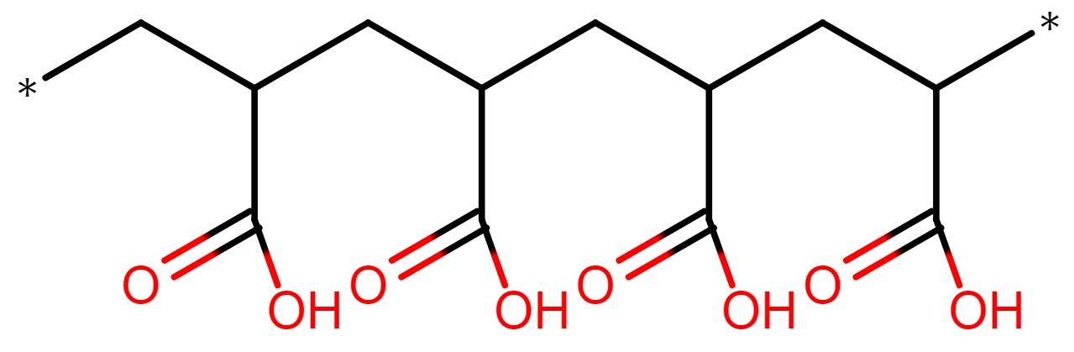
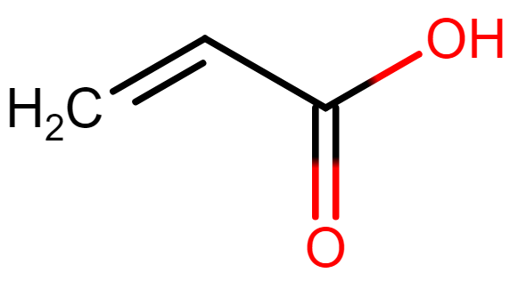
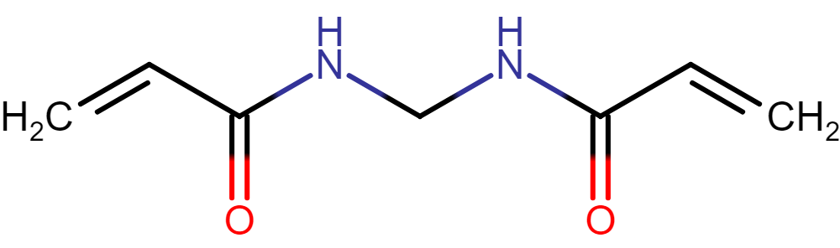
A simplified scheme of the polymerization of acrylic acid
cross-linking comonomer
N,N'-methylene-bis-acrylamide

Slide 21
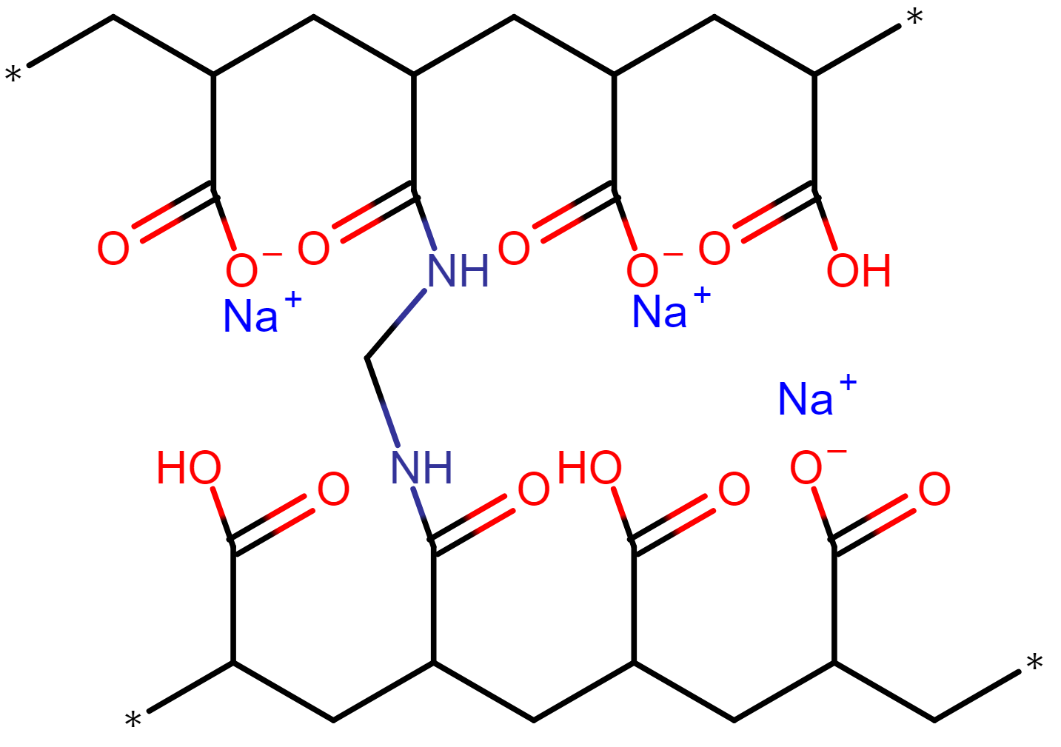
Cross-linked and partially neutralized PAA
cross-linking comonomer
N,N'-methylene-bis-acrylamide

Slide 22
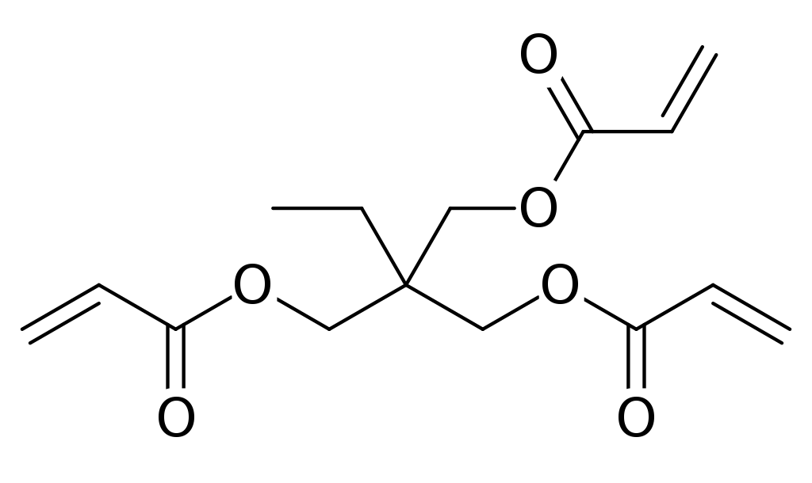
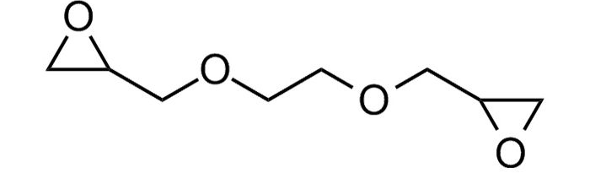
PAA cross-linking
provides:
  insolubility of the resulting product
  mechanical properties of the resulting hydrogel
  reduces the amount of extractable components (linking macromolecules increases the average molecular weight)
the more cross-linked the PAA, the stronger the hydrogel, but the less it can sorb
  PAA then cannot swell as much
cross-linking comonomers
  N,N'-methylene-bis-acrylamide
  trimethylolpropane triacrylate (TMPTA)
crosslinking of PAA homopolymer
  ethylene glycol diglycidyl ether (EGDGE)
    reacts with ready-made PAA macromolecules

Slide 23
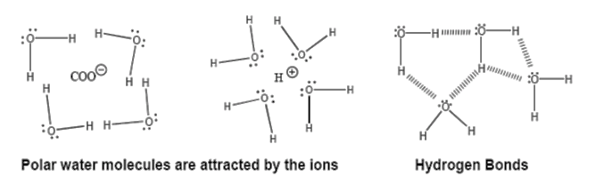
Water sorption and PAA swelling
water with secondary bonds binds to charged or partially charged parts of macromolecules and to ions trapped inside the network
the difference of osmotic pressures inside the PAA and in the sorbed liquid
  cations inside the PAA network (e.g. Na+) are practically not washed out, because they are held by a large number of partially negatively charged parts of the macromolecules
segments of chains of the same charge that come too close repel each other
  thus helping the hydrogel to expand

Slide 24
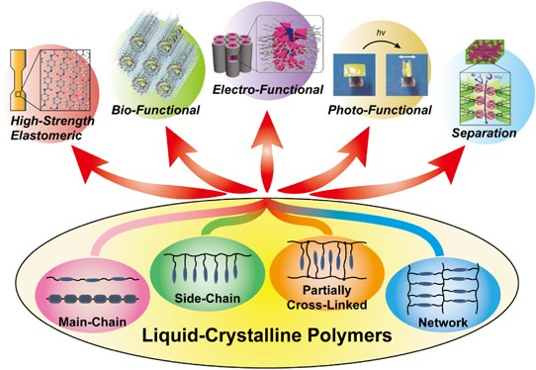
Polymer liquid crystals

Slide 25
Liquid crystals
1888 – discovery of liquid crystals (F. Reintzer)
the liquid-crystalline phase in polymeric substances was described by Paul John Flory (1954 onwards)
the first liquid-crystalline polyester on the market in 1972
  Ekkcel I-200
significantly anisotropic molecules that can change their orientation in space under the influence of a force field
transition between isotropic and anisotropic matter

Slide 26

Liquid crystals
formed by mesogens
  a molecule or part thereof, responsible for liquid-crystalline behavior
  rod-shaped or disc-shaped (one or two dimensions significantly different)
creates oriented structures in the external force field
  after orientation, they show different optical, electrical and magnetic properties, density, etc.
types:
  lyotropic liquid crystals
    molecules with mesogens dissolved in a foreign liquid phase
  thermotropic liquid crystals
    molecules with mesogens acting in the mass above the melting temperature
  smectic phase (highly symmetric even at long distances)
  nematic phase (less symmetric and rather at shorter distances)
    solid ↔ smectic ↔ 𝑛𝑒𝑚𝑎𝑡𝑖𝑐 ↔ liquid
an increase in T

Slide 27
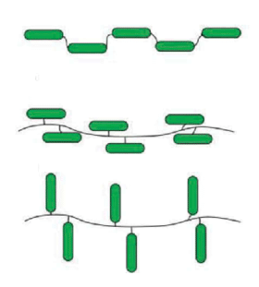
Polymer liquid crystals (LCP)
mesogens as a repeating part of a macromolecule
thermotropic
  only works above T_{g}
a combination of rigid (rods or disks) and flexible segments
  on the main chain
    chain-like
  off the main chain
    orthogonal
    ridge-like

Slide 28
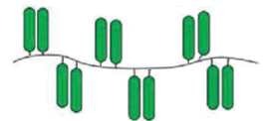

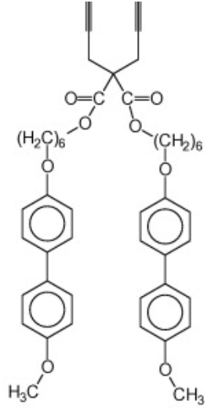
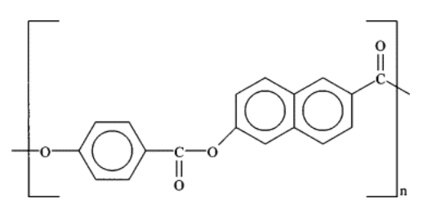
Polymer liquid crystals (LCP)
orthogonal LCP
(mesogens off the main chain)
chain-like LCP
(main chain mesogens)

Slide 29
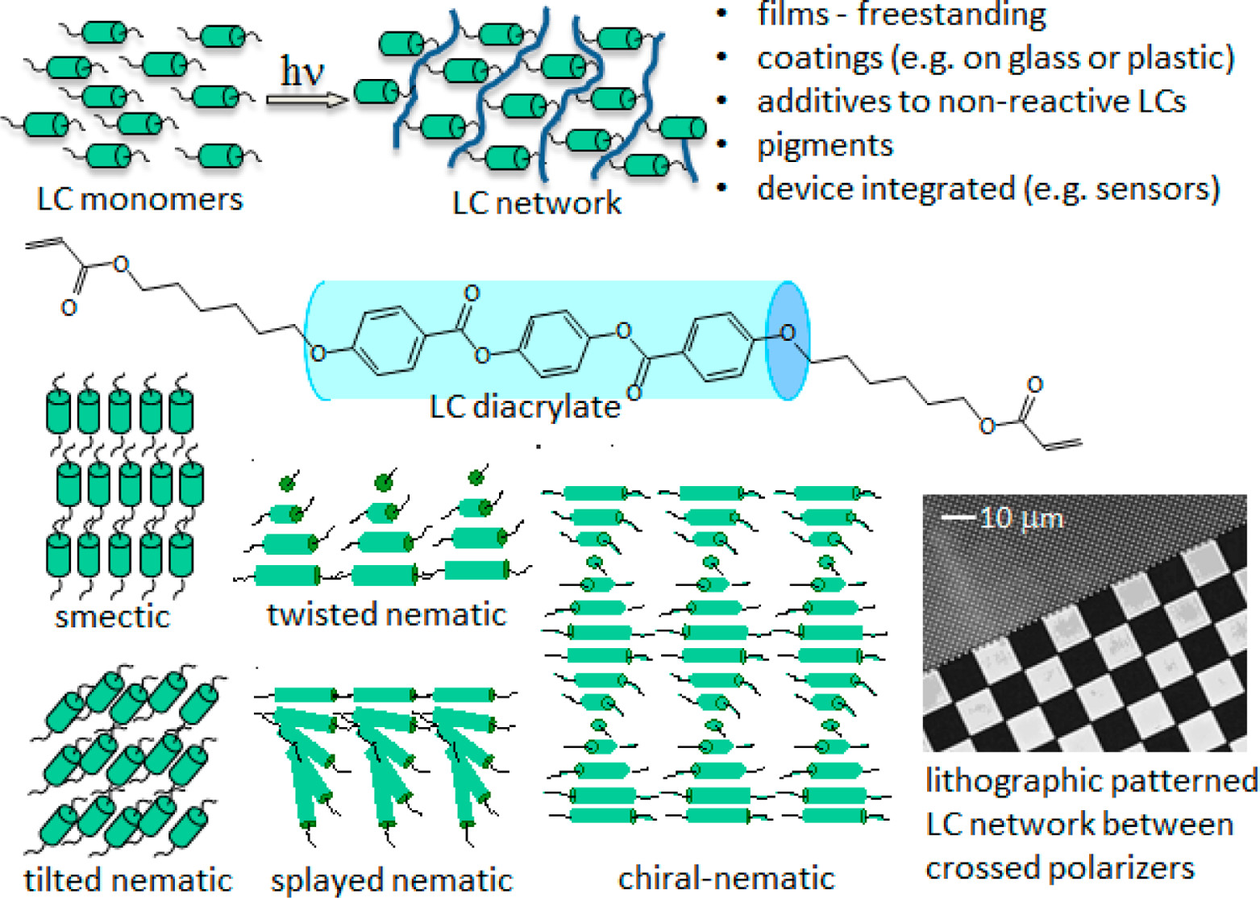
Polymer liquid crystals (LCP)

Slide 30
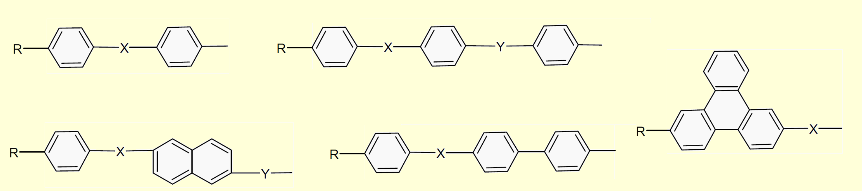
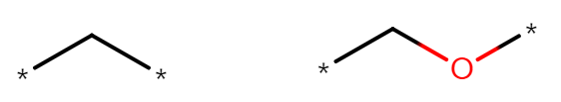
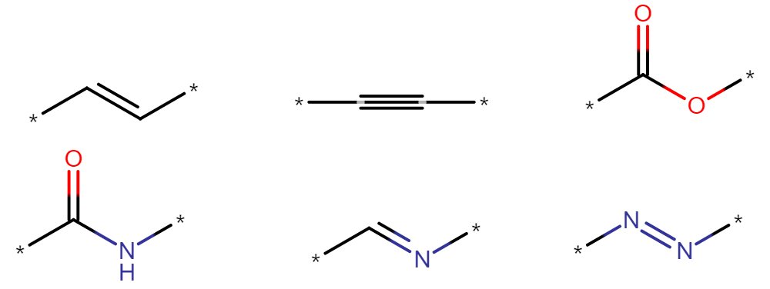
Examples of mesogens
only works above T_{g}
R … flexible group
X and Y ... inflexible groups
  alkene, alkyne, ester, amide, secondary (ald)imine, azo compound
alkylene
alkoxy
alkendiyl
(vinylen)
alkyndiyl
ester
secondary aldimin
azo compound
Notes:
(ald)imin

Slide 31
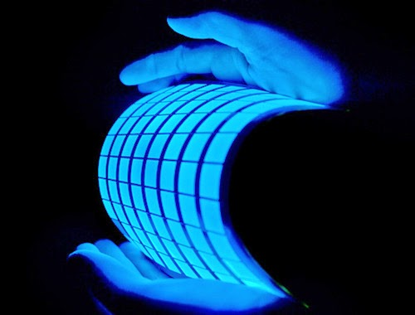
Electroconductive polymers

Slide 32
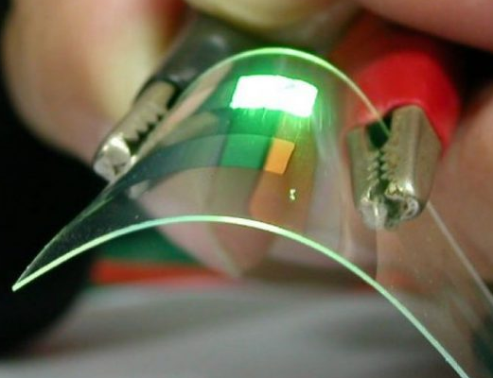
Electroconductive polymers
polymers are usually insulators
increasing the conductivity of the polymer
  polymer with conjugated e- in the main chain
    conjugated chain → movable π e-
    representatives
      polyacetylene (ie polyethylene)
        conductivity comparable to metals
        it burns in the air
      polyaniline
      polyphenylene-vinylene
        pure aromatic backbone
      poly(p-phenylene)
      polythiophene
      polypyrrole
  redox doping (supplied e-)

Slide 33
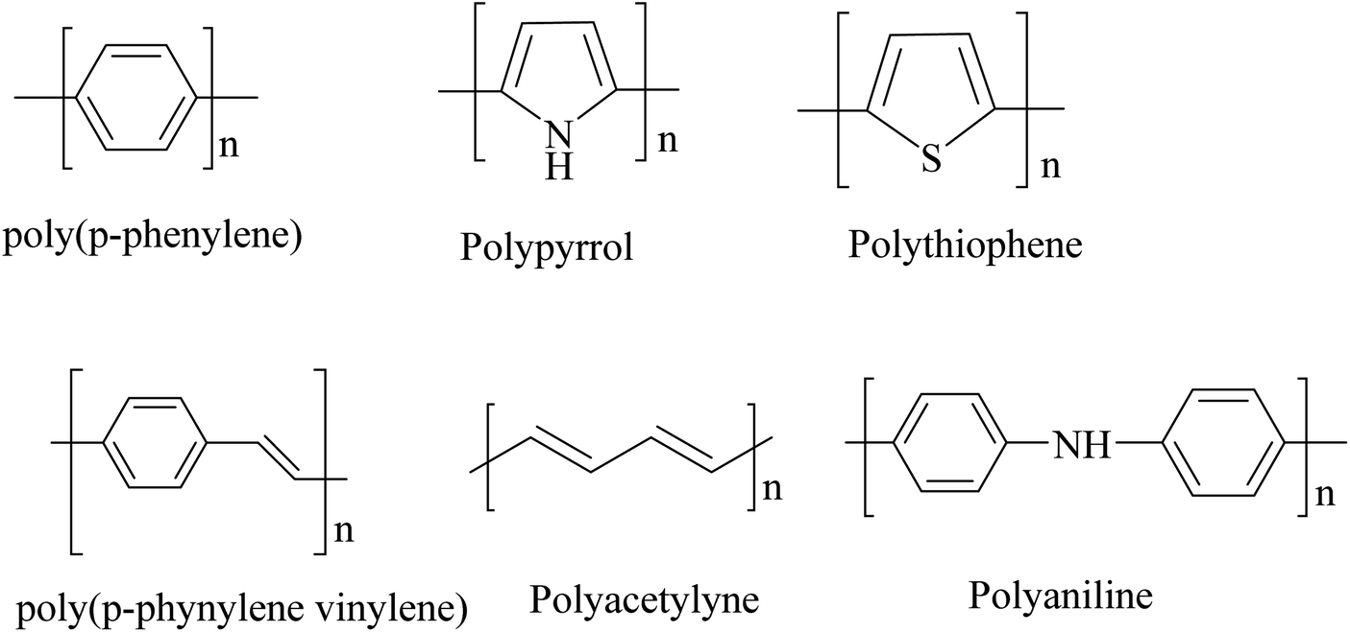
Electroconductive polymers

Slide 34
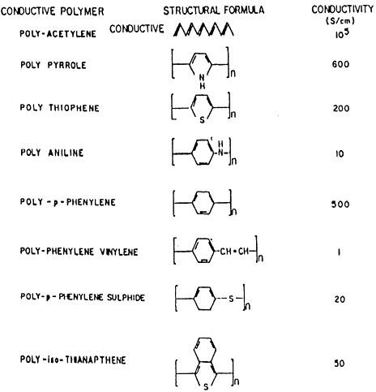
Electroconductive polymers

Slide 35
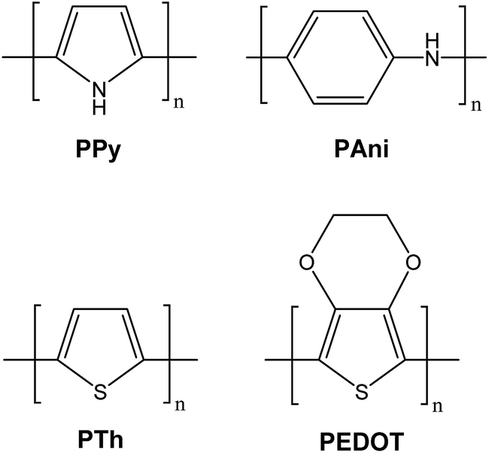
Use of electroconductive polymers
anti-corrosion protection of metals
accumulators
  many times lighter than the existing one
electrochromic devices
  the electrically conductive polymer can have a different color in its original and doped state
  information storage
gas separation
  oxygen-nitrogen, methane-CO2
  with repeated doping of polyaniline, pores of a defined size will be formed

Slide 36
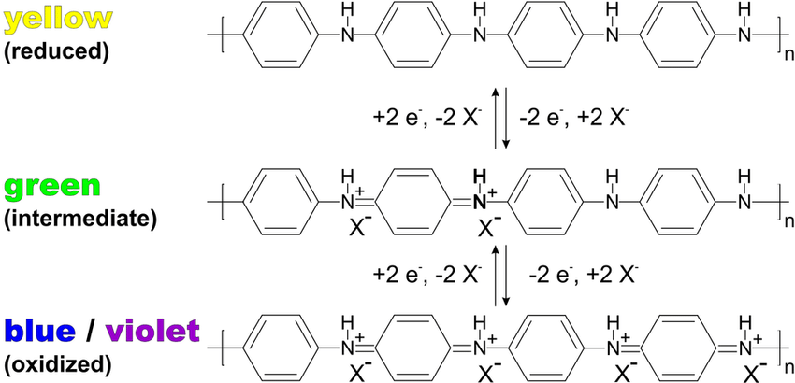
Redox color changes of polyaniline

Slide 37

Photosensitive polymers

Slide 38
Photosensitive polymers
not to be confused with photopolymers
  synthetic resins cured by (usually UV) radiation
changes the structure under the action of light
  returnable
  irreversibly
classic photography – photosensitive substances applied in emulsion (defined particle size)
  they allow for virtually infinite magnification
    to the size of the molecules – “What more would you like to see? Quarks?”
  change in structure → change in optical density
    optical data storage
  medicine

Slide 39
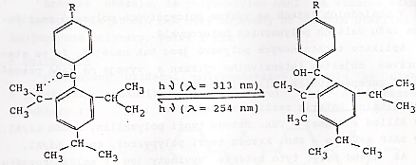
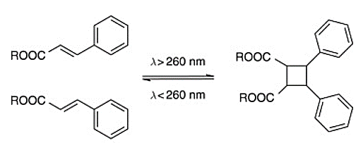
Photosensitive polymers
photocyclization of triisopropyl-benzophenones

Slide 40
Polymer ion exchangers

Slide 41
Polymer ion exchangers (ionex)
acidic or basic functional groups on a suitable polymer support
water softening
  originally for steam boilers
  water demineralization
  extraction of precious metals from very dilute solutions
accumulators

Slide 42


Ion exchangers (cathexes)
cathexes
  $$−RK_{1}+K_{2}^{+}↔−RK_{2}+K_{1}^{+}$$
  e.g. PS porous copolymer with divinylbenzene (crosslinker) + functional group (sulphonic -SO₃H)

Slide 43
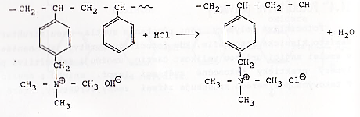

Ion exchangers (annexes)
annexes
  $$−RA_{1}+A_{2}^{−}↔−RA_{2}+A_{1}^{−}$$
  e.g. PS porous copolymer with divinylbenzene (crosslinker) + functional group (quaternary ammonium salt)

Slide 44
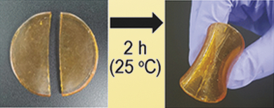
Self-healing polymers

Slide 45
Self-healing polymers
they convert the mechanical energy into that which allows the broken chain to be linked with other chains
  physically
    diffusion of macromolecules to a new surface
    entanglement of macromolecules into a physical network
  physico-chemical
    diffusion of macromolecules to a new surface
    the formation of a covalent or supramolecular network
      reversible or irreversible

Slide 46
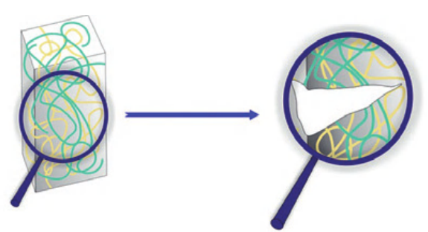
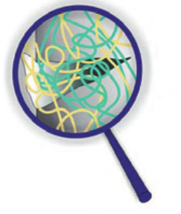
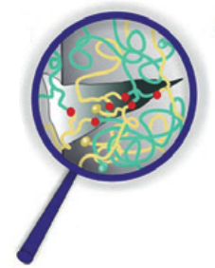

Surface bonding methods
mechanical
damage
diffusion of molecules
chemical reaction

Slide 47

Physical bonding of surfaces

Slide 48

Physico-chemical bonding (irreversible)

Slide 49


Examples of reversible cross-linking

Slide 50
Ostatní

Slide 51

Baropolymers
polymers that respond to pressure by melting at normal temperatures
  non-crosslinked block polymers
the possibility of recycling without the need for heating
  does not reduce the average degree of polymerization by thermal degradation
  can be repeated many times (not just 2-3 times)
given by the change in phase equilibrium
  phase of block A and phase of block B can be separated at a given pressure and temperature (I have 2 phases)
  by reducing the pressure, the curve can be lowered and the point will reversibly reach the region of unlimited miscibility
  after re-reducing the pressure back solidification
unlimited miscibility
H
higher
pressure
T_{H}
limited miscibility

Slide 52



Polymers in medicine

Slide 53
Biocompatible polymers
must meet the characteristics given by law
must not cause side reactions in the body (e.g. allergies)
  they should be inert in the body environment
  few residues (according to the tables)
UHMWPE, PP, PA6 (threads), PEEK, PTFE, PVDF

Slide 54
Biodegradable polymers
must meet the characteristics given by law
they degrade in the body environment without side effects
  degradation is known in advance, "controlled"
degradation time of the polymer in the body
  applicability
  the time during which the material retains its mechanical property
  complete resorption
  the time it takes for the body to break down the material so much that it is not noticeable
diferentiation by origin
  natural
    chitosan, collagen, hyaluronic acid (mainly bacterially formed, formerly from animal bodies), alginates
    now on the decline (badly modified, difficult repeatability of production)
  synthetic
    polycaprolactone, polylactic acid, polyglycolic acid, polylactic/polyglycolic acid copolymers (various proportions), polydioxanone, bacterial biodegradable polymers (hydroxybutyrates, hydroxyvalerates, hydroxysuccinates), polyurethanes

Slide 55



Example:
contact lenses
  poly(hydroxyethyl) methacrylate (HEMA)
  gel structure (relatively tolerable for the eye)
    Otto Wichterle
    MERCURY
    disadvantageously patented
protective packaging of medicines
polymeric drug carriers
prosthetics

Slide 56
Thank you for your attention

Slide 57

Merry Christmas

